Slide 1
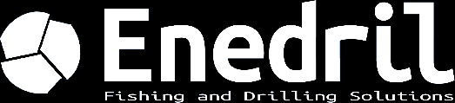
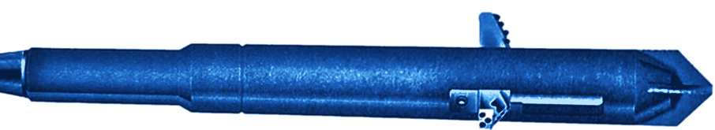
SINCE 2013 IN LONS, NEAR PAU (FRANCE)
DIRECTIONAL DRILLING
& FISHING
Solutions for geothermal, oil & gas and underground gas storage projects.
98,500 m
75
drilled
wells, up to 3,000 m TVD
142
2,500
fishing, workover and P&A jobs
tools in stock
ISO 9001:2015
www.enedril.com

Slide 2
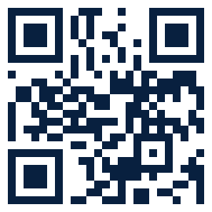
WHAT WE DO
DIRECTIONAL DRILLING & MWD
PDM 3-1/8" to 9-5/8", RSS, MWD up to 200°C, in-house well planning.
FISHING
Rods, strings, stuck tools. Response 24/48 h.
WORKOVER
Section milling, wash over, casing repair.
PLUG & ABANDONMENT
Safe abandonment of wells.
WHY ENEDRIL
EXPERIENCE
EXCELLENCE
CUSTOM SOLUTIONS
RELIABILITY
Let's talk about your project
+33 (0)5 59 04 50 45
info@enedril.fr
www.enedril.com
3 avenue des Lacs, 64140 Lons (France)
Scan to discover us

