Slide 1
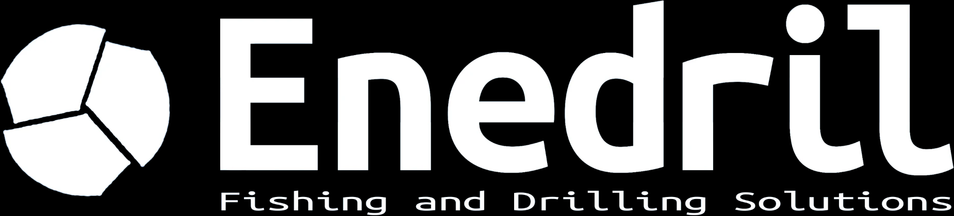
DIRECTIONAL DRILLING
& FISHING SOLUTIONS
FRANCE

Slide 2
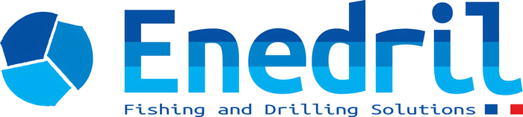
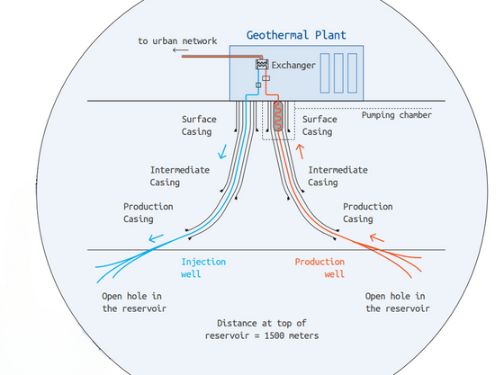

ABOUT US
Enedril (formerly Mustang Oil Services) is an independent French company founded in 2013, specialised in directional drilling, fishing and well intervention for geothermal, oil & gas and underground gas storage projects, in France and abroad. Run since 2022 by Fabien and Alexis, it combines field experience with technical know-how, and is known for being fast, flexible and easy to work with.
98,500 m
75
WHY CHOOSE US
EXPERIENCE
Years in the industry and a wide range of projects completed across sectors.
drilled
wells, up to 3,000 m TVD
142
2,500
EXCELLENCE
Dedication to excellence, safety and innovation for superior results.
OUR FACILITIES
fishing, workover and P&A jobs
tools in stock
Since 2021 we operate from Lons, near Pau, with two fully equipped workshops of more than 1,000 m², a 5 t overhead crane, a break-out unit, a jar tester, lathe, milling and grinding machines and a separate welding shop.
A 3,500 m² outdoor yard stores tubulars, stabilizers and on-site containers.
A rare equipment stock in France: mud motors from 3-1/8" to 9-5/8", shock tools, drilling jars, MWD kits and a very wide range of fishing tools.
OUR VALUES
RESPECT
For our clients, our teams and the people and places around us.
CUSTOM SOLUTIONS
Every project is unique: tailored tools and procedures.
TEAMWORK
Real success comes from strong values and working together.
RELIABILITY
A partner ready to go the extra mile to meet your needs and deadlines.
ENVIRONMENT
Caring for the environment is at the core of what we do.
OUR PURPOSE
Supporting the next generations in the energy transition by contributing to the production of more responsible energy.
ISO 9001:2015 CERTIFIED
Quality followed on every job, from start to finish. About 15 clients supported each year, in France and abroad.
Geothermal doublet: injection and production wells
Enedril · Fishing and Drilling Solutions · 3 avenue des lacs, 64140 Lons (France) · info@enedril.fr · +33 (0)5 59 04 50 45
2

Slide 3
OUR STORY
From Mustang Oil Services to Enedril: a company with a history, and a new dynamic.
2013
2019
2022
2025
MUSTANG OIL SERVICES
The company starts as Mustang Oil Services, dedicated to fishing only.
DIRECTIONAL DRILLING + FISHING
Directional drilling joins fishing: the offer now covers drilling projects as well as interventions.
NEW OWNERS
Fabien Jacquot and Alexis Estines take over the company.
ENEDRIL
Rebranding: Mustang Oil Services becomes Enedril, Fishing and Drilling Solutions.
CONTINUITY
Since the takeover in 2022, the activities continue as before: fishing, workover, plug and abandonment and directional drilling, with the same commitment to our clients.
A NEW DYNAMIC
Fabien and Alexis want to give the company a new momentum, with, among other steps, the 2025 rebranding that gave birth to Enedril.
TODAY: independent French company based in Lons, near Pau, specialised in directional drilling, fishing and well intervention for geothermal, oil & gas and underground gas storage.
Enedril · Fishing and Drilling Solutions · 3 avenue des lacs, 64140 Lons (France) · info@enedril.fr · +33 (0)5 59 04 50 45
3

Slide 4
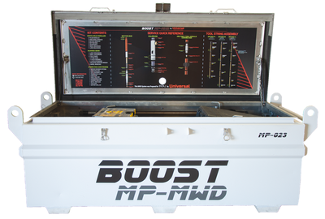
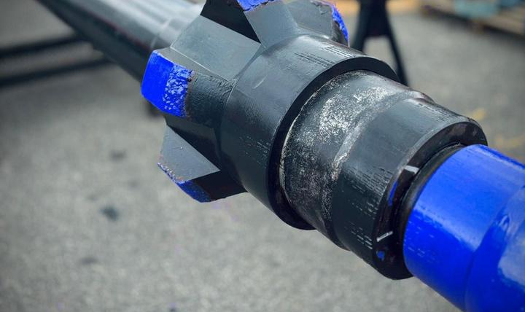
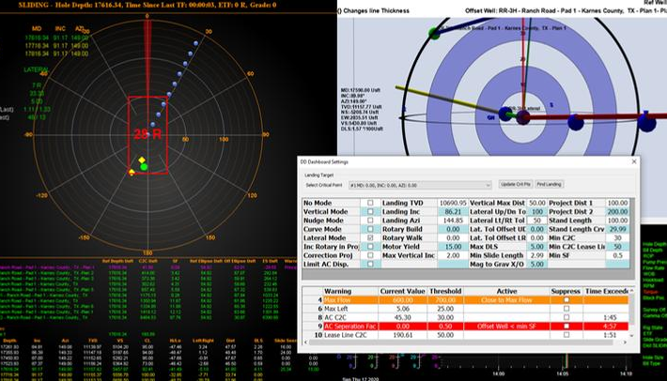
DIRECTIONAL DRILLING & MWD
Advanced directional drilling for complex wells with high precision requirements: downhole motors (PDM), rotary steerable systems (RSS) and high-temperature MWD tools. Experienced Directional Drillers and MWD Engineers steer and optimise the trajectory continuously, with well planning done in-house.
BOOST MUD PULSE MWD SYSTEM
Rock solid performance for aggressive drilling conditions. A positive mud pulse system sending surveys, directional telemetry, gamma ray and other sensor data to surface in real time.
3-1/8" to 9-5/8"
RSS
up to 200°C
PDM motors, HT power sections
Push and point-the-bit
MWD kits, HT electronics
■ Field-proven design, standard rating 185°C, 200°C version available
■ Top and bottom mounted positive pulse systems
■ Motor-driven anti-plugging pulser: performs in LCM and high-solids mud
■ Wide range of flow rates and rotary speeds, easy to assemble and service
■ Down-linking for adjustable logging sequences (4 programmable)
OUTSIDE DIAMETER
47.6 mm (1.875")
PRESSURE RATING
20,000 psi
MUD MOTORS & RSS
PDMs from 3-1/8" to 9-5/8" OD, wide range of power sections incl. high-temperature stators. Push and point-the-bit RSS.
WELL PLANNING
Innova and DrillScan: torque and drag, hydraulics and anti-collision, for safe and efficient drilling. Full simulation, high-frequency data recorder.
TEMPERATURE
-20 to 185°C
COLLAR SIZES
3.5" to 8"
FLOW RATE
75 - 1,200 gpm
BATTERY LIFE
400+ h (2 modules)
SHOCK LIMIT
500 g
INTERNAL MEMORY
24 MB
ALSO AVAILABLE
Survey equipment (LWD, gyro, dual telemetry)
Turbodrilling
Jar placement
Telemetry: inclination, azimuth, toolface, gamma ray, shock, vibration, RPM, stick-slip, temperature, annular pressure, battery status.
Non-magnetic equipment
Slimhole tools 3-1/2"
High-temperature systems
Inclination | Azimuth | Toolface | Temperature
±0.10° | ±0.50° | ±0.20° | ±0.5°C
98,500 m drilled · 75 wells · up to 3,000 m TVD
Enedril · Fishing and Drilling Solutions · 3 avenue des lacs, 64140 Lons (France) · info@enedril.fr · +33 (0)5 59 04 50 45
4

Slide 5
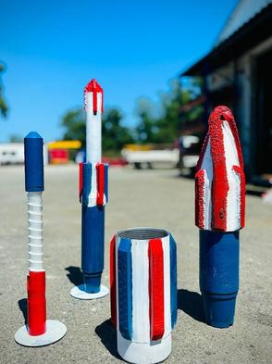
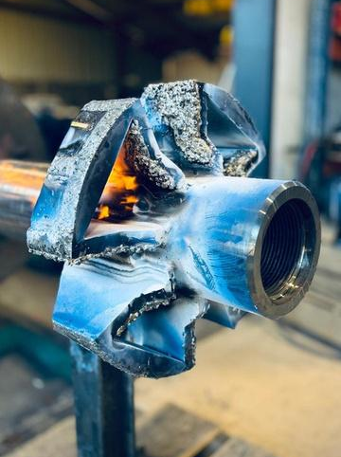
FISHING, WORKOVER & P&A
Fishing, workover and plug & abandonment: the full range of operations to recover, restore and secure wells during drilling, workover or abandonment. Our fishing team responds quickly with a large rental and sale fleet, backed by our own workshop and custom tool design.
2,500
24 / 48h
142
ISO 9001
tools available
response time
fishing, workover and P&A interventions
certified quality management
FISHING
WORKOVER
PLUG & ABANDONMENT
Recovery of rods, strings, BHAs and stuck or lost tools.
Jarring and impact tools, shock tools, intensifiers.
Overshots, spears, die collars, magnets, taper taps.
Tools for rental or purchase.
Well restoration and preparation for return to production.
Section milling and wash over.
Casing repair: scrapers, impression blocks, junk baskets.
Reaming with RTU, DTU and SPX underreamers.
Safe, definitive abandonment of wells.
Cutting with hydraulic pipe cutters and section mills.
Whipstocks and sidetracks, packers, bridge plugs, liner hangers.
Cold cutter, wellhead replacement, casing jack, tanks.
WATER WELLS TOO
We also work on water wells, typically between 300 and 1,000 m, in support of drilling contractors. Habits formed on 3,000 m wells mean we handle shallow wells with the same rigor.
CUT & PULL
Hydraulic and external pipe cutters, spears and overshots to cut and pull casing, tubing or stuck strings.
REAMING
Rotary and directional underreamers, hole openers, roller reamers and SPX drag-type underreamers.
MILLING
Junk mills, pilot and taper mills, section mills and washover shoes.
WHERE WE WORK
Based in Lons (64), south-west France. We mobilise across metropolitan France within 24 to 48 hours in an emergency, and have international experience in Europe and North Africa. A single dedicated team follows each job from diagnosis to resolution.
Enedril · Fishing and Drilling Solutions · 3 avenue des lacs, 64140 Lons (France) · info@enedril.fr · +33 (0)5 59 04 50 45
5

Slide 6
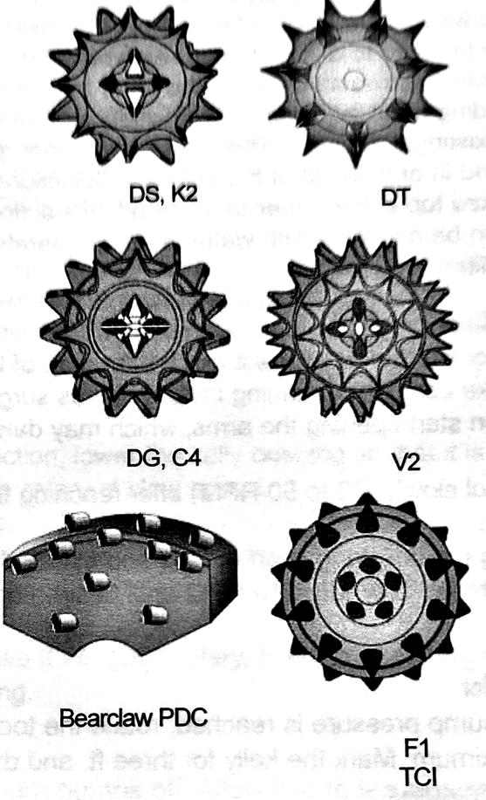
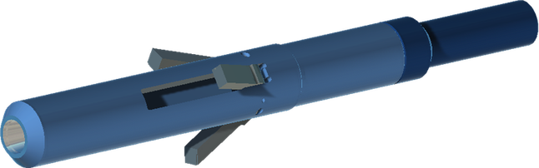
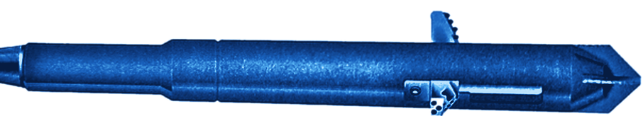
TOOL CATALOGUE
A selection of the main tools in stock, for rental or purchase. The full catalogue and technical data sheets are available on request. Sizes in inches; tool series are quoted where applicable.
CLEANING | Range
Casing scraper | 3-5/8" - 7-7/8"
Impression block | 2-1/8" - 13-1/2"
Reverse circ. junk basket | 5-5/8" - 17"
Junk basket | 3-1/2" - 13-3/8"
CUTTING | Range
Hydraulic pipe cutter | 3600, 5700, 8200, 11700s
Section mill | 3600, 5500, 8200, 11700s
External hydraulic cutter | 5-5/8" - 8"
REAMING & ENLARGEMENT | Range
Rotary underreamer (RTU) | DTS 350, 5700, 8200
Drilling-type underreamer (DTU) | 5700, 8200, 12000, 18000
Master Driller | 8200, 14000
Hole opener | 14-3/4"
SPX drag-type underreamer | 5700
Roller reamer | 8200
MILLING & WASHOVER | Range
Economill | 3-3/4" - 12-1/8"
Junk mill | 2-1/8" - 17-3/8"
Super junk mill | 3-3/4" - 18-3/8"
Pilot mill | 3-1/4" - 8-1/2"
Taper mill | 2-1/2" - 18-1/2"
Washover shoe | 2-9/16" - 13-3/8"
RECOVERY | Range
Die collar | 4" - 9-5/8"
Fishing magnet | 3-3/4" - 15"
Spear, internal | 6-3/4" - 8"
Spear | 2-3/8" - 20"
Overshot | SFS, SH, XSH, FS
Taper tap | 3-1/16" - 8"
JARRING & IMPACT | Range
Fishing jar | 3-1/8" - 8"
Jar intensifier | 3-1/8" - 6-1/2"
Safety joint | 3-1/2" - 8"
Stabilizer | 3-1/8" - 9-1/2"
Crossover (XO) | 3-3/8" - 11-3/4"
Bit / Float sub / Bull nose | 2-3/16" - 10-1/4"
FOR WATER WELLS
typically 300 - 1,000 m
UNDERREAMERS
DTU and SPX data sheets available
HYDRAULIC PIPE CUTTER
Data sheet available
Cut & pull: hydraulic pipe cutters, external cutters, spears, overshots, jars.
Reaming: RTU, DTU, SPX drag-type, hole openers, roller reamers.
Milling: junk mills, pilot mills, taper mills, section mills, washover shoes.
Stock available, response within 24/48h anywhere in metropolitan France.
DTU: 6 cutter options (milled tooth, TCI, PDC Bearclaw). SPX: PDC drag-type, arms dressed with tungsten carbide.
■ Internal hydraulic cutter for single or multiple casing strings.
■ Mainly for well abandonment, when casings are cemented.
■ Four tool diameters cutting 4-1/2" to 36".
■ Up to 400 L/min, 35 - 60 bar.
DOWNHOLE TOOLS AND SPECIAL INTERVENTIONS: drilling bits (PDC), jars, stabilizers, tubulars, circulating subs, whipstocks and sidetracks, packers, bridge plugs, liner hangers, casing jack. Custom tools designed with an API 5 & 7 certified machine shop. To request a quotation, specify tool type, size or series, connections and operation.
Enedril · Fishing and Drilling Solutions · 3 avenue des lacs, 64140 Lons (France) · info@enedril.fr · +33 (0)5 59 04 50 45
6

Slide 7
Enedril
3, avenue des lacs
64140 Lons (FRANCE)
info@enedril.fr
+33 (0)5 59 04 50 45
www.enedril.com

