Slide 1
Reinforcement Learning for segmentation of image data
First corrector: Prof. Dr. Fred Hamprecht
Second corrector: Dr. Anna Kreshuk

Slide 2
Why?
RL is weakly supervised
Computation of evaluation score does not need to be differentiable
Notes:
Eval score calculation can be anything
- fully supervised
- fully unsupervised and non diffble
- mixture
- sparse labels …

Slide 3
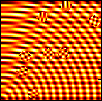
The toy problem
Instance segmentation for discs
Separated from background by
phase shifted cosine interferences
8-10 discs per 128x128 raw image
with a radius between 8 and 10 pixels

Slide 4
Pixel affinities
Agent predicts changes for affinities
Problem becomes too large
Downsize problem by predicting merge affinities of neighboring superpixels in a rag
Notes:
Watersheding algorithms on affinity graphs sensitive to single „bad“ affinities.
Holes in affinity graph cause merged objects.
In mtxwtsd case bad mutexes cause separation of objects.
Problem size is too large to solve.
Go has 250 moves per state
3 attractive and 3 repulsive aff per pixel

Slide 5
Overall setup
Separation into feature extraction and RL
Using superpixels for downsizing
Extract features per pixel and agglomerate over superpixel
Predict merge affinity for each edge in the superpixel rag

Slide 6
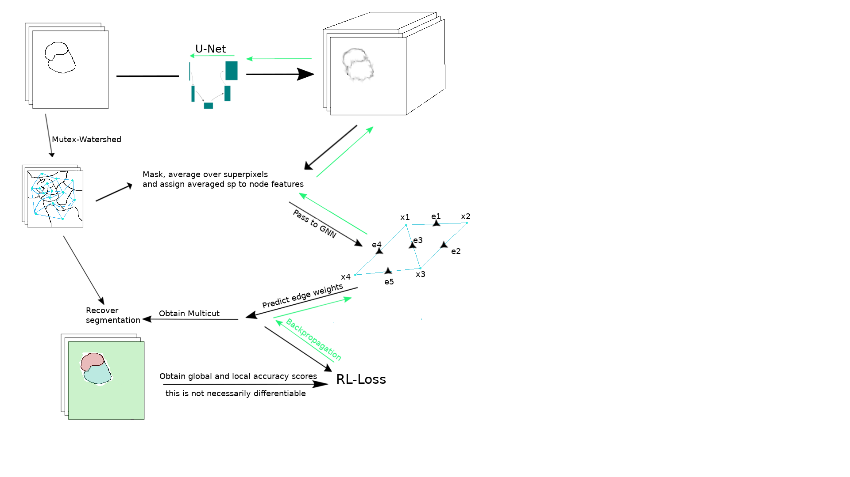
Contrastive loss for predicting pixel embeddings
GNN consists of interchanging convolution on nodes and edges
Calculating a MC based on predicted edge weights
Segmentation is recovered from SP and MC result.

Slide 7
Feature extraction
Contrastive loss in pretraining
Backprop RL loss through FE
Notes:
What is contrastive loss
Supervised and unsupervised contrastive loss
Semantic if obj non touching
Instance if obj. touching.

Slide 8
GNN
Convolving edge and node features
Notes:
Batch norm

Slide 9
Superpixel generation
Mutex watershed with affinities based on forward difference of incidental pixels
Intensify repulsive edges

Slide 10
The model in RL terminology
Environment
Agent
State
Action
Mc + reward gen
GNN + FE
s_t = [ rw, esp, eseg_t ]
Sigmoid tf of sample from π
Notes:
Single step or multistep ?
Multistep (necessary if sparse rewards)
More stable (not diverging)
Single step
Simple action value (normalizable)

Slide 11
Choosing a RL algorithm
Continuous or discrete action space
Sota for discrete actions is ACER or Rainbow
For continuous actions SAC

Slide 12
Soft Actor Critic
Critic loss term
Notes:
Maximum entropy RL
Normal Q-learning with soft value iteration
empirical expectation
Entropy not empirical
Gradient only for variance
Pi is gaussian mixture

Slide 13
Actor loss term:
Notes:
If it would be softmax over reward and reward is gt per edge, this is nothing else than supervised learning with DKL
Policy gradient → Cross entropy loss.
Base lines normalize reduce variance → softm
AC self supervised training where „labels“ are approximated.
DKL useful here because it logs the softmax term
Alpha large in the beginning – small probs
small lateron when Q can be trusted more → larger probs

Slide 14
The problem of local optima
RL-methods are prone to converge quickly into local optima
Careful modeling of the reward function and exploration strategy can prevent this
For CNN training Dice loss has shown to flatten out class imbalances
Notes:
superpixels are oversegmentation → many merge edges
few repulsive edges
naturally generating local optima of 0

Slide 15
Action values on subgraphs
Critic estimating an action value for each subgraph
Subgraphs are found using a simple heuristic
Size of all subgraphs is fixed
Action value on subgraphs is obtained by “many“ graph convolutions followed by global pooling
Notes:
Finding subgraphs that overlap and have high density
Highest density subgraphs of size k is np-hard

Slide 16
Adding the subgraph objective yields the actor gradient loss term
Notes:
One state action value per subgraph
Pi is gaussian mixture model
(multivariate gaussian with diagonal COV matrix)
→ random vars independent →
probas multiplied

Slide 17
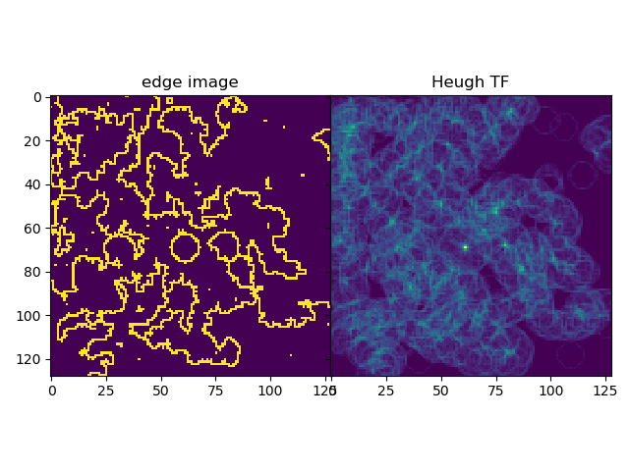
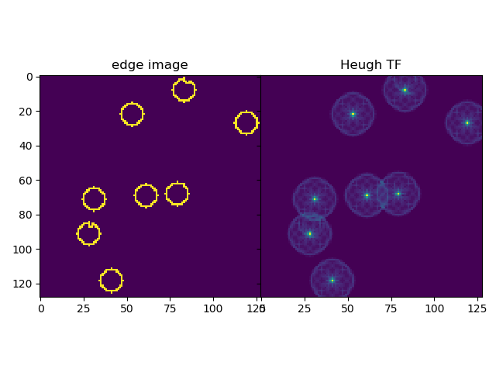
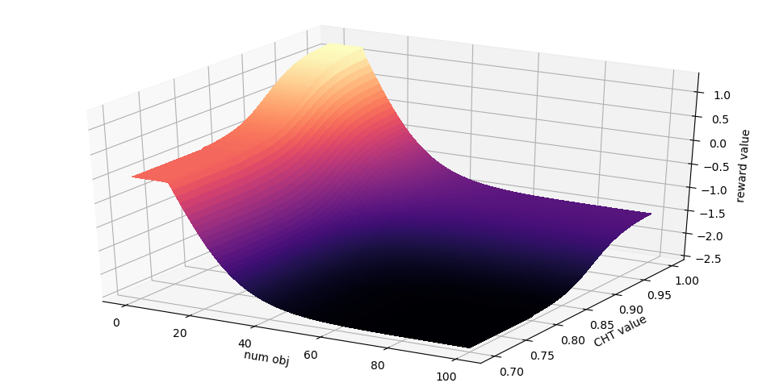
The reward generation
Dice score over the subgraphs
Unsupervised reward using scores from the CHT of the final segmentation
Notes:
actor uses Q vals for update.
noisy approx. → rewards not too smooth with strong apparent maxima.
exponential function good fit
Reward landscape for superpixel belonging to a detected circle
Subgraphs not per object because diff size

Slide 18
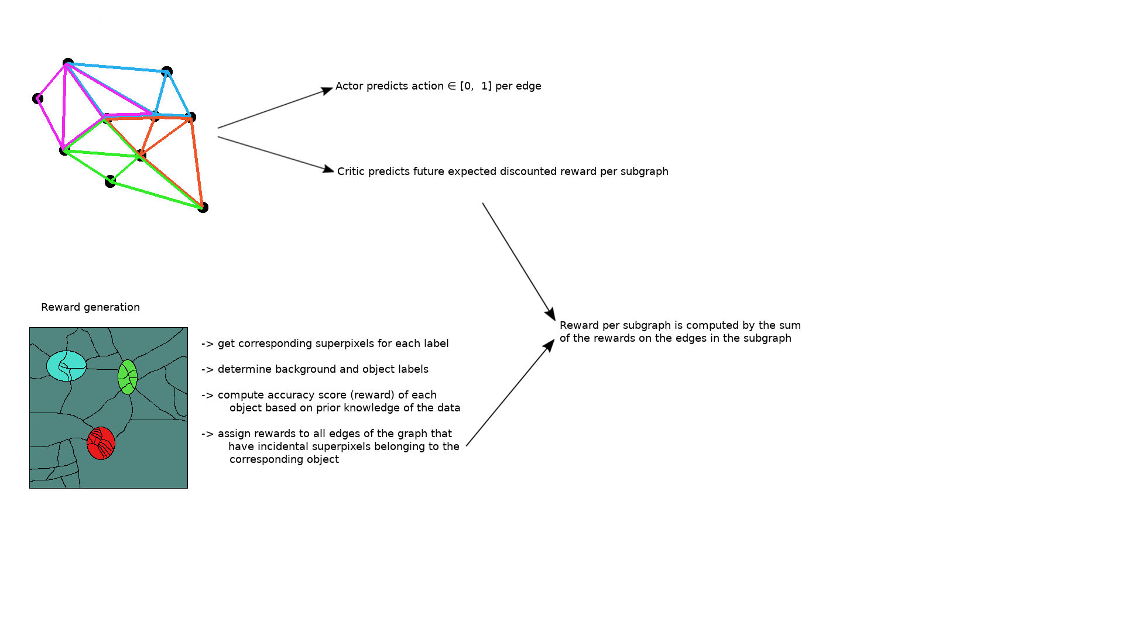
Notes:
Rewards per subgraph

Slide 19
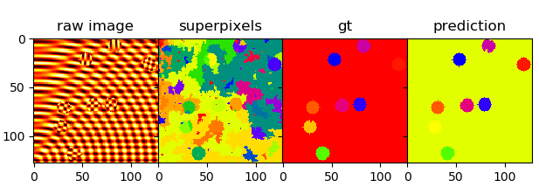
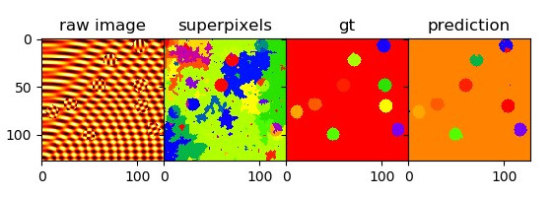
Examples
Dice rewards:
CHT rewards:

Slide 20
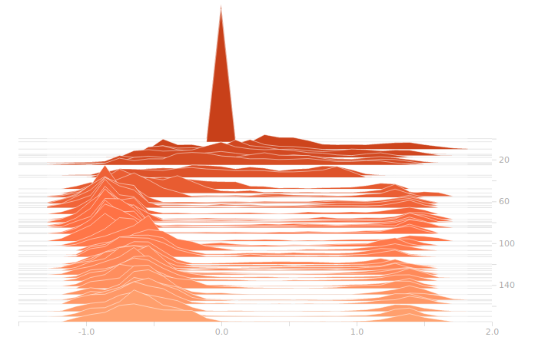
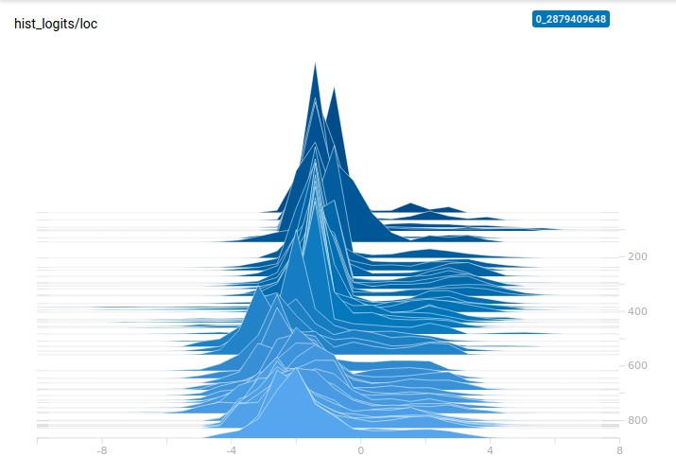
Histogram for predictions of µ
Dice rewards:
CHT rewards:
Notes:
Left is dice, right is CHT reward

Slide 21
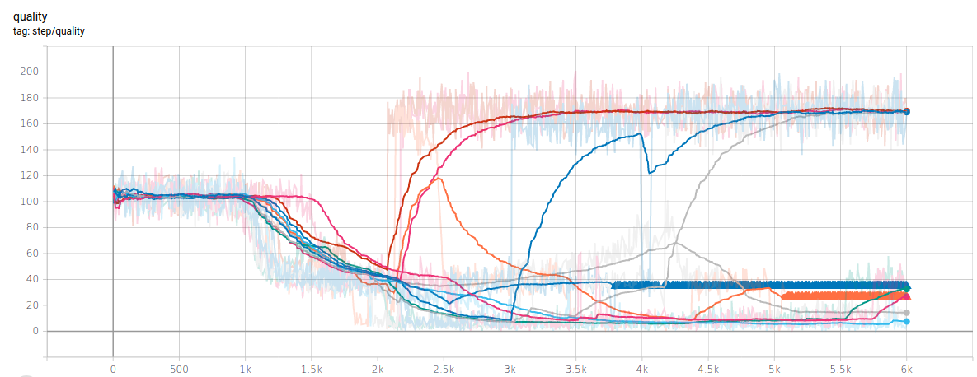
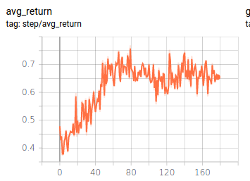
Average return and importance of seeds

Slide 22
Ongoing work
Subgraphs with various scales
Embedding space for instance segmentation
Segmentation of rectangles and circles of varying color
“simple“ natural image instance segmentation tasks

Slide 23
Sources
J. Gilmer, S. S. Schoenholz, P. F. Riley, O. Vinyals, and G. E. Dahl, “Neural message passing for quantum chemistry,” 2017.
Tuomas Haarnoja*, Aurick Zhou*, Kristian Hartikainen*, George Tucker, Sehoon Ha, Jie Tan, Vikash Kumar, Henry Zhu, Abhishek Gupta, Pieter Abbeel, Sergey Levine.
Soft Actor-Critic Algorithms and Applications. arXiv preprint, 2018

