Slide 1
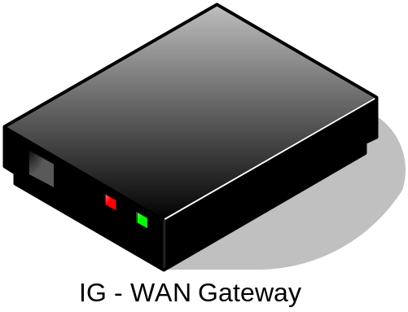
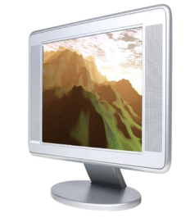

HNI
-
IGI
HNI
-
INI
Internet
OITF TV
Managed
DLNA device

