Slide 1

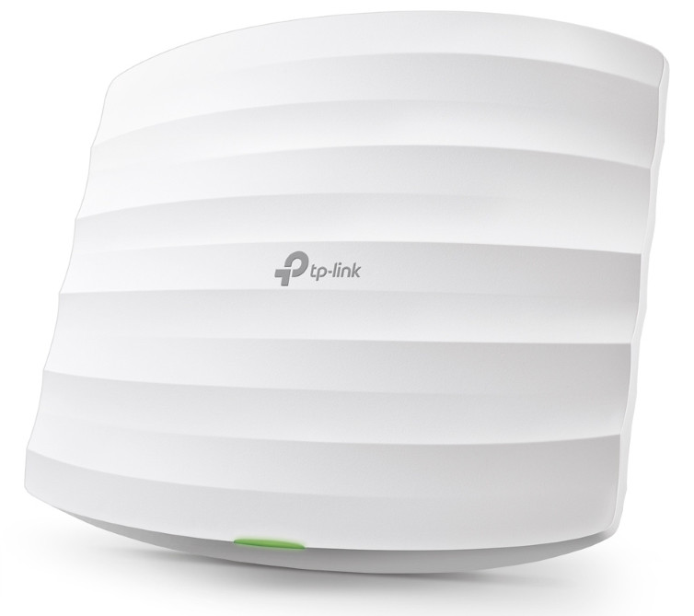
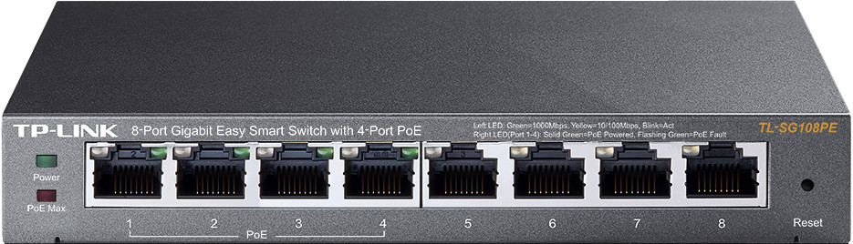

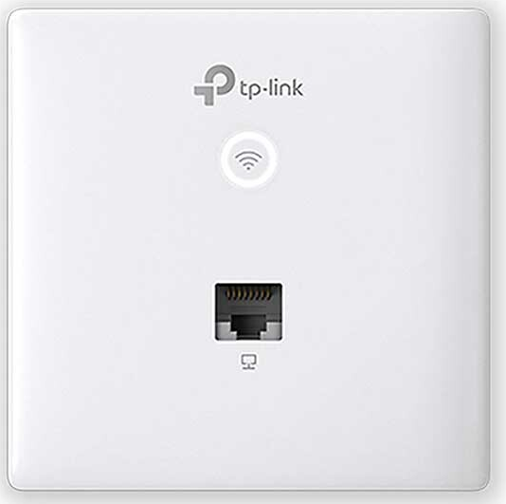
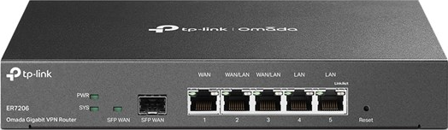

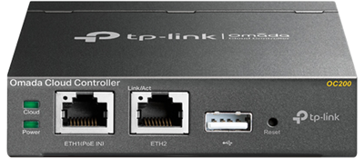

EAP225
TL-SG2210P
New Zealand
USA
UK
EAP230-Wall
ER7206
EAP230-Wall
OC200
TL-SG2210P
EAP230-Wall

