Slide 1
Frontend and Backend Integration

Slide 2
Step 1
Step 1: the simple html form processing with backend response
index.html is the simple frontend web apps with form processing, the backend processing is called by
action="http://localhost:8000/bmi" method="post"
2.1_Server/server2.py is a program to start the backend (ref: SU1, Chapter 2, form p. SU2-13)
python3 serve2.py

Slide 3
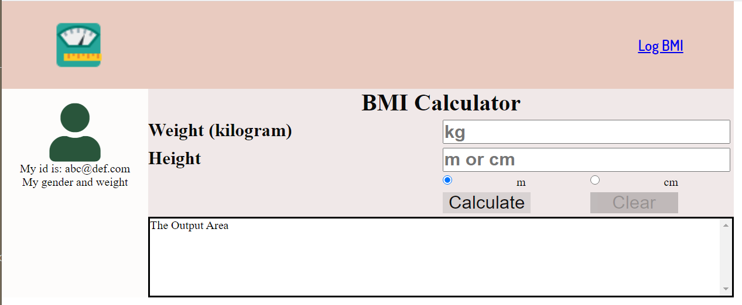
Step 2
Step 2: the frontend with mixed grid and flex layout methods.

Slide 4
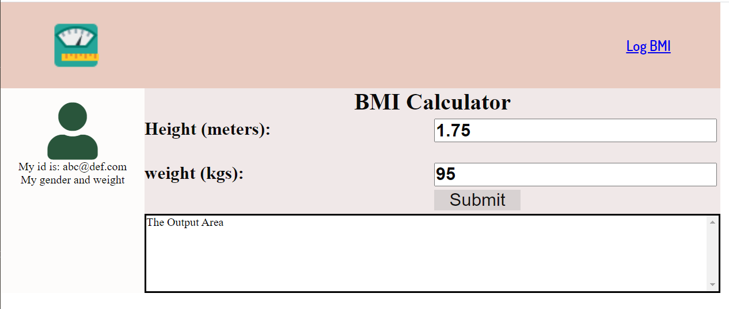
Step 3
Step 3: Integration of backend and frontend using ajax.

