Slide 1
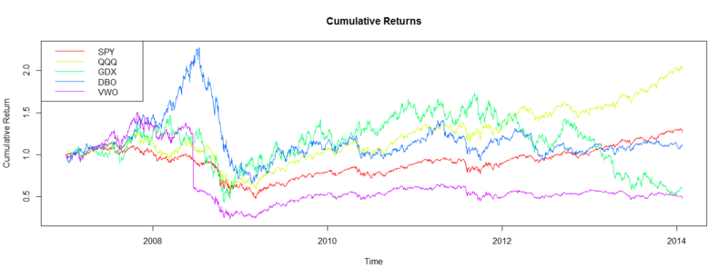
Time Series

Slide 2
What is a Time Series
Anything that is observed or measured at many points in time forms a time series.
Many time series have a fixed frequency – data points occur at regular intervals
Others are irregular
How you refer to time series data depends on the application:
Timestamps, specific instants in time
Intervals, periods of time
Experiments, experiment # or elapsed time
We will focus mostly on the first one .

Slide 3
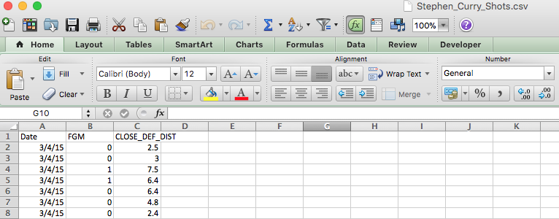
Steph Curry
Steph Curry’s shots over the 2015 Season are time series. Let’s read in this data.

Slide 4
Steph Curry
In a time series you want the datetime to be the index

Slide 5
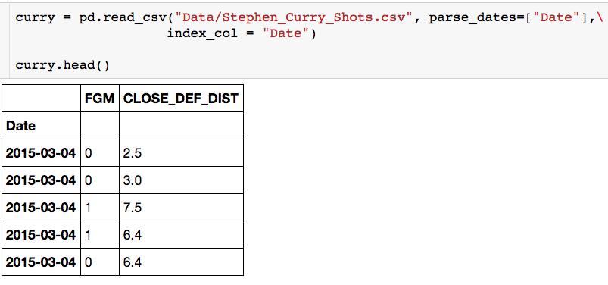
Steph Curry
What was Steph’s monthly FG %?
When Steph gets hot, do defenders get closer to him?

Slide 6
Steph Curry
Lets have a closer look at this index

Slide 7
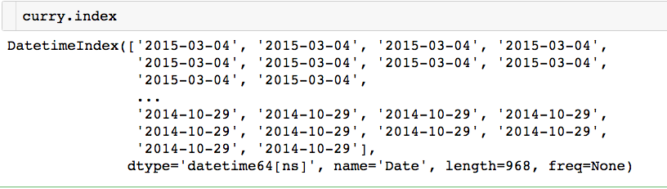
DateTimeIndex
Numpy datetime64 type (goes down to nanosecond)

Slide 8
DateTimeIndex
Currently there is no frequency.
Numpy datetime64 type (goes down to nanosecond)

Slide 9
DateTimeIndex
Currently there is no frequency.
Numpy datetime64 type (goes down to nanosecond)
Lets see how we can create a DateTimeIndex

Slide 10
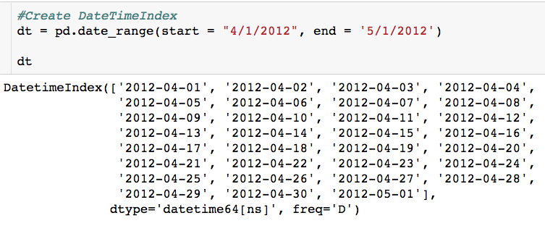
Period_Range
Pandas.date_range() is responsible for generating a DateTimeIndex with an indicated length or period.
Default frequency is days or D

Slide 11
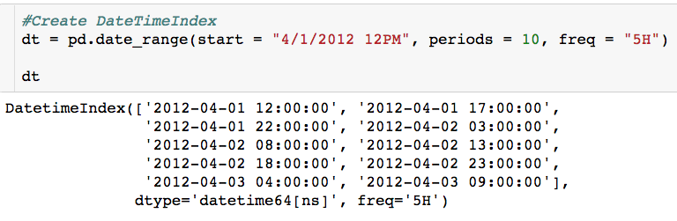
Period_Range
Number of data points in the time series
5 hour frequency

Slide 12
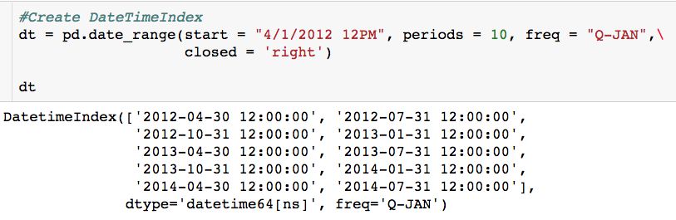
Period_Range
Quarterly frequency with year ending in January
Pick the right side of the interval

Slide 13
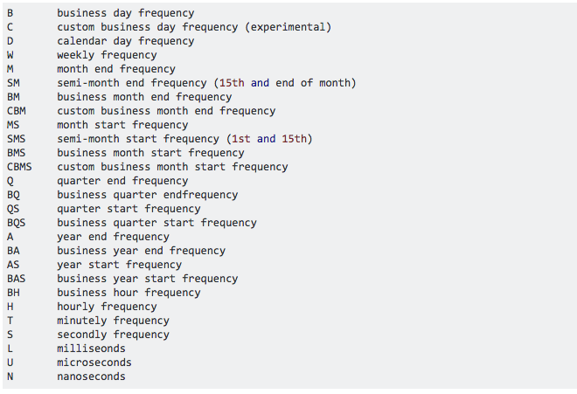
Period_Range - Frequencies

Slide 14
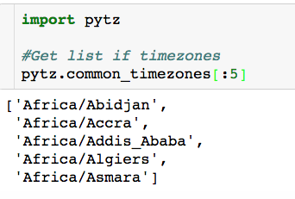
Time Zones
In Python, time zone information comes from the 3rd party package pytz:

Slide 15
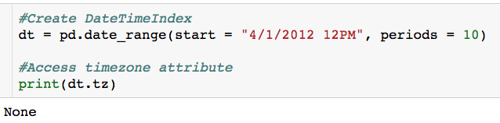
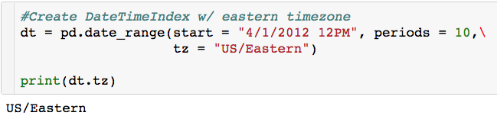
Time Zones
By default, time series in pandas are time zone naive
Date ranges can be generated with a time zone set using the tz argument

Slide 16
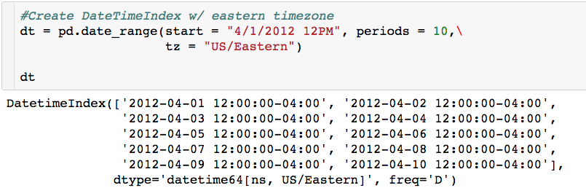
Time Zones
Let’s look at the date time index:
Timezone = US/Eastern
UTC offset

Slide 17
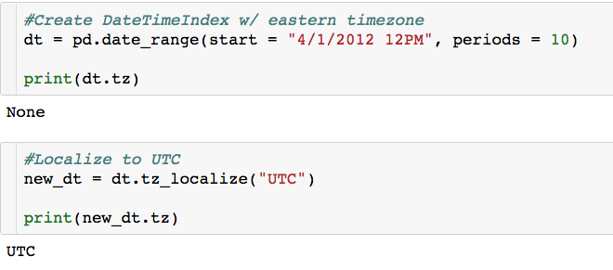
Time Zone Conversion
Conversion from naïve to localized timezone is done through tz_localize method:

Slide 18
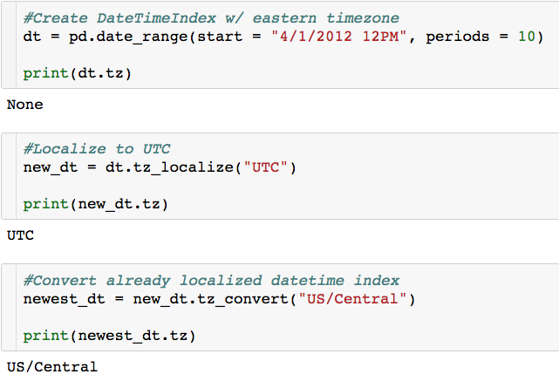
Time Zone Conversion
Once a time series has been localized, it can be converted to another time zone using tz_convert

Slide 19
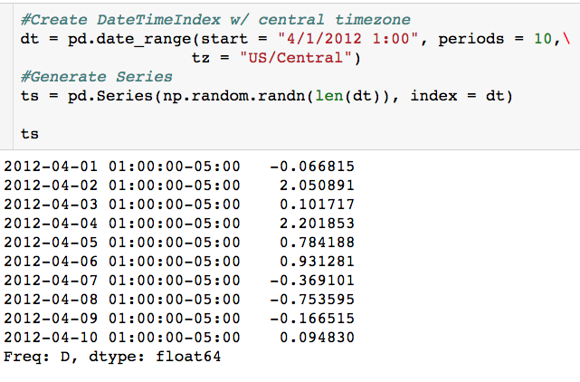
Time Series
A time series is a pandas series where the index is a datetime index. (All of this will work on dataframes also)

Slide 20
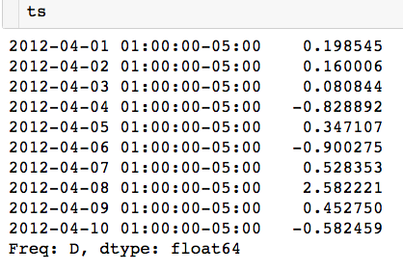

Indexing + Selection
Multiple ways to index:

Slide 21

Indexing + Selection
Multiple ways to index:

Slide 22

Indexing + Selection
Multiple ways to index:

Slide 23
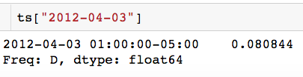
Indexing + Selection
This return a series
Multiple ways to index:

Slide 24
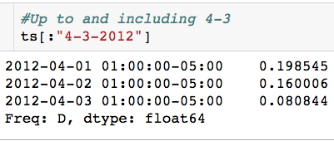
Indexing + Selection
Slice contiguous element:

Slide 25
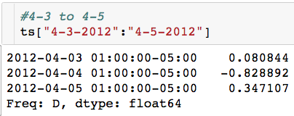
Indexing + Selection
Slice contiguous element:

Slide 26
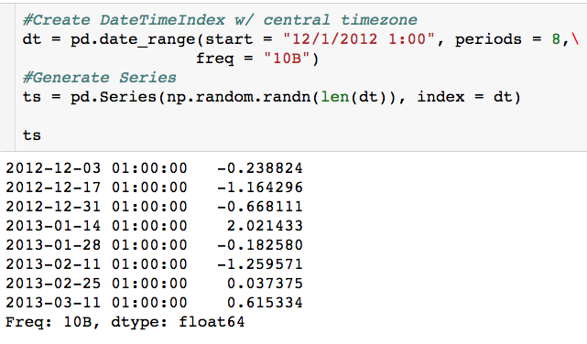
Indexing + Selection
New time series

Slide 27
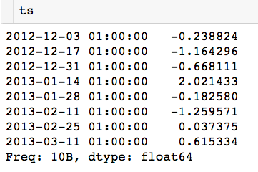
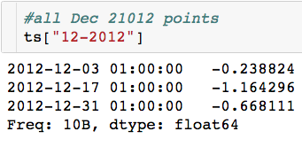
Indexing + Selection
All Dec. 2012 data points:

Slide 28
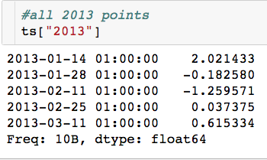
Indexing + Selection
All 2013 data points:

Slide 29
Common TS Operations
Shifting: moving data backward or forward
Useful for computing daily changes
Resampling: converting between frequencies
Group By for time series data
Moving Window Functions: Compute statistic of time series based on moving window
Rolling mean

Slide 30
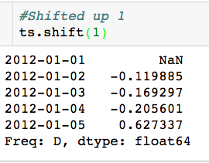
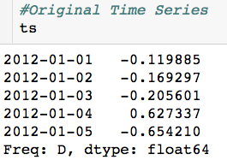
Shifting
Dataframes and Series have a shift method for doing naïve shifts backward and forward, leaving the index unmodified.

Slide 31
Shifting
Dataframes and Series have a shift method for doing naïve shifts backward and forward, leaving the index unmodified.
Notice we lose this data point

Slide 32
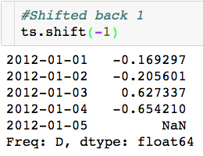
Shifting
Dataframes and Series have a shift method for doing naïve shifts backward and forward, leaving the index unmodified.

Slide 33
Shifting
Dataframes and Series have a shift method for doing naïve shifts backward and forward, leaving the index unmodified.
Notice we lose this data point
Why is this useful?

Slide 34
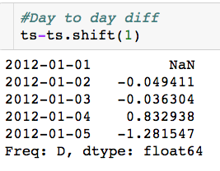
Shifting
Can easily compute the day to day difference:

Slide 35
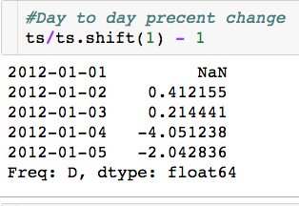
Shifting
Can easily compute the day to day percent change:

Slide 36
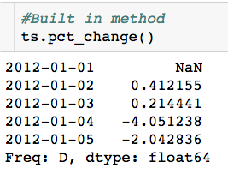
Shifting
There is actually a built in method to do this:

Slide 37
Shifting W/ Frequency
Naïve shifts discard data
If frequency of the ts is known, this can be passed to the shift to prevent this

Slide 38
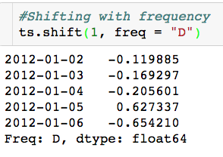
Shifting W/ Frequency
Naïve shifts discard data
If frequency of the ts is known, this can be passed to the shift to prevent this

Slide 39
Shifting W/ Frequency
Naïve shifts discard data
If frequency of the ts is known, this can be passed to the shift to prevent this
Now we don’t lose any data here

Slide 40
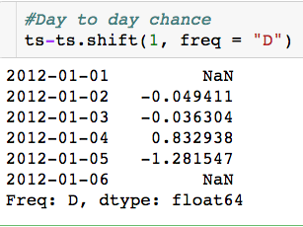
Shifting
Can easily compute the day to day difference without losing data:

Slide 41
Resampling
Resampling refers to the process of converting a time series from one frequency to another.
Aggregating higher frequency data to a lower frequency is called downsampling.
Aggregating lower frequency data to a higher frequency is called upsampling.
Not all resampling falls into either of these two categories: Example?
Pandas ts objects are equipped with resample method, which is the main function for all frequency conversion.

Slide 42
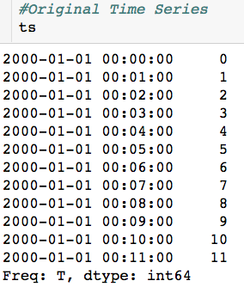
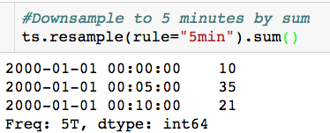
Downsampling

Slide 43
Downsampling
What timestamp to use as bin label?

Slide 44
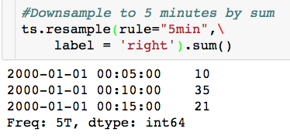
Downsampling W/ Label
Label = ‘left’ would produce the plot from the previous slide
There is an argument closed = ‘left/right’ which controls inclusivity of endpoints of bins.

Slide 45
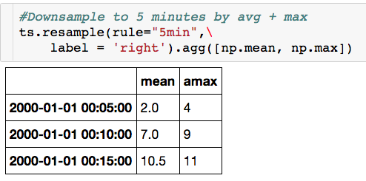
Downsampling W/ Multiple Functions
Notice that I get back a dataframe in this case

Slide 46
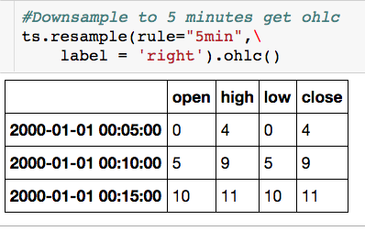
Downsampling W/ Multiple Functions
Built in open, high, low, close!

Slide 47
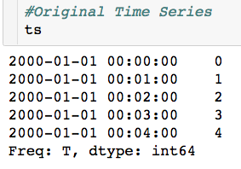

Upsampling

Slide 48
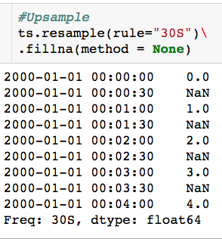
Upsampling

Slide 49
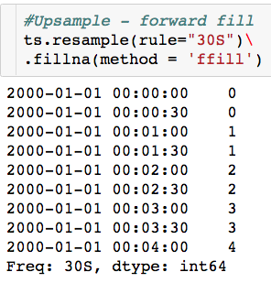
Upsampling

Slide 50
Moving Window Functions
Apply statistics or other functions to sliding window or exponentially decaying weights.
Automatically exclude missing data
Rolling means, medians, max, correlations
Exponentially weighted moving averages
Pandas ts objects are equipped with rolling method, which is the main function most of the moving window functions.

Slide 51
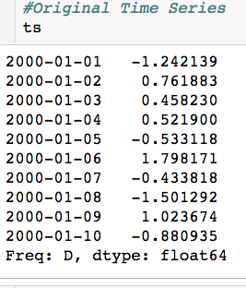
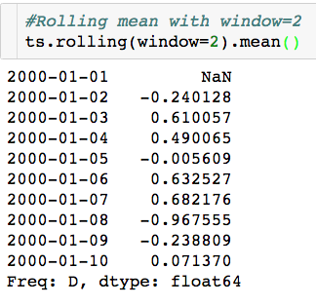
Moving Window Functions

Slide 52
Moving Window Functions
Why is there an NaN?

Slide 53
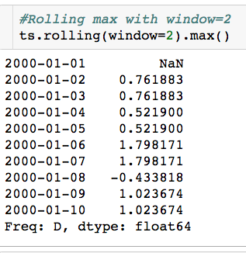
Moving Window Functions

Slide 54
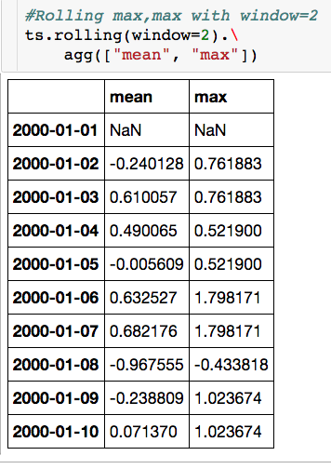
Moving Window Functions

Slide 55
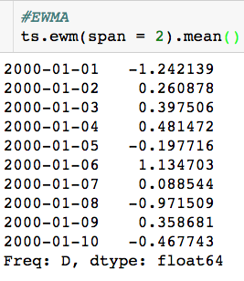
Moving Window Functions
Span = window length

