Slide 1
Module 8: Packages + Monte Carlo Optimization
Monte Carlo

Slide 2
Python Packages
Python has many built in packages that makes things a lot easier.
Here are the main ones we will consider
  os: operator system interface
  numpy: matrix algebra, random number generation
  scipy: random number generation, optimization
  pandas: reading csv/xls files, data analytics, plotting

Slide 3
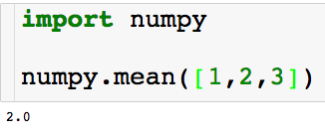
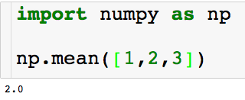
Importing Python Packages
There are two main ways to import packages:
Using the mean module in the numpy package

Slide 4
Numpy + Scipy
These package are useful for simulation and efficient computation
Things we can do with numpy and scipy:
  Generate random numbers
  Matrix algebra – matrix inversion, eigenvalues, dot products, etc …
  Solve linear program

Slide 5
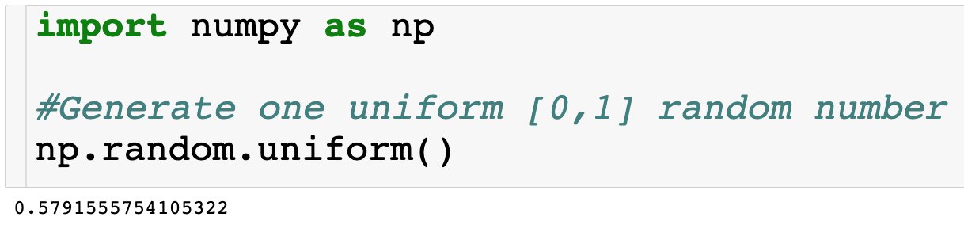
Numpy – Generate Random Number

Slide 6
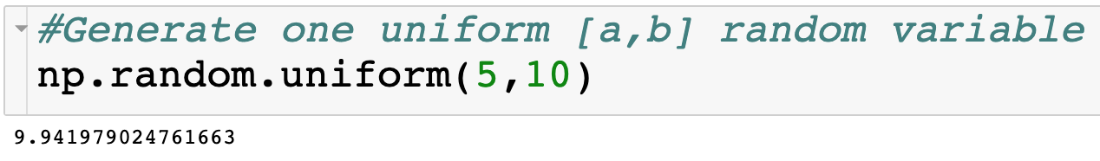
Numpy – Generate Random Number

Slide 7
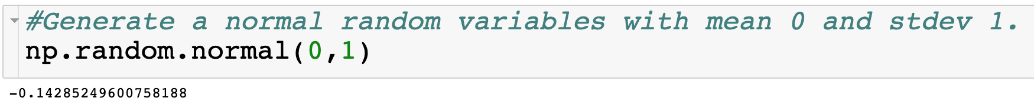
Numpy – Generate Random Number

Slide 8
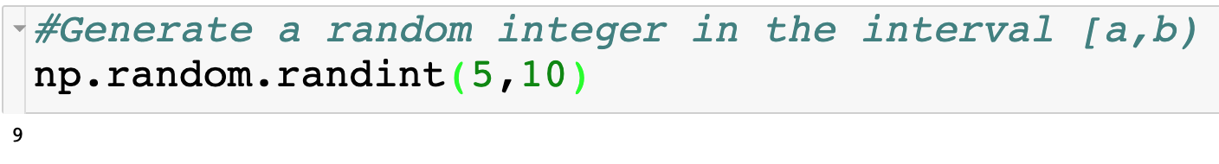
Numpy – Generate Random Number

Slide 9
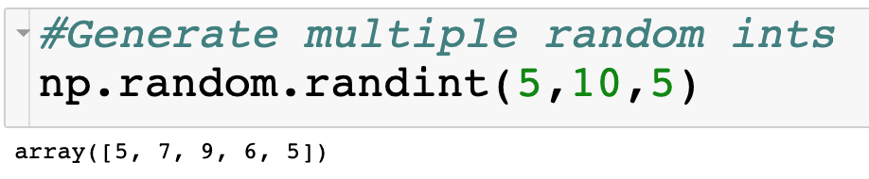
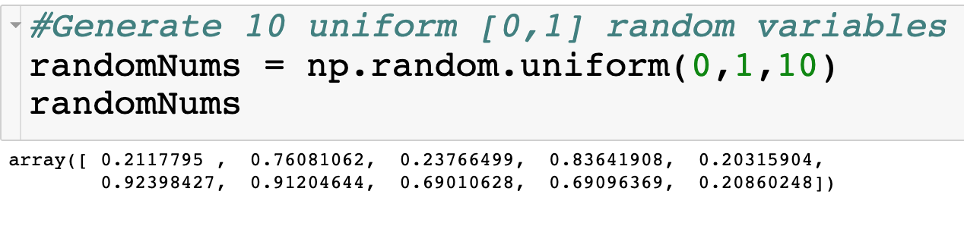
Numpy – Generate Arrays of Random Number
Numpy arrays

Slide 10
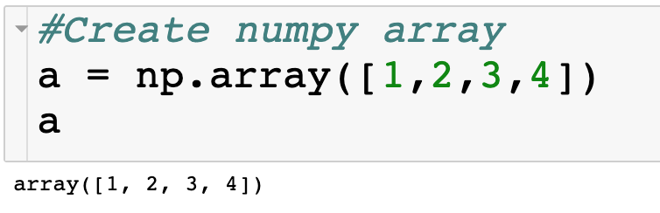
Numpy Arrays
Numpy arrays behave like lists…

Slide 11
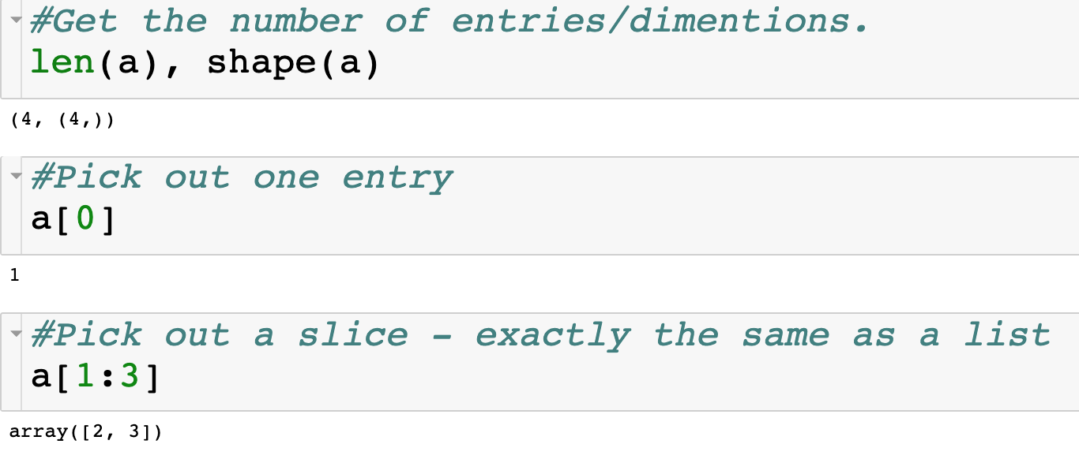
Numpy Arrays
Numpy arrays behave like lists…

Slide 12
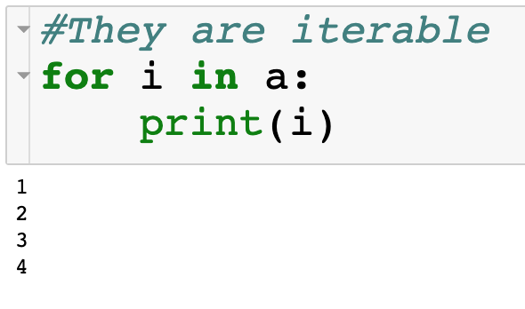
Numpy Arrays
Numpy arrays behave like lists…

Slide 13
Pandas
This will be our main package for data analytics
Things we can do with pandas:
  Read/write csv and excel files
  SQL
  Data visualization
  Regression

Slide 14

Monte Carlo Simulation
Use simulation to get a handle on randomness
  Estimate probabilities of events
    Probability of getting straight flush
  Estimate expected values
    Expected return of portfolio
    Payout of gambling strategy
  Approximate stochastic optimization problems
    Newsvendor problem
    Evaluate heuristics

Slide 15
Probability w. Dice
What is the probability that the max number of three six sided dice is greater than 3?
  Roll three 6 sided die N times.
  For each roll, compute the max of the three dice
  Count the number that are greater than 3- call count_3
  Estimate the probability as count_3/N.

Slide 16

Probability of a Straight Flush
What is the probability of being dealt a straight flush in a 5 card poker hand?
  Generate N 5 card poker hands.
  Count how many are a straight flush - call count_sf
  Estimate the probability as count_sf/N.

Slide 17
Estimating Expected Value
Interested in collecting baseball cards coming out of cereal boxes
There are 5 types of cards
Buy 4 boxes, come home, open all boxes and check all cards
What is the expected number of different cards
E.g. if we get the cards 1, 3, 3, 5 out of 4 boxes, then the number of different cards is 3.

Slide 18
Monte Carlo Approach
Assumption: The probability of getting each card out of a box is equal
Generate the cards coming out of the 4 purchased boxes
Count the number of different cards
Replicate N times and report average over the N trials.

Slide 19
Building a Confidence Interval
Each time we rerun the Monte Carlo we get different results due to the inherent randomness
How much confidence can we put on our estimates?
Let X be the random variable that represents the number of different cards that we get.
We are interested in estimating the expected value of X

Slide 20
Building a Confidence Interval

Slide 21
Number of Trials Needed for Certain Precision

Slide 22
Number of Trials Needed for Certain Precision

Slide 23
Number of Trials Needed for Certain Precision

Slide 24
Number of Trials Needed for Certain Precision

Slide 25

Simulation Optimization
You have $1000 and are considering investing it in three stocks: Orange, Moogle and Snapcat.
You notice that the historical returns for each of these three socks are normal distributed with the following parameters
 | Orange | Moogle | Snapcat
mean | 8 | 15 | 3
stdev | 6 | 15 | 1
How should I allocate my $1000 amongst the three stocks to maximize my expected return?

Slide 26
Simulation Optimization
 | Orange | Moogle | Snapcat
mean | 8 | 15 | 3
stdev | 6 | 15 | 1
What is my expected return if I invest $500 in Orange and $250 in the other two stocks?

Slide 27
Simulation Optimization
 | Orange | Moogle | Snapcat
mean | 8 | 15 | 3
stdev | 6 | 15 | 1
What is my expected return if I invest $500 in Orange and $250 in the other two stocks?
Use Monte Carlo Simulation!

Slide 28
Simulation Optimization
You have $1000 and are considering investing it in three stocks: Orange, Moogle and Snapcat.
You notice that the historical returns for each of these three socks are normally distributed with the following parameters
Caveat: If you have a negative return you will get fired, which which has a cost to you of $10K.
 | Orange | Moogle | Snapcat
mean | 8 | 15 | 3
stdev | 6 | 15 | 1

Slide 29
Simulation Optimization
 | Orange | Moogle | Snapcat
mean | 8 | 15 | 3
stdev | 6 | 15 | 1
What is my expected return if I invest $500 in Orange and $250 in the other two stocks?
Here is the Monte Carlo:
  Sample returns for the three stocks
  Compute total return given investment and sampled returns for each stock
    If return is negative we incur $10K cost
  Repeat Steps 1 and 2 N times
  Return average total return over the N trials

Slide 30
Simulation Optimization
 | Orange | Moogle | Snapcat
mean | 8 | 15 | 3
stdev | 6 | 15 | 1
So, how do I find the optimal allocation of the $1000?

Slide 31
Simulation Optimization
 | Orange | Moogle | Snapcat
mean | 8 | 15 | 3
stdev | 6 | 15 | 1
So, how do I find the optimal allocation of the $1000?
  Repeat the MC simulation for all allocations of $1000 of the three stocks and then picks the best!

Slide 32
Simulation Optimization
 | Orange | Moogle | Snapcat
mean | 8 | 15 | 3
stdev | 6 | 15 | 1
So, how do I find the optimal allocation of the $1000?
  Repeat the MC simulation for all allocations of $1000 of the three stocks and then picks the best!
  Are we guaranteed that we invest all $1000?

Slide 33
Simulation Optimization
 | Orange | Moogle | Snapcat
mean | 8 | 15 | 3
stdev | 6 | 15 | 1

Slide 34

Simulation Optimization
AB delivers it’s beer to vendors using third party delivery trucks.
Before the day commences, AB decides on two weights of beer trailers that they preload so they can just load into the third trucks.
The third party trucks have variable weight (Uniform(10K,35K) lbs.) and once loaded with the trailers their weight cannot exceed 40K lbs.
Once truck arrives, always assign lower cost trailer.
  Every lbs over 40K costs $1
  Every pound under 40k costs $0.75
  How can I optimally choose the two pre loaded trailer weights

Slide 35
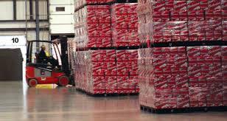
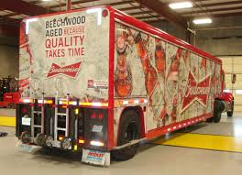
Simulation Optimization

Slide 36
Simulation Optimization

Slide 37
Simulation Optimization

Slide 38
Simulation Optimization

Slide 39

Simulation Optimization

Slide 40
Simulation Optimization
Question: What two weights should I choose?

Slide 41
Simulation Optimization
What is the expected cost if I choose weights of 20K and 30K?
Here is the Monte Carlo:
  Sample a truck arrival
  Find the optimal truck assignment
  Compute cost
  Repeat steps 1-3 N times
  Return the average over the N trials

Slide 42
Simulation Optimization
What is the expected cost if I choose weights of 20K and 30K?
Here is the Monte Carlo:
  Sample a truck arrival
  Find the optimal truck assignment
  Compute cost
  Repeat steps 1-3 N times
  Return the average over the N trials
Optimize over the weights through enumeration again!

