Slide 1
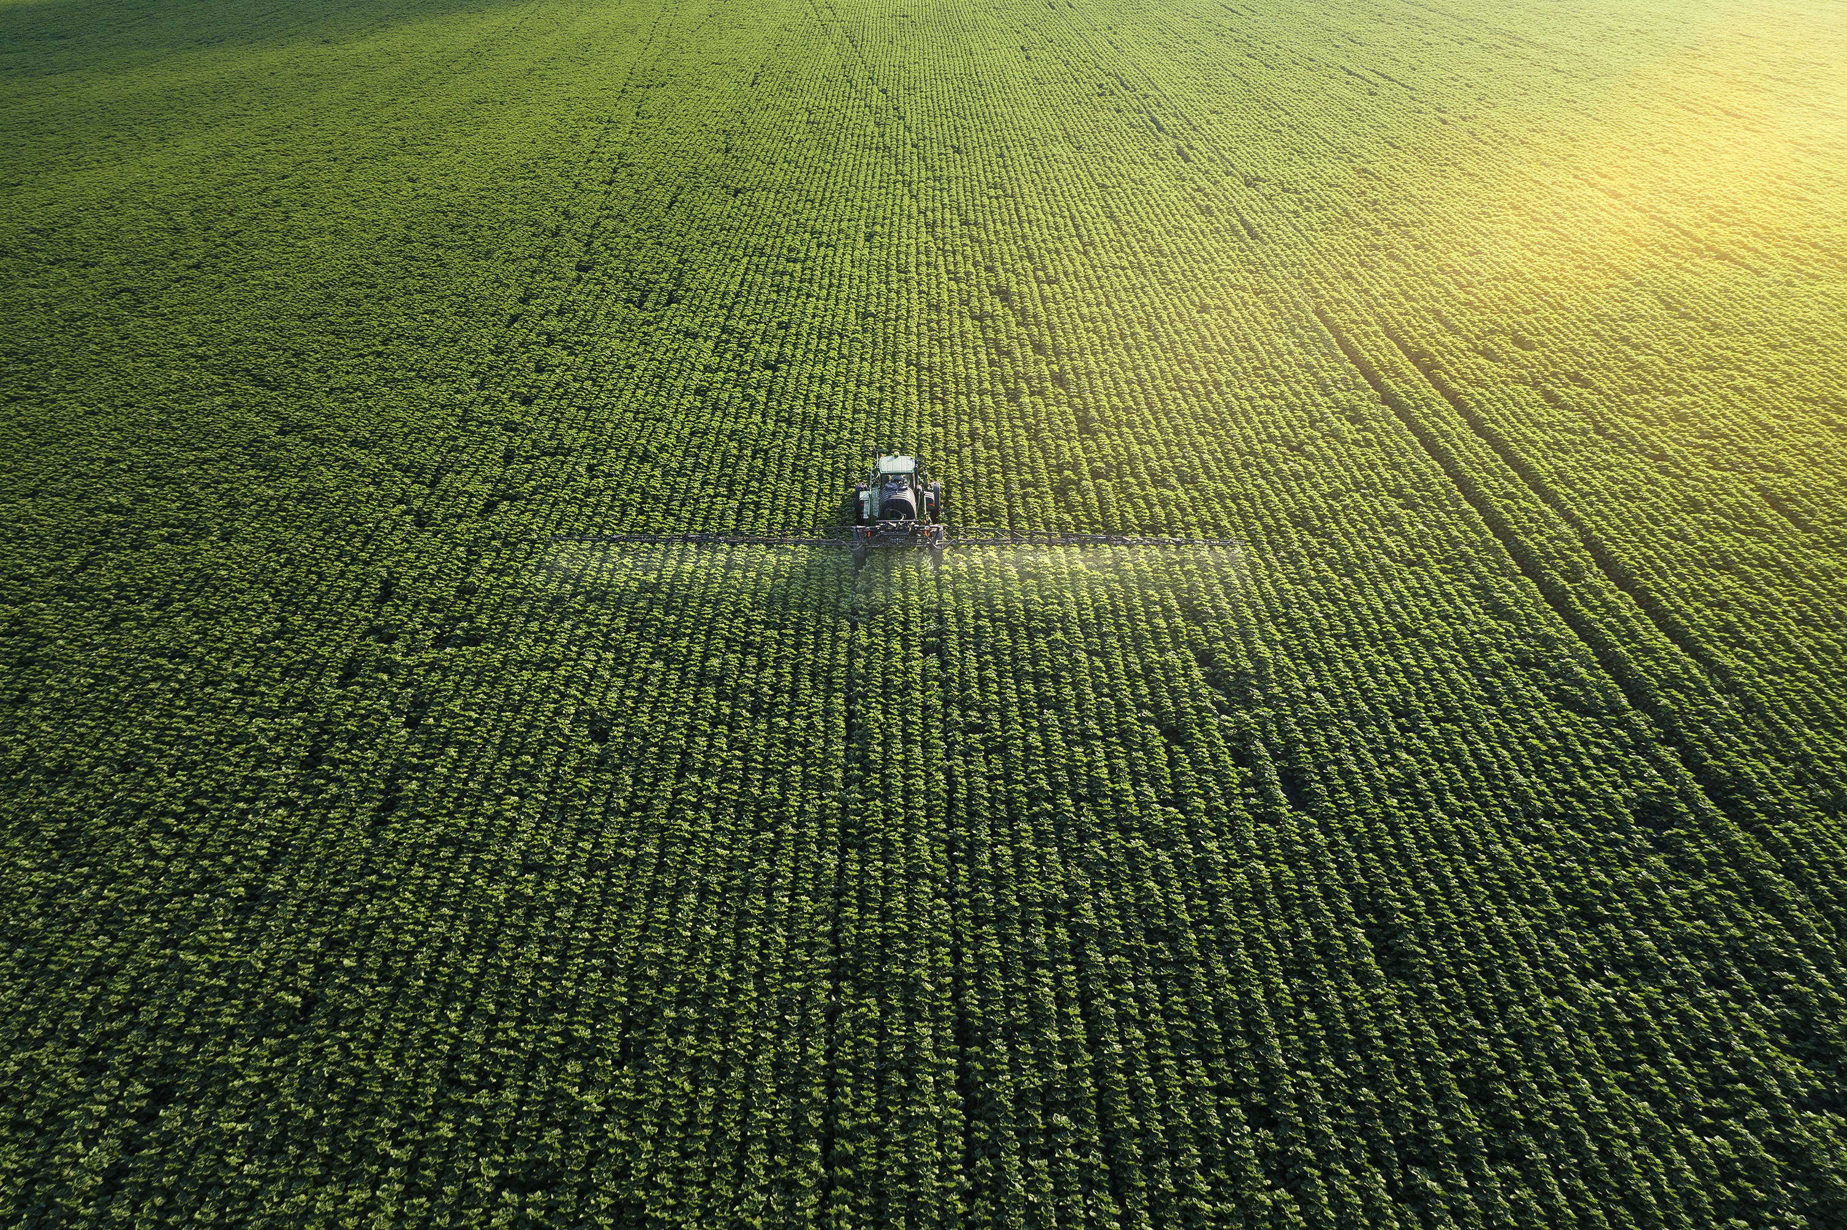
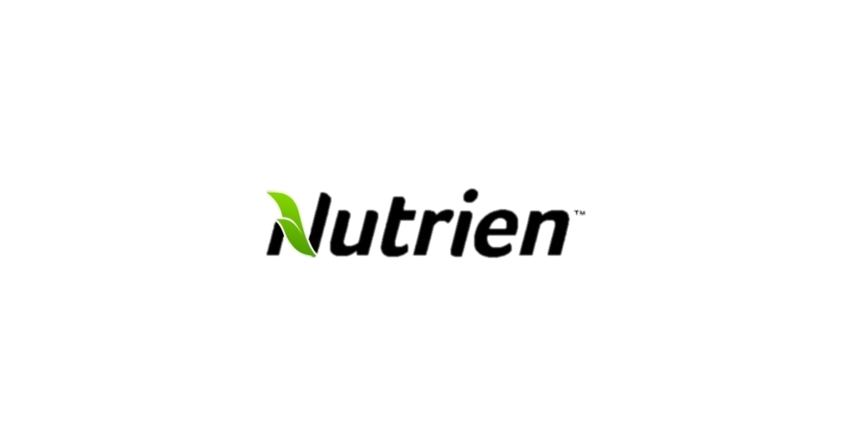
The Natural Step – Team #2
XTSE: NTR
Evan Calllahan, Ali Hassan, Paul Hughes, Andrew Russell, Andrew Vargo, Zachary Ziegler
Notes:
Zac
Good [morning/afternoon]. Today our team is applying The Natural Step framework, or TNS, to Nutrien Limited, the Saskatoon-based global leader in crop inputs and agricultural services. Over the next thirteen slides we'll walk through the industry backdrop, explain why we selected this company, run Nutrien through a stoplight-style sustainability life cycle assessment built on TNS's four system conditions, identify the red hotspots that came out of that analysis, and then use backcasting and the ABCD method to build a practical project plan the company could actually execute. We'll close with the business case we'd bring to Nutrien's executives and board: why acting on these hotspots reduces risk, improves access to capital, and strengthens the case for continued shareholder support. Our goal isn't just to critique the company, it's to build a realistic, sequenced path from where Nutrien is today toward a more sustainable and more competitive future state. Let's start with the industry.

Slide 2
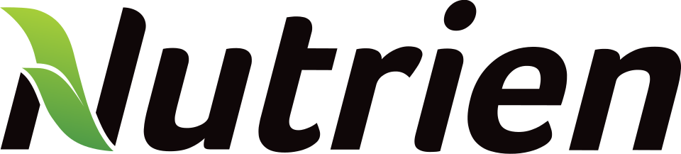
Company Overview
01
FOOTPRINT
02
WHAT NUTRIEN DOES
• Headquartered in Saskatoon, Saskatchewan
• Production operations in Canada, the U.S. and Trinidad
• Headcount: 25,100
• Produces and distributes essential crop nutrients
• Supplies growers with crop inputs and services
• Links large-scale production with the Nutrien Ag Solutions retail network
03
INDUSTRY
04
PRODUCTS & SERVICES
• Agricultural inputs and services
• Fertilizer mining and manufacturing
• Crop-input retail and distribution
• Potash, nitrogen and phosphate fertilizers
• Seed, crop protection and nutritional products
• Agronomy, digital tools and grower services
Notes:
-Footprint - Nutrien is a global agricultural company headquartered in Saskatoon, Saskatchewan, with approximately 25,100 employees and products and services reaching more than 50 countries. Its operations span production, distribution and retail, giving Nutrien a significant presence across the global agricultural value chain.
-What Nutrien Does - Nutrien connects large-scale crop nutrient production with agricultural retail and grower services. Its upstream business produces and distributes potash, nitrogen and phosphate, while its Retail business works directly with farmers to provide the inputs and services they need throughout the growing cycle.
-Industry - Nutrien operates within the agricultural inputs and services industry, with major exposure to fertilizer production, mining, manufacturing, distribution and agricultural retail. Its scale makes it an important participant in global food production, particularly through its position as a major producer of essential crop nutrients.
Products and Services - Nutrien's offerings extend beyond fertilizer. Its portfolio includes potash, nitrogen and phosphate, as well as seed, crop protection products, agronomic services and other agricultural inputs. This broad offering allows Nutrien to support growers from crop planning through production, rather than simply supplying fertilizer.
Citations –
Nutrien Ltd. (2026). 2025 sustainability report.
Nutrien Ltd. (n.d.). Leading the future of global agriculture. https://www.nutrien.com/

Slide 3
Why Nutrien?
01
DIRECT TNS FIT
02
CLEAR SUSTAINABILITY
Heavy reliance on water, land, minerals. Environmental impacts tangible and assessable.
Fertilizer supports food security while creating pressure through emissions, water use, runoff and resource depletion.
Industry Leaders
NATURAL SYSTEMS
03
STRONG SDG ALIGNMENT
04
INTEGRATED SYSTEMS
Water • land • minerals
Direct links to SDGs 2, 6, 7, 12, 13 and 15.
The same issue can be tested through environmental, human and economic lenses revealing both value and trade-offs.
HUMAN + ECONOMIC VALUE
Food security • livelihoods • long-term competitiveness
05
MEASURABLE ESG PERFORMANCE
06
BUSINESS RESILIENCE
Published targets and performance metrics allow evidence-based evaluation of whether actions match environmental impacts.
Dependence on water, energy and agricultural land connects sustainability challenges to long-term performance and competitiveness.
Notes:
Direct TNS Fit - Nutrien demonstrates a strong fit with the TNS framework because its sustainability strategy considers the interconnection between environmental, social, and economic systems. Its approach focuses on producing agricultural inputs while addressing resource use, emissions, water, biodiversity, safety, and community impacts. Nutrien also describes its vision as delivering shareholder value through safe and sustainable operations, showing that sustainability is integrated into its broader business strategy rather than treated as a standalone initiative (Nutrien, 2026)
Clear Sustainability - Sustainability is embedded in Nutrien's corporate strategy and reporting. The company publishes a dedicated Sustainability Report and provides an interactive sustainability data tool that tracks financial, operational, and sustainability performance. This provides measurable evidence that sustainability is incorporated into decision making and performance evaluation (Nutrien, n.d.).
Strong SDG Alignment - Nutrien's sustainability priorities align closely with several UN SDGs, particularly SDG 2: Zero Hunger, through its role in global food production; SDG 6: Clean Water and Sanitation, through Affordable and Clean Energy; through water stewardship; SDG 12: Responsible Consumption and Production; and SDG 13: Climate Action. This alignment reflects the company's broader focus on improving agricultural productivity while managing environmental impacts (United Nations, n.d.)
Integrated Systems - Nutrien operates across much of the agricultural value chain, from fertilizer production and distribution to agricultural retail and services. This gives the company an integrated systems perspective because its sustainability impacts extend from resource extraction and manufacturing through to farmers and food production. Nutrien specifically emphasizes creating long-term value across the agricultural value chain (Nutrien, 2026).
Measurable ESG Performance - A major strength is Nutrien's use of quantifiable ESG metrics and targets. Its sustainability data tool provides financial, operational, and sustainability information, while its Sustainability Report tracks progress against sustainability priorities and performance. This supports greater accountability and allows stakeholders to evaluate whether Nutrien is actually making progress rather than simply making sustainability claims (Nutrien, n.d.).
Business Resilience - Sustainability is also connected to Nutrien's long-term business resilience. In its 2025 results, Nutrien highlighted operational reliability, automation, portfolio optimization, disciplined capital allocation, and investments designed to strengthen long-term growth and resilience. This demonstrates how environmental and operational considerations can support both sustainability and financial performance (Nutrien, 2026)
Citations –
Nutrien Ltd. (2026). 2025 sustainability report.
Nutrien Ltd. (2026, February 18). Nutrien reports full-year 2025 results and provides 2026 guidance.
Nutrien Ltd. (2026, February 27). Nutrien files 2025 annual disclosures.
Nutrien Ltd. (n.d.). Sustainability data tool. Nutrien. https://www.nutrien.com/sustainability/sustainability-highlights/sustainability-data-tool
United Nations. (n.d.). The 17 goals. United Nations Department of Economic and Social Affairs, Sustainable Development. https://sdgs.un.org/goals

Slide 4
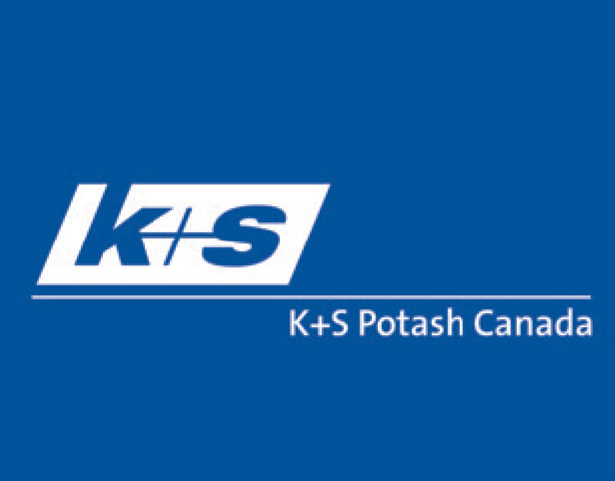
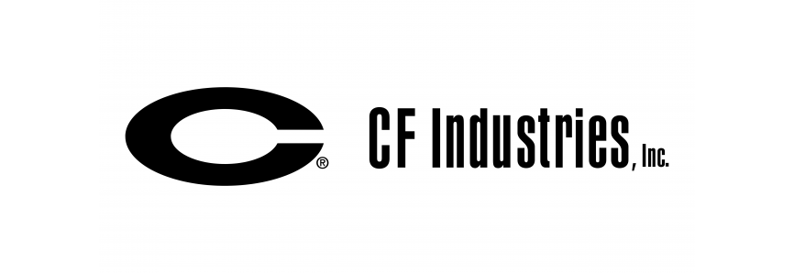
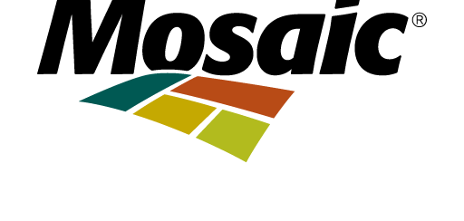
Stakeholders, Competitors, and Value Chain
Stakeholders
Competitors
Value Chain
Investors
Farmers/Producers
Growers/Customers
Communities
Suppliers
Indigenous Peoples
Employees
Government/Regulators
Mosaic
  Potash & Phosphate Fertilizers
CF Industries
  Nitrogen Fertilizers
K+S Potash
  Potash
Upstream
  Mining & Production
Midstream
  Logistics & Distribution
Downstream
  Products & Services
Key Competitors
Notes:
-Nutrien operates in a highly competitive global fertilizer market. Key competitors include Mosaic, CF Industries, and K+S. Mosaic is primarily focused on potash and phosphate, CF Industries on nitrogen, and K+S on potash. Nutrien's competitive advantage is its diversified portfolio and integrated position across fertilizer production, distribution, and agricultural retail (Nutrien, 2025).
-Nutrien’s value chain is vertically integrated across upstream fertilizer production, midstream transportation and distribution, and downstream agricultural retail. Its retail business provides growers with crop nutrients, crop protection products, seed, agronomic services and financial solutions. This integrated model allows Nutrien to serve growers throughout the agricultural value chain (Nutrien, 2026).
-Nutrien’s key stakeholders include employees, growers/customers, investors/shareholders, suppliers, communities, Indigenous peoples, governments and regulators. Maintaining relationships with these groups is important to Nutrien’s ability to operate, access resources, serve customers and create long-term value (Nutrien, 2026).
Citations:
Nutrien Ltd. (2026). 2025 sustainability report.
Nutrien Ltd. (2025). 2025 Nutrien fact book. 2025 Nutrien Fact Book
LogoShape. (2025). Mosaic vector logo [Logo]. LogoShape
Free PNG Design. (n.d.). CF Industries logo [Logo]. https://freepngdesign.com/cf-industries-png-transparent-logo-10890.html
K+S Potash Canada. (n.d.). KSPC logo [Logo]. https://ks-potashcanada.com/logos-branding/

Slide 5
News & Notable Advancements
COMMUNITY & PROCUREMENT
49%
98%
$1.1B
POTASH AUTOMATION
NITROGEN RELIABILITY
potash procurement spend across 2020–2024
of potash ore tonnes were mined by automation in 2025 — our roadmap pushes this past 65%.
record ammonia operating rate in H1 2025; debottlenecks completed at Redwater and Geismar.
$567M
of that spend with Indigenous-owned companies
<$60/t
NH₃
COST OF PRODUCTION
LOW-CARBON AMMONIA
35%
controllable cash cost per potash tonne held below $60 in Q1 2026 — automation cuts cost, not just emissions.
EXMAR collaboration to build an ammonia-fuelled vessel positions ammonia as marine fuel, not just fertilizer.
of 2024 community giving directed to sustainable agriculture
Momentum is real — but efficiency-shaped. Automation, reliability and cost are advancing fastest; the absolute-emissions and worker-safety gaps in our SLCA remain open.
Notes:
In 2025, Nutrien invested in more than 2,180 charities and non-profits globally.
Nutrien prioritizes local and Indigenous participation within its potash supply chain. The company has implemented procurement initiatives designed to increase Indigenous employment and contracting opportunities throughout its supplier network
In 2020, Nutrien set a target of “25 x 25” – that by 2025, at least 25 percent of the local, relevant spend in the potash operating segment would be with Indigenous-owned suppliers, or suppliers who have at least 15 percent Indigenous employment.
Source: https://cdn.sanity.io/files/ixv7nalm/production/f6424ec8f9d6a68fb53d31bb0a5a0eb17f30e244.pdf
Source: https://www.nutrien.com/news/stories/a-billion-dollar-playbook

Slide 6
The Natural Step: Four System Conditions
A sustainable society does not systematically increase or degrade these four things.
SC1
SC2
SC3
SC4
Earth's Crust
Society-Made Substances
Nature's Cycles
Human Needs
Does not increase concentrations of substances extracted from the earth's crust (fossil fuels, metals, minerals).
Does not increase concentrations of substances produced by society (synthetic chemicals, persistent compounds, N₂O).
Does not degrade nature through overharvesting, land disturbance, or ecosystem/biodiversity loss.
Does not create structural barriers to people meeting their basic needs (safety, livelihood, community wellbeing).
OUR STOPLIGHT METHOD
GREEN = industry leader on this condition • YELLOW = industry average • RED = industry laggard, with citations behind every rating.
Notes:
The Natural Step defines sustainability through four conditions: reducing dependence on extracted materials like fossil fuels, minimizing harmful synthetic substances, protecting ecosystems from degradation, and ensuring people can meet their basic social and economic needs.
We evaluated Nutrien's four business segments, Potash, Nitrogen, Phosphate, and Retail, against each of these conditions using a stoplight approach with green, yellow and red.
This allowed us to assess where Nutrien is performing well and where challenges remain. All ratings presented in the matrix are supported by evidence from Nutrien disclosures and external sources.
Source: https://thenaturalstep.org/approach/the-system-conditions/

Slide 7
SLCA Stoplight Matrix
Raw Materials
Production
Packaging & Distribution
Use
End of Life
SC1 · Materials from the Earth's crust
AVERAGE
LAGGARD
AVERAGE
LEADER
LAGGARD
SC2 · Man-made materials
AVERAGE
AVERAGE
AVERAGE
LAGGARD
AVERAGE
SC3 · Degradation of the biosphere
AVERAGE
AVERAGE
AVERAGE
LAGGARD
AVERAGE
SC4 · Undermining human needs
LEADER
LEADER
LEADER
AVERAGE
LEADER
Industry leader
Industry average
Industry laggard
FOUR RED CELLS — OUR HOTSPOTS
SC1 · Production — fossil gas is the feedstock for ammonia, not just the fuel.
SC1 · End of Life — tailings and salt stockpiles left on the landscape.
SC2 · Use — nutrient runoff from applied fertilizer.
SC3 · Use — biosphere degradation from over-application.
Sources: Nutrien 2024 Global Sustainability Report; Form 40-F (FY2024); team analysis.
Notes:
Nutrien is still mining raw ore and minerals. Notably potash due to the extnesive global demand currently. They also focus on other business line products like nitrogen and phosphate.
Due to minimal competition in Canada on the potash segment, and the years of experience (coninous improvement) we have placed them as the industry average
Under S4 we can see that Nutrien is categorized as an industry leader and this is because of their econtinous efforts to invest back into the community, investment in sustainabiltiy intiatives and localized supply chain management. While other factors do play in.
A serious area for improvement is among the use category which Evan will discuss more and how waste streams effect the environment.

Slide 8
Hot Spot 1 Permanent Contamination Risk: System Condition 1 at End of Life
Mining Waste with No Viable Remediation Pathway
TAILINGS: PERMANENT LAND CONTAMINATION
DEFERRED FINANCIAL LIABILITIES
Tailings are composed of salt, brine and clay. They are held in Tailings Management Areas (TMA)
GYPSTACKS: SEEPAGE RISK
$1.3B
Phosphogypsum (phosphorous fertilizer by‑product)mounds contain naturally occurring radioactive material (NORM) and acidic leachate that threaten surrounding soil and groundwater.
ASSET RETIREMENT OBLIGATIONS
23 MILLION M³ INJECTED UNDERGROUND
Legally required future reclamation costs
Saline process water is permanently disposed into deep geological wells — an irreversible act with unknown long-term aquifer consequences.
29 MILLION TONNES OF WASTE — ANNUALLY
$343M
Non-hazardous mining by-products accumulate year over year, with surface disposal posing ongoing ecosystem exposure risk.
ACCRUED ENVIRONMENTAL COSTS
Contingent liabilities for active contamination
remediation
COMBINED LIABILITY
$1.7B
Notes:
Hot spot 1 is due to the large number of byproducts from production which creates huge amounts of permanent waste which creates major end‑of‑life challenges under condition 1.
This is Potash mining produces byproduct tailings in large volumes (salt, brine, clay).
this must be permanently stored in engineered Tailings Management Areas (TMAs).
Another byproduct is called Gypstacks which are massive engineered mounds of phosphogypsum (phosphorous fertilizer by‑product).
At end of asset life, Nutrien is legally required to reclaim TMAs, gypstacks, and disturbed operating land.
All of this waste results in a total liability of 1.7 billion dollars, this is where we see environmental risk being a part of cost
Other notes
Per Jones this is an area where we see the environmental costs getting priced into risk, Nutrien even uses a 520 year discounted cash flow for potash obligations
The Loi 1988 paper provided the figure of potash tailings density of an average of 1.57 Mg/M^3 (P. 27)
Refrences
Nutrien Ltd., 2025 Sustainability Report (dated Feb. 27, 2026) — pp. 14, 16, 19, 20, 27–29, 40–41. Nutrien's sustainability disclosures hub: nutrien.com/sustainability
Nutrien Ltd., 2025 Annual Report — referenced for Note 22 (Asset Retirement Obligations) as cited by the Sustainability Report; investor filings hub: nutrien.com/investors/financial-reporting
The Natural Step. (2018, May 14). Our approach: The natural step framework. The Natural Step. https://thenaturalstep.org/approach/
Jones, G. (2026). Sustainable Finance Essentials: Turning Risk into Resilience. [Power point]. Delphi.
Loi, J. I. K. (1988). Engineering Properties of Potash Tailings (Doctoral dissertation, University of Saskatchewan).
National student exchange. (2026). University of Calgary. Nse.Org. https://nse.org/campus/36246932860

Slide 9
Hot Spot 2 and 3 Fertilizer Runoff
System Condition 2 during Use
System Condition 3 during Use
CHEMICAL CONCENTRATION
ECOSYSTEM DESTRUCTION
Planetary Boundaries Breached
Dead Zones & Algal Blooms
N & P FLOWS — BOTH EXCEEDED
EUTROPHICATION POTENTIAL
Nitrogen and phosphorus biogeochemical flows rank among the most critically exceeded planetary bounds
Nutrient runoff fuels explosive algal blooms that rapidly deplete dissolved oxygen in waterways, producing hypoxic dead zones in which aquatic life cannot survive.
Fertilizer use is the primary driver of this issue, continuously pushing Earth's biogeochemical systems beyond their safe operating limits.
The resulting biodiversity collapse affects all living organism that inhabit the effected area
Notes:
Hot spot 2 and 3 both tie to fertilizer run off from their nitrogen and phosphorus products
This isn’t emissions but if we think of this through the GHG reporting frame work these are scope 3 emissions, tied to the use of their fertilizer
The condition 2 is because of the concentration of the chemicals specifically tied to the Bio Geo Chemical flows Lynda showed us, Phosphorous and Nitrogen two planetary bounds that are beyond the safe limits.
Condition 3 is from the biodiversity loss in water the fertilizer runs off into the ground water
This is called Eutrophication which means the runoff is fertilizing the water causing massive algae blooms which then die, and the decomposition uses up all of the oxygen leaving none for other marine life
References:
Beach, L. (2026). PB Pres 2026. [Power Point]. Deloitte. (n.d.). Circular economy: From theory to practice. BIO by Deloitte.
The Natural Step. (2018, May 14). Our approach: The natural step framework. The Natural Step. https://thenaturalstep.org/approach/
World Resources Institute. (2024). Eutrophication and Hypoxia. World Resources Institute. https://www.wri.org/initiatives/eutrophication-and-hypoxia/learn
Agriculture Canada. (2021). Risk of water contamination by nitrogen - agriculture.Canada.Ca. Canada.Ca. https://agriculture.canada.ca/en/environment/resource-management/indicators/risk-water-contamination-nitrogen
Ritchie, H., Rosado, P., & Roser, M. (2022). "Environmental Impacts of Food Production." Our World in Data — used for the 78% agricultural-eutrophication and ~26% food-system-emissions industry benchmarks cited under System Condition 2: ourworldindata.org/environmental-impacts-of-food

Slide 10
Future State Vision & UN SDG Alignment
OUR PROPOSED 2035 VISION
“Nutrien: the world's safest, lowest-carbon crop-input producer — closing the nutrient loop from mine to field, with zero preventable harm to workers or watersheds.”
SDG 2 · Zero Hunger
SDG 6 · Clean Water
SDG 8 · Decent Work
SDG 13 · Climate Action
TARGET 2.4
Sustainable, productive food systems — already Nutrien's stated ambition, so this is the goal we hold them to, not sell them.
TARGET 6.3
Reduce untreated pollution released to water — our nutrient-runoff and tailings hotspots (SC2 + SC3).
TARGET 8.8
Safe and secure working environments — our SC4 hotspot after three fatalities in 2024–25.
TARGET 13.2
Integrate climate measures into strategy — our SC1 fossil-gas dependence in nitrogen production.
Each goal is anchored to a specific UN target and a live SLCA hotspot — chosen because our analysis found the gap, not because they photograph well.
Notes:
Andrew R
We developed a future-state vision for Nutrien that focuses on becoming the world's safest and lowest-carbon crop-input producer while minimizing harm to workers, communities, and ecosystems.
To support this vision, we identified four UN Sustainable Development Goals that are most relevant to Nutrien's operations.
SDG 2, Zero Hunger, reflects Nutrien's core role in supporting agricultural productivity and global food security through fertilizer production. This is especially importsant given how global food consumption is only increasing
SDG 6, Clean Water and Sanitation, addresses key challenges related to water use, tailings management, and nutrient runoff across Nutrien's operations.
Andrew V
SDG 8, Decent Work and Economic Growth, emphasizes the importance of worker health and safety and the need to eliminate preventable workplace incidents. Safety is a core tenant of Nutrien
Finally, SDG 13, Climate Action, focuses on reducing greenhouse gas emissions, particularly within nitrogen fertilizer production, which represents one of Nutrien's most significant sustainability challenges.
Together, these SDGs provide a clear framework for evaluating Nutrien's current performance and identifying the strategic actions needed to achieve its future sustainability goals.

Slide 11
Where Nutrien Sits Today — and the 2035 Target Phase
Sustainability Path
Rejection
Non-responsiveness
Compliance
Efficiency
Strategic Proactivity
The Sustaining Corporation
Human
SC4 → SDG 8
TODAY
2035 TARGET
Economic
cross-cutting → SDG 2
TODAY
2035 TARGET
Environmental
SC1–SC3 → SDG 6, 13
TODAY
2035 TARGET
HUMAN
ECONOMIC
ENVIRONMENTAL
Strategic Proactivity → Sustaining Corporation
Efficiency → Strategic Proactivity
Efficiency → Strategic Proactivity
Governance already links safety, EDI and a disclosed Indigenous Strategy. The shift: workforce capability becomes the growth engine — Zero Harm (2027) plus re-skilling from 65%+ automated mining.
Today sustainability is argued as cost-and-returns. The shift: low-carbon ammonia from 1.2 Mt to 3+ Mt makes decarbonisation a revenue line, with GHG screens gating capex from 2028.
Headline results are intensity gains (−15% GHG/t) that volume growth can mask. The shift: absolute Scope 1+2 targets and CCUS at two more nitrogen sites change the asset base.
Why not The Sustaining Corporation on all three? A single-industry producer with a chemically emissions-intensive core product cannot credibly claim industry-agenda leadership by 2035 — Human is the one path where the capability and partnership foundations already exist.
Source: Perrott, B. (2014), “The sustainable organisation: blueprint for an integrated model,” Table I; Nutrien 2024 Global Sustainability Report.
Notes:
Andrew v
60s
Perrott lets us name what kind of organisation Nutrien currently is. Gold is today, green is 2035 — and the three paths deliberately don't line up.
Environmental and Economic sit at Efficiency. Every number Nutrien reports is intensity-based — −15% GHG per tonne, −9% per tonne of ammonia — so total emissions can rise with volume while the metric improves. Sustainability is a cost-and-returns case, not the strategy.
Human is further along, at Strategic Proactivity: safety and sustainability sit together at Board level, and the Indigenous Strategy ties workforce policy to procurement. But three fatalities in 2024–25 show the execution gap — which is why Zero Harm is sequenced first.
Our targets: one phase up for Environmental and Economic — absolute emissions targets and low-carbon ammonia as a revenue line, not a cost line. Human goes two, because 65% automation makes re-skilling the constraint on growth.
Possible question & answer – why not target the top phase everywhere?
The Sustaining Corporation needs a diversified business model and industry-agenda leadership. A single-industry producer with an emissions-intensive core product can't credibly claim that by 2035.
TRANSITION
“Next slide: the sequenced plan — every block on that Gantt maps back to one of these three rows.”
REFERENCES
Perrott, B. E. (2014). The sustainable organisation: Blueprint for an integrated model. Journal of Business Strategy, Table I.
Nutrien Ltd. (2025). 2024 Global Sustainability Report.
Nutrien Ltd. (2025). Form 40-F Annual Report, FY ended December 31, 2024. SEC.
Nutrien Ltd. (2025). Safety & Sustainability Committee mandate; Indigenous Strategy disclosures.
Robèrt, K.-H., Broman, G., & Basile, G. (2013). Framework for Strategic Sustainable Development (SC1–SC4).
United Nations (2015). The 2030 Agenda for Sustainable Development (SDGs 2, 6, 8, 13).

Slide 12
Backcasting: Guiding Questions & Top Priorities
THE THREE GUIDING QUESTIONS
1) Does it move Nutrien in the right direction on all four system conditions? 2) Does it provide a flexible platform for future improvement? 3) Is it likely to produce sufficient return to fund the next step?
1
2
3
4
Low-Carbon Ammonia & CCUS Scale-Up
Zero Harm Safety & Automation Rollout
Precision Ag & Enhanced-Efficiency Fertilizer Push
Tailings & Phosphogypsum Circularity Program
Directly attacks the largest red hotspot (SC1/SC2); existing Redwater/Alberta Carbon Trunk Line pathway proves ROI; opens access to green-premium and carbon-linked financing.
Responds to the most urgent hotspot (SC4) after 3 fatalities; automation already cuts both injury exposure and cost self-funding over time.
Cuts runoff (SC2) at the point of use; monetizable through the existing 1,800+ location retail network and premium product margins.
Targets the SC3 land hotspot; reduces long-term reclamation liability and future regulatory/legal exposure.
Notes:
Paul
Backcasting uses three guiding questions to filter down to what's actually actionable. Does the idea move the company in the right direction on all four system conditions at once, rather than just one? Does it create a flexible platform that future improvements can build on, rather than a dead end? And is it likely to generate enough return to fund the next step, so the transition can pay for itself over time? Running our thirteen ideas through those three questions, four rose to the top. First, scaling low-carbon ammonia and carbon capture, because it attacks our biggest hotspot and Nutrien already has a proven pathway at Redwater. Second, a Zero Harm safety and automation rollout, responding directly to the fatalities and self-funding through efficiency gains. Third, pushing precision agriculture and enhanced-efficiency fertilizer through the retail network, which cuts runoff while being monetizable through existing infrastructure. And fourth, a tailings and phosphogypsum circularity program that reduces long-term land liability. Land and water pushed us to think across the whole value chain at once, from cutting waste generated during mining to finding productive uses for manufacturing by-products to partnering with farmers on fertilizer efficiency so less nutrient runoff reaches local watersheds.

Slide 13
Brainstorm: 13 Ideas Across Four Hotspots
Unfiltered and unranked — generated against the four SLCA hotspots before any prioritisation.
Climate & Emissions · SC1 + SC2
Land & Circularity · SC3
Scale green/blue ammonia using renewable H₂ and CCUS
Expand CO₂ capture (Alberta Carbon Trunk Line model) to more nitrogen sites
Set Science Based Targets (SBTi) beyond the internal 2030 commitment
Accelerate automated / tele-remote mining across all potash and phosphate sites
Scale ultrafine-flotation tailings-reduction technology company-wide
Develop phosphogypsum beneficial-reuse pathways (construction, soil amendments)
Nutrient Loss & Growers · SC2 + SC3
People & Safety · SC4
Expand enhanced-efficiency fertilizers (controlled-release, nitrification inhibitors)
Grow precision-agriculture / variable-rate tools via the retail network
Launch grower watershed partnerships (buffer strips, cover-crop incentives)
Expand the grower carbon program (insets/offsets) to more acres
Launch a company-wide “Zero Harm” safety transformation with independent audits
Extend Indigenous procurement / equity models beyond potash to all segments
Publish site-level safety leading indicators, not just lagging fatality counts
Next: the three backcasting questions filter these 13 down to the four we fund.
Notes:
Paul
Before narrowing anything down, we opened the floor completely — the goal at this stage was volume, not judgment. That session surfaced thirteen ideas touching all four hotspots. Climate generated the most activity, with suggestions ranging from scaling green and blue ammonia production to expanding carbon capture infrastructure to setting science-based targets we'd have validated externally. Safety and automation produced a different flavor of idea, less about new technology and more about accountability: independent audits of a company-wide Zero Harm program, a faster automation timeline, and publishing leading indicators instead of only reporting fatalities after they happen. Land and water pushed us to think across the whole value chain at once, from cutting waste generated during mining to finding productive uses for manufacturing by-products to partnering with farmers on fertilizer efficiency so less nutrient runoff reaches local watersheds. One idea didn't sit neatly inside a single hotspot but came up anyway, and the group felt it belonged: extending Indigenous procurement and equity partnerships beyond potash into the nitrogen and phosphate businesses.

Slide 14








From Baseline to Backcasted 2035
Executive Transition Architecture: Bridging Operational Risk to Long-Term Enterprise Resilience
01 / CURRENT BASELINE
02 / THE STRATEGIC BRIDGE
03 / TARGET HORIZON
4 Material Hotspots
4 Sequenced Initiatives
2035 Backcasted Vision
Core segment-level operational exposures
Translating ambition into a fundable, board-ready plan
Aligned to 4 United Nations SDGs
Fossil-Dependent Nitrogen
Decarbonization & Low-Carbon Amonia
Land & Tailings Impacts
Tailings & Circularity
SDG 2
SDG 6
Zero Hunger
Clean Water
Worker Safety Hazards
Zero-Harm Safety & Automation
SDG 8
SDG 13
Decent Work
Climate Action
Nutrient Runoff
Precision Agriculture & Runnoff reduction
TEAM STRATEGIC TAKEAWAY
"Sustainability and competitiveness are the same project here every fix we prioritized also protects margin, capital access, or license to operate."
Notes:
Ali
So to bring everything together, Nutrien looks strong on paper, including its MSCI AA rating, but our analysis identified several material risks underneath that headline rating.
We focused on four main hotspots: fossil-fuel dependence in nitrogen production, land and tailings impacts, worker safety, and nutrient runoff.
Using backcasting, we defined what a credible Nutrien could look like by 2035, aligned with SDGs 2, 6, 8, and 13, and then worked backward from that future state.
That led us to four priority initiatives: low-carbon ammonia, tailings and circularity, safety and automation, and precision agriculture with runoff reduction.
Our main takeaway is simple: for Nutrien, sustainability and competitiveness are not separate goals. The same actions that reduce sustainability risks can also protect margins, access to capital, and the company’s license to operate.
Thank you

Slide 15
Pressure-Testing the TNS Strategy Through Four Lenses
1
Financial Lens
2
Market Lens
What is required to create value?
Are these profitable, growing markets?
MSCI AA rating vs. segment-level hotspots — a valuation gap peers can exploit
Automation and efficiency gains are self-funding; protect ROIC
Carbon pricing erodes the momentum case at gas-intensive nitrogen sites
~10 billion people to feed by 2050 sustains core crop-input demand
Low-carbon ammonia and enhanced-efficiency fertilizer are premium adjacencies
Runoff and carbon regulation across NA/EU is reshaping the profit pool
Value-Creating
Strategy Choices
3
Competitive-Advantage Lens
Nutrien's four TNS priority projects, 2027–2035
4
Operating-Model Lens
What does it take to win here?
Do we have an organization that can deliver?
Largest upstream producer; majority of accessible global potash reserves
Redwater / Alberta Carbon Trunk Line gives a CCUS head start peers lack
1,800+ retail locations — unmatched channel for precision ag
Three 2024–25 fatalities expose a safety-management capability gap (SC4)
One sequenced 2027–2035 capital program, not isolated initiatives
Site-level leading indicators and SBTi validation to manage performance
All four lenses converge: the projects that close our TNS hotspots are the same projects that create value sustainability and competitiveness are one strategy here.
Source: McKinsey on Finance No. 68, “Seeing your way to better strategy” (2018)
Notes:
Andrew V
60s
Before we ask executives for capital, we tested the strategy through McKinsey's four lenses — because a plan that only works on the sustainability lens isn't a strategy, it's a wish.
Financially, the efficiency and automation work is largely self-funding, and carbon pricing quietly erodes the do-nothing case at gas-intensive nitrogen sites.
On the market lens, demand is durable — roughly 10 billion people to feed by 2050 — and low-carbon ammonia and enhanced-efficiency fertilizer are premium adjacencies, not charity.
Competitively, Nutrien already holds what peers don't: the Saskatchewan reserve position, a CCUS head start at Redwater, and 1,800-plus retail locations to monetise precision ag.
The operating model is the honest weakness — three fatalities point to a capability gap, so this runs as one sequenced program with site-level leading indicators and SBTi validation.
All four lenses converge: the projects that close our hotspots are the same projects that create value.
IF ASKED — why use a McKinsey strategy framework on a sustainability project?
Because executives fund business cases, not moral cases. This is the language they already use — and it forces us past the financial and market lenses that get overweighted, into whether we can actually win and actually deliver.
IF ASKED — how can there be a valuation gap if Nutrien is rated MSCI AA?
The rating is company-level; our hotspots are segment-level. That distance between the badge and the operations is exactly the gap a competitor or an activist investor can exploit.
TRANSITION
“So the strategy holds through all four lenses — which is what lets us make the business case to the executives.”
REFERENCES
McKinsey & Company (2018). Seeing your way to better strategy. McKinsey on Finance, No. 68, November 2018.
Nutrien Ltd. (2026). Full-Year 2025 Results and 2026 Guidance (potash automation at 49%; ammonia operating rates).
Nutrien Ltd. (2025). 2024 Global Sustainability Report.
Nutrien Ltd. (2025). Form 40-F Annual Report, FY ended December 31, 2024. SEC.

Slide 16
Project Plan: Sequenced Roadmap to the 2035 Vision
A = Awareness (done) → B = Baseline (our SLCA + Perrott matrix) → C = Compelling vision (2035) → D = Down to action, below. Funded as one sequenced capital program.
2027
2028
2029
2030
2031
2032
2033
2034
2035
Priority 2 · Zero Harm Launch
SC4 Human Needs → SDG 8
Safety audit + automation at fatality-linked sites
12 mo
Priorities 2 + 4 · Automate & Pilot Circularity
SC3 Nature's Cycles → SDG 6, 8
Automated mining to 65%+ of potash tonnes; phosphogypsum reuse pilots at 2 sites
Priority 1 · Scale Low-Carbon Ammonia
SC1 + SC2 → SDG 13
1.2 Mt → 3+ Mt capacity; CCUS added at 2 more nitrogen sites
Priority 3 · Retail-Wide Precision Ag
SC2 + SC3 → SDG 6, 2
Enhanced-efficiency fertilizer + variable-rate incentives across NA, AU, SA
All Priorities · Lock In & Validate
All four SCs → SDG 2, 6, 8, 13
Commercialize phosphogypsum reuse; SBTi-validated targets; report vs. all 4 SDGs
Bar length = duration, 2027–2035 · Colour = TNS hotspot owner: rust = SC4 safety · sage = SC3 land · green = SC1/SC2 climate · gold = SC2/SC3 runoff · charcoal = all four
Each block also moves a Perrott path: Zero Harm and re-skilling drive Human toward The Sustaining Corporation; CCUS moves Environmental to Strategic Proactivity; retail incentives pull growers into shared plans, moving Economic; SBTi validation locks both in by 2035.
Sources: Nutrien 2024 Global Sustainability Report; Nutrien Form 40-F (FY2024); team backcasting analysis (ABCD — Down to Action).
Notes:
ANDREW V 70s at most
A and B are behind us — Awareness of the framework, and the Baseline SLCA. C was the 2035 vision. This slide is D: down to action, sequenced and costed.
2027 — Zero Harm. A twelve-month company-wide safety audit and automation acceleration plan at every site connected to a recent fatality. Most urgent hotspot, and the fastest one to act on.
2027–29 — Automate and pilot circularity. Automated mining past 65% of potash ore tonnes, plus phosphogypsum reuse pilots at two sites.
2028–31 — Scale low-carbon ammonia. Capacity from 1.2 Mt toward 3+ Mt, with carbon capture added at two more nitrogen sites.
2029–32 — Retail-wide precision ag. Enhanced-efficiency fertilizer and variable-rate tools across the retail network in North America, Australia and South America.
2032–35 — Lock in and validate. Phosphogypsum reuse commercialised, SBTi-validated targets achieved, progress reported against all four SDGs.
The sequencing is the argument: safety first because it's a licence-to-operate risk, and the capital-heavy work lands after automation has freed up cash and capability.
IF ASKED — why not start with low-carbon ammonia, the biggest lever?
Because it's also the slowest and most capital-intensive. The 2027–29 safety and automation work builds the cash and the capability, and CCUS siting needs that lead time anyway.
IF ASKED — why 2035 and not Nutrien's own 2030 target date?
Their 2030 commitment is an intensity target. Ours is an absolute one, and that requires changing the production asset base — a multi-turnaround horizon, not a reporting cycle.
TRANSITION
“That's the plan. Last piece is the business case — why the executives should fund it.”
REFERENCES
Nutrien Ltd. (2025). 2024 Global Sustainability Report.
Nutrien Ltd. (2025). Form 40-F Annual Report, FY ended December 31, 2024. SEC.
Nutrien Ltd. (2026). Full-Year 2025 Results and 2026 Guidance — 49% of potash ore tonnes mined by automation.
Robèrt, K.-H., et al. (2013). Framework for Strategic Sustainable Development — ABCD planning method.
United Nations (2015). The 2030 Agenda for Sustainable Development (SDGs 2, 6, 8, 13).

Slide 17
REFERENCES
Sources & Citations
1. Nutrien Ltd. “2024 Global Sustainability Report.” nutrien.com/sustainability
2. Nutrien. “Sustainability — ESG Overview.” nutrien.com/sustainability/esg-portal/esg-overview
3. Nutrien Ltd. Form 40-F, FY2024 & FY2025 (GHG emissions, tailings management disclosures). SEC EDGAR.
4. Nutrien Ltd. Form 6-K, Vanscoy Tailings Management Area disclosure (2025). SEC EDGAR.
5. Mine Safety and Health Administration (MSHA). “March 1, 2024 Fatality — Final Report,” White Springs, FL.
6. United Steelworkers. “Steelworkers mourn the death of Nutrien potash mine worker in Rocanville, Sask.” GlobeNewswire, May 21, 2024.
7. The American Prospect. “OSHA Office Closure in ‘Cancer Alley’ Raises Fears About Risks to Workers,” Apr. 18, 2025.
8. KnowESG. “Nutrien Ltd. (NTR) ESG Rating” (MSCI / Sustainalytics / LSEG scores).
9. Nutrien. “Michele Tuchscherer Brings Innovation to the Potash Industry” (tailings flotation technology).
10. Nutrien. “A Collaborative Success: Nutrien Achieves 2025 Freshwater Reduction Target.”
11. Our World in Data. “Environmental Impacts of Food Production.” ourworldindata.org
12. Johnson Shoyama Graduate School of Public Policy. “Saskatchewan Potash at a Crossroads.”
SOURCES & CITATIONS
14 / 14
Notes:
This final slide lists every source behind our analysis: Nutrien's own sustainability reports and SEC/SEDAR regulatory filings for emissions, water and tailings data; the Mine Safety and Health Administration's fatality report for the Florida incident; GlobeNewswire and United Steelworkers reporting on the Saskatchewan fatality; The American Prospect's reporting on the Louisiana fatality; KnowESG for third-party MSCI, Sustainalytics and LSEG ratings; Nutrien's own news coverage of its tailings-reduction innovation and water target achievement; Our World in Data for industry-wide context on nutrient runoff, which was also the additional resource linked in our assignment brief; and a Saskatchewan public-policy research piece for industry and competitive context. Every rating on our stoplight matrix and every claim in our hotspot slides traces back to one of these twelve sources. We're happy to share the full reference list and answer any questions about our methodology.

