Slide 1
Test Presentation

Slide 2
Introduction
This is a test presentation
Testing image insertion with special characters

Slide 3
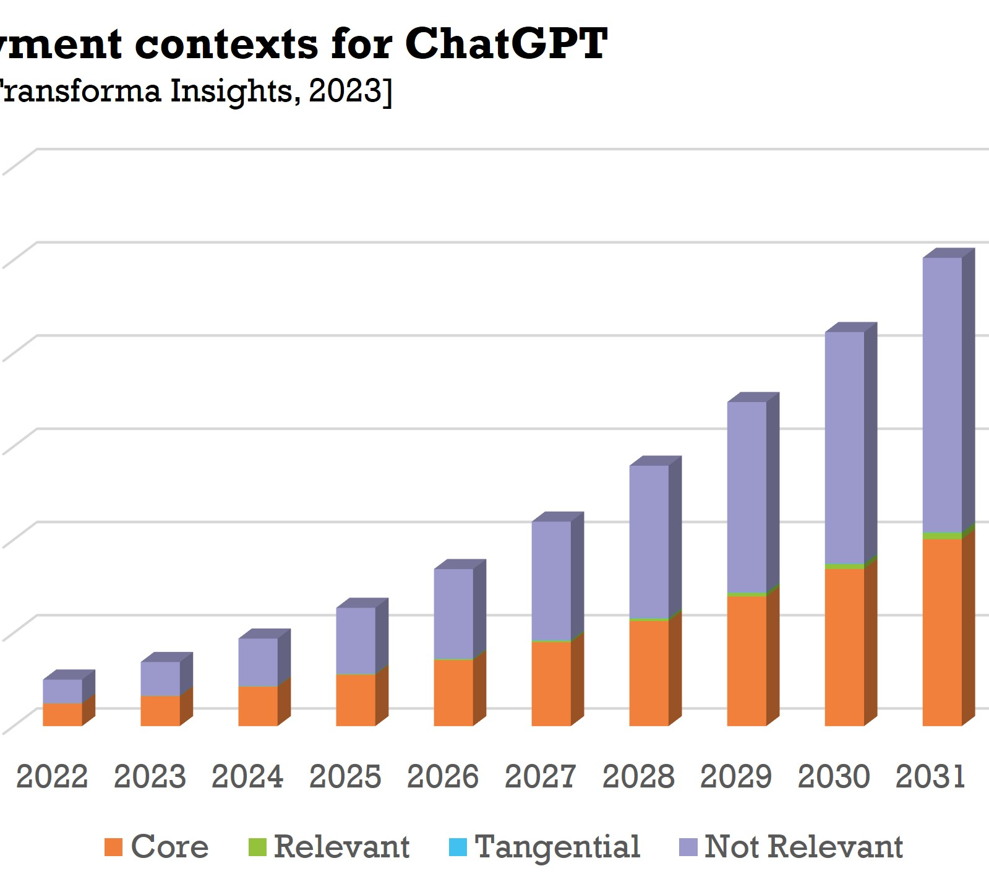
Image Test Slide
This slide contains an image
The image path may have special characters

Slide 4
Conclusion
Testing complete
PowerPoint should generate successfully

