Slide 1
AI Technology Overview

Slide 2
Introduction to AI
Artificial Intelligence is transforming industries
Machine Learning and Deep Learning are key technologies
Applications are growing exponentially

Slide 3
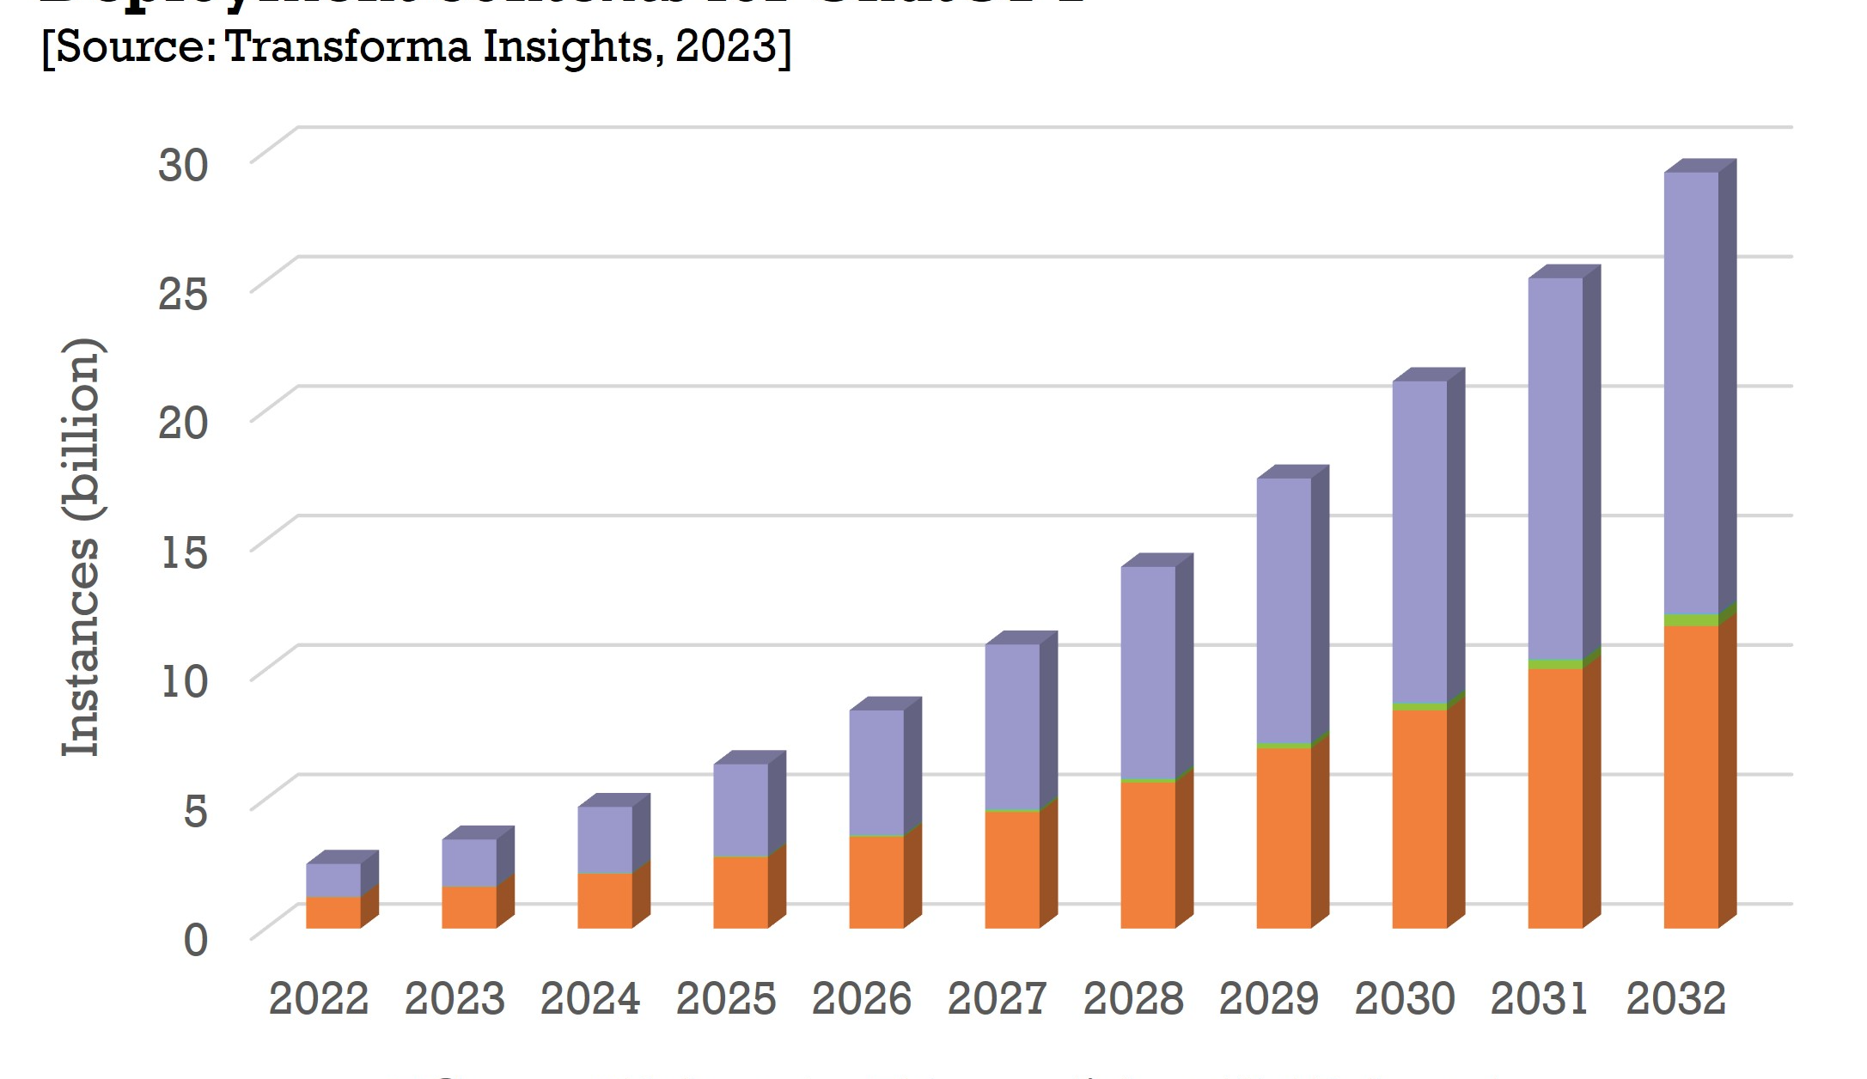
Key Applications
Healthcare: Disease diagnosis and drug discovery
Finance: Fraud detection and algorithmic trading
Transportation: Autonomous vehicles

Slide 4
Future Trends
More powerful AI models
Ethical AI development
AI democratization

Slide 5
Conclusion
AI is the future
Continuous learning is essential

