Slide 2
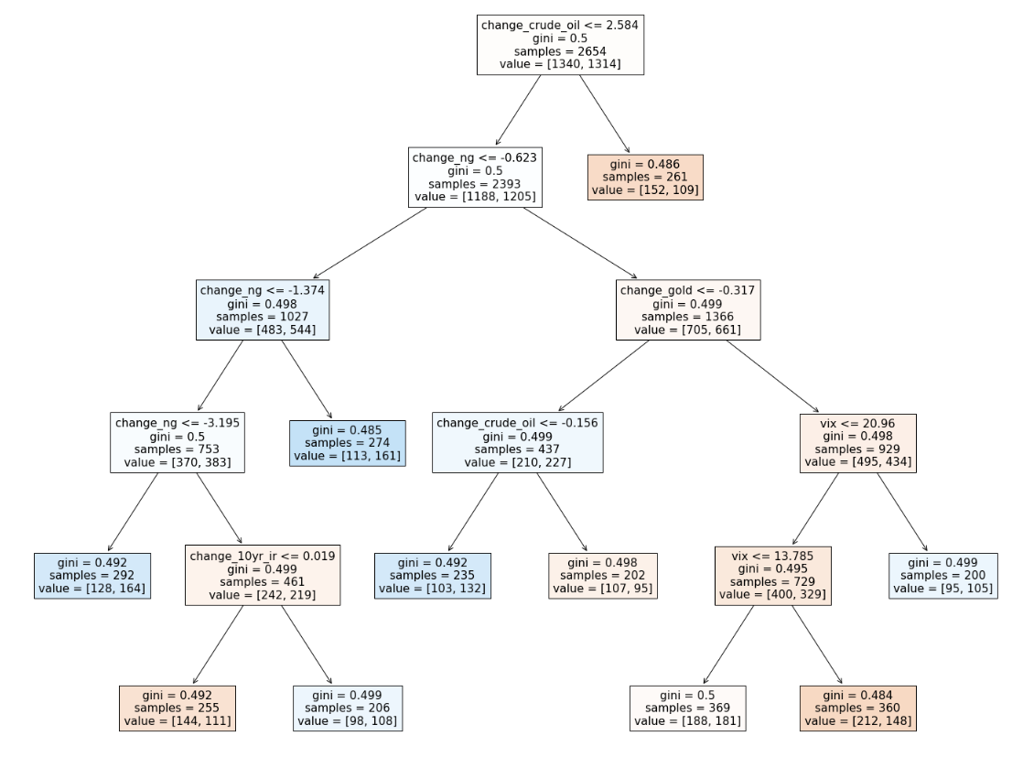

Preliminar model : Decision Tree Model
Accuracy is very low
Slight overfitting
Overfitting increases dramatically if we increase splits

Slide 3
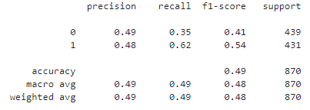
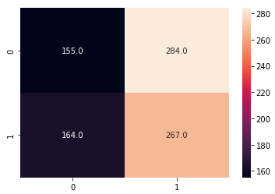
Random Forest Model
Confusion Matrix
Precision show very low values:
Not even 50% of the clases we have predicted as positive or negative are actually corrrect
Recall is not good either:
From all negative clases just 35% were predicted correctly while this rate increases a Little bit to 62 for positive classes

Slide 4
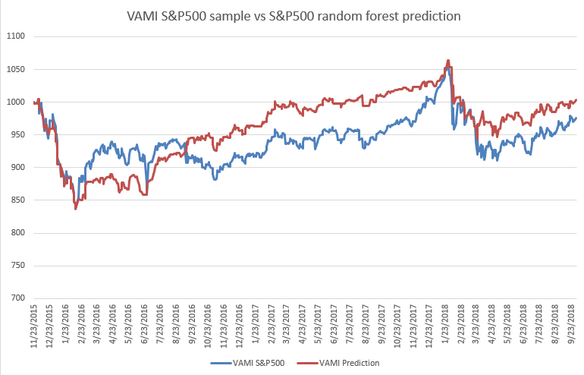
Model Performance
Is this a Random Walk (population µ= 0)?
If we can not discard this is not a Random Walk, then strategy is not viable
H0 : µ= 0 (Population mean = 0) There is no advantage
H1: µ≠ 0
t = 0.43
p-value = 0.67 (>> 0.05) We can not reject Random Walk Behaviour

Slide 5
Conclusions
Financial Time series show specific statistical properties that do not appear in other areas called stylized facts
2 classification methods were used in this approach in order to validate trading potential of machine learning models
Decision Tree model does not provide any advantage and is prone to overfit
Random Forest model does not provide any advantage for these features selection
Next Steps
New classification models and features set should be tested

