Slide 1
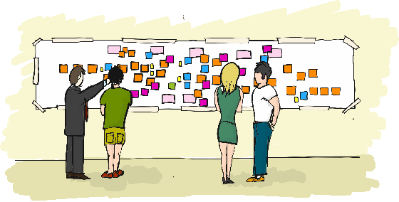

The real Deal of
How Business drives your Architecture
Marcello Pauli

Slide 2
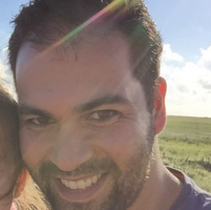


Who is speaking?
Marcello Pauli
married, 1 daughter
Software Architect & Developer, working in Hamburg
~ 7 yrs. development on a Mainframe
~ 1 yr. Business analyst banking domain
~ 5 yrs. development client/server/web in .Net
@pauli_marcello
working for Softfair GmbH
domain: insurence market, guidance and digitalization

Slide 3
Disclaimer

Slide 4
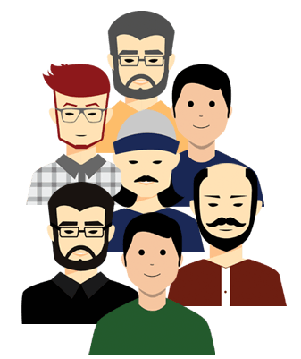

We dealt wrong with User Stories
New table column
Mapping
Change WCF Operation
Something with logic
„5 Points“
… so what we need to fulfill the business needs …
How many Storypoints you guess?
PO
Dev Team

Slide 5
A CRM system example
public class CustomerService
{
public void SaveCustomer(CustomerDTO c)
{
// some validation here
...
SaveToDatabase(c);
}
}
Onboarding a new customer
As Fiona
I want to be able to save new customers
So that they can be handled for all our business processes.

Slide 6
A CRM system example
public class CustomerService
{
public void SaveCustomer(CustomerDTO c)
{
// some validation here
...
pCustomer = LoadFromDb(c.Id)
If (pCustomer == null)
{
// this is a new customer
SaveToDatabase(c);
return;
}
// existing customer
SaveToDatabase(pCustomer, c);
}
}
Edit customer information
As Fiona
I want to be able to edit customers data
So that we have up-to-date customers information for every business process.

Slide 7
A CRM system example
public class CustomerService
{
public void SaveCustomer(CustomerDTO c)
{
// some validation here
...
pCustomer = LoadFromDb(c.Id)
If (pCustomer == null)
{
// this is a new customer
DetermineClosestAccountManager(c)
SaveToDatabase(c);
return;
}
// existing customer
if (c.Address != pCustomer.Address)
{
DetermineClosestAccountManager(c)
}
SaveToDatabase(pCustomer, c);
}
}
Determine account manager
As Fiona
I want a new account manager as closest to customers residence to be determined by the system and send an information to the customer and to the new account manager
So that appointments between customers and account managers can be done more easily.
This should happen for new customers and when customers address changes.

Slide 8


The catastrophe
Why did you send the information twice to the customer?
?!

Slide 9

Software quality
Build the right thing
Build the thing right
Find a sweetspot to
build the right thing right

Slide 10
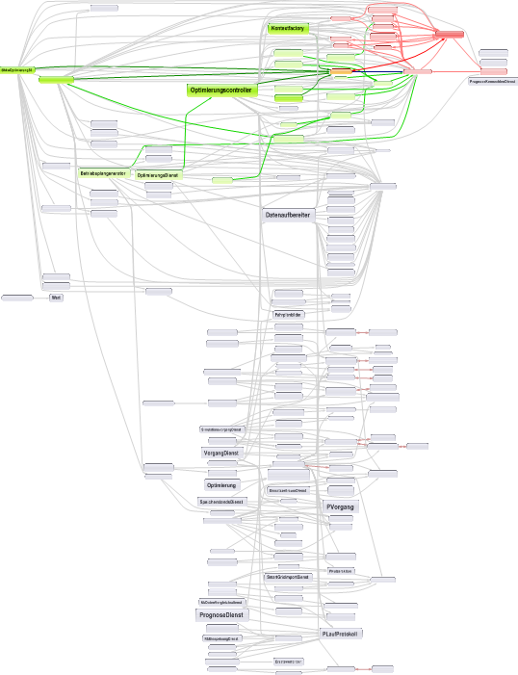
Working on some legacy code
Business process isn‘t visible within the codebase
I spent a lot of time in reading code before finding the right place
I have to translate from business model to code model
It took me a long time to implement new small features
System is very bug prone
Hard to test, sometimes even impossible
Everyones beloved „Big Ball of Mud“ Architecture

Slide 11
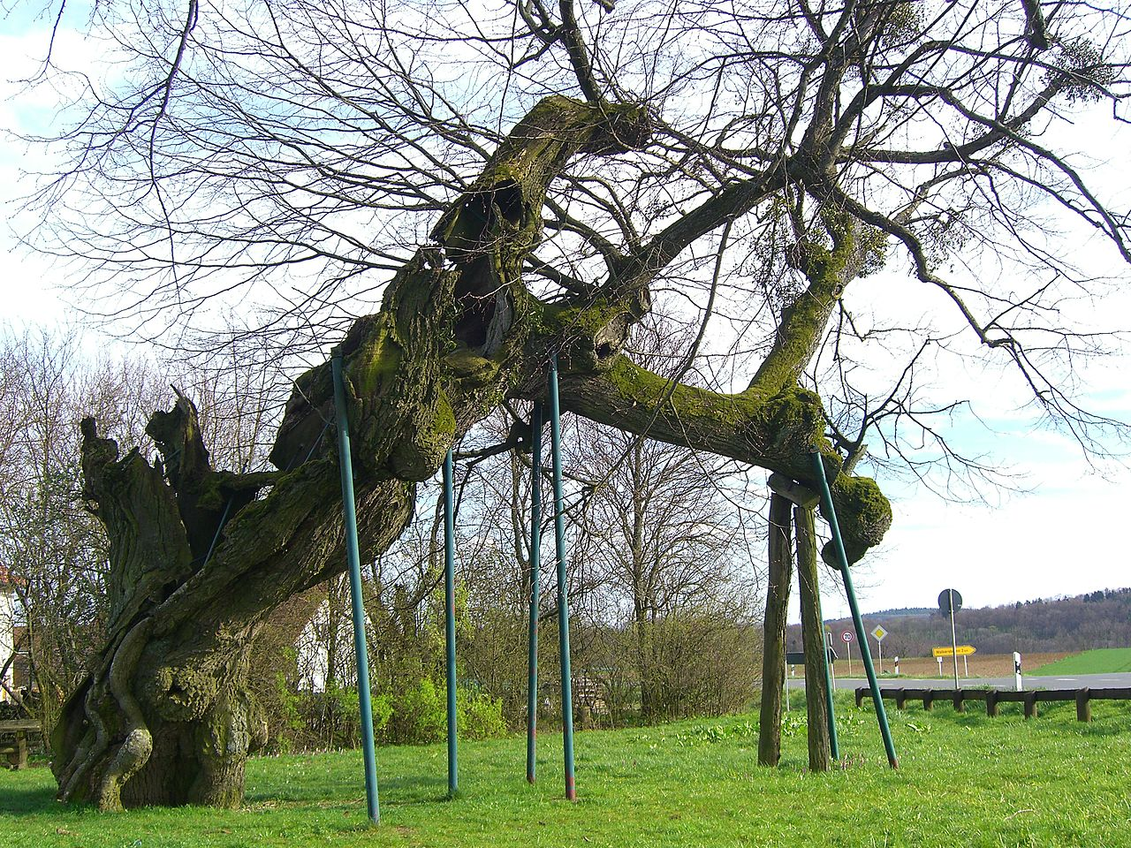
There is a story you can learn from

Slide 12
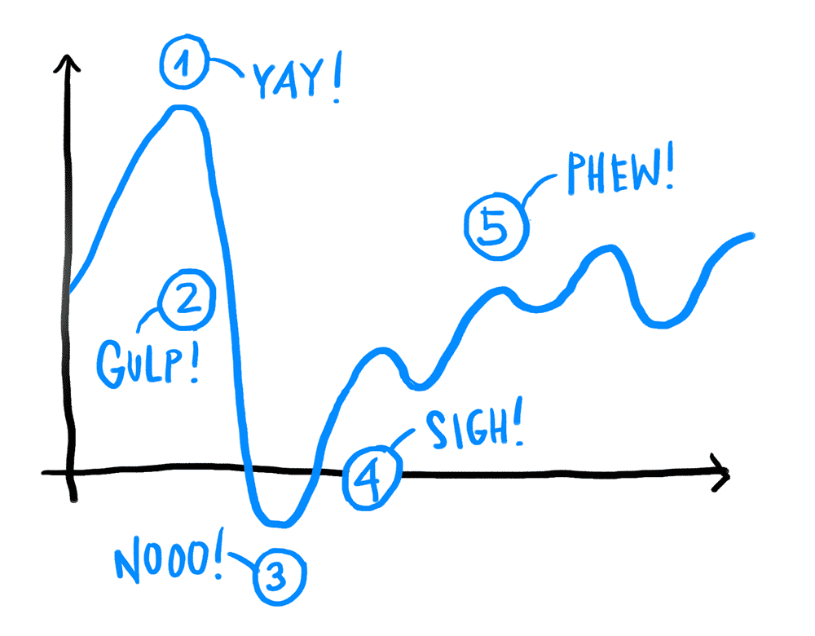
Learning on the domain is hard

Slide 13
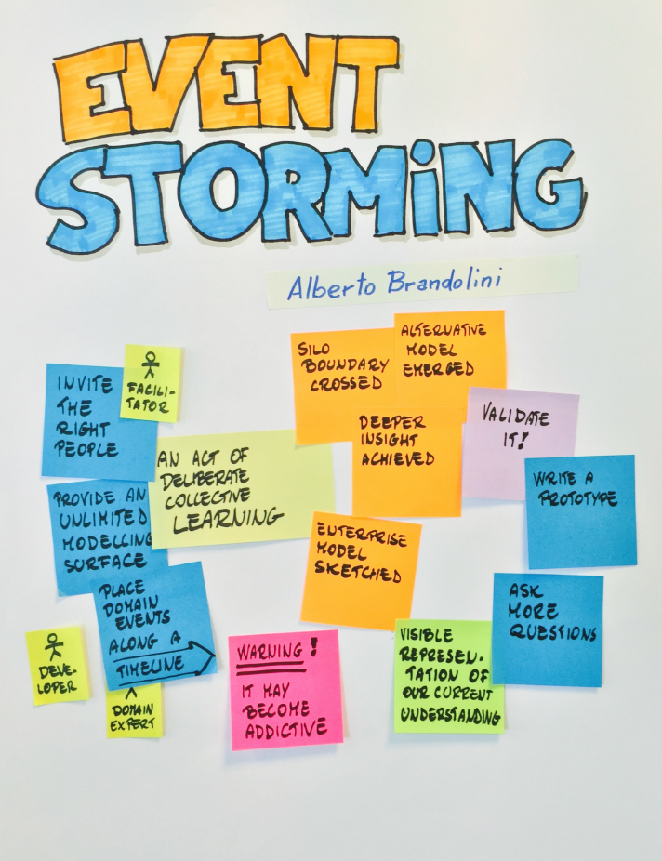
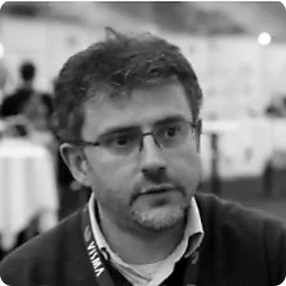

The inventor
@ziobrando
https://leanpub.com/introducing_eventstorming

Slide 14
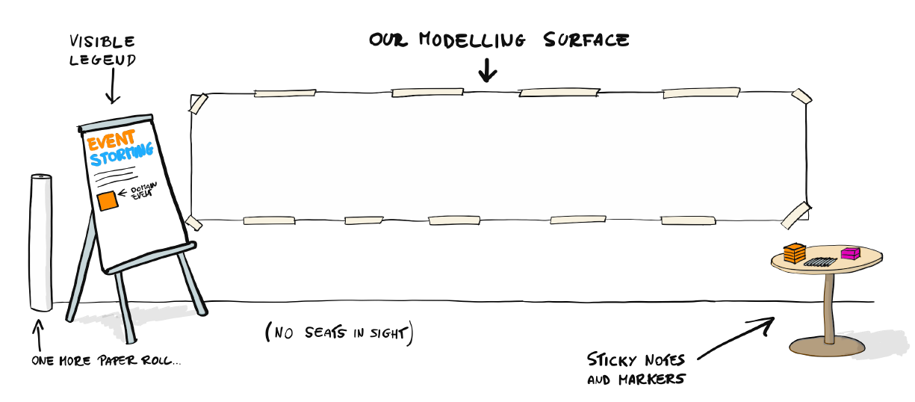
Hack the space

Slide 15
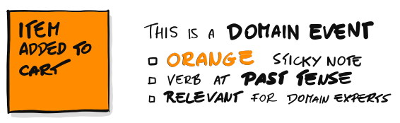
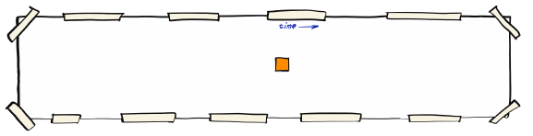
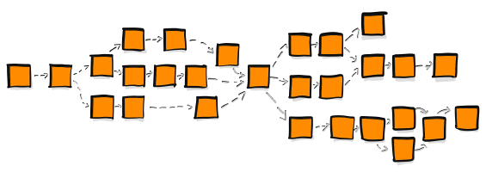
Start with „Domain Events“

Slide 16
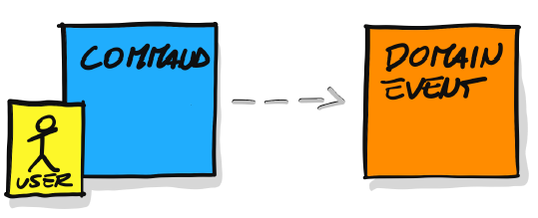
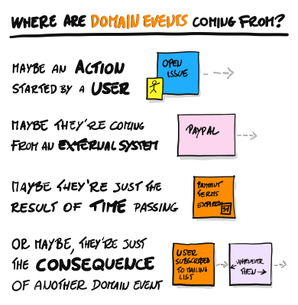
„Domain Events“ come from

Slide 17
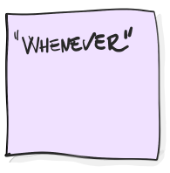

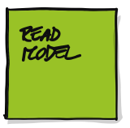
… there are some more colours

Slide 18
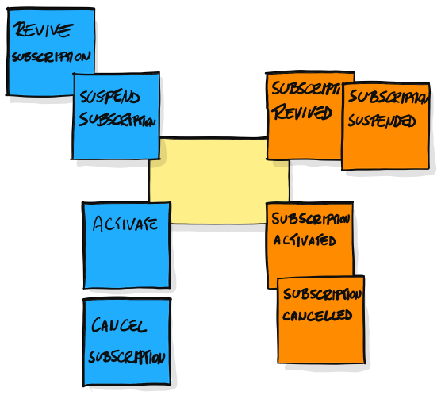
Design matters

Slide 19
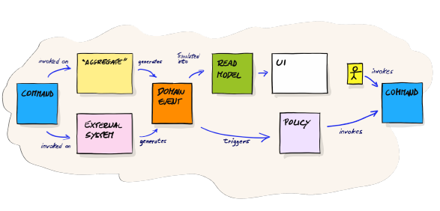
What it might look like

Slide 20
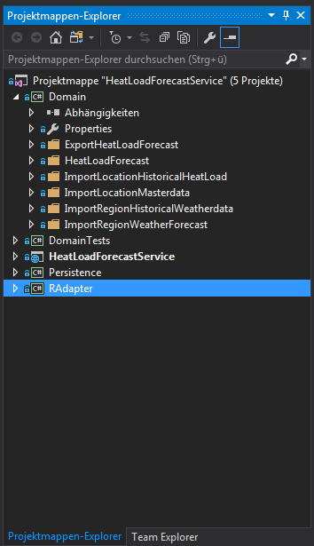
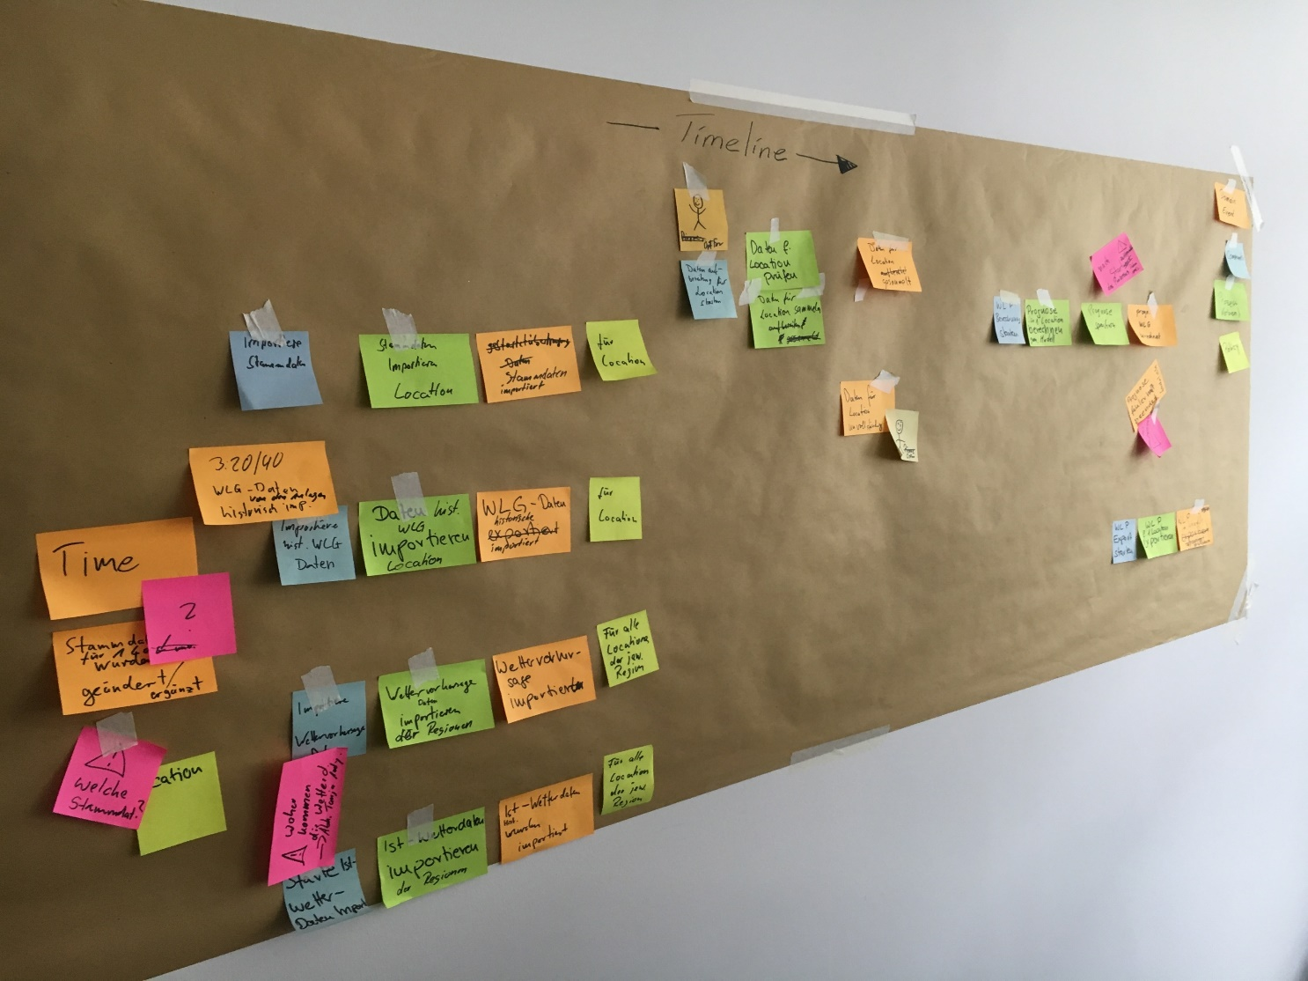
This is the „Big Picture“ of your business
HeatLoadForecastService
HeadLoadForecast
ImportLocationMasterdata
ImportLocationHistoricalHeatLoad
ExportHeadLocadForecast
ImportRegionWeatherForecast
ImportRegionHistoricalWeatherdata

Slide 21
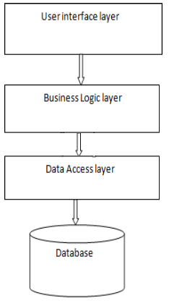
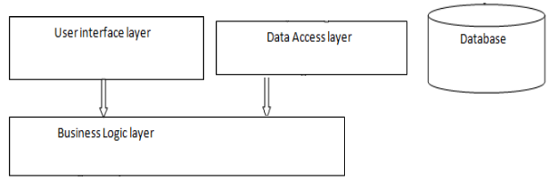
When it comes to architecture
Layered Architecture

Slide 22
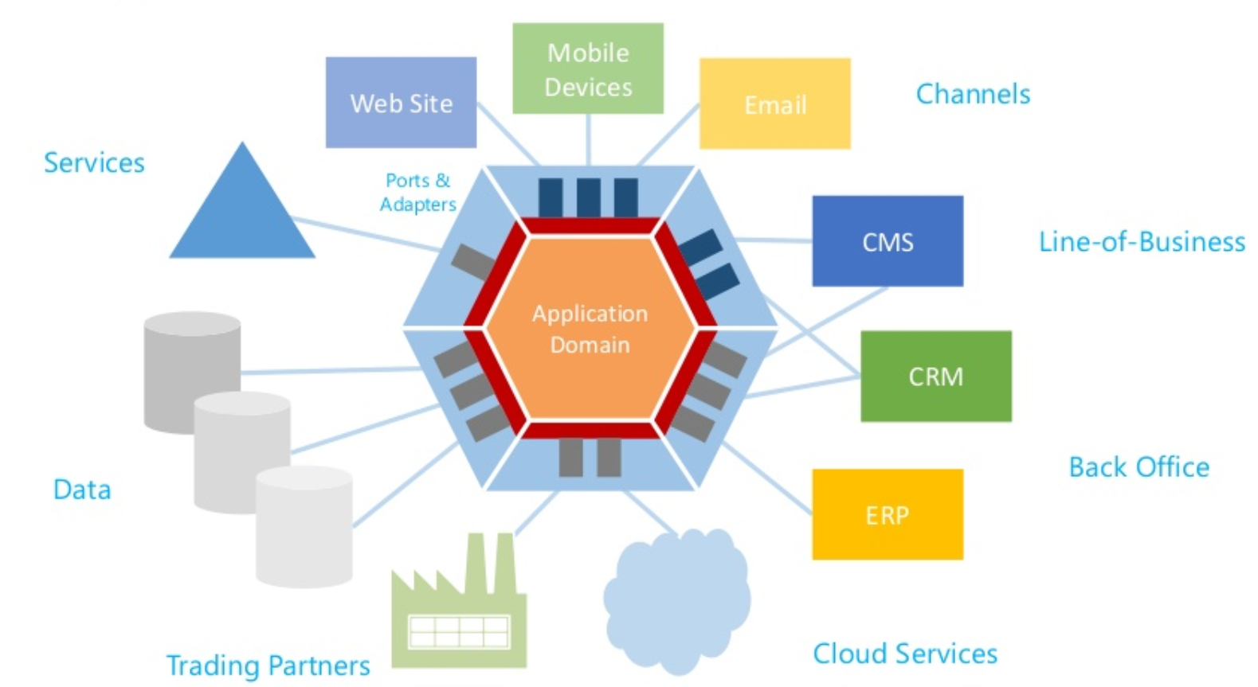
When it comes to architecture
The inside-out approach
Hexagonal Architecture

Slide 23
Code code code…
Bla bla bla
Show me your code!

Slide 24
Our lessons learned
A common understanding on what the business needs is crucial

Slide 25
Our lessons learned
Developing an application is a learning process, coding is a sideffect

Slide 26
Our lessons learned
Build the software inside out
Seperate business code from technical concerns

Slide 27
Our lessons learned
Try to align your architecture
with your business process

Slide 28
Our lessons learned
Modelling is a challange
Challenge your model

Slide 29
Our lessons learned
Be pragmatical!
Don‘t be a perfectionist, just make it valuable

Slide 30
How to get started?
There is a greenfield on any brownfield
Find impacts on your current business workflow
Get new teammates up to speed
How is your week organized?
There will be two workshops in April – hurray!

Slide 31
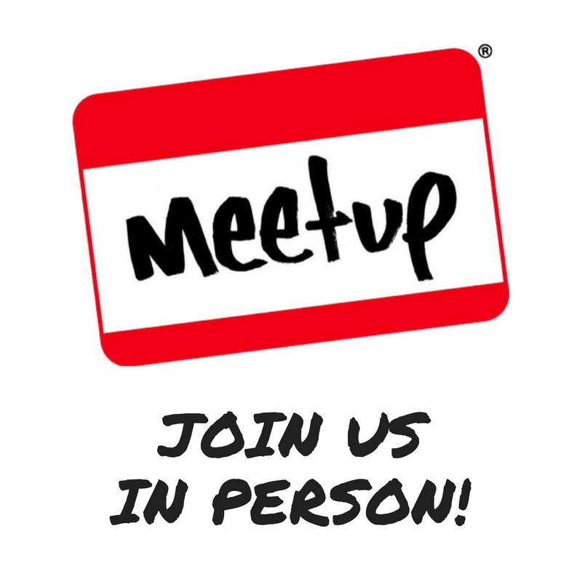
Thanks and good bye
… but wait – any questions?
@pauli_marcello

