Slide 1

myHomeSearch

Slide 2
myHomeSearch San Diego School District Home Search Project
Where can someone buy a house within their budget to get the best high school?
Compile data to show which homes are available in the vicinity of various public school .

Slide 3
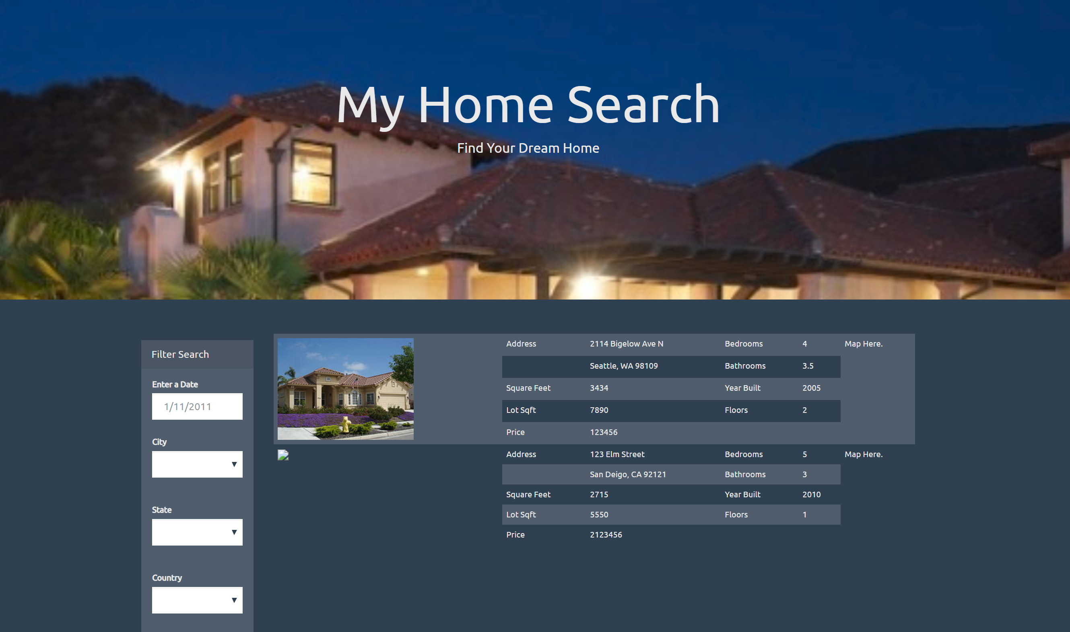

Slide 4
Resources
Zillow API
Cartographic Boundary Shapefiles - School Districts https://www.census.gov/did/www/schooldistricts/data/boundaries.html
American Fact Finder - San Diego County School Districts (Elementary) Poverty and Income - General Economic Characteristics https://factfinder.census.gov/faces/tableservices/jsf/pages/productview.xhtml?pid=ACS_17_5YR_DP03&src=pt
Niche.com

Slide 5
Possible Data to Compile
San Diego map designated by zip codes
Top high schools in San Diego with map coordinates and ranking
Single family homes with 3-4 bedrooms within 5 miles of selected school
Median home price for each zip code

Slide 6
Possible Outputs
Graph of median price of houses in zip code of and ranking of schools
Graph of median price of houses in zip code of and ranking of schools
Map of San Diego divided by zip codes
Markers on map of public high schools – click shows pop-up of name, ranking
Houses available for sale within a radius circle of 5 miles

