Slide 1
How to choose the best accommodation for vacation in Belgium?
Data management
Iman Ajdamova S190958
Pauline Colle S192012

Slide 2
Table of contents
01
02
03
Visualisation
Webscrapping and data collection
Modelling

Slide 3
01
Webscrapping and data collection

Slide 4

Data collected
Source of the data: website Abritel
Period considered: 04/09/2023 - 17/09/2023
Area considered: Belgium
Data collected:
Name of the ad
Type of accommodation
Whether the host is considered as premium
The price per night and the total price
How many appreciations/reviews the ad has
The type of accouncement: private or professional
The number of guests
The number of bedrooms
The number of beds
The localisation and its GPS coordinates

Slide 5
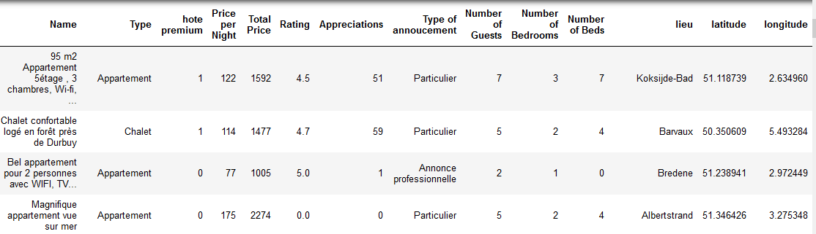
Data frame of collected data
Number of observation: 423

Slide 6
02
Visualisation

Slide 7
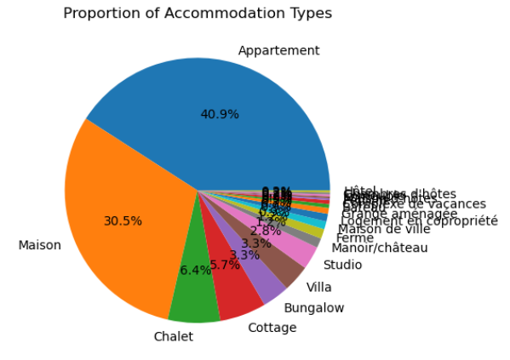
Proportion of each type of accommodation
Main type of accommodation:
Apartment
House
→ More choice available

Slide 8
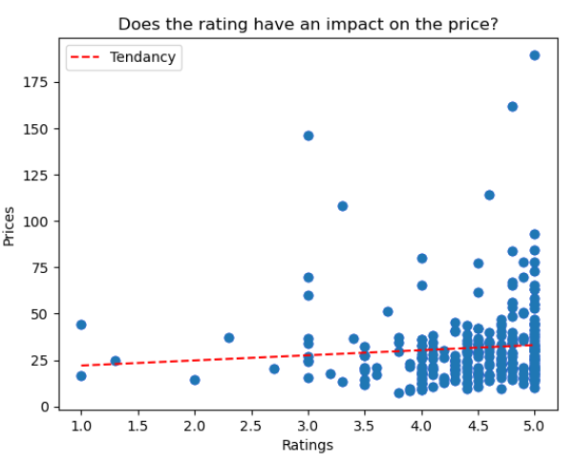
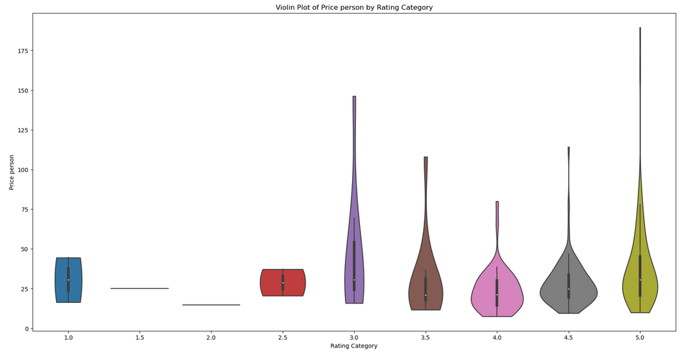
Price-Rating
Sign of a sligthly positive relationship, especially for the higher levels of rating: better rating = sligthly higher price
Lack of observation for the lower level of rating.

Slide 9
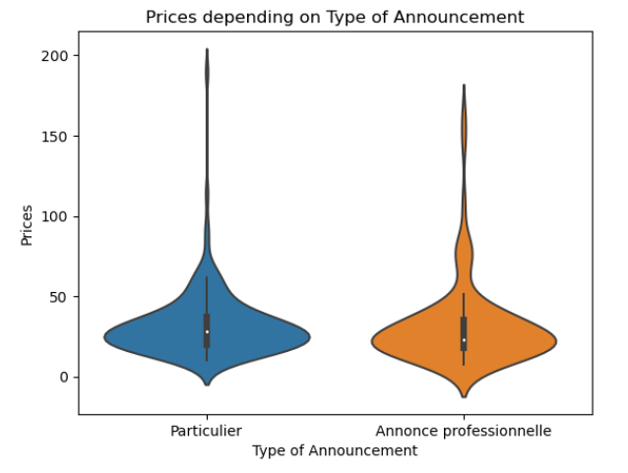
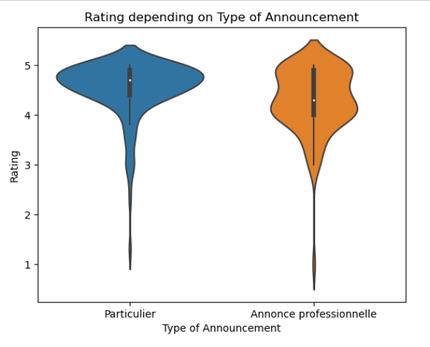
Type of announcement
Very similar, however we can notice that ads of private parties have slightly higher prices and slightly higher ratings (observations are more dispersed).

Slide 10
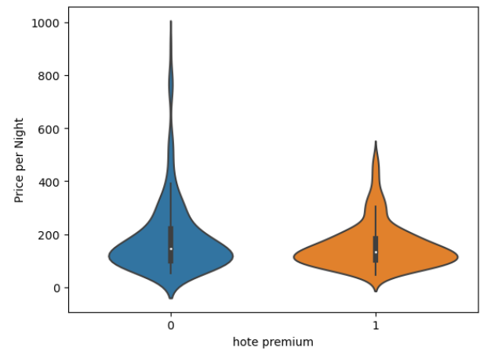
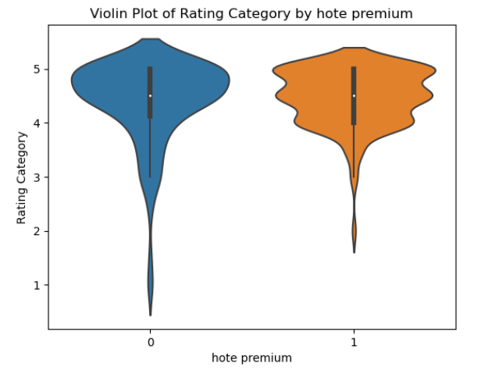
Premium host
Once again, very similar but ads tagged ‘Premium’ seem to be less expensive and better rated.

Slide 11
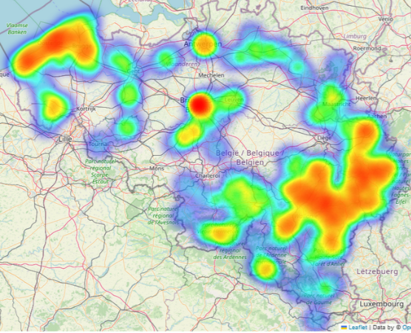
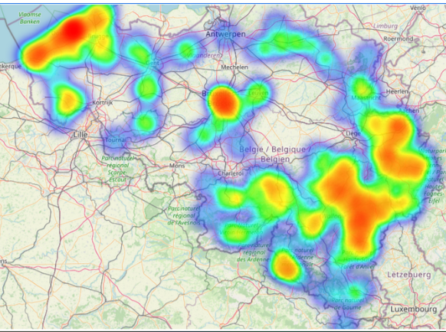
How are price and rating influenced by localisation?
Where are the most expensive accommodations?
Where are the best-rated accommodations?

Slide 12
03
Modelling

Slide 13
Supervised machine learning
Objective: determine which variables matter in determining the price
Linear regression
Dependent variable: logarithm of the price per night
R² = 0.35
RMSE = 0.42
Independent variable, their coefficient and p-values:
 | Rating | Guests | Bedrooms | Nb beds | Appreciations | Latitude | Longitude | Premium host
Coeff | 0.02 | 0.04 | 0.25 | 0.06 | -0.07 | 0.12 | -0.03 | 0.06
P-values | 0.44 | 0.53 | 0 | 0.12 | 0.02 | 0 | 0.23 | 0

Slide 14
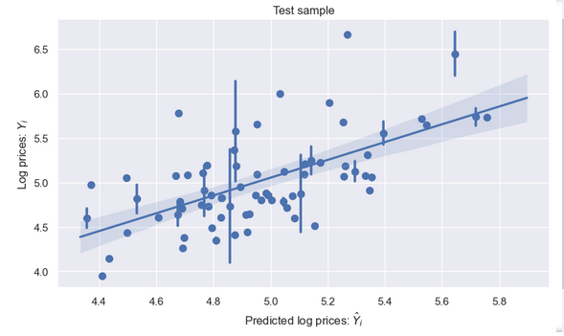
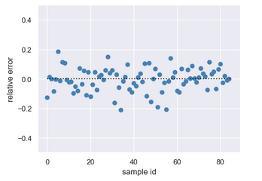
Graphical representation
Binned regression plot
Plot of the relative error

Slide 15
Thank you for your attention

