Slide 1

VCI Digital Model
Modelling and Simulation Master in Informatics and Computing Engineering
Authors Diogo Samuel Fernandes Juliane Marubayashi Paulo Ribeiro
Instructor Prof. Rosaldo Rossetti

Slide 2
Index
Context
Data format
Map cleaning
Strategy
SUMO configuration
Results
Conclusions

Slide 3
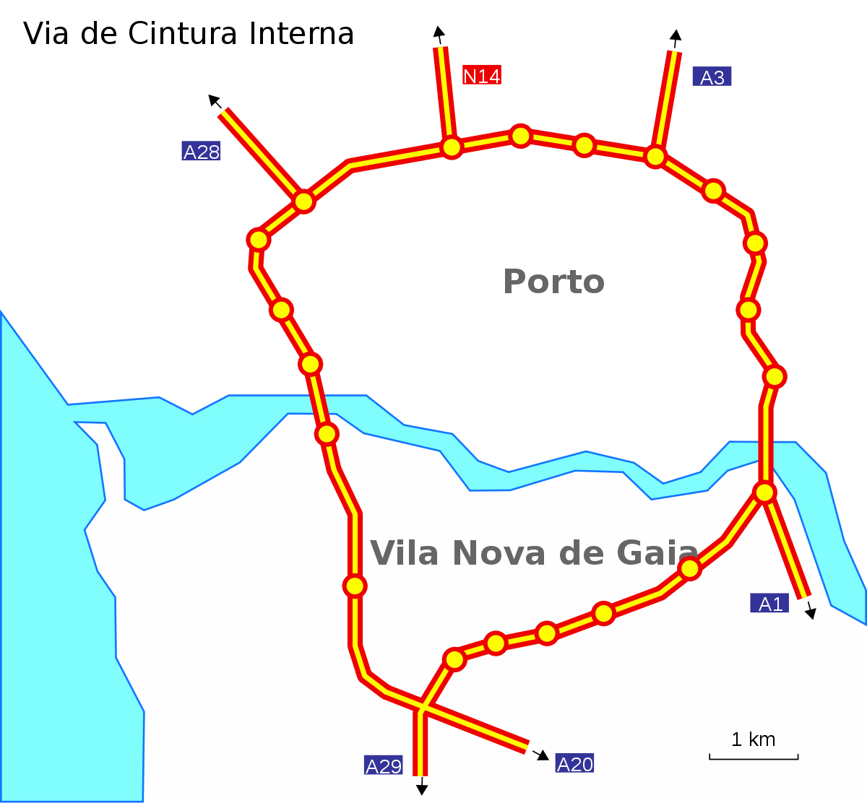
Context
Porto is the city with the highest affluence of cars in Portugal. The increased traffic causes many problems, such as excessive pollution and stress, among others.
In the context of smart cities, a large amount of data from the VCI (Via de Cintura Interna) motorway was gathered by inductive-loop sensors underneath the pavement all over the VCI.
With this data, it is possible to recreate the observed and measured traffic on the streets in a simulation to test new ideas and solutions for improving traffic performance in real cities.
https://pt.m.wikipedia.org/wiki/Ficheiro:VCI.svg

Slide 4
Data format
The subject's instructor supplied the data and explained it in "The Prediction of Traffic Flow with Regression Analysis" paper.
Description of the sensors in the VCI in CSV format, as described below:
Gathered information by the sensors from 2013 to 2015, separated in files in an interval of 5 minutes along some days in a year.
EQUIPMENTID,description,latitude,longitude,description2,roadsectionId
121725,AEDL - A1 297+975 CT3687,"41,11113","-8,608549",Santo Ovideo - A44/A29,177
121726,AEDL - A1 300+250 CT3688,"41,12538","-8,635809",A44/A29 - Canidelo,178
121727,AEDL - A1 300+920 CT3689,"41,12975","-8,635617",Canidelo - Afurada,179
121729,AEDL - A20 0+650 CT3683,"41,07731","-8,577477",Carvalhos - Canelas,165
121730,AEDL - A20 1+930 CT3684,"41,08205","-8,575104",Carvalhos - Canelas,165
121737,AEDL - A20 2+600 CT3721,"41,09138","-8,574559",Canelas - Avintes(N222),166
"AGGREGATE_BY_LANE_BUNDLEID","AGG_ID","EQUIPMENTID","AGG_PERIOD_START","AGG_PERIOD_LEN_MINS","NR_LANES","LANE_BUNDLE_DIRECTION","TOTAL_VOLUME","AVG_SPEED_ARITHMETIC","AVG_SPEED_HARMONIC","AVG_LENGTH","AVG_SPACING","OCCUPANCY","LIGHT_VEHICLE_RATE","VOLUME_CLASSE_A","VOLUME_CLASSE_B","VOLUME_CLASSE_C","VOLUME_CLASSE_D","VOLUME_CLASSE_0","AXLE_CLASS_VOLUMES"
9577808,448873,121729,"2015-01-01 11:55:00",5,3,"D",48,"97.77","94.9","443.75","283.4","1.54","100",0,48,0,0,0,"{E2:48}"
9577809,448874,121729,"2015-01-01 12:00:00",5,3,"C",40,"98.25","95.17","459.25","539.5","1.3","100",0,40,0,0,0,"{E2:40}"
9577810,448875,121729,"2015-01-01 12:00:00",5,3,"D",53,"97.75","94.8","441.32","352.89","1.68","100",0,53,0,0,0,"{E2:53}"
9577811,448876,121729,"2015-01-01 12:05:00",5,3,"C",52,"97.08","92.44","471.54","373.28","1.77","98.08",0,51,0,1,0,"{E2:51;E3:1}"
9577812,448877,121729,"2015-01-01 12:05:00",5,3,"D",71,"101.24","98.34","439.3","255.36","2.21","98.59",1,69,1,0,0,"{E2:71}"
9577813,448878,121729,"2015-01-01 12:10:00",5,3,"C",36,"101.22","96.29","480.83","626.07","1.19","97.22",0,35,0,1,0,"{E2:36}"
Notes:
Present the format of the two main files of the data and where they were obtained.

Slide 5
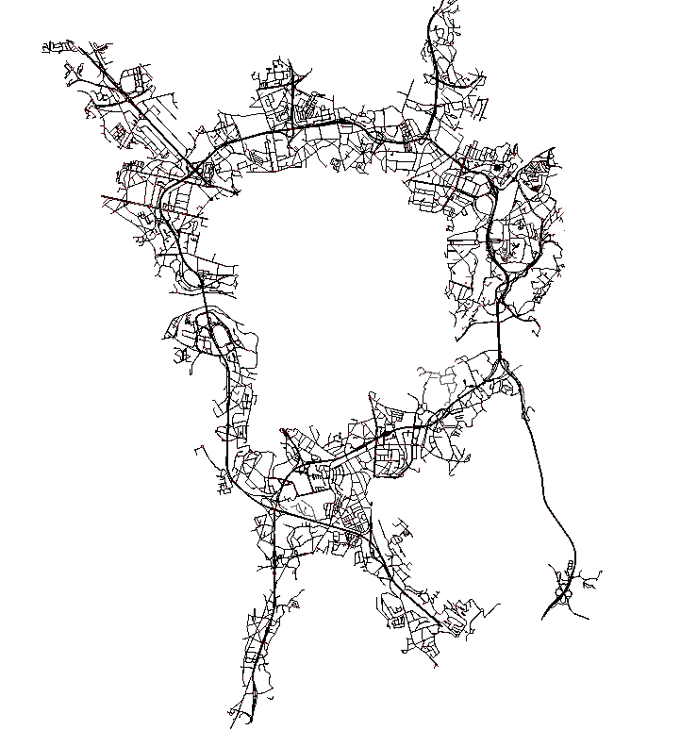
Map Cleaning
To establish an adequate simulation environment, we obtained a map of Porto and Gaia cities from Open Street Map (OSM). However, the representation also contained unnecessary information, which could harm the simulation or prevent it from running. Thus, we cleaned the map, following the steps below:
Use netconvert script to remove unnecessary lanes (train, pedestrian, etc);
Remove non-VCI roads from the map using NETedit;
Use once again netconvert script with argument --remove-edges.isolated true to remove dangling nodes and isolated edges;
Notes:
Explained why and how we cleaned the map.

Slide 6
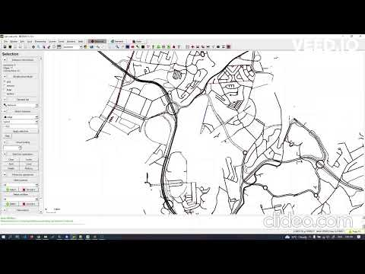
Map Cleaning (NETedit)

Slide 7
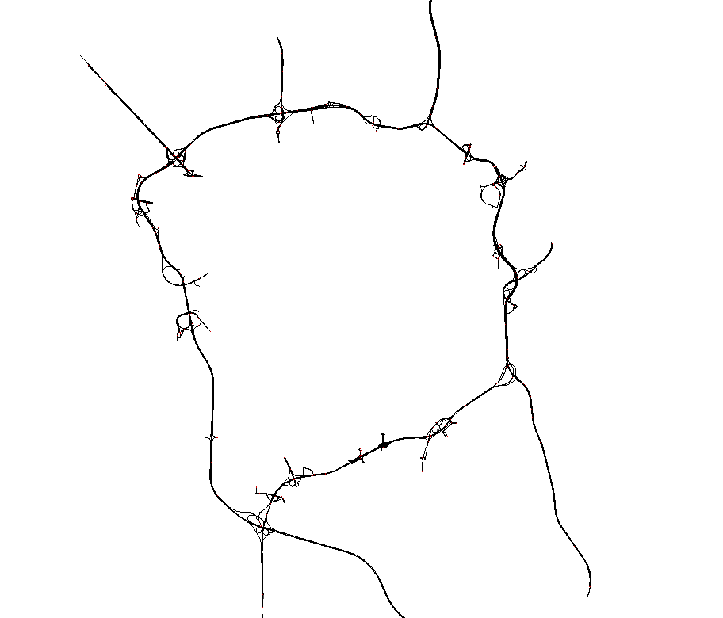
(1) Strategy - Creating the OD matrix
An OD matrix denotes a map's possible origin/destination points. We implemented an "automatic" strategy to recognize these points:
Create a new version of the map where only the VCI remains.
Then we created a script that analyses every node of the map.
If the node contains an outgoing edge but not an ingoing, it enters the VCI.
If it has an ingoing edge but not an outgoing, then it is exiting the VCI.
The edges exiting the VCI are the destination edges and the edges entering the VCI are the origin edges. In total, there were 858 origin/destination pairs.
Notes:
What are OD matrixes and how to get all the Origin/Destination pairs

Slide 8
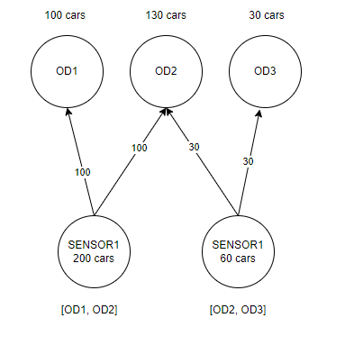
(2) Strategy - Number of vehicles in OD matrix
Each OD pair has an established shortest path once processed and stored in a txt file.
A sensor has a number N of routes that pass through it. Considering that we can derive the total volume Y of cars that passes through each sensor in one hour, according to real data, we divided this volume by each OD pair that pass through it equally.
As the number of cars might saturate SUMO, we tested the simulation using proportional values for the number of cars (10%, 25%, 50%, …)
Notes:
How to

Slide 9
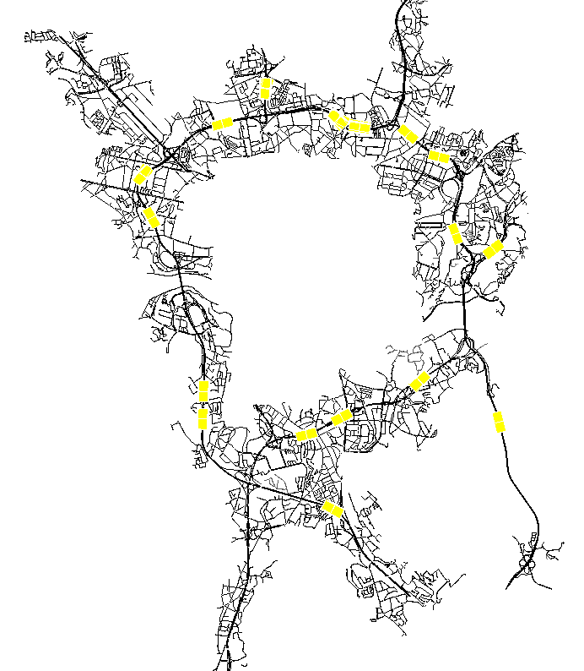
(3) Strategy - Simulation Sensors
Adding sensors to SUMO simulation requires creating an XML file (detectors.add.xml) containing their ID, lane, position, and frequency to store data.
We discovered the location of the sensors in the network by comparing it with the VCI map, using their latitudes and longitudes.
In real life, a single sensor measures traffic in both directions. In the simulation, it is necessary to place a sensor in each lane. Therefore, it was necessary to carry out further processing to group these data in both directions, so that they could be compared.
We identified the direction of each simulation sensor by appending an underscore to its lane, along with the lane direction (0 corresponds to the direction C, internal VCI ring, and 1 corresponds to D, external VCI ring).
<additional>
<inductionLoop id="121725_20" lane="95367752#0_0" pos="121.94" freq="300" file="simulation.out.xml"/>
<inductionLoop id="121725_21" lane="95367752#0_1" pos="121.94" freq="300" file="simulation.out.xml"/>
<inductionLoop id="121725_30" lane="839842702_0" pos="1069" freq="300" file="simulation.out.xml"/>
<inductionLoop id="121725_31" lane="839842702_1" pos="1069" freq="300" file="simulation.out.xml"/>
</additional>

Slide 10

(4) Strategy - Calculating the error
There are two main strategies for calculating the error.
Compares SUMO’s output with every record of the real data.
Calculate the volume of cars in each simulation sensor per hour and compares this result with the same calculation applied to the real data.
We decided to apply the error to three metrics: total volume of cars that entered and left the sensor road during the observation at hand, arithmetic mean speed and harmonic mean speed.
The type of error we used is the mean absolute error, which is given by:
n = number of observations (nº of records in the first strategy and nº of hour blocks in the second);
y = real sensor values;
x = SUMO sensor values;
e = difference between both values.
We chose this error measure because it is less sensitive to outliers, which are very frequent in inductive loop data detectors.

Slide 11
SUMO configuration
In addition to defining the network and vehicle route files, it was necessary to define the simulation termination time. The value 9000 corresponds to the total number of seconds of the observations used, which in this case corresponded to the average of 2,5h in the morning period of the year 2015.
<configuration>
<input>
<net-file value="vci.net.xml"/>
<route-files value="vci.rou.xml"/>
<additional-files value="detectors.add.xml"/>
</input>
<time>
<begin value="0"/>
<end value="9000"/>
</time>
<processing>
<time-to-teleport value="0"/>
</processing>
<report>
<no-duration-log value="true"/>
<no-step-log value="true"/>
</report>
</configuration>

Slide 12
Results
We tested the various scenarios to find out which one was closest to the real traffic behaviour on the VCI.
The maximum value in each scenario corresponds to the totality of cars resulting from the equal division of the flows of each sensor by the OD pairs whose routes pass through them.
Strategy 1:
10% | 25% | 50% | 75% | 100%
47,576.070 | 46,954.375 | 46,835.290 | 47,223.463 | 47,029.250
Strategy 2:
10% | 25% | 50% | 75% | 100%
4,671.672 | 4,485.051 | 4,412.266 | 4,346.030 | 4,193.740

Slide 13
Conclusion
This project creates a descriptive model of the VCI, to test new scenarios, understand its current problems and prescribe new solutions for future improvement.
We've successfully applied modelling methodologies to enhance and validate the descriptive model. Although the error is still significant, by exploring more scenarios, the variation of the error will follow a diminishing marginal return and stabilize at some moment.
As the OD matrices describe every pair of origin and destination of the VCI in the map, the modifications in this type of file involve changing the number of cars in the OD matrix.

