Slide 1
Home
TV Shows
Movies
News & Popular
My list
Watchlist
INFORMATION RETRIEVAL
MILESTONE 2
Paulo Ribeiro, up201806505
Pedro Ferreira, up201806506
Pedro Ponte, up201809694

Slide 2
TABLE OF CONTENTS
01
Collection
02
Indexing
Schema
Retrieval
03
04
03
Evaluation
04
Future Work & Improvements
01
02
Definition
Document
Preparing Solr
03
04
Definition
Tokenizers & Filters
Queries results
05
06
Metrics
Results relevance
Milestone 3 goals

Slide 3
01
Collection
Home
TV Shows
Movies
News & Popular
My list
Watchlist
01

Slide 4
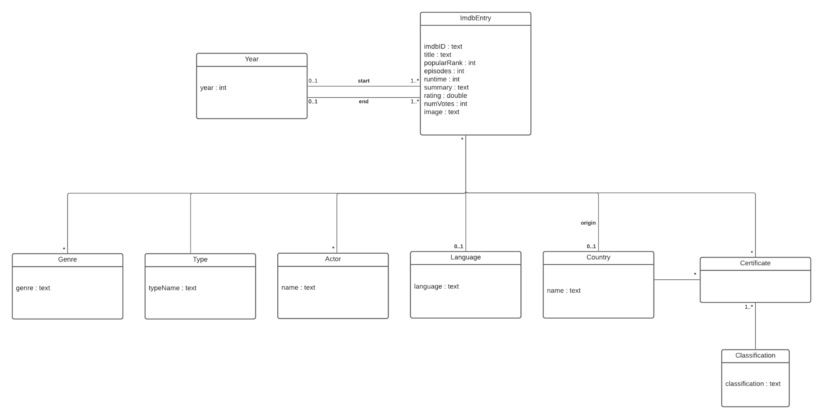
Collection
Home
TV Shows
Movies
News & Popular
My list
Watchlist
Collection: All shows in the dataset obtained from Milestone 1
Document: A show
The dataset is a single CSV file which, for convenience, we transform into a JSON file
Notes:
Da milestone anterior temos todos os shows guardados num dataset no formato CSV onde cada coluna corresponde a um atributo diferente e cada linha a um show diferente.
Baseados nisto, apenas necessitamos de criar um core que contém todos os shows, correspondendo a cada documento um show diferente.

Slide 5
02
Indexing
Home
TV Shows
Movies
News & Popular
My list
Watchlist
02

Slide 6
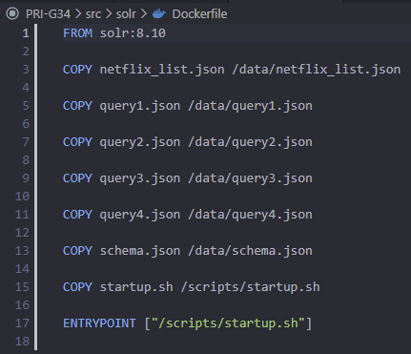
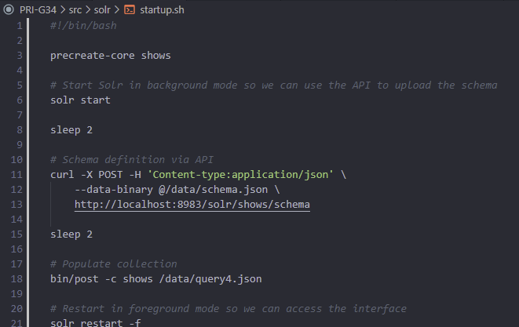
Indexing
Home
TV Shows
Movies
News & Popular
My list
Watchlist
Run Docker image based on Solr’s container
Dockerfile to define a custom image and perform all the basic setup operations
Script to automatically create a core (shows), define our schema and populate the database
Notes:
Dockerfile - Permite realizar todas as operaçoes de configuração do solr automaticamente todas as vezes que se inicia a imagem - copia e coloca na pasta data o dataset, os subconjuntos utilizados para a avaliação das queries, o schema e também um script
Startup - cria o core shows, define o schema (neste caso via API) e popula o core

Slide 7
03
Schema
Home
TV Shows
Movies
News & Popular
My list
Watchlist
03

Slide 8
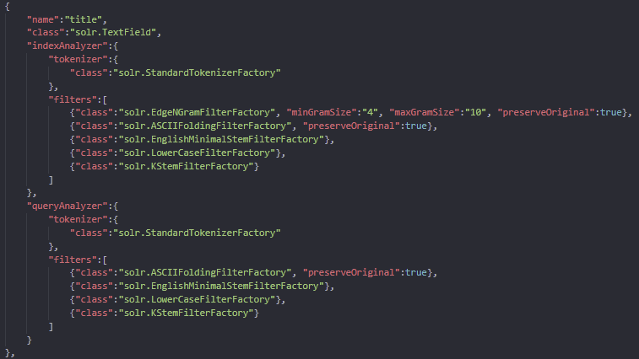
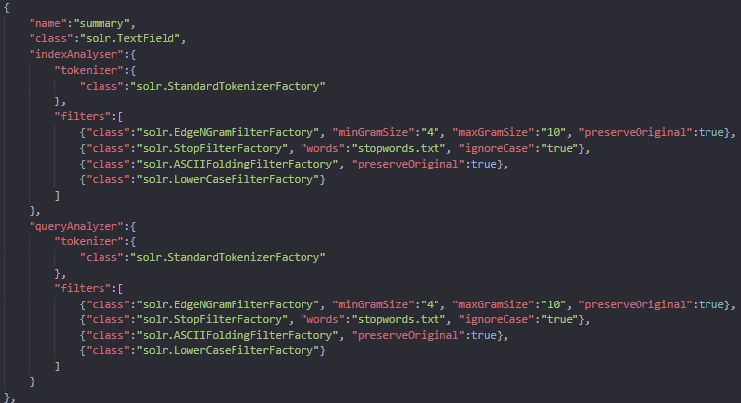
Schema
Home
TV Shows
Movies
News & Popular
My list
Watchlist
Create some field-types:
id
title
certificate
type_plural
lower_clean
summary
cast
Notes:
Title:
Ambos analysers:
ASCIIFoldingFilterFactory - converter chars para o respetivo codigo ASCII, por ex: uma palavra escrita com ou sem acento retornarem o mesmo resultado
EnglishMinimalStemFilterFactory - transformar plural em singular
LowerCaseFilterFactory - transformar em letras minusculas
KStemFilterFactory - reduzir a palavra à sua base - por ex, doing, does, did -> do
Apenas index:
EdgeNGramFilterFactory - gerar edge n gram tokens, de forma a obter resultados para titulos que contenham uma palavra semelhante, por ex: English apresentara resultados para English ou Englishman
Summary:
EdgeNGramFilterFactory - pelo mesmo motivo que no title
StopFilterFactory - descartar palavras que estao na stoplist de forma a facilitar a pesquisa: por ex, pesquisa ’story man leverages single’ leva-nos até a miniserie “Halston” que contem no summary ‘The story of aman who leverages his single’
ASCIIFoldingFilterFactory -
LowerCaseFilterFactory

Slide 9
03
Retrieval
Home
TV Shows
Movies
News & Popular
My list
Watchlist
04

Slide 10
Query 1: English-related shows
Home
TV Shows
Movies
News & Popular
My list
Watchlist
Information need: Shows with the word 'English'
Relevant judgement: The language of the show must be ‘English’ or the summary should contain the word ‘English’, but if the language of 2 shows were both English, the one who also had the word in the summary would appear first.
Query(q): summary : “English” OR language : “English”
defType: edismax
Query Fields (qf): language^2 summary

Slide 11
Query 2: Shows containing occurrence of verb Do
Home
TV Shows
Movies
News & Popular
My list
Watchlist
Information need: Shows from United States released between 2017 and 2021 with ‘Do’ in title
Relevant judgement: The origin country of the show must be ‘United States’ and the start year should be between 2017 and 2021, and, finally, the title must have ‘do’ related words ('doing', 'done', 'did', …)
Query(q): originCountry : “United States” AND startYear : [2017 TO *] and title : “Doing”
defType: lucene
tie: 1

Slide 12
Query 3: High rating with Russian or Portuguese certificate
Home
TV Shows
Movies
News & Popular
My list
Watchlist
Information need: Ended shows between 2010 and 2020 with Russian or Portuguese certificates limited by rating
Relevant judgement: The rating of the show must be higher than 7 and must have been released after 2010 and ended until 2020. The certificates available for that show should contain an entry for Russia or for Portugal. The order of the results implies that shows with higher number of votes appear first
Query(q): rating : [7 TO *] AND startYear : [2010 TO *] AND endYear : [* TO 2020] AND (certificate : “Rússia” OR certificate : “Portugal”)
defType: lucene
sort -> numVotes : DESC

Slide 13
Query 4: Action Series Actors
Home
TV Shows
Movies
News & Popular
My list
Watchlist
Information need: Action series with actors D.B., Lesley-Ann, J.K. or Matt
Relevant judgement: The show cast must have ‘D.B’ or ‘Lesley-Ann’ or ‘Matt’ and the genre must be ‘Action’. The results should be ordered by the number of episodes, which sub-intends that the user is only interested in series.
Query(q): (cast : “DB” OR cast : “Lesley Ann” OR cast : “jk” OR cast : “Matt”) AND genres : “Action”
defType: lucene
sort -> episodes : ASC

Slide 14
03
Evaluation
Home
TV Shows
Movies
News & Popular
My list
Watchlist
05

Slide 15
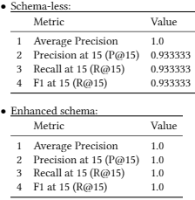
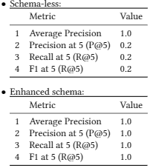
Evaluation
Home
TV Shows
Movies
News & Popular
My list
Watchlist
Query 1
Query 2
 | Query 1 | Query 2
 | 20 shows 15 relevant ‘Englishman’ in the summary | 20 shows 5 relevant Variances of verb ‘Do’

Slide 16
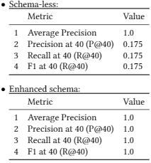
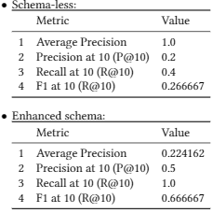
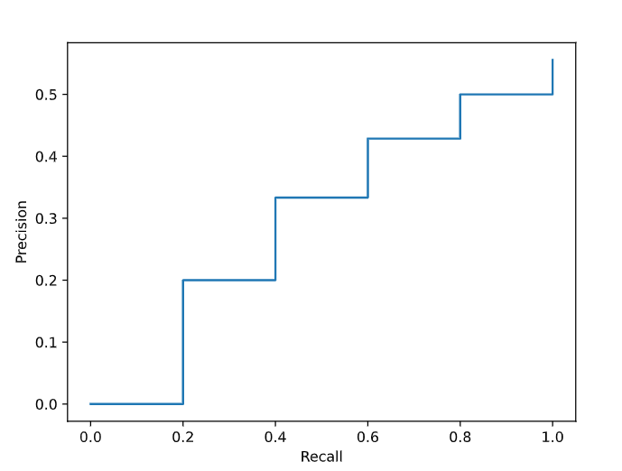
Evaluation
Home
TV Shows
Movies
News & Popular
My list
Watchlist
Query 3
Query 4
 | Query 3 | Query 4
 | 100 shows 40 relevant ‘Rússia’ certificates accentuation | 30 shows 5 relevant User expects only series

Slide 17
03
Future Work
Home
TV Shows
Movies
News & Popular
My list
Watchlist
06

Slide 18
FUTURE WORK & IMPROVEMENTS
SEARCH INTERFACE
RETRIEVAL UPGRADES
FINAL RESULT
Home
TV Shows
Movies
News & Popular
My list
Watchlist
QUERY IDEAS
Think of new queries in order to better evaluate and test the final search system
Development of an interface to facilitate user interaction
Additional schema changes in order to have a more robust and relevant search system
Our goal is an elaborate information search and retrieval system

Slide 19
THANKS!
Home
TV Shows
Movies
News & Popular
My list
Watchlist
Do you have any questions?

