Slide 1
DATA
PREPARATION MILESTONE 1
Home
TV Shows
Movies
News & Popular
My list
Watchlist
Paulo Ribeiro, up201806505
Pedro Ferreira, up201806506
Pedro Ponte, up201809694

Slide 2
TABLE OF CONTENTS
01
Original Dataset
02
Pipeline Diagram
UML Diagram
Data Processing
03
04
03
Data Exploration
04
Future Work & Improvements
01
02
origin
size
format
Data processing flow
03
04
Conceptual model for the data domain
Cleaning
Scraping
05
06
Statistics Table
Charts
Search system
Database storage

Slide 3
01
Original Dataset
Home
TV Shows
Movies
News & Popular
My list
Watchlist
01
Netflix dataset characterisation

Slide 4

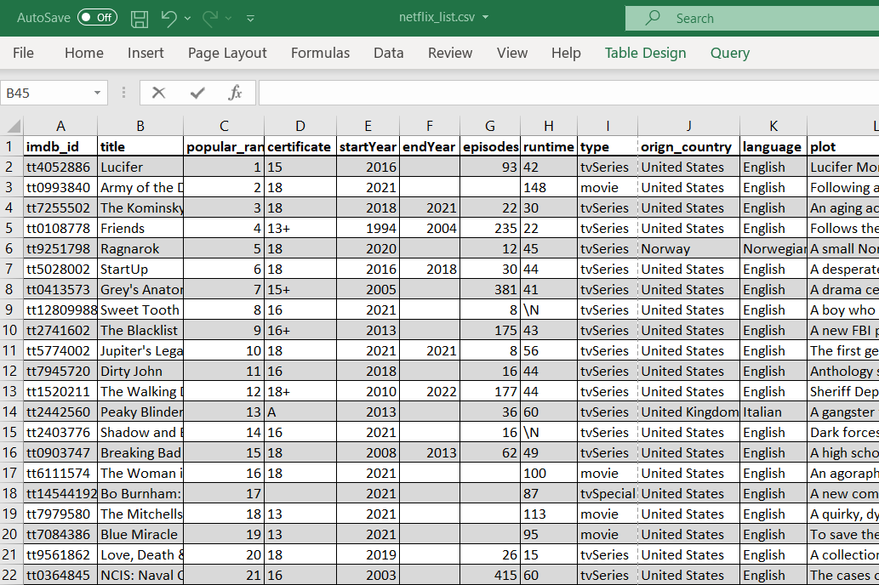
ORIGINAL DATASET
FINAL DATASET
Home
TV Shows
Movies
News & Popular
My list
Watchlist
7008 rows and 19 columns
6.29 Mb of space
Missing or Invalid values
6216 rows and 17 columns
6.02 Mb of space
Fixed and complete dataset

Slide 5
02
Pipeline Diagram
Home
TV Shows
Movies
News & Popular
My list
Watchlist
02
Data Processing flow

Slide 6
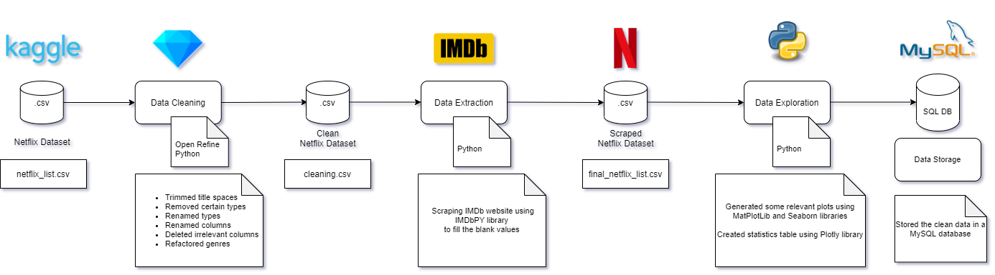
PIPELINE DIAGRAM
Home
TV Shows
Movies
News & Popular
My list
Watchlist

Slide 7
03
UML Diagram
Home
TV Shows
Movies
News & Popular
My list
Watchlist
03
Conceptual model for the data domain

Slide 8
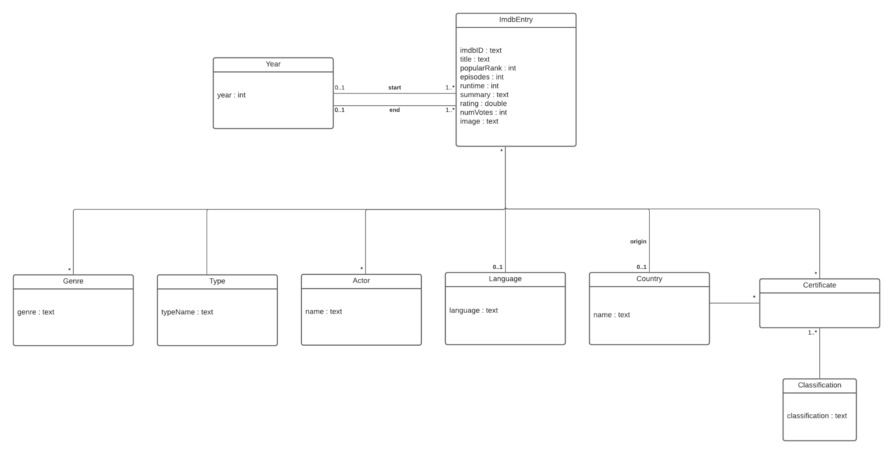
UML Diagram
Home
TV Shows
Movies
News & Popular
My list
Watchlist

Slide 9
04
Data Processing
Home
TV Shows
Movies
News & Popular
My list
Watchlist
04

Slide 10
DATA PROCESSING
CLEANING
EXTRACTION
Home
TV Shows
Movies
News & Popular
My list
Watchlist
Trimmed spaces
Removed types
Renamed types
Renamed columns
Deleted columns
Refactored genres
IMDb Scraping using IMDbPY library

Slide 11
03
Data Exploration
Home
TV Shows
Movies
News & Popular
My list
Watchlist
05

Slide 12
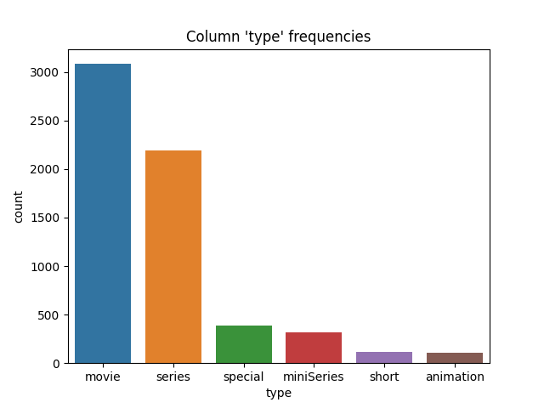
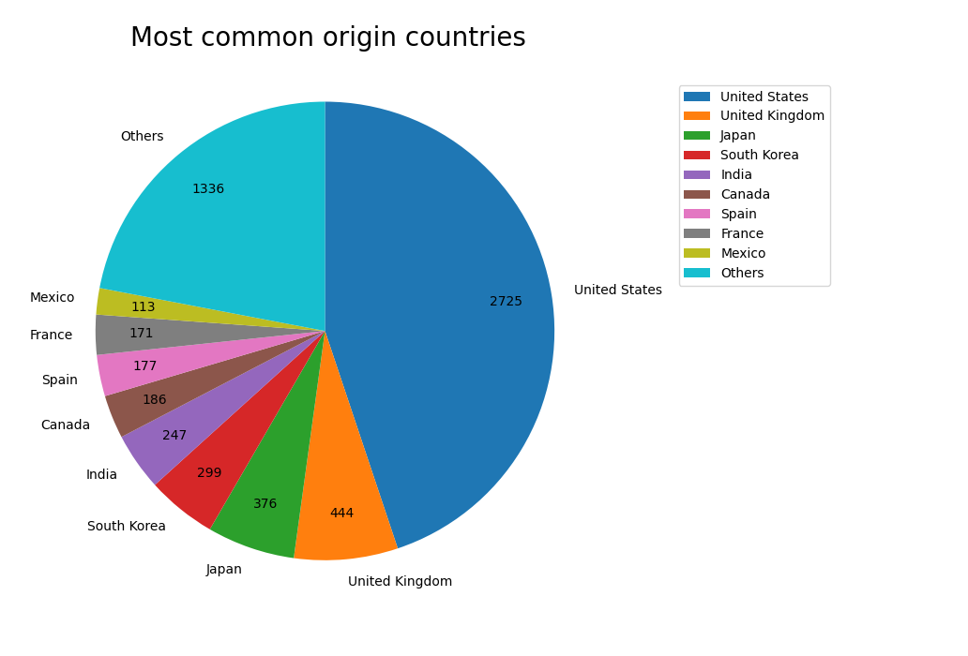
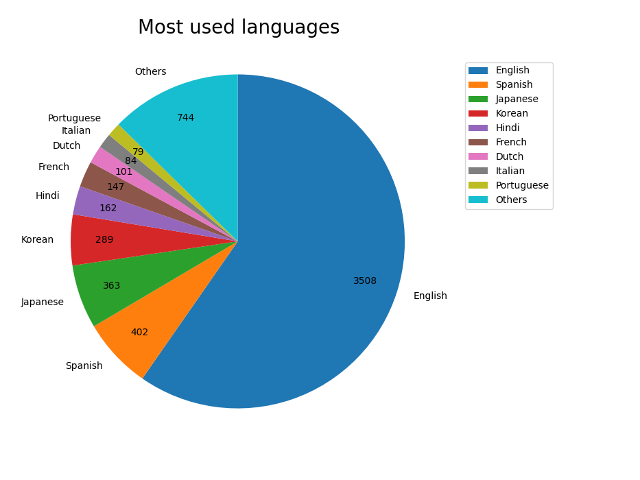
Data Exploration
Home
TV Shows
Movies
News & Popular
My list
Watchlist

Slide 13
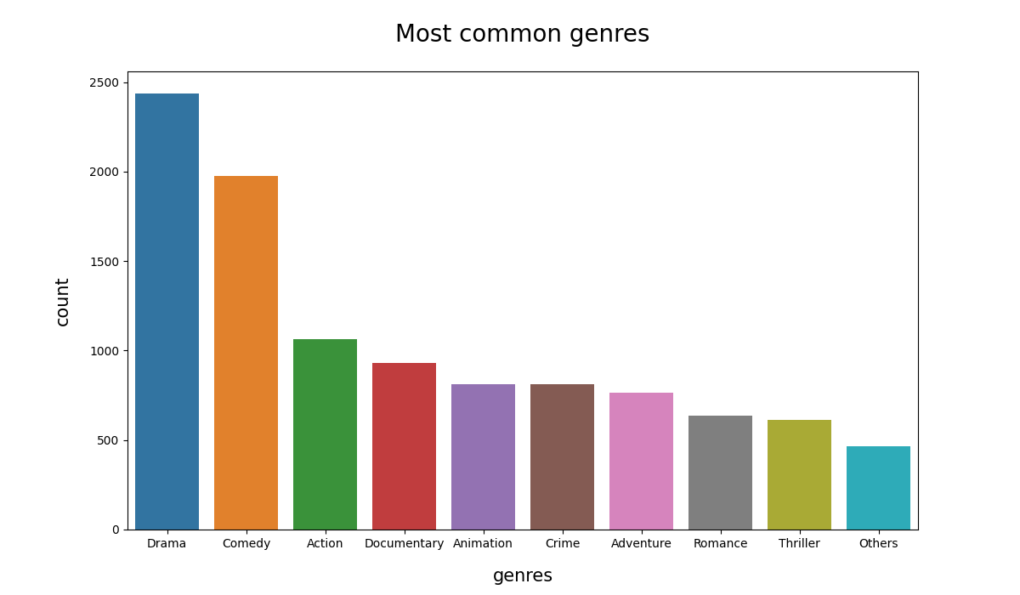
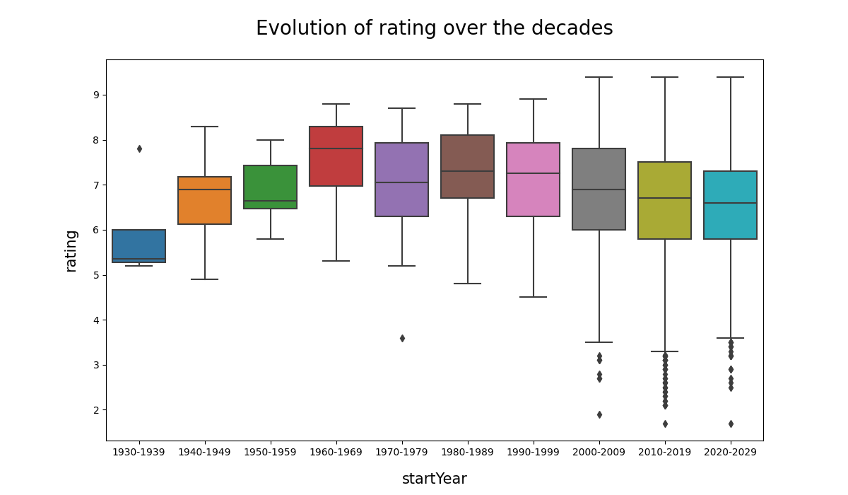
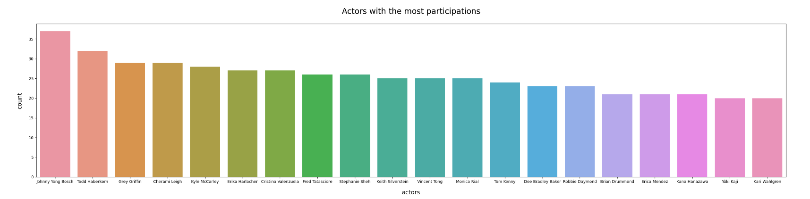
Data Exploration 2
Home
TV Shows
Movies
News & Popular
My list
Watchlist

Slide 14
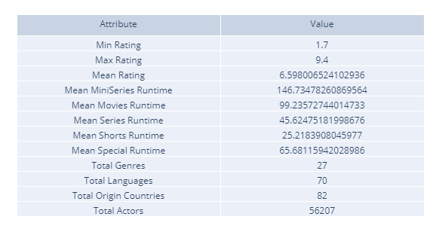
Data Exploration 3
Home
TV Shows
Movies
News & Popular
My list
Watchlist

Slide 15
03
Future Work
Home
TV Shows
Movies
News & Popular
My list
Watchlist
06

Slide 16
FUTURE WORK & IMPROVEMENTS
SEARCH
FINAL RESULT
Home
TV Shows
Movies
News & Popular
My list
Watchlist
INFORMATION
RETRIEVAL
DATA STORAGE
Storing the data in a MySQL database
Use of an information retrieval tool to do exploration with free-text queries
Use of features and techniques with the goal of improving the quality of the search results
Our goal is an elaborate information search and retrieval system

Slide 17
THANKS!
Home
TV Shows
Movies
News & Popular
My list
Watchlist
Do you have any questions?

