Slide 1


A Modelling Methodology Towards
Automated Generation of Road
Network Digital Twins
Author Paulo Ribeiro
Supervisor Prof. Rosaldo Rossetti
Receiving Enterprise ARMIS
Company’s Supervisor Eng. José Macedo
Master’s Thesis
Master in Informatics and Computing Engineering
Notes:
~13s

Slide 2
Agenda
Problem & Goals
Related Work
Baseline Methodology
Proposed Framework
Results and Analysis
Conclusions & Future Work
Notes:
~26s

Slide 3

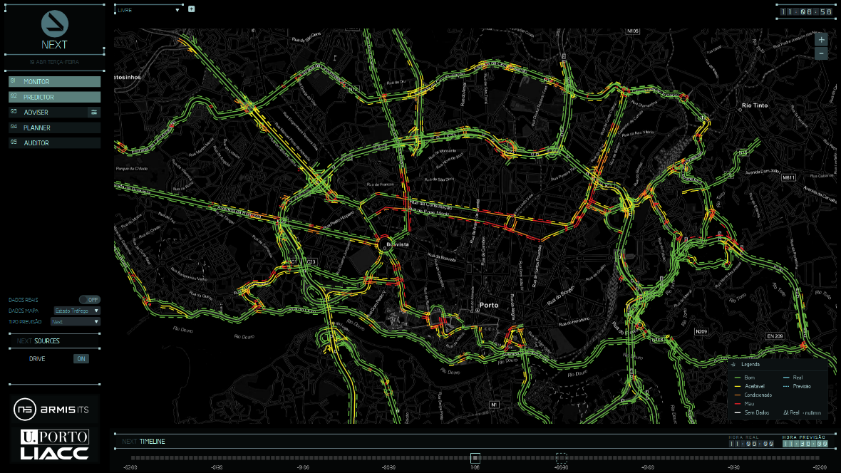
Context
Urban mobility has been facing increasing challenges, such as traffic congestion and accidents.
All these problems stem from the inefficient management of transport flows, which led to the emergence of Intelligent Transport Systems (ITS).
A new concept emerges to ensure the effectiveness of the ITS: the Digital Twin.
Notes:
~1m11s

Slide 4
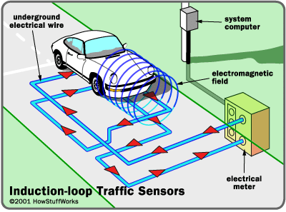
Problem
Building a Digital Twin for Road Networks is an extremely challenging task.
Stationary detectors like Inductive Loop Detectors have limited network coverage.
Furthermore, building a realistic traffic simulation scenario is a time-consuming task.
Each instance of building a Digital Twin for a new road network requires following this exhaustive process.
Notes:
~1m05s

Slide 5
Motivation
In addition to promoting the proliferation of this new technology in the literature, the proposed framework will significantly accelerate the creation of Digital Twins for road networks.
The spared time by the automatic preparation of a base simulation can be leveraged to develop additional functionalities to augment its capabilities.
Notes:
~40s

Slide 6
Goals
To develop a framework for building Digital Twins, applicable to all road networks.
Specifically, the framework should automatically generate a Digital Twin that reliably simulates the actual traffic behaviour given a representation of the roads and data of the Inductive Loop Detectors present in that network.
In order to achieve this goal, the following specific objectives need to be fulfilled:
Scrutiny and processing of data from sensors;
Development of the framework using the microscopic traffic simulator SUMO;
Model validation through comparison with sensor data.
Notes:
~52s

Slide 7
Related Work
Several implementation scenarios for these tools were analysed in order to identify common steps or problems in their development:
Acquiring and preparing a digital network representation is a typical initial stage.
Inductive Loop Detectors continue to serve as the predominant data source.
SUMO has emerged as one of the most widely employed simulators.
All these works were all developed with an intense focus on the road network under study.
Consequently, their methodologies are intricately tailored to the peculiarities of the respective scenarios, hindering the potential for the methodology’s reuse in different contexts.
Notes:
~1m38s

Slide 8
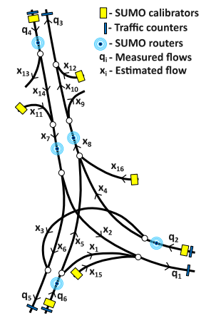
Baseline Methodology
The framework’s baseline methodology is based on the works in [1] and [2], which present a methodological approach for building a Digital Twin for the Geneva Motorway (DT-GM), in Switzerland, in SUMO.
The authors initially sketched a schematic diagram to represent the network structure, denoting each road segment with a variable representing the traffic flow in veh/h.
Then, they extracted the region of interest from OpenStreetMaps, converting it to SUMO format, and used SUMO's NETEDIT module to perform manual adjustments to the network.
[1] Krešimir Kušic, Rene Schumann, and Edouard Ivanjko. «Building a Motorway Digital Twin in SUMO: Real-Time Simulation of Continuous Data Stream from Traffic Counters». In 2022 International Symposium ELMAR, 2022
[2] Krešimir Kušic, René Schumann, and Edouard Ivanjko. «A digital twin in transportation: Real-time synergy of traffic data streams and simulation for virtualizing motorway dynamics», 2023.
Notes:
~42s

Slide 9
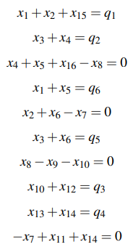
Baseline Methodology
The proposed methodology employs a workaround to the limitation of sensor coverage by estimating the traffic flow between network segments.
For this, the authors begin by establishing a system of linear equations based on the principle of conservation of traffic flow.
Notes:
~36s

Slide 10
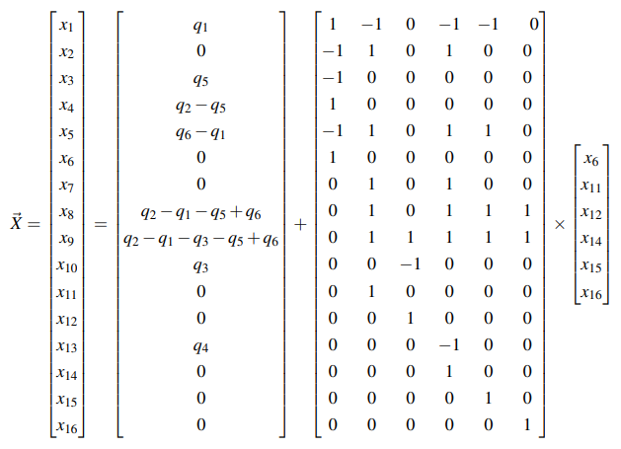

Baseline Methodology
Subsequently, the authors proceed to derive the solution of the linear system of equations, which represents the flow balance’s general solution in the flow model.
In practice, all flows must be non-negative.
Therefore, restriction is added.
This solution resulted in six free variables.
Notes:
~41s

Slide 11
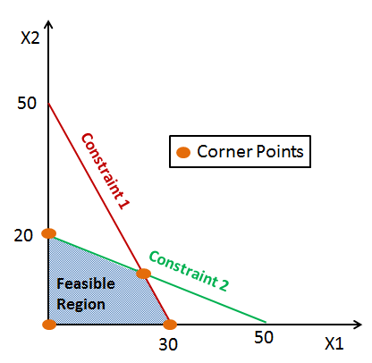
Baseline Methodology
To estimate the values of the six free variables, the authors employ a linear programming approach, which enables searching for feasible solutions using the Simplex algorithm.
More specifically, this methodology defines two steps of the Simplex algorithm.
In the first stage, the restriction is applied, resulting in the definition of the extreme points of the feasible region for the free variables.
The second stage imposes additional restrictions on the range of each free variable based on the intensity level for the corresponding road at each time of the day.
Notes:
~52s

Slide 12
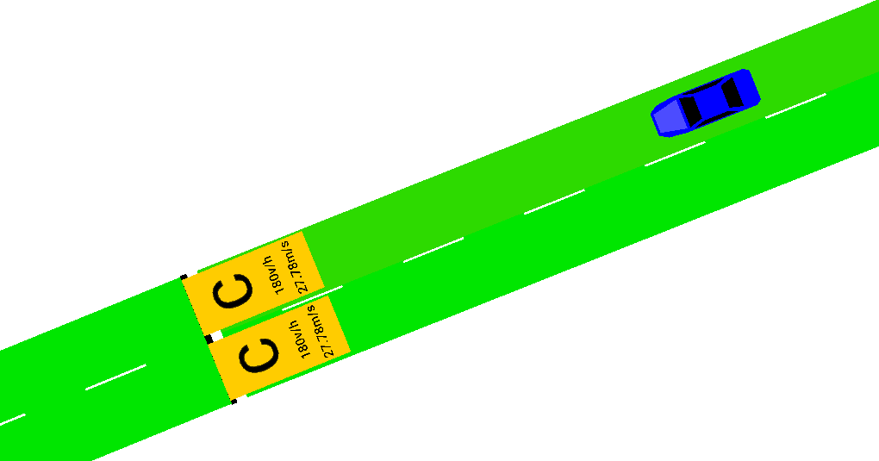
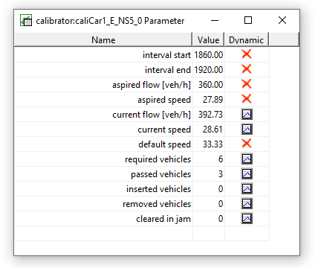
Baseline Methodology
The calculated flows must then be used for the calibration of the model, which is performed using SUMO's calibrator objects.
The authors started by defining some initial uniform vehicle entry flows, which enable the activation of these objects.
The network calibrators are dynamically accessed every minute via TraCI, a SUMO interface that provides access to the simulation at runtime.
Notes:
~46s

Slide 13
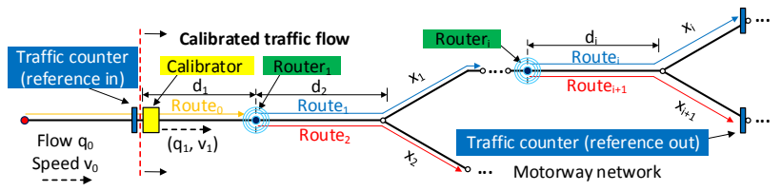
Baseline Methodology
After the calibrator has inserted the appropriate traffic flow, it is necessary to disseminate it across the network, by allocating routes to vehicles.
The distribution of routes is determined probabilistically, reflecting the probability of a vehicle following a given route.
The rerouting mechanism, designated Dynamic Flow Calibrator (DFC), calculates probability distributions based on the flow values ​​calculated in the previous stage, and assigns routes to vehicles that cross a given router according to these probabilities.
Notes:
~56s

Slide 14
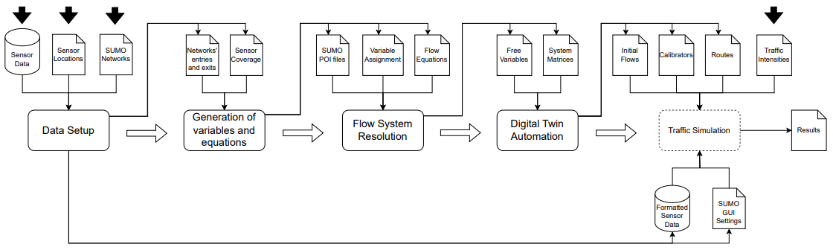
Proposed Framework
The developed framework can be divided into four primary phases:
Notes:
~33s

Slide 15
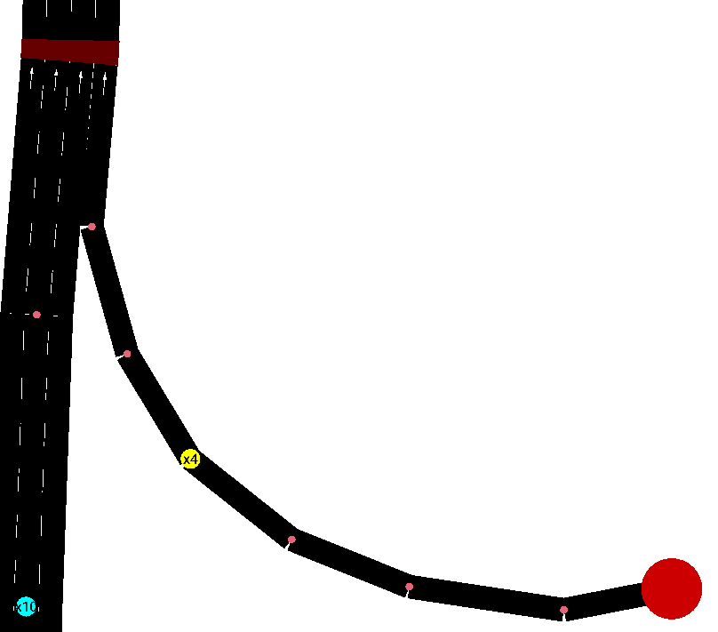
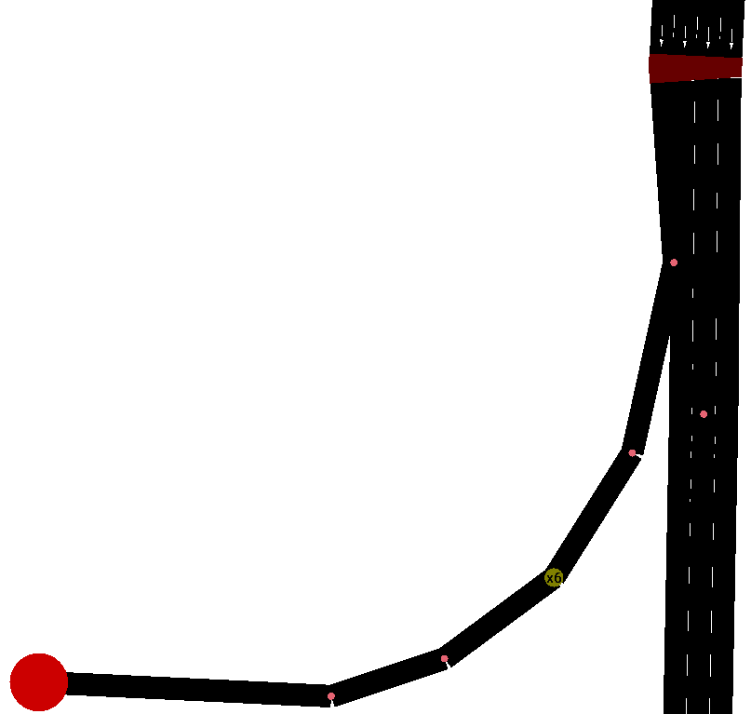
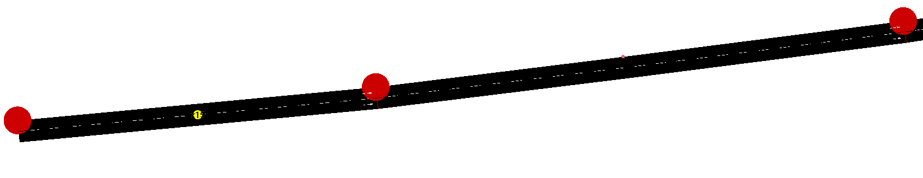
Proposed Framework
Data Setup
In addition to preparing sensor data by grouping vehicle counts into one-minute blocks, the first phase also deals with finding out the coverage of each sensor. This first phase also deals with detecting the network's entries and exits:
If the node has no incoming edges, it is an entry node.
If the node has no outgoing edges, it is an exit node.
Example of a continuation edge
Example of an entry node
Example of an exit node
Notes:
~42s

Slide 16
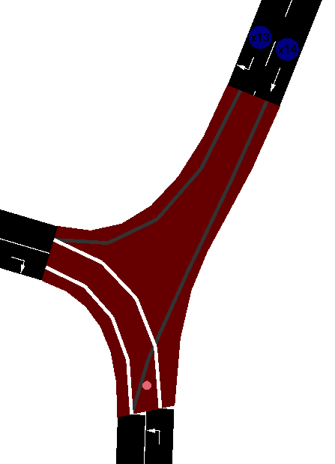
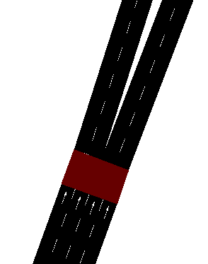
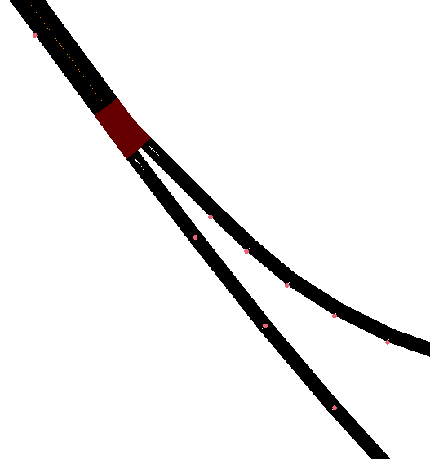
Proposed Framework
Generation of variables and equations
To assign variables to the edges of the network in the second phase, the program begins by generating new variables for the network's entries and exits. Then, a search begins by traversing the network from the entries, finding four possible scenarios:
During this stage, the program also places a router before every split.
continuation edge split | merge complex nodes
Example of a split
Example of a merge
Example of a complex node
Notes:
~1m17s

Slide 17
Proposed Framework
Flow System Resolution
In the third phase, the program generates the augmented matrix of the system of equations, and then converts it to the reduced row-echelon form, through Gaussian elimination operations.
This phase determines the free variables of the system, in addition to the matrices related to the system solution, used to calculate the remaining variables during the simulation.
Notes:
~17s

Slide 18
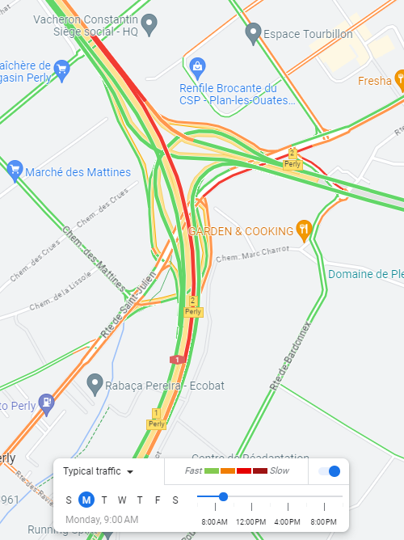
Proposed Framework
Digital Twin Automation
The fourth phase begins by generating the calibrators, the initial flows and the vehicle routes.
The routes of the calibrators, initial flows and vehicles are generated through a depth-first search (DFS).
For the calibrators, this search starts at each calibrator edge, for the initial flows it starts at the edge of the network entry, and for the vehicles it starts at each router edge.
For the three cases, the search ends in two possible scenarios:
It reached a router edge;
It reached a network exit edge.
Finally, the framework executes the Digital Twin, which constantly updates the simulation flows, recording their values ​​every minute.
Notes:
~1m

Slide 19

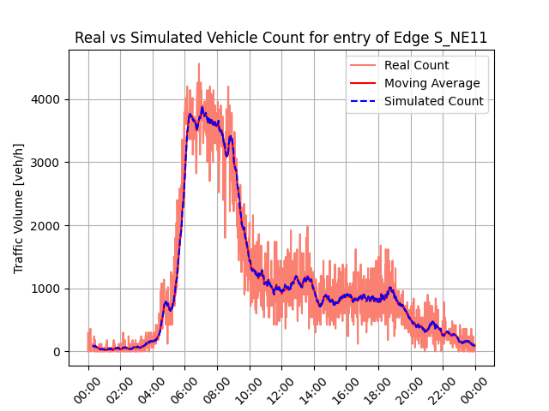
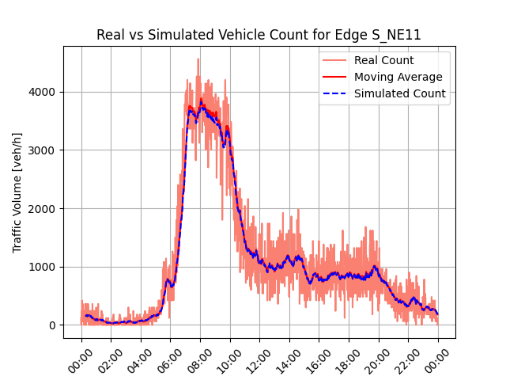

Results and Analysis
Geneva Motorway
Inflow from the southern part of the network ( )
(a) DT-GM Methodology
(b) Framework w/ Google Maps intensities
(c) Framework w/ DT-GM intensities
Notes:
~43s

Slide 20

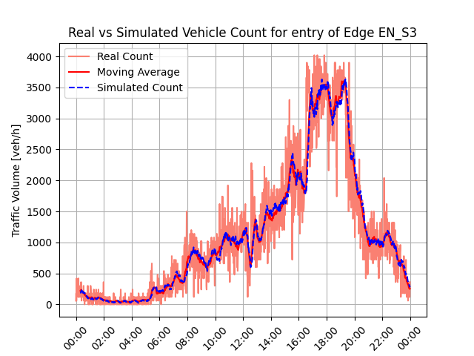
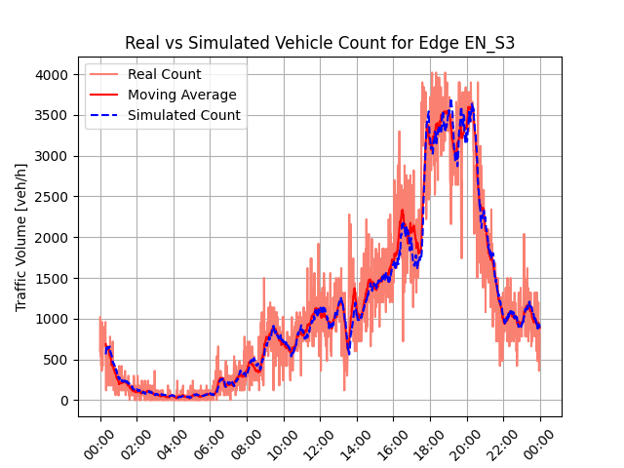

Results and Analysis
Geneva Motorway
Outflow from the southern part of the network ( )
(a) DT-GM Methodology
(b) Framework w/ Google Maps intensities
(c) Framework w/ DT-GM intensities
Notes:
~38s

Slide 21
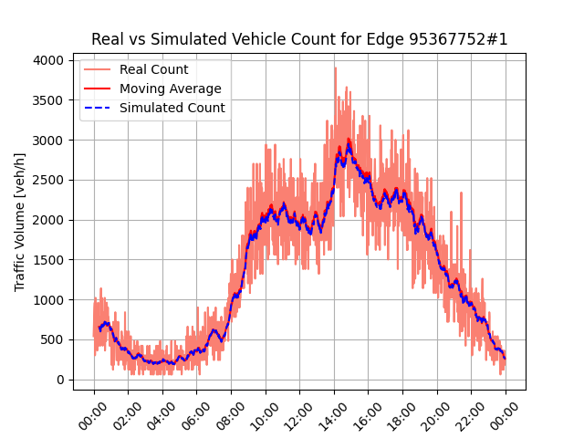
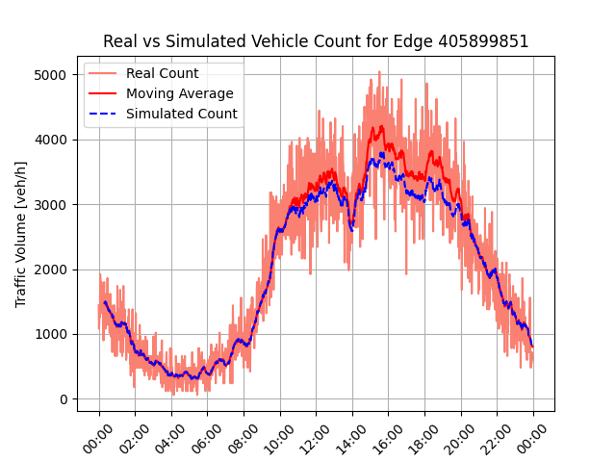
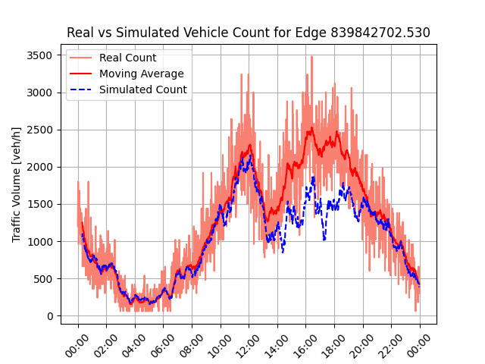
Results and Analysis
VCI’s Nó de Coimbrões
Flows on some entries and exits of the Nó de Coimbrões’ network
(a) Inflow from the eastern
part of the network
(b) Inflow from the western
part of the network
(c) Outflow from the eastern
part of the network
Notes:
~1m24s

Slide 22
Conclusions & Future Work
The results of the framework demonstrated the viability of this approach, allowing reliable traffic replication to be achieved, as long as the initial network adjustment process is adequate.
Regarding future work, it would be interesting to derive multiple instances of a base simulation to explore what-if scenarios, or include traffic prediction.
Furthermore, the framework could be adapted to work with real-time data, as the base methodology has already proven itself capable of doing so.
Finally, it is always relevant to apply the framework to new use cases, to validate its applicability.
Notes:
~42s

