Slide 1
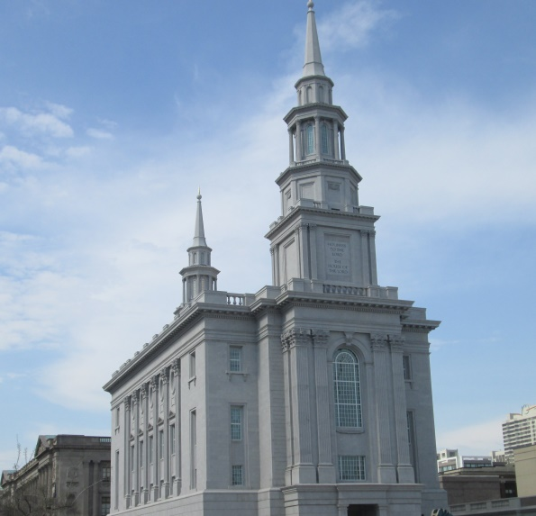
Come and See
Best when viewed in
Slideshow mode
Suggestions on Inviting Everyone to the Philadelphia Temple Open House

Slide 2
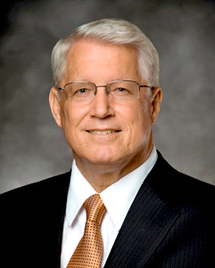
Bishop Dean Davies
Heavenly Help for Our Mortal Journey

Slide 3
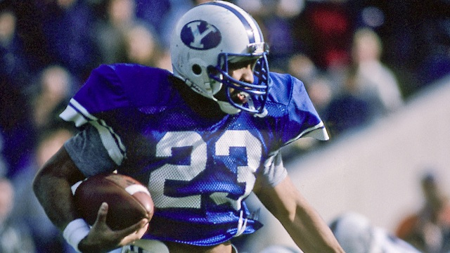
Vai Sikahema

Slide 4
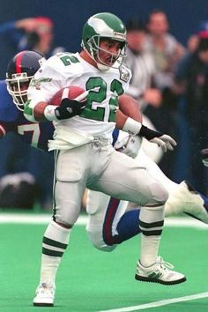

Vai Sikahema

Slide 5
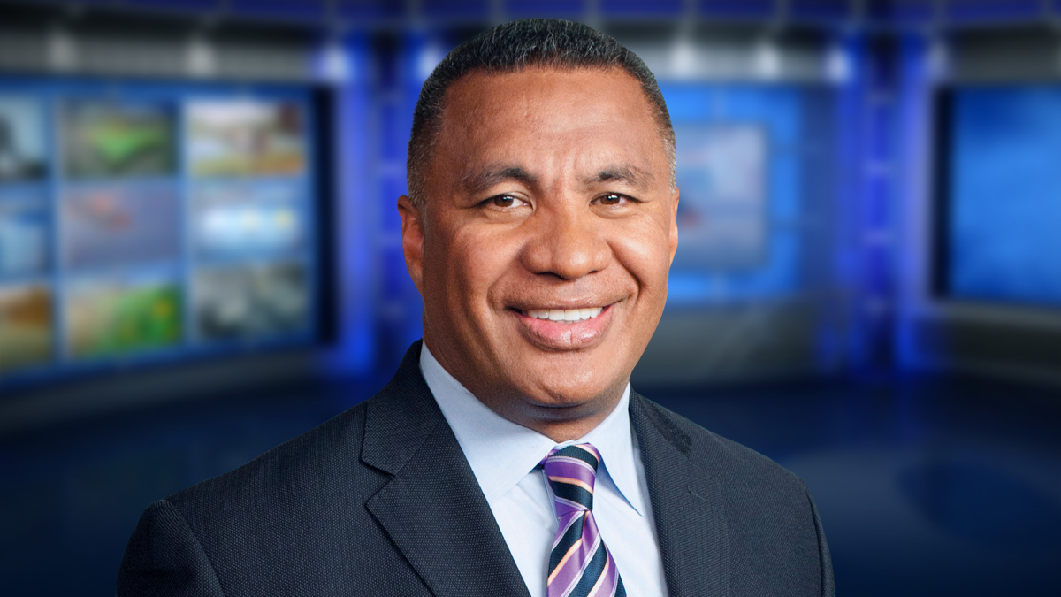
Vai Sikahema

Slide 6
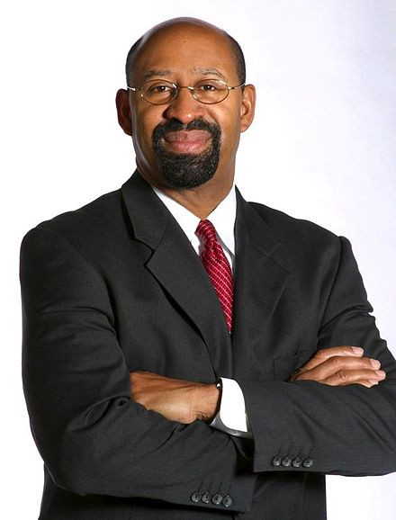
Mayor Michael Nutter

Slide 7
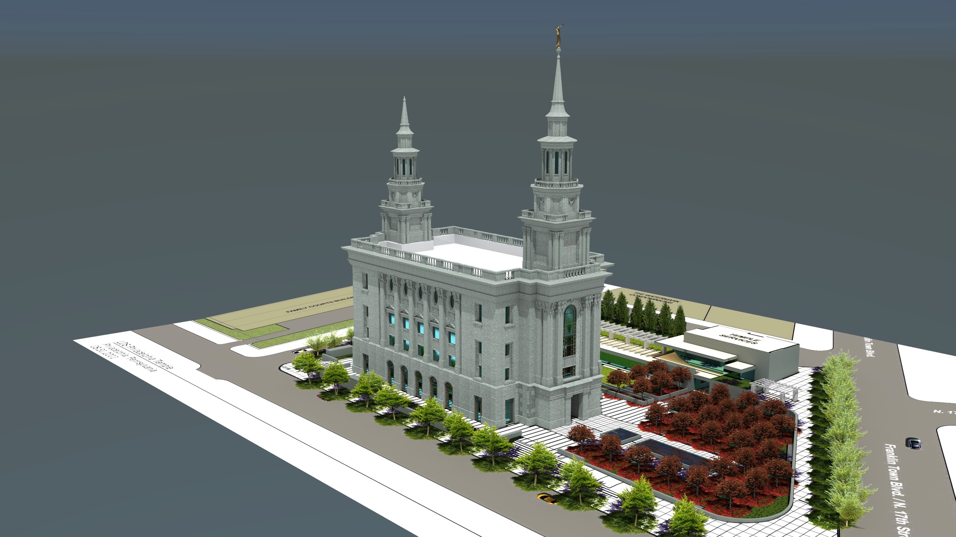
Temple Proposal

Slide 8
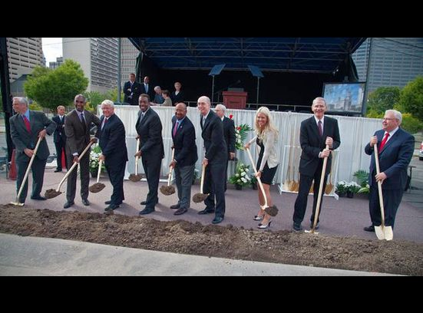
Philadelphia Temple Begins

Slide 9
Agenda
A Model Invitation
Information on the Open House
Member Invitation Cards
Preparing to Invite
Identifying Who to Invite
Suggestions on How to Invite
Answering Questions
Practicing to Invite through Role Playing
The Challenge

Slide 10
A Model Invitation
The day after John the Baptist declared Jesus to be the Lamb of God, Jesus found Philip and extended the invitation to follow Him. Philip accepted that invitation.
He then went looking for his friend, Nathaniel, to share with him the joy he now had. Finding Nathaniel, he testified that he had found Him of whom the prophets had testified would come – Jesus of Nazareth.
We all know of Nathaniel’s next question, “Can there any good thing come out of Nazareth?” What we don’t know is what was behind Nathaniel’ question. But, Philip’s kind response was warmly inviting. He simply said, “Come and see.”
Nathaniel accepted that invitation and had an experience that increased his faith and changed his life.

Slide 11
Information About the Open House
Wednesday, August 10 through Friday, September 9
Mondays: 8:00am – 5:00pm
Tuesdays thru Saturdays: 8:00am – 8:00pm
No Tours on Sundays

Slide 12
Information About the Open House
Tour Description:
The tours will begin in the new meetinghouse next to the temple
Visitors will be shown a brief video providing an explanation of the purpose of temples
Small groups will then enter the temple and be guided through the rooms on all four floors
A brief explanation of the purpose of specific rooms will be given by a tour guide
At the end of the guided tour, there will be sister missionaries available in a reception area to answer questions anyone may have
Visitors are welcome to fill out a comment card, if they wish
There is also a reception area and roof top garden where they can take pictures with the temple behind them
Visitors will learn of our faith in Christ and eternal nature of families
Tours will be available in Spanish as well as other languages

Slide 13
Information About the Open House
Tours should take approximately 45 minutes
A tour will begin about every 5 minutes
Parking is limited. The Member Invitation Cards will have a map with nearby parking lots identified
Use of public transportation is strongly recommended. SEPTA’s Suburban Station is closest
Carpooling is also strongly recommended if visitors do not wish to use public transportation
Visitors should go to the website on the Member Invitation Card to obtain free tickets
Registration is strongly recommended
Walk-ins are possible, but there may a longer wait for those who do not register in advance

Slide 14
Member Invitation Cards
Invitations have been sent to the stake presidents for distribution to members
English and Spanish versions will be available
Electronic versions will also be available

Slide 15
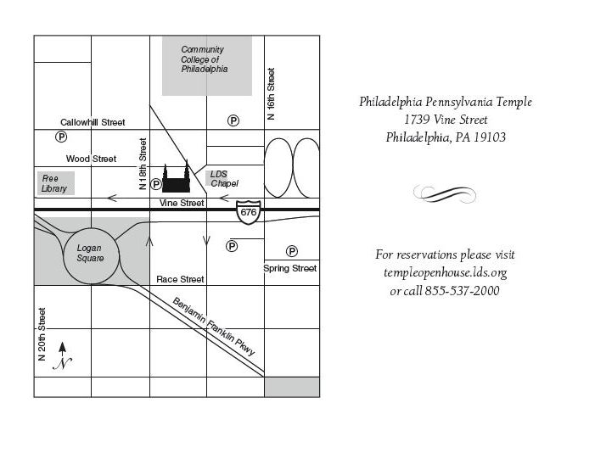
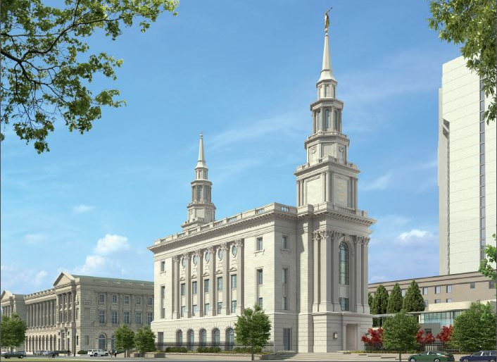
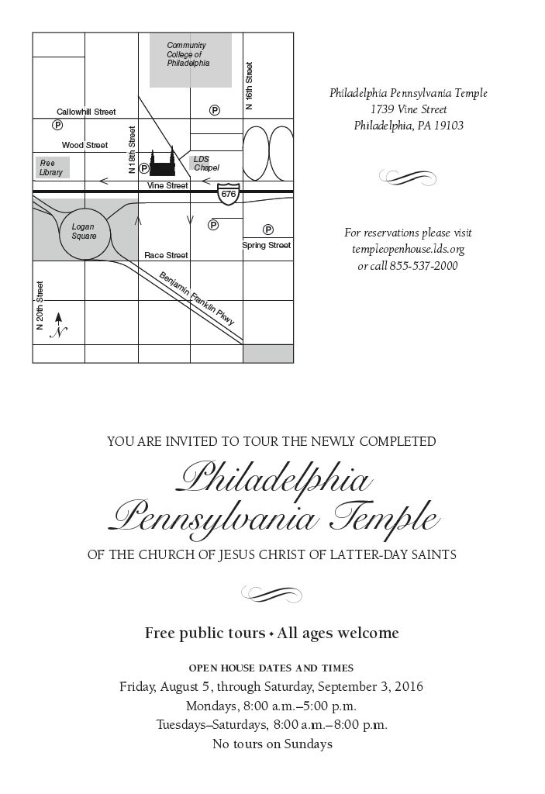
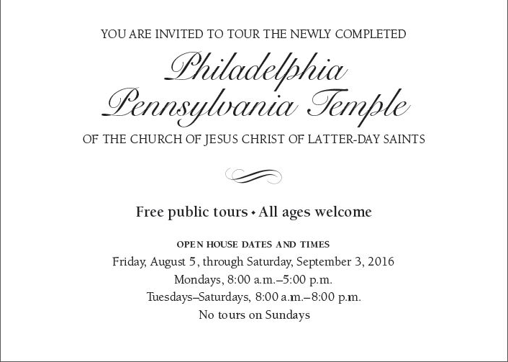
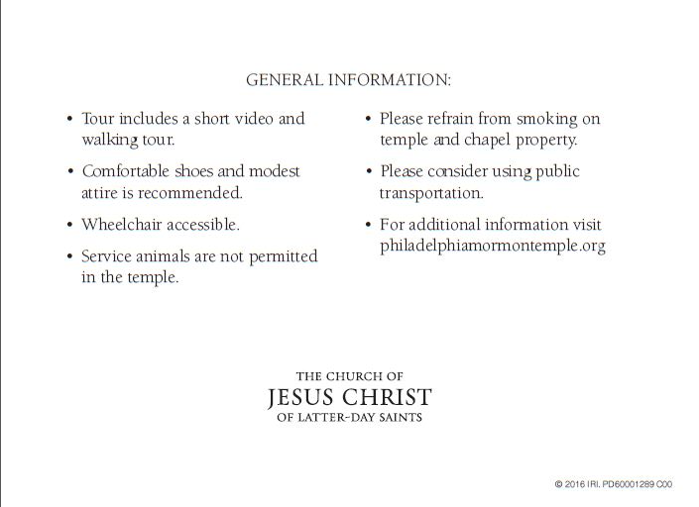
Member Invitation Cards
Wednesday, August 10 through Friday, September 9

Slide 16
Preparing to Invite
Remember:
You’re just asking if they would like to visit the Temple
They are your friends
But, if you need a little help
There is no fear in love; but perfect love casteth out fear (1 John 4:18)
But this is not all; they had given themselves to much prayer, and fasting; therefore they had the spirit of prophecy, and the spirit of revelation, and when they taught, they taught with power and authority of God (Alma 17:3)

Slide 17
Identifying Whom to Invite
This invitation should not be limited to those who you think are be ready for baptism!
The Open House is not a proselyting activity
It is just a chance for your friends to feel the spirit of the Temple
Make a list of people you would like to invite:
Families you home/visit teach, neighbors, friends, family, coworkers, doctors and dentists, anyone you have already talked to about the temple or the Church
Groups, such as local genealogy/historical centers
Talk with your family around the dinner table or in Family Home Evenings about who you should invite
When someone’s name comes to mind, write it down!

Slide 18
Suggestions on How to Invite
IN PERSON OR OVER THE PHONE
Always have Member Invitations Cards with you
Know the dates of the Open House
Create opportunities to invite someone, or look for opportunities that present themselves
Invite a friend to lunch
Talk to your neighbor “over the backyard fence”
Talk with friends between classes or on the bus stop
Chat with someone during a break at work
Schedule special visiting/home teaching visits - don’t assume active members will automatically go
Make a special phone call to a friend
Post a Member Invitation Card where it can be seen

Slide 19
Suggestions on How to Invite
IN PERSON OR OVER THE PHONE
Start the invitation with things like:
“Have you ever wondered what Mormon temples look like inside or what their purpose is?”
“Did you know that my Church is building a new temple in Philadelphia? Here is a picture of it.”
“My Church is holding an open house for the new temple we are building in Philadelphia, and I’ve been thinking about who I would like to invite.”
“Do you know why Mormons are so interested in genealogy?”
“I see you are interested in genealogy. Do you know what Mormons believe about our ancestors?”

Slide 20
Suggestions on How to Invite
IN PERSON OR OVER THE PHONE
Give a little more information like:
“Temples are very special and sacred to Mormons.”
“Temples are very meaningful to me and I’d like to share a unique opportunity with you.”
“The Church is holding an open house where you can tour the temple for free.”
Extend the invitation with things like:
“Here is an invitation card with information on the Temple Open House.”
“As my friend, would you like to come with me and get a tour of the inside?”

Slide 21
Suggestions on How to Invite
VIA EMAIL OR TEXT
Make emails personal…avoid mass emails. Personal invitations will more likely be accepted.
Include in your email comments as if you were talking to them in person
start the invitation
give a little more information
extend the invitation
Keep the invitation short and simple
Include an electronic version of the Member Invitation Card
Include the link to the website where they can reserve their free tickets

Slide 22
Suggestions on How to Invite
VIA SOCIAL MEDIA
Facebook
Like the Philadelphia Mormon Temple Facebook page: https://www.facebook.com/philadelphiamormontemple
Share posts from the page on your own personal page
Twitter
Consider following @PhillyLDSTemple and re-tweeting events
Instagram
Consider doing the same: PhillyLDSTemple

Slide 23
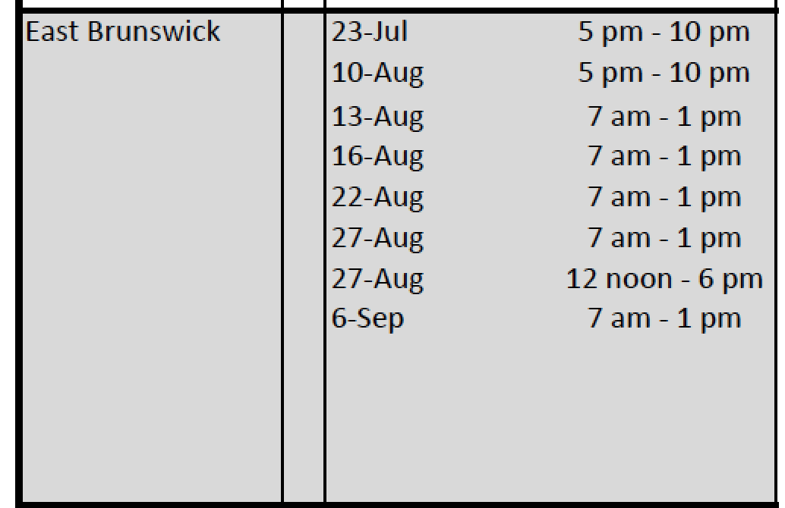
Volunteer Sign-up

Slide 24
Suggestions on How to Invite
VIA SOCIAL MEDIA
Take pictures of your loved ones, church auxiliary groups, home and visiting teaching families, or youth groups by the temple and post them online—use the #PhillyLDSTemple
Include simple comments about your love of the temple and its beauty
Be careful how you respond to questions because many – all at different levels of understanding - will read your answers.
Keep answers and comments simple, kind, and respectful

Slide 25
Answering Questions
Listen to the promptings of the Spirit
Keep answers simple
Remember not to share things too sacred to discuss outside of the temple
Speak in tones reflective of the sacredness of Temples
Emphasize that we worship the Savior in the Temples
Many questions are answered by the Member Invitation Cards. Be sure you have one with you
Don’t be afraid to say “I don’t know” if you can’t answer a question

Slide 26
Answering Questions
Remember:
We are trying to reach those who are not members of our church. We want messages about the temple to be easily accessible and relevant to everyone.
Please avoid the use of church jargon that may not be understood.

Slide 27
Answering Questions
INSTEAD OF:
PERHAPS SAY:
Ward
Stake
Ordinance
Covenant
Endowment
Testimony
Baptisms for the dead
Sealing
Worthy members
Temple Recommend
Congregation
Region
Religious ceremony or sacred rite
Promise or commitment
Religious ceremony, sacred rite, instruction
Personal conviction
Special ceremonies on behalf of our ancestors
Religious ceremony binding a couple and families forever
Church members who are actively engaged in the faith
Authorization by Church leaders that one is able to enter the temple

Slide 28
Answering Questions
Click on a Question to discuss possible answers:
What are Mormon or LDS temples?
What is the difference between a temple and an ordinary church building?
What goes on inside LDS or Mormon temples?
Why is family so important to Mormons?
Do Mormons believe that families will live together in heaven?
Why do Mormons perform baptisms for the dead?

Slide 29
Answering Questions
Click on a Question to discuss possible answers
What does it mean to “dedicate” a temple?
After the temple is dedicated, why can’t people who are not Mormons go inside?
Why are only some Mormons allowed into temples?
What is it like inside the temple?
Is the Philadelphia Temple just like the Salt Lake Temple or the Washington DC Temple?
Will missionaries start contacting me if I go to the Open House?

Slide 30
Practicing through Role Playing
Role playing can be an excellent way to prepare and overcome any hesitancy to invite someone to the Open House.
Who would like to come up and role play extending an invitation and answering questions?

Slide 31

The Challenge: Wouldn’t it be wonderful if 150,000 of heavenly father’s children attended the Philadelphia Temple Open House?
WHAT CAN we DO TO HELP Make THAT HAPPEN?

Slide 32
Go Forth and Invite!

Slide 33
Questions and Suggested Answers

Slide 34

How Would You Answer….
What are Mormon or LDS temples?
Temples are sacred places where members of the LDS Church can pray and commune with their Father in Heaven. Temples are quiet, sacred and an integral part of the LDS faith, providing members the opportunity to participate in religious ceremonies, such as marriages and baptisms.
Click to Return to Questions

Slide 35
How Would You Answer….
What is the difference between a temple and an ordinary church building?
Attending Church on Sundays is similar to attending church in other Christian religions. Church meetinghouses are open to all, and everyone is welcome to attend. There, we worship Jesus Christ together in what is called a sacrament meeting. That is followed by various classes of instruction. During the week, other Church activities are held there, such as neighborhood dinners, youth activities, or even a community blood drive.
Temples, which are closed on Sundays, are used only for sacred ceremonies that bless individuals and bind families together for eternity. During the week, they typically open early in the morning and quietly operate throughout the day.
Click to Return to Questions

Slide 36
How Would You Answer….
What goes on inside LDS or Mormon temples?
In temples, members are taught about Jesus Christ and the purpose of life. In the temple we learn where we came from, the creation of the Earth, and what is possible for us after we die. We also make sacred promises to follow the Savior. Sacred ceremonies or rites are performed to bind husband, wife, and children together as families forever. These ceremonies are also performed by members on behalf of their deceased ancestors who did not have the opportunity while they lived on the earth to make these promises.
Click to Return to Questions

Slide 37
How Would You Answer….
Why is family so important to Mormons?
We believe that the family is ordained of God. Happiness in family life is most likely to be achieved when founded upon the teachings of the Lord Jesus Christ.
Click to Return to Questions

Slide 38
How Would You Answer….
Do Mormons believe that families will live together in heaven?
Yes! We believe the sealing power that the Lord gave to Peter in the New Testament is held by leaders in the Church today. Thus, we believe that if a man and woman have their marriage “sealed” in a temple and keep their promises to each other and to the Lord, their marriage will not end at death, but will continue throughout the eternities. Children can also be sealed to their parents and the family can be together forever.
Click to Return to Questions

Slide 39
How Would You Answer….
Why do Mormons perform baptisms for the dead?
Jesus taught that baptism is essential to enter the Kingdom of God. Many have lived and died without the opportunity to hear the gospel of Jesus Christ. We believe they are being taught the gospel while they wait to be resurrected. We perform baptisms on their behalf so that, if they accept the gospel, they will have received the ordinance of baptism. If they choose not to accept the gospel, we have still provided a sacred service of love to those individuals who have gone before us.
This is why the Church is so interested in Genealogy and Family History.
Click to Return to Questions

Slide 40
How Would You Answer….
What does it mean to “dedicate” a temple?
The dedication of a temple, in a real way, gives the building to the Lord. The temple becomes the house of the Lord. A dedication is a simple meeting where talks are given, hymns are sung, and a prayer is offered to dedicate the temple to the Lord.
Click to Return to Questions

Slide 41
How Would You Answer….
After the temple is dedicated, why can’t people who are not Mormons go inside?
Since a dedicated temple is considered the House of the Lord, it should not seem strange that the temples are held sacred and only those who have prepared themselves through baptism into the LDS Church and live according to the teachings of the Church should be able to enter such a special place.
But, before a temple is dedicated, an open house is held for the general public (typically for several weeks). The Open House for the Philadelphia Temple is August 10 through September 9. During the open house, public tours are provided so the public can see the inside of a temple. Brief explanations of the purpose of the various rooms in the temple will be given.
COME AND SEE!
Click to Return to Questions

Slide 42
How Would You Answer….
Why are only some Mormons allowed into temples?
Much like algebra is needed to understand calculus, members of the Church must have enough time in the Church to learn the basics of the doctrine of the Church so they will better understand what is being taught in the temple. We hold the ceremonies of the temple so sacred that only those who are living the standards of the Church are able to enter. And because these things are sacred, we do not talk about them in detail outside of the temple.
Click to Return to Questions

Slide 43
How Would You Answer….
What is it like inside the temple?
Many people are under the impression that the interior of a Latter-day Saint temple is like a great hall or cathedral. Actually, temples are made up of numerous smaller rooms designed to accommodate ceremonies such as marriages and baptisms, small gatherings for instruction, as well as personal reflection and contemplation. Inside the temple, Church members change into simple and modest white clothing before taking part in temple ceremonies. The white temple clothing symbolizes purity and reverence.
COME AND SEE!
Click to Return to Questions

Slide 44
How Would You Answer….
Is the Philadelphia Temple just like the Salt Lake Temple or the Washington DC Temple?
We do the same things as in the Salt Lake or Washington temples, but the interior decorations and design are different. The Philadelphia temple was designed to reflect the architecture and history of the City of Philadelphia.
Click to Return to Questions

Slide 45
How Would You Answer….
Will missionaries start contacting me if I go to the Open House?
No. We are simply inviting our friends to see the inside of the Temple. No one will ask you for your name or contact information. You may leave a comment card if you wish, but you do not need to include your name.
Click to Return to Questions

