Slide 1
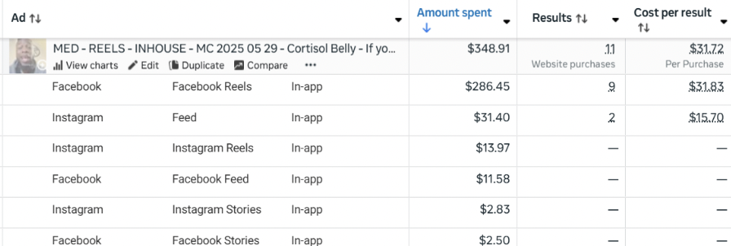
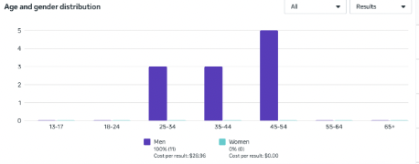
YOUR TITLE HERE - Replace with your actual title
Date Created - Month Day, Year
AA1
FB Link
IG Link

