Slide 1
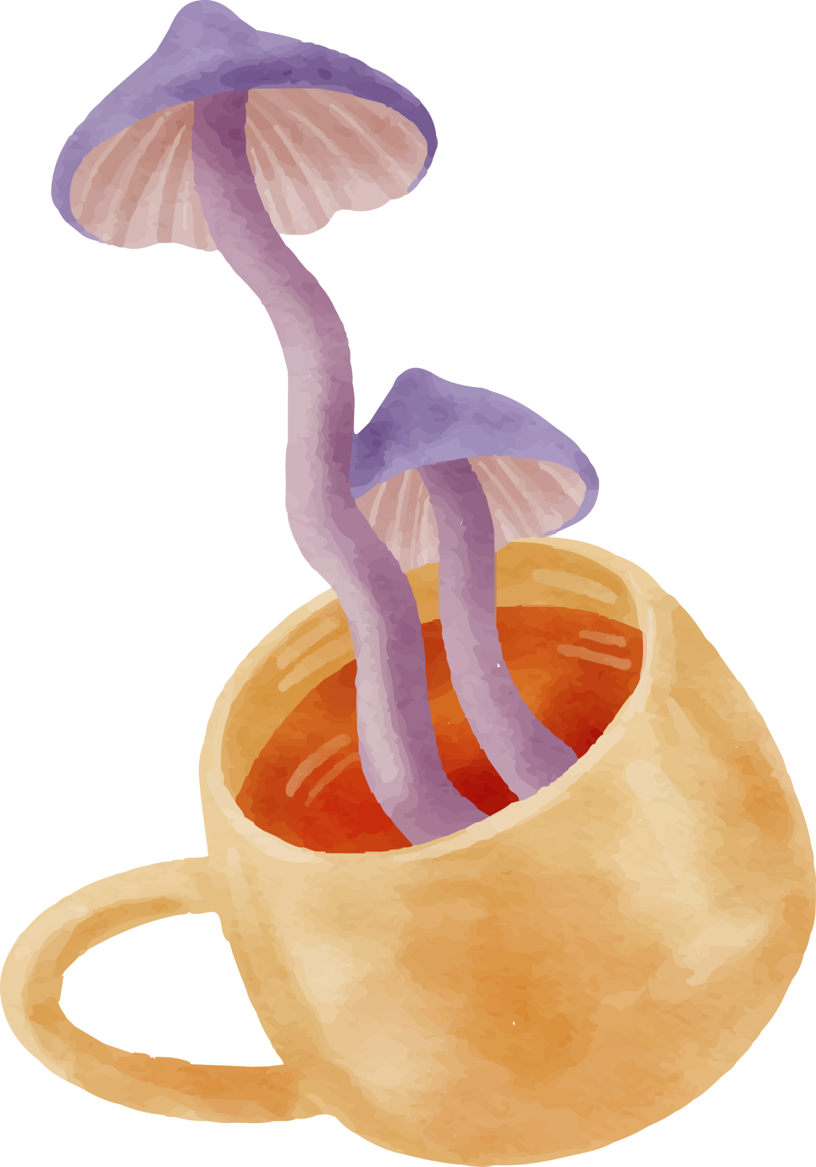


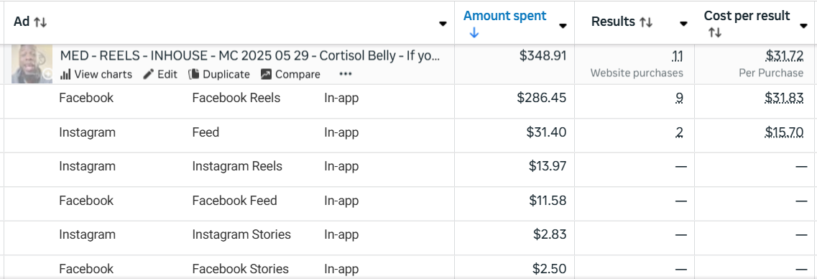
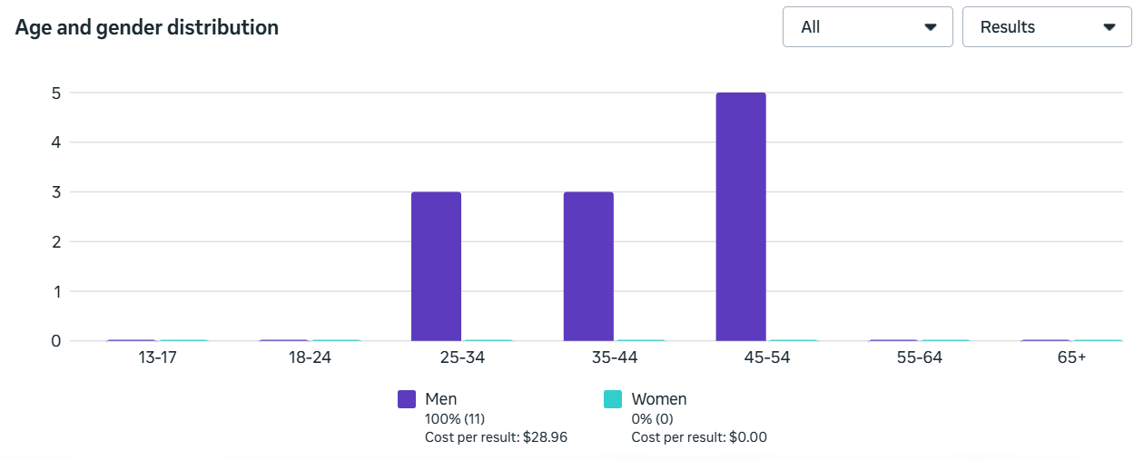

MED - REELS - INHOUSE - MC 2025 05 29 - Cortisol Belly - If you have alcohol belly, just stop drinking alcohol. - AIRIDAS/NENAD - CHARLES - Rron
Spend - $348.91 67.7%
CAC (Hyros Scientific) - $58.15
CAC (Hyros Last Click) - $43.61
CAC (Clicks Only - Northbeam) - $57.58 (86.2%)
CAC (Last non-direct touch - Northbeam) - $43.61 (∞%)
New Visits ( Northbeam) - 51.23% (20.4%)
ECR (Northbeam) - 3.74% 603.2%
Date Created - Jul 2, 2025
AA1
FB Link
IG Link

