Slide 1

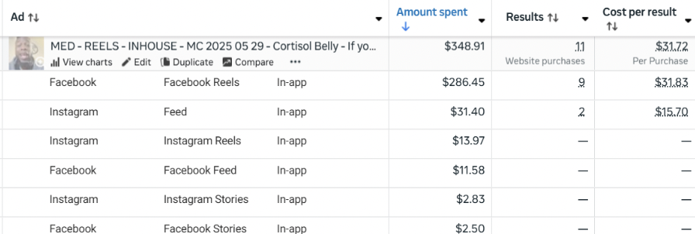
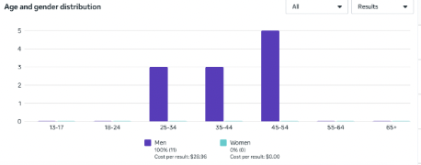
Sample Campaign 1
Spend - $348.91 CAC (Hyros Scientific) - $58.15 CAC (Hyros Last Click) - $43.61 CAC (Clicks Only - Northbeam) - $57.58 CAC (Last non-direct touch - Northbeam) - $43.61 New Visits (Northbeam) - 51.23% ECR (Northbeam) - 3.74% Date Created - Jul 2, 2025
AA1
FB Link IG Link

Slide 2
Sample Campaign 2
Spend - $250.00 CAC (Hyros Scientific) - $45.20 CAC (Hyros Last Click) - $38.50 CAC (Clicks Only - Northbeam) - $52.30 CAC (Last non-direct touch - Northbeam) - $40.10 New Visits (Northbeam) - 48.75% ECR (Northbeam) - 4.20% Date Created - Jul 3, 2025
AA2
FB Link IG Link

