Slide 1
Equilibrium Optimization (EO) Algorithm
(Paul) Peng Jianhong
UID: 3035906980

Slide 2
History & Overview
Meta-heuristic search
Physics Inspired
Swarm Intelligence (SI)
Evolutionary Algorithm (EA)
PSO, ACO, Bee Colony, Whale Optimizer
GA, ES
Simulated Annealing, Equilibrium Optimizer
Human behavior inspired
Imperalist Competitive Algorithm (ICA)
Published in 2019 by teams from Illinois Institute of Technology and Torrens University
Inspired by physics – control volume mass balance models
Outperforms most algorithms like GA/PSO by 60-90% using Friedman Test
Search Paradigm​ | Stochastic​
Programing Paradigm​ | Non-linear programming​
Search fashion​ | ​Population-based

Slide 3


Inspiration
Mass (material) balance in physics
Rate of change = flow rate x (equilibrium concentration – current concentration) + generation rate
Integrate over time t and solve for C:
Where:
λ = Q / V (turnover rate)
F = e ^ ( − λ(t − t0))
Similar to a combination of GA and PSO

Slide 4

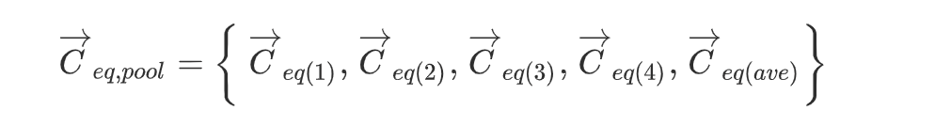
EO Algorithm - initialization
Initialize population of size N:
Where:
Cmin and Cmax are the min and max possible value of the search space
Rand is a random vector in [0, 1]
Equilibrium candidates
Select the 4 best candidates so far, plus the mean of all best candidates
"Concentrations" C are encodings of solutions

Slide 5
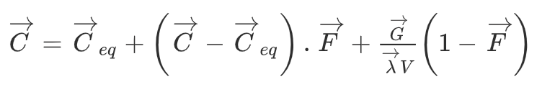
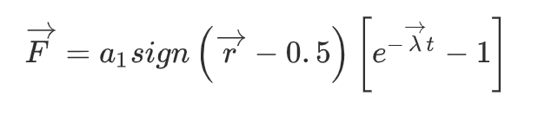
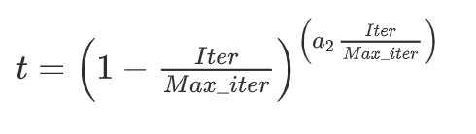
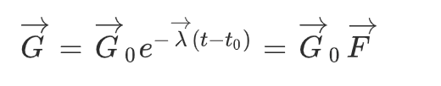
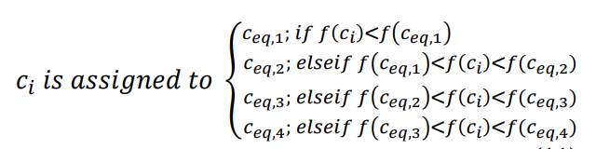
EO Algorithm – update sequence
Calculate new concentration
F: direction decided randomly; value controlled by lambda and decayed
G: decayed overtime to help with convergence
Update equilibrium (can be maintained in a priority queue)

Slide 6
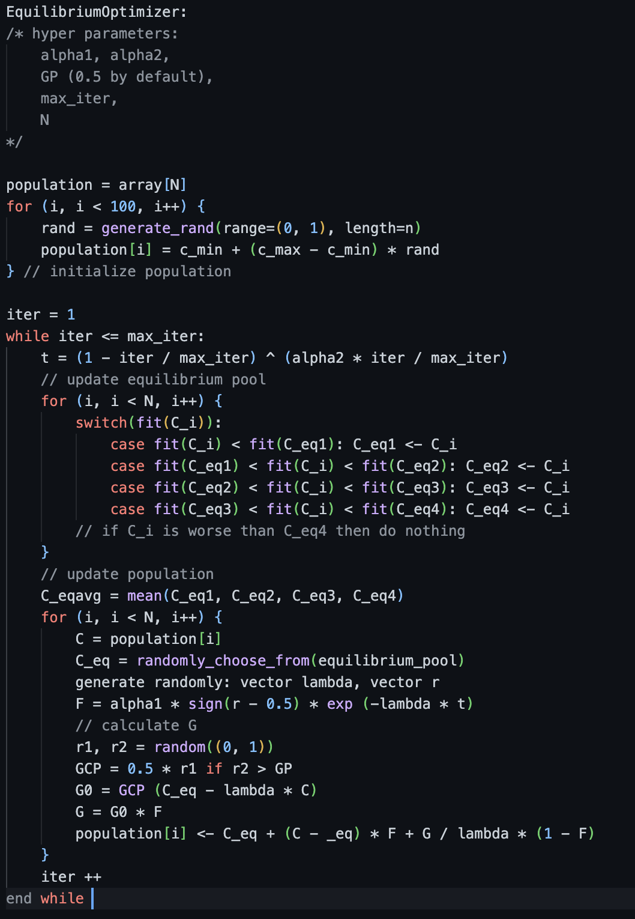
EO Algorithm – Pseudo code

Slide 7
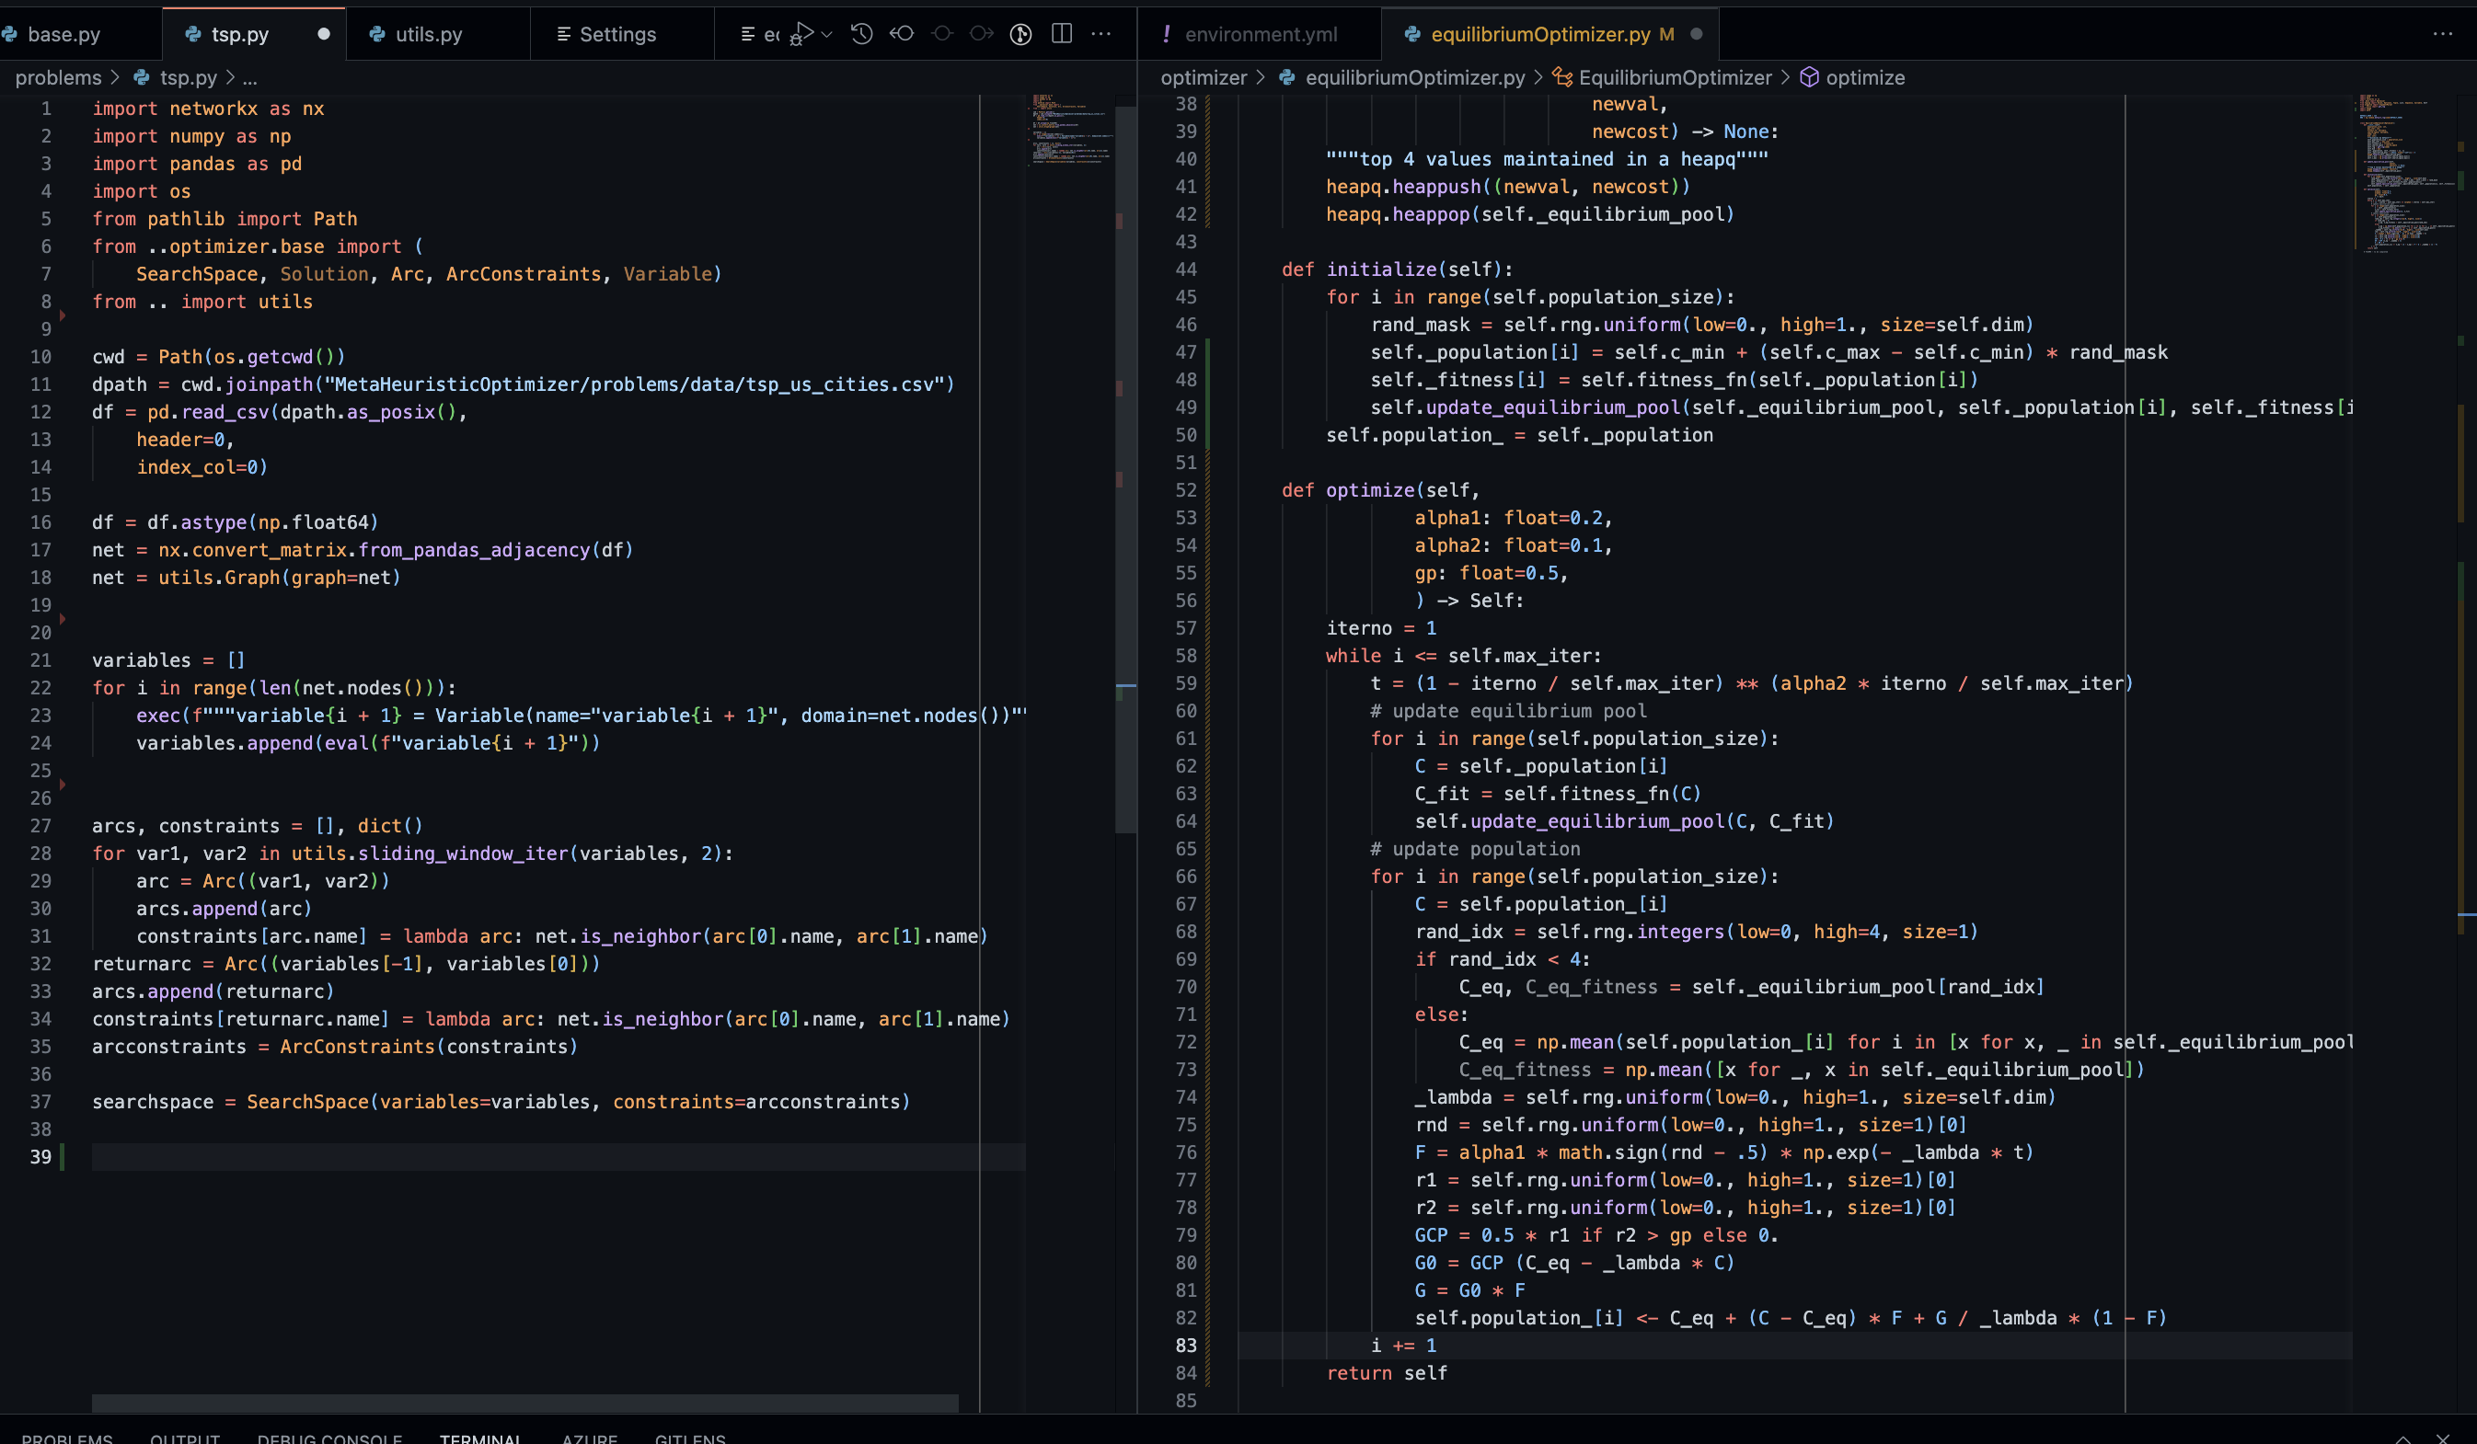
Implementation
TSP
Encoding: Use the ranking of elements to encode sequence into vector
My implementation in python:
https://github.com/pauljhp/MetaHeuristicOptimizer

Slide 8
Computational Complexity
Time complexity:
Two main loops inside each iteration
O(EO) = O(mnd + mcn)
M – number of iterations
N: size of population
D: dimention of problem
C: cost of fitness function
For TSP, cost of fineness function is of O(d)
- O(EO) = O(mnd)
Space complexity:
Only the current population and equilibrium are kept in memory
O(EO) = O(nd)
Notes:
Similar to PSO and GA

Slide 9
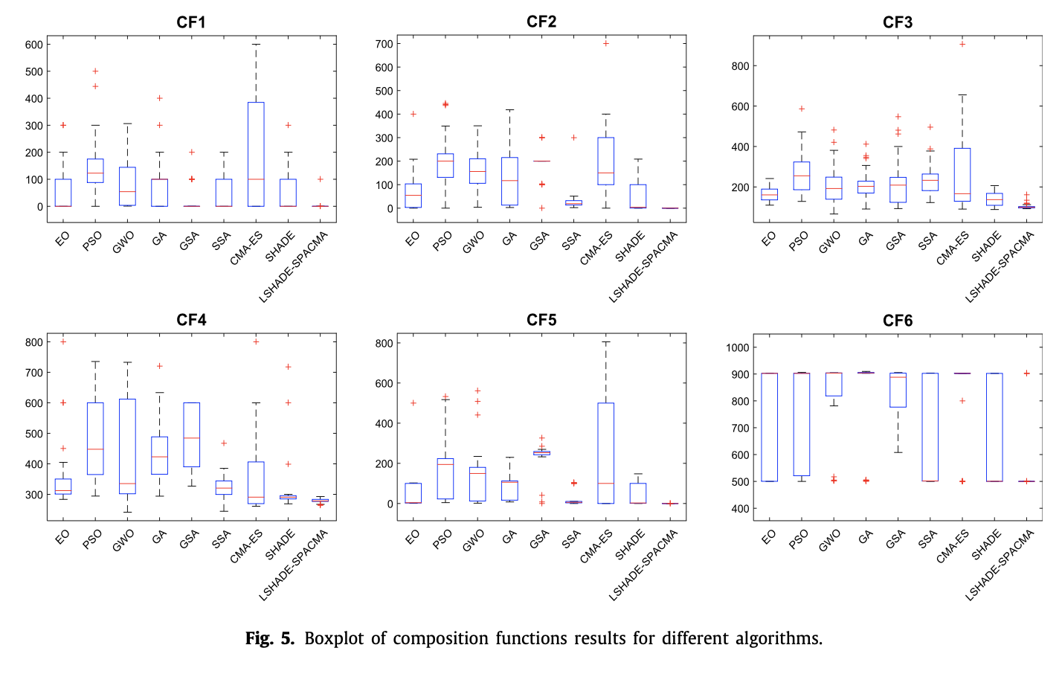
Performance

Slide 10
Adaptation & Application
Applications
Energy flow
Power system distribution
Further development:
Binary EO (A Faramarzi et al)
Multi-strategy EO (Y Li et al)

Slide 11
Summary
EO is a relatively new, physics inspired optimizer
Similar time complexity with GA and PSO, better/more stable performance due to memory saving feature from the equilibrium pool
Balances exploration and exploitation:
Saving best-so-far candidates makes sure the candidate pool doesn’t get worse
Random selection from the pool and existence of average vector helps with exploration
Future work:
Hyper parameter tuning
Population update procedure
Questions?

Slide 12
Reference
https://www.sciencedirect.com/science/article/pii/S0950705119305295
https://www.sciencedirect.com/science/article/abs/pii/S0378778822006740
https://journals.plos.org/plosone/article?id=10.1371/journal.pone.0276210
https://ieeexplore.ieee.org/document/1501604 (composition test function)
https://inass.org/wp-content/uploads/2021/08/2021103105.pdf

