Slide 1

Data-based modeling of slug flow crystallization with uncertainty quantification

Slide 2
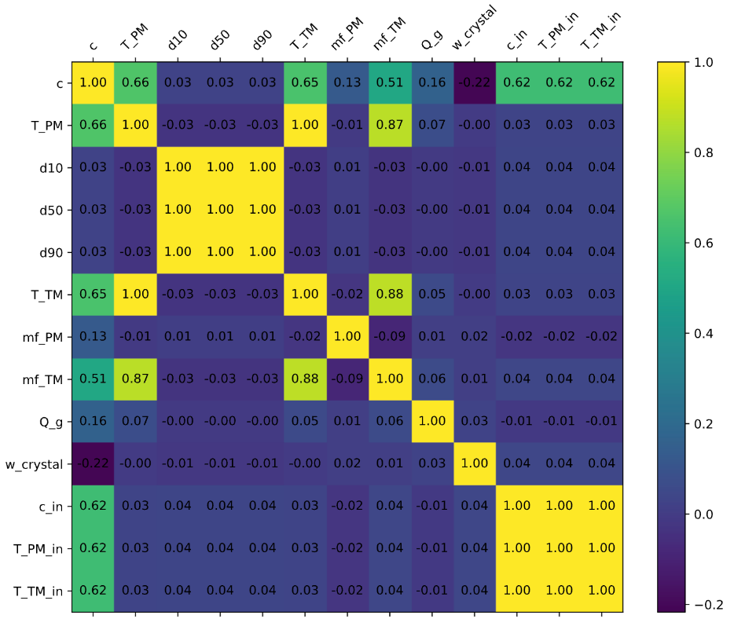
Loading, Analyzing and Visualizing the Data
All data files are loaded and merged into one data frame
Cleaning the data and assigning a unique trajectory IDs
Generating histograms and boxplots
Creating correlation matrix
→ ideal positive correlation
→ ideal negative correlation
→ no correlation
Create pairwise scatter plot between all features
$$1$$
$$−1$$
$$0$$

Slide 3
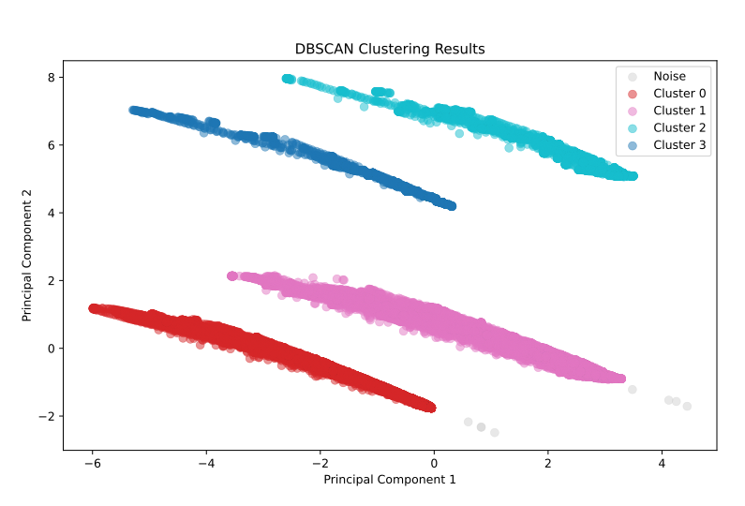
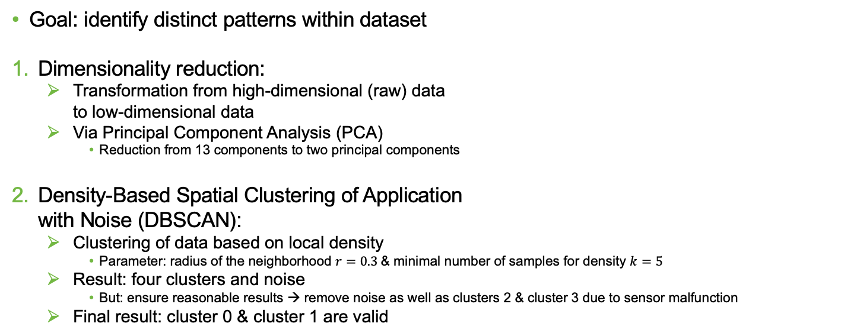
Clustering
Goal: identify distinct patterns within dataset
Dimensionality reduction:
Transformation from high-dimensional (raw) data to low-dimensional data
Via Principal Component Analysis (PCA)
Reduction from 13 components to two principal components
Density-Based Spatial Clustering of Application with Noise (DBSCAN):
Clustering of data based on local density
Parameter: radius of the neighborhood $r=0.3$& minimal number of samples for density $k=5$
Result: four clusters and noise
But: ensure reasonable results → remove noise as well as clusters 2 & cluster 3 due to sensor malfunction
Final result: cluster 0 & cluster 1 are valid

Slide 4

Data Splitting
Cluster -1 (Noise)
Cluster 0
Cluster 1
Cluster 2
Cluster 3
Only consider valid clusters
No random sample selection, due to temporal dependencies from lagged input windows
Splitting at trajectory level
Prevents information leakage from overlapping time steps
Cluster-wise splitting
Ensures generalization across different behavioral modes
Don’t use the first $lag−1$ values per trajectory
Avoids the use of incomplete data points
Avoid incorrect connections between the trajectories
Cluster 0
70 % train
Cluster 0
20 % val
Cluster 0
10 % train
Cluster 1
70 % train
Cluster 1
20 % val
Cluster 1
10 % test
70 % training data
20 % validation data
10 % testing data

Slide 5



Nonlinear AutoRegressive with eXogenous Inputs (NARX) Model
Architecture:
Flexible feedforward neural network
Variable number of hidden layers & neurons
Includes configurable dropout for regularization
Configurable:
Activation function
Learning rate
Batch size
Epochs
Training:
Adam optimizer
MSE Loss
Output layer with six neurons
Hyperparameter Optimization:
Bayesian optimization
50 trails to minimize MSE on validation set
$$\left[y_{k−lag},…,y_{k−1},y_{k}\right]$$
NARX
Model
$${\hat{y}}_{k+1}$$
$$\left[u_{k−lag},…,u_{k−1},u_{k}\right]$$

Slide 6



Optimized NARX Model
65 neurons
64 neurons
6 neurons
Optimized Hyperparameters:
$lag=5$ → 65 input neurons
One hidden layer with 64 neurons
Dropout $d={5⋅10}^{−5}$
Learning rate $lr=7⋅{10}^{−5}$
Activation: ReLU
60 epochs
Batch size $b=16$
Initial MSE of 0.0329 Final MSE of 0.0028 → improvement of 91.48 %
$$⋮$$
$$⋮$$

Slide 7
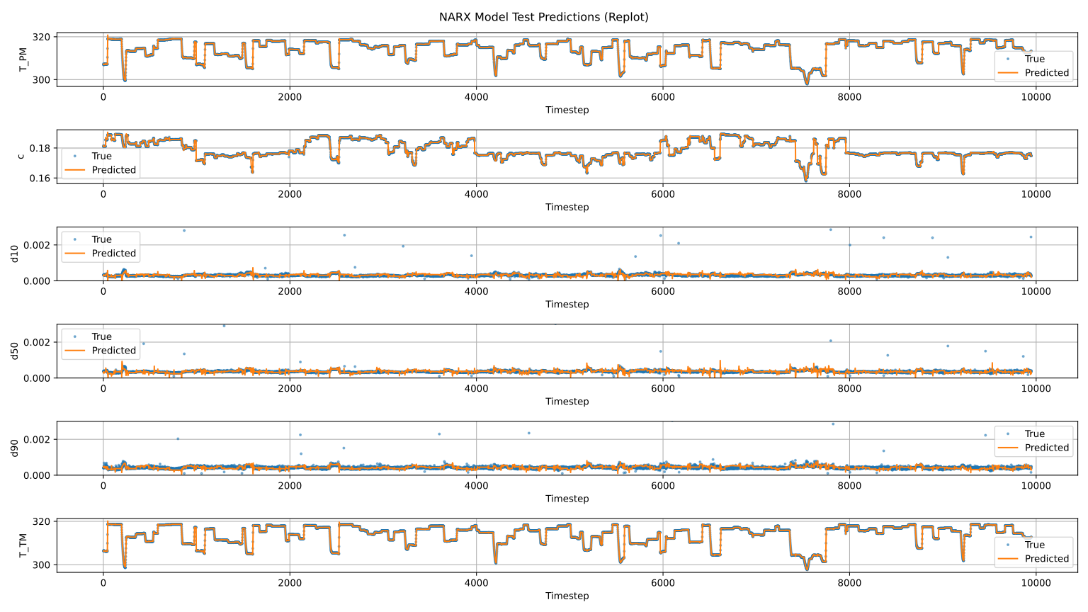
NARX Model Performance – Test Data

Slide 8
Conformalized Quantile Regression (CQR)
Standard neural networks predict a single value – but no uncertainty
CQR adds confidence intervals around predictions
CQR estimates 80% prediction intervals using quantile regression
Two models are trained to predict the 0.1 and 0.9 error quantiles
Pinball loss is used to train these quantile regressors
Allows asymmetric treatment of over- and under-predictions
A calibration step adjusts intervals using value Q
Ensures actual coverage matches the desired 80%
Hyperparameters are the same as for the NARX model
Notes:
To quantify prediction uncertainty, we applied Conformalised Quantile Regression, or CQR. Unlike standard neural networks, which produce single-point estimates, CQR adds confidence intervals by training two quantile regressors — one for the 10th and one for the 90th percentile of the error distribution. These models were trained using the pinball loss function on the residuals between predicted and true values, allowing asymmetric handling of over- and underestimation. To avoid the effort of re-tuning, we reused the hyperparameters from the NARX model, since the residual data shares similar structure and dynamics. Finally, a calibration step following Romano (2019) was applied to ensure 80% coverage.

Slide 9
CQR Performance Results on Test Data
Very good performance for concentration and particle sizes (e.g. c with 80% and very narrow intervals)
Lower coverage for temperature variables (T_PM, T_TM) due to high noise and fluctuations in the measurement data
Overall: CQR reliably captures uncertainty for stable output variables and delivers tight, informative prediction intervals
Target Variable | Coverage | Interval Width
T_PM | 0.443 | 0.133
T_TM | 0.512 | 0.134
c | 0.818 | 0.001
d10 | 0.772 | 0.001
d50 | 0.973 | 0.002
d90 | 0.763 | 0.001
Notes:
To assess the effectiveness of Conformalized Quantile Regression, we evaluated its performance across all target variables. This table summarizes the results. For concentration and particle sizes, coverage was close to the 80 percent target. The best result was achieved for d50, with 97.3 percent coverage and a very narrow interval of 0.002. The temperature variables, however, show lower coverage. This is due to large fluctuations in the measurements and very small residuals from the NARX model, which make quantile regression more challenging. In principle, performance could be improved through hyperparameter optimization. However, this was not carried out due to limited computational resources. Overall, the results show that CQR performs well for stable targets and provides reliable uncertainty estimates.

Slide 10
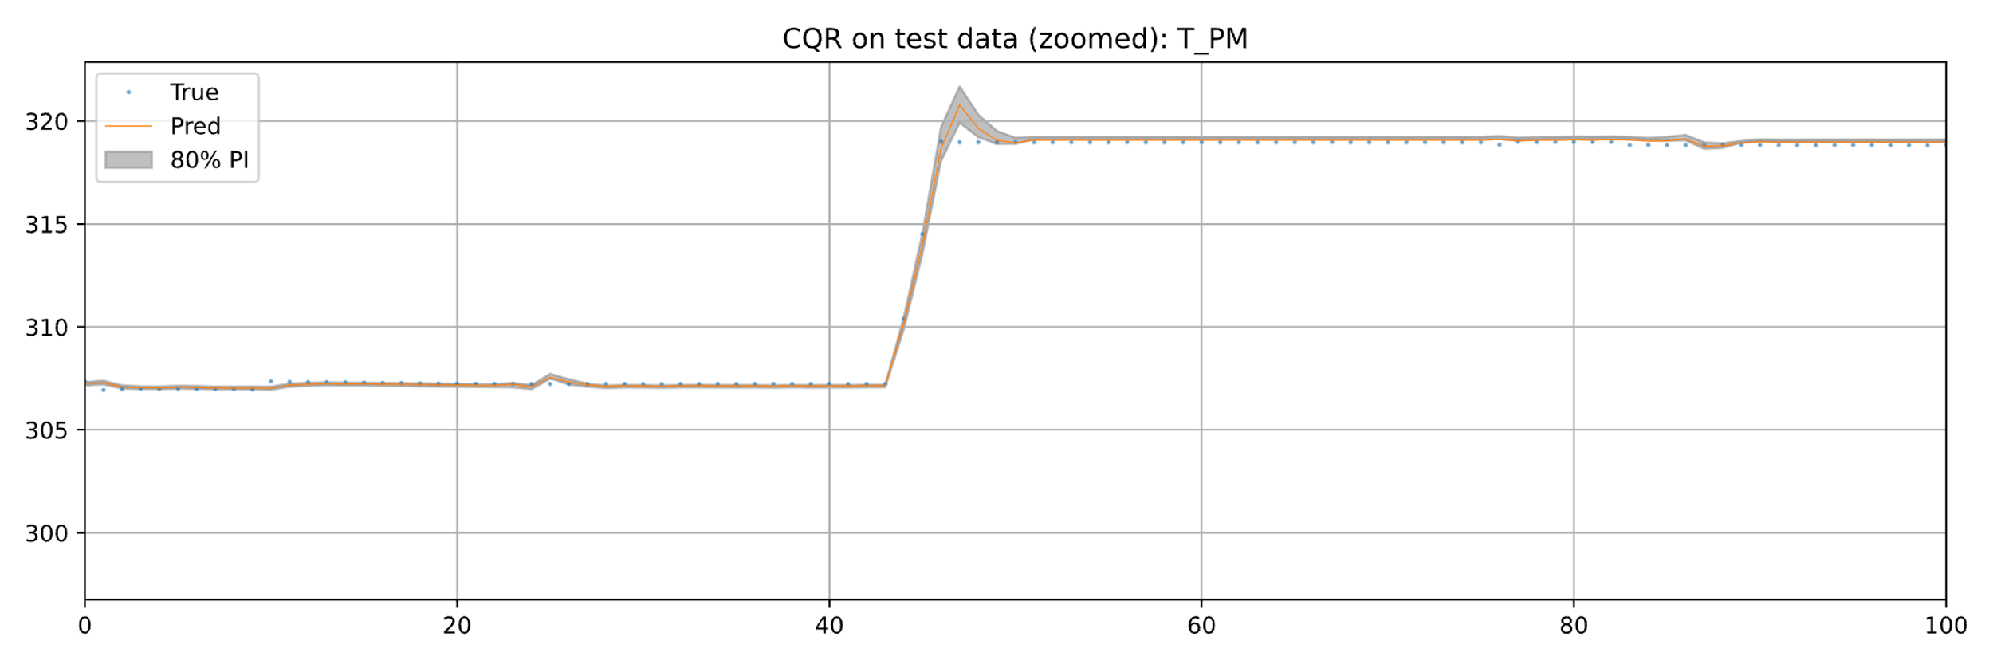
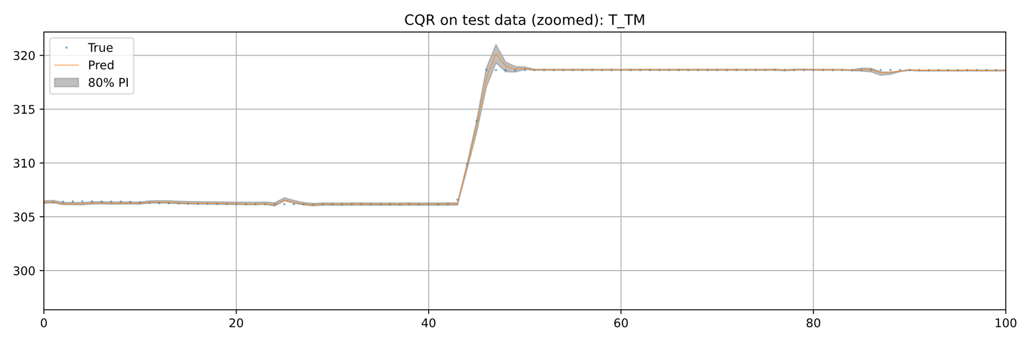
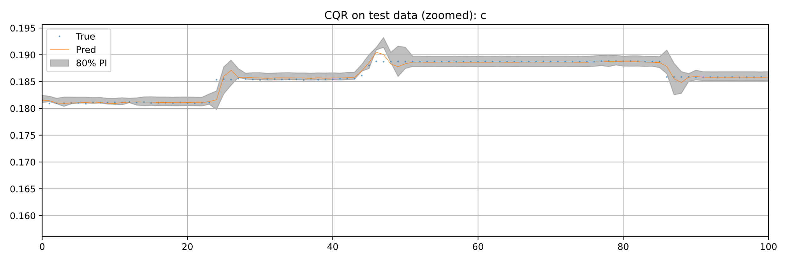
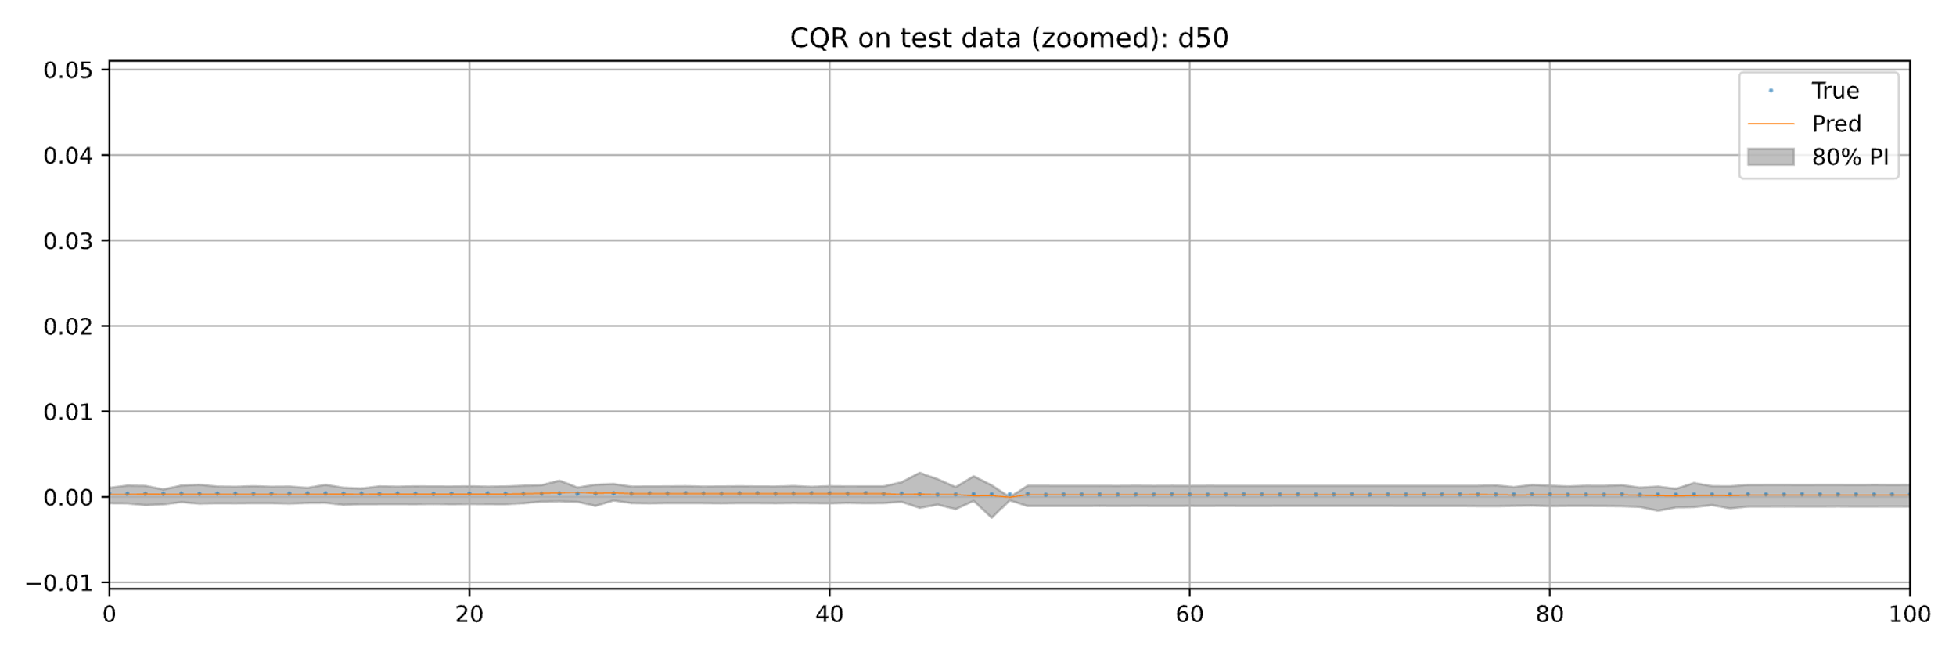
CQR Performance Results on Test Data
Notes:
To illustrate the results from the table, the following plots show prediction intervals for four selected targets, focusing on the first 100 time steps. The blue dots are the true values, the orange line is the prediction, and the gray area shows the 80 percent interval. For T_PM and T_TM, intervals widen with increasing fluctuation, but coverage stays limited. For concentration, the interval remains narrow and covers most values. The best result is seen for d50, with a tight interval and near-perfect coverage. These examples show that CQR adapts to local uncertainty and performs best on stable targets.

Slide 11
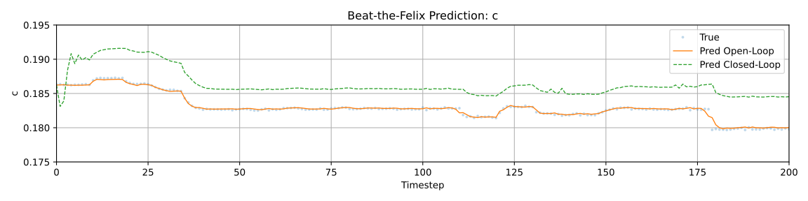
Beat-the-Felix
Evaluation of model performance in open- and closed-loop modes
Open-Loop: High accuracy across all target variables
Closed-Loop: Initial error in closed-loop: model trained only on perfect data; first predictions based on own outputs → early mistakes propagate
Notes:
In the Beat the Felix evaluation, the model is tested in both open- and closed-loop mode. In open-loop, it receives correct inputs at each step, resulting in accurate predictions — as seen by the orange line closely matching the blue ground truth. In closed-loop, shown by the green line, only one initial input is given. The model then relies on its own outputs, which leads to an initial error. Since it was trained only on perfect data, it is not calibrated for autonomous prediction. These early errors accumulate over time, causing the prediction to drift away from the true values.

Slide 12
Beat-the-Felix
Benchmarks
 | Open Loop |  | Closed Loop
State | MSE | MAE | MSE | MAE
c | 2.472e-05 | 6.630e-04 | 4.808e-08 | 9.700e-05
T_PM | 0.133 | 0.151 | 0.013 | 0.073
d50 | 1.895e-06 | 8.481e-05 | 1.438e-06 | 6.437e-05
d90 | 3.063e-07 | 5.572e-05 | 1.566e-06 | 8.005e-05
d10 | 4.578e-07 | 4.387e-05 | 1.823e-06 | 7.393e-05
T_TM | 0.120 | 0.144 | 0.0139 | 0.0676
Achieved values of the presented model
 | Open Loop |  | Closed Loop
State | MSE | MAE | MSE | MAE
c | 5.355e-08 | 1.231e-04 | 2.032e-05 | 4.380e-03
T_PM | 6.048e-03 | 6.165e-02 | 6.756e-01 | 7.743e-01
d50 | 6.226e-09 | 3.837e-05 | 1.265e-05 | 3.536e-03
d90 | 1.538e-06 | 9.721e-05 | 1.643e-06 | 3.774e-04
d10 | 7.667e-07 | 8.533e-05 | 7.271e-06 | 2.533e-03
T_TM | 3.915e-03 | 5.081e-02 | 5.418e-01 | 6.771e-01
NARX model shows lower MSE/MAE on Beat-the-Felix (open & closed loop) vs. benchmarks
Notes:
All in all, our model achieved lower errors than the Felix benchmarks. The tables show that our results outperform the benchmarks in almost every point. Thank you for listening to our final project presentation.

