Slide 1
Data-based modeling of slug flow crystallization with uncertainty
quantification

Slide 2

Data Splitting
Cluster -1 (Noise)
Cluster 0
Cluster 1
Cluster 2
Cluster 3
Delete clusters with incorrect values
No random sample selection, due to temporal dependencies from lagged input windows
Splitting at trajectory level
Prevents information leakage from overlapping time steps
Cluster-wise splitting
Ensures generalization across different behavioral modes
Don’t use the first $lag−1$ values per trajectory
Avoids the use of incomplete data points
Cluster 0
70 % train
Cluster 0
20 % val
Cluster 0
10 % train
Cluster 1
70 % train
Cluster 1
20 % val
Cluster 1
10 % test
70 % training data
20 % validation data
10 % testing data

Slide 3



Nonlinear AutoRegressive with eXogenous inputs (NARX) Model
Architecture:
Flexible feedforward neural network
Variable number of hidden layers & neurons
Includes configurable dropout for regularization
Configurable:
Activation function
Learning rate
Batch size
Epochs
Training:
Adam optimizer
MSE Loss
Output layer with six neurons
Hyperparameter Optimization:
Bayesian optimization
50 trails to minimize MSE on validation set
$$\left[y_{k−lag},…,y_{k−1},y_{k}\right]$$
NARX
Model
$${\hat{y}}_{k+1}$$
$$\left[u_{k−lag},…,u_{k−1},u_{k}\right]$$

Slide 4



Optimized NARX Model
65 neurons
64 neurons
6 neurons
Optimized Hyperparameters:
$lag=5$ → 65 input neurons
One hidden layer with 64 neurons
Dropout $d={5⋅10}^{−5}$
Learning rate $lr=7⋅{10}^{−5}$
Activation: ReLU
60 epochs
Batch size $b=16$
Initial MSE of 0.0329 Final MSE of 0.0028 → improvement of 91.48 %
$$⋮$$
$$⋮$$

Slide 5
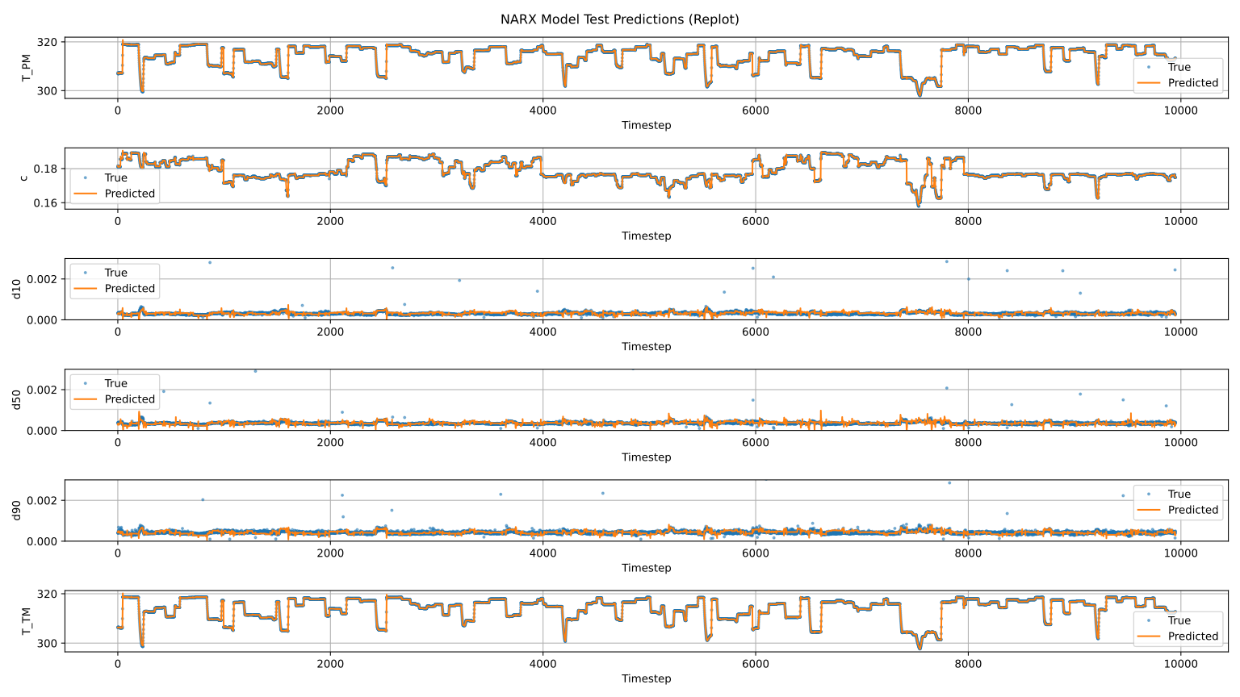
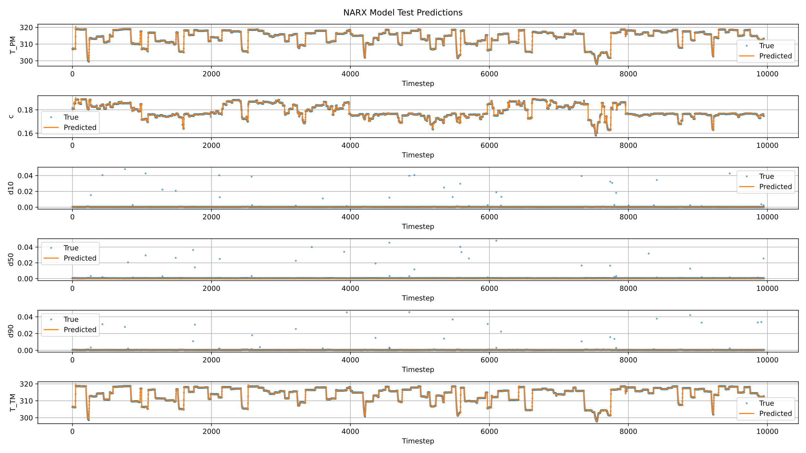
NARX Model Performance – test data

Slide 6
Conformalized Quantile Regression (CQR)
Standard neural networks predict a single value – but no uncertainty → CQR adds confidence intervals around predictions
CQR estimates 80% prediction intervals using quantile regression → Two models are trained to predict the 0.1 and 0.9 error quantiles
Pinball loss is used to train these quantile regressors
→ Allows asymmetric treatment of over- and under-predictions
A calibration step adjusts intervals using value Q
→ Ensures actual coverage matches the desired 80%
Notes:
To quantify the uncertainty of our model predictions, we applied Conformalized Quantile Regression, or CQR. While standard neural networks produce single-point predictions without expressing uncertainty, CQR extends this by creating confidence intervals around the predictions. It does so by training two quantile regressors that estimate the lower and upper bounds of the expected error distribution — specifically the 10th and 90th percentiles. We used the pinball loss function to train these models, which allows asymmetric treatment of over- and underestimation. Finally, a calibration step with the value Q ensures that the actual coverage of the prediction intervals matches the target confidence level, which in our case is 80%.

Slide 7
CQR-Setup
We set alpha = 0.2 to construct 80% prediction intervals
The same hyperparameters as in the NARX model are reused → Hyperparameter tuning via Bayesian Optimization is possible
Notes:
In order to construct 80% prediction intervals, we set alpha to 0.2. This defines the range between the 10th and 90th percentiles. For model consistency, we reused the same hyperparameters as in our previously optimized NARX model. Although we had prepared a script for Bayesian hyperparameter optimization of the CQR models, we did not execute it due to time and computational constraints

Slide 8
CQR Performance Results on Test Data
Very good performance for concentration and particle sizes (e.g. d50 with 97.3% coverage and very narrow intervals)
Lower coverage for temperature variables (T_PM, T_TM) due to high noise and fluctuations in the measurement data
Overall: CQR reliably captures uncertainty for stable output variables and delivers tight, informative prediction intervals
Target Variable | Coverage | Interval Width
T_PM | 0.443 | 0.133
T_TM | 0.512 | 0.134
c | 0.818 | 0.001
d10 | 0.772 | 0.001
d50 | 0.973 | 0.002
d90 | 0.763 | 0.001
Notes:
The results show that CQR performs very well for stable output variables such as concentration and particle sizes. For example, the d50 variable achieved over 97% coverage with an extremely narrow interval width of just 0.002. In contrast, temperature variables showed lower coverage, which we attribute to stronger noise and fluctuations in the measurement data. Overall, CQR reliably captures uncertainty where the underlying model and data are stable, and it delivers sharp, informative prediction intervals.

Slide 9
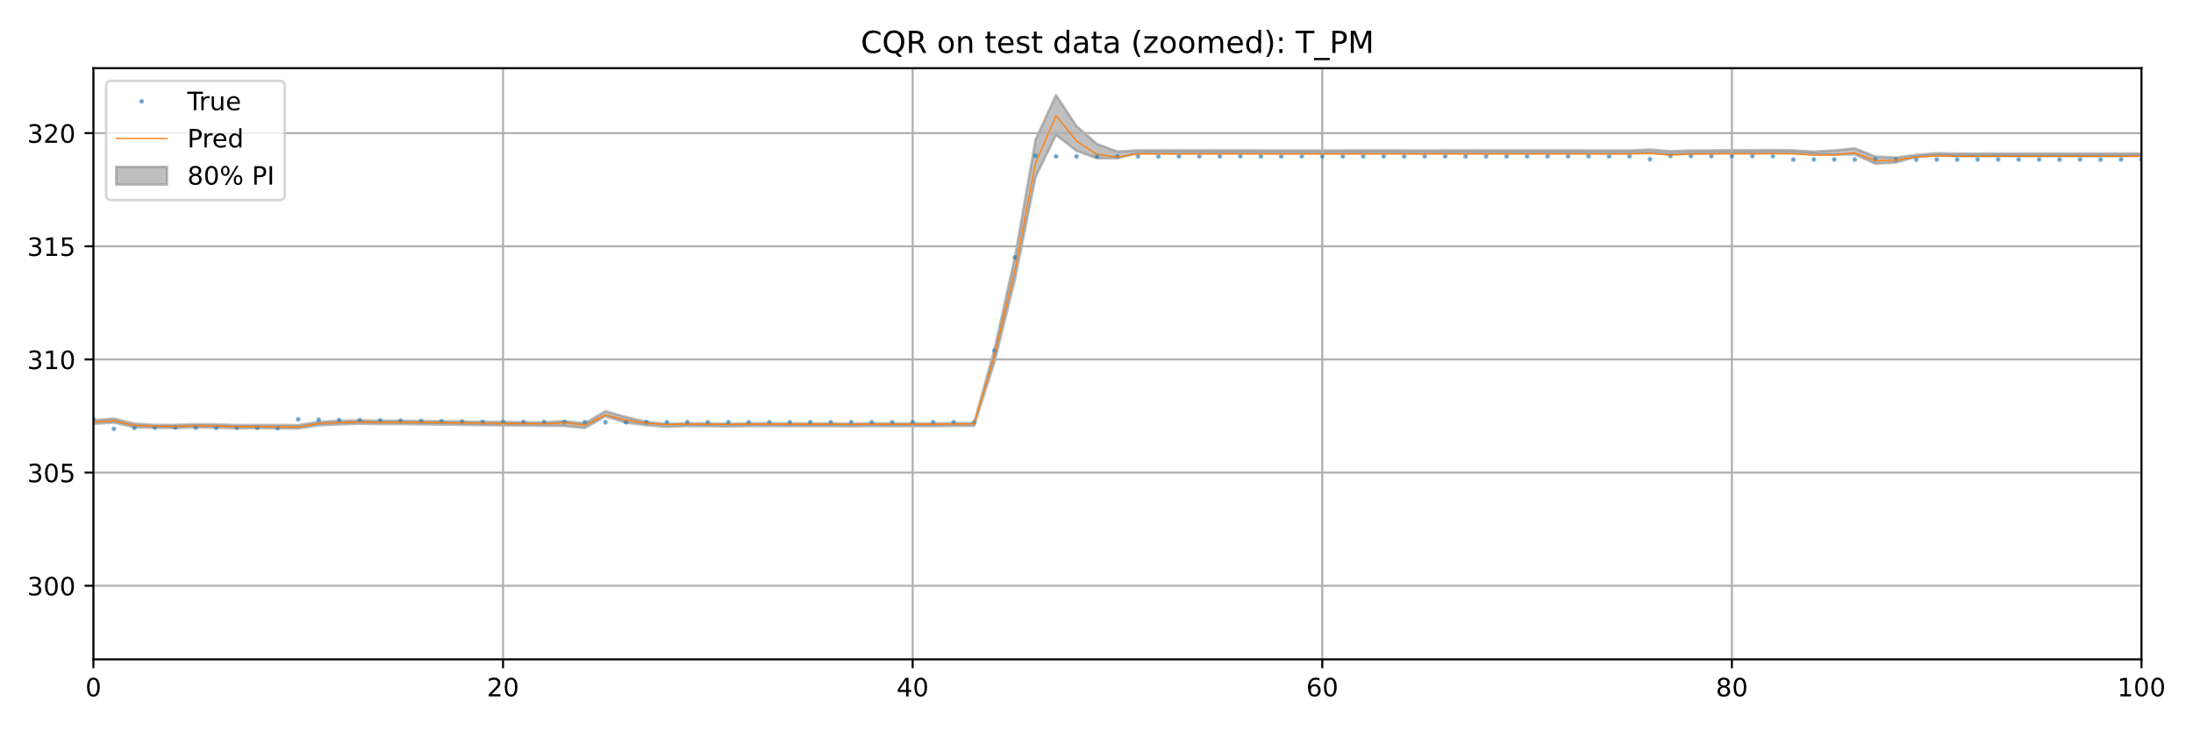
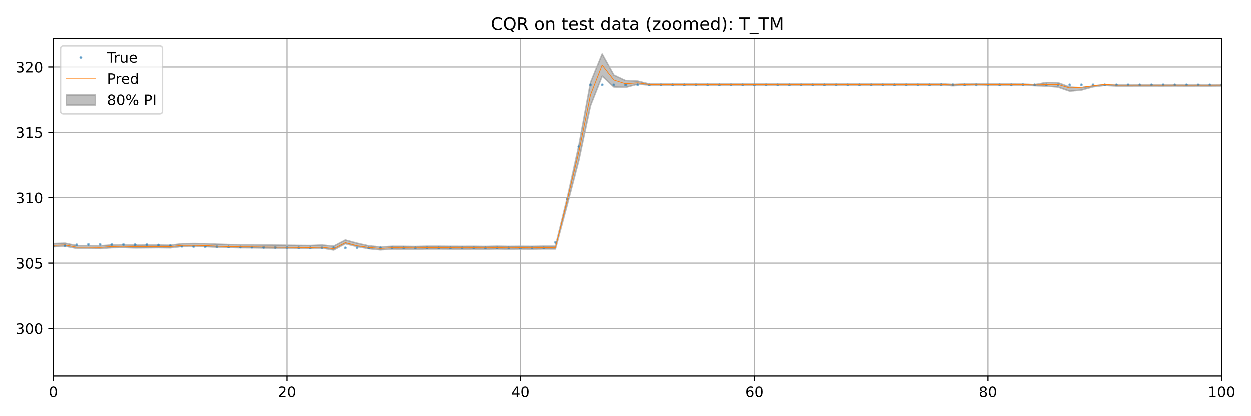
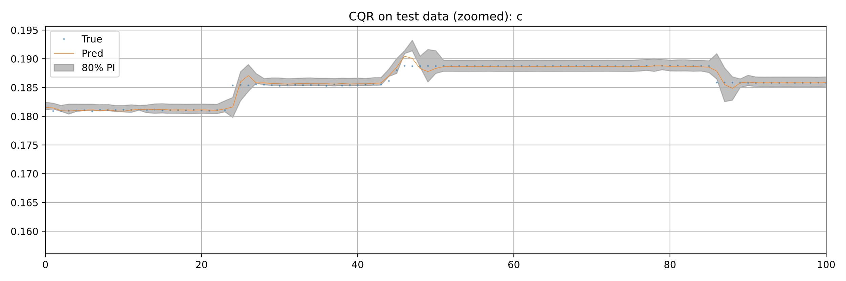
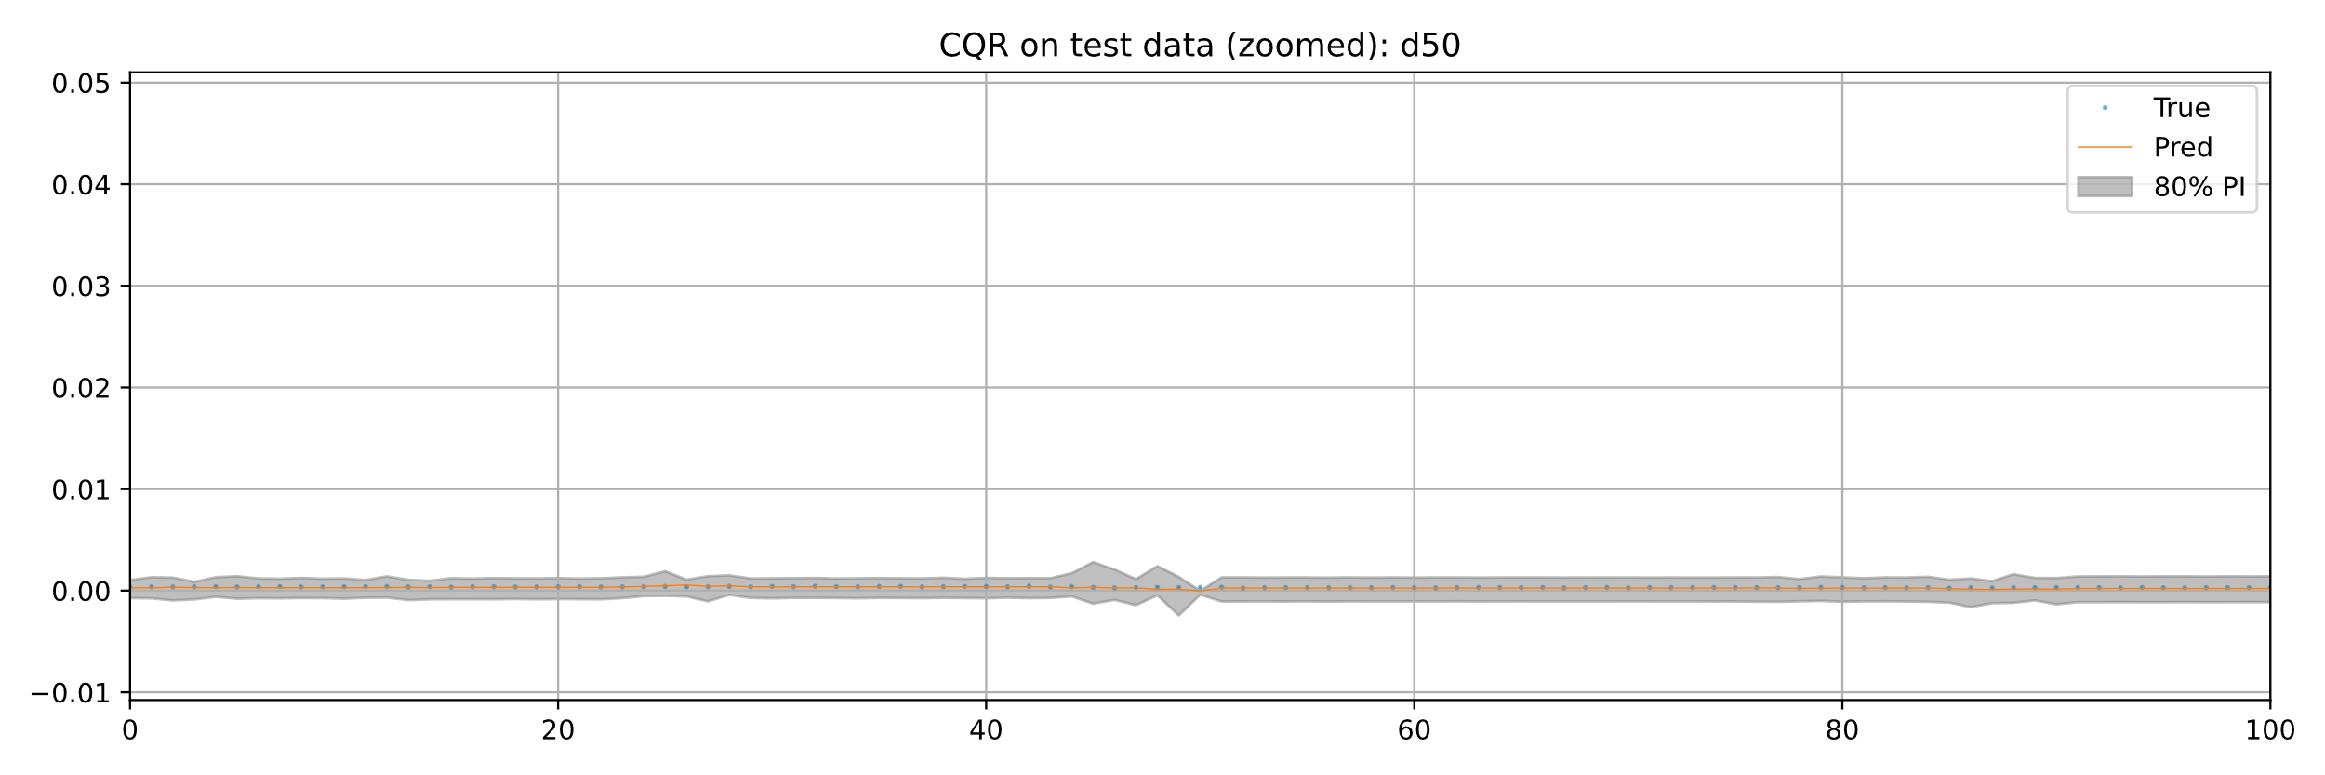
CQR Performance Results on Test Data
Notes:
The following plots illustrate how well CQR captures uncertainty across different output variables. We start with T_PM, where the gray area shows the 80% prediction interval, the orange line represents the predicted values from the NARX model, and the blue dots show the actual measured values. As we can see, the true values often fall outside the gray band, indicating that the interval does not reliably capture the real fluctuations. This is likely due to high measurement noise in the temperature data. The same applies to T_TM, where the prediction intervals are wider, but still miss a significant number of actual values — again showing that uncertainty in thermal variables is harder to quantify accurately. For concentration (c), the situation improves: the blue dots mostly lie within the gray band, and the intervals are much narrower, reflecting a more stable model behavior and better coverage. Finally, we highlight d50 as the best-performing target: here, the prediction interval is both very narrow and consistently includes nearly all true values. This indicates that for the particle size median, the model’s prediction is not only sharp but also highly reliable.

