Slide 1
Basics of Modern Missing Data Analysis
Kyle M. Lang and Terrence D. Jorgensen
Center for Research Methods and Data Analysis
University of Kansas

Slide 2
Topics to be Covered
An introduction to the missing data problem
Missing Data Mechanisms
Ad hoc missing data techniques
Modern missing data analysis
EM
MI
FIML
Syntax examples of MI and FIML

Slide 3
A Comment on Notation
Y=(Y_{obs},Y_{miss})
P(X) – Probability of X
P(X|Y) – Probability of X given Y (conditioned on Y)
P(X|Y,Z) – Probability of X given Y and Z (conditioned on Y and Z)
ℓ - Loglikelihood

Slide 4
What is Missing Data?
Unobserved data with true population values
Nonresponse on sample surveys
Attrition in longitudinal studies
Un-administered materials in planned missingness designs
Data lost unintentionally
Note: Not all unobserved data are truly missing

Slide 5
Patterns of Missing
Three primary patterns of missing
1) Univariate
2) Monotone
3) Arbitrary

Slide 6
Univariate Pattern of Missing
X | Y | Z
2 | 5 | 8
3 | 4 | 3
4 | 5 | 7
5 | 3 | 5
3 | 4 | .
6 | 2 | .
4 | 3 | .
6 | 1 | .
2 | 6 | .
Missingness
occurs on
only a single
variable.

Slide 7
Monotone Pattern of Missing
T1 | T2 | T3 | T4
1 | 3 | 4 | 6
2 | 3 | 5 | 2
3 | 6 | 3 | 3
2 | 5 | 6
3 | 3 | 4
2 | 6
6 | 3
6
7
PM_{t+1} ≥ PM_{t}
Most commonly
due to attrition
Very common
in longitudinal
data

Slide 8
Arbitrary Pattern of Missing
There is no
apparent pattern
to the missing
values.
Probably the most
common
manifestation of
missing data.
X | Y | Z
1 | 5 | 2
. | 5 | 5
6 | . | 6
. | . | 7
3 | 4 | .
5 | . | 7
7 | 6 | .
4 | 3 | 5
. | 4 | 3

Slide 9
The Causes of Missingness
Missing data are missing for a reason
The Missing Data Mechanism
Missing Completely at Random (MCAR)
Missing at Random (MAR)
Missing Not at Random (MNAR)

Slide 10
Missing Completely at Random
MCAR missing can be viewed as a random sample of the complete data.
There are no meaningful correlates of the missing data, either measured or unmeasured.
A survey is administered to an undergraduate biology class
Some item responses are not collected because a page of the measure was accidentally excluded from the survey packet, for a few of the students.
Almost entirely recoverable

Slide 11
Missing at Random
The missingness is correlated with a measured variable other than that which contains the missingness.
The missingness can have a systematic cause, but the cause has been captured in the dataset.
Highly religious subjects fail to respond to items assessing attitudes towards sex.
If you have a measure of religiosity in the data, this is MAR missing.
Very well recovered with appropriate techniques

Slide 12
Missing Not at Random
The missingness is correlated with the variable containing the missingness or an unmeasured variable.
Subjects with very high or very low household income fail to respond to an SES item
Participant level on an item is dictating their response rates
If there is no measure of religiosity in the previous example, that missingness is MNAR
Very poorly recovered even with appropriate techniques

Slide 13
Ignorability
Almost all missing data techniques require the missingness mechanism be ignorable
Ignorability
To safely ignore the missing data mechanism, Rubin (1976) showed that
1) A MAR mechanism must give rise to the loss of information
2) The parameters of substantive interest (θ) and those which contribute to the missingness (ξ) must be distinct

Slide 14
Ignorability II
Specifically, for the first tenet to hold:
The probability of missingness conditioned on both Y_{obs} and Y_{miss} must be no more informative than that conditioned on only Y_{obs}

Slide 15
Ignorability III
For the second tenet to hold:
Frequentist: The joint parameter space (θ,ξ) must be the Cartesian cross-product of the individual parameter spaces θ and ξ.
Bayesian: Any possible joint prior applied to (θ,ξ) must factor into unique marginal distributions of θ and ξ.

Slide 16
Ad Hoc Techniques
Listwise & Casewise Deletion
Mean Substitution
Regression Imputation / Conditional Mean Substitution

Slide 17
Listwise & Casewise Deletion
Both entail deleting unobserved information
Listwise deletion removes all cases with at least one unobserved value
Casewise deletion removes pairs of values from the calculation of sufficient statistics
Both can entail a substantial loss of sample size
100 X 100 Matrix, 20 missing values
.2% of data missing
20% of data deleted
In the case of a nonrandom missingness mechanism, the truncated dataset will cease to be generalizable to the larger population.

Slide 18
Mean Substitution
Every missing value is replaced with the mean of its scale
This can lead to a substantial loss of variability
Causes regression towards the mean
Can attenuate the true population relationships between variables

Slide 19
Regression Imputation
The variable with missingness is regressed on all other variables, and the predicted values are used as replacements for the missing values
Leads to artificially precise standard errors
Amplifies the conformity of the missing value with the linear trend
This can artificially inflate the correlations between variables

Slide 20
General Problem with Single Imputation Techniques
Single imputation techniques assume that the imputed value is an unbiased estimate of the true population value
Leads to artificially precise standard errors
Biases Wald tests and Confidence Intervals
Coverage under 95% for an alpha of .05
Increased Type I error rate

Slide 21
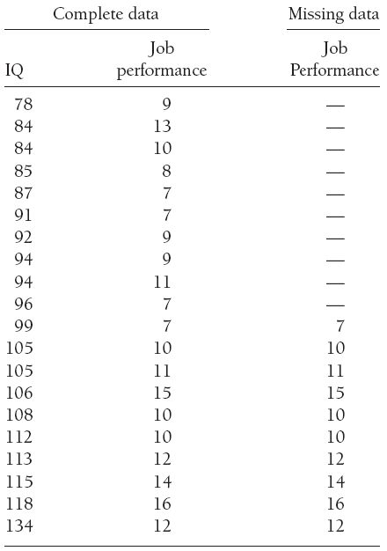
Example
A company administers IQ tests when hiring
IQs < 99 are not hired, so no job performance scores can be collected
What is the relationships between job performance and IQ?

Slide 22
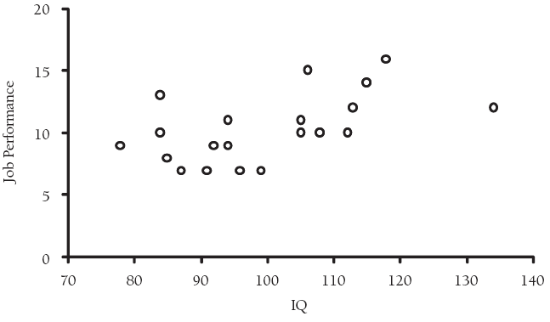
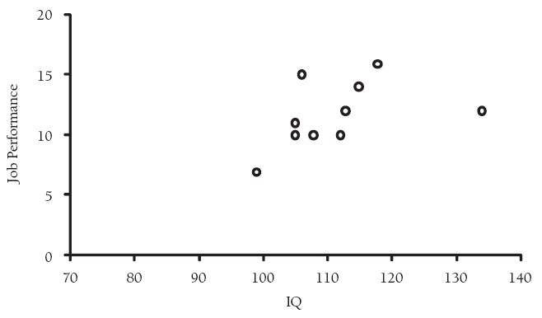
Example
IQ = 99
Complete data
Missing data
Listwise deletion only analyzes the observed data

Slide 23
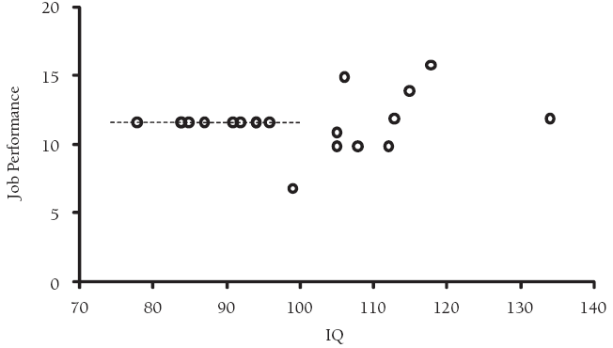
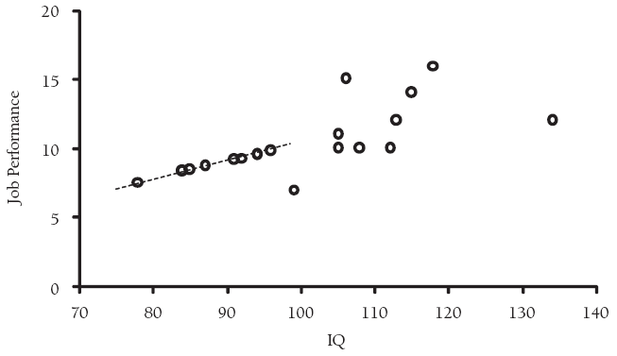
Example
Mean Imputation
No error
Unrealistic values to replace true values
Changes regression line
Regression Imputation
Doesn’t change line, but assumes it wouldn’t
Still no error, false certainty that this is the right line

Slide 24
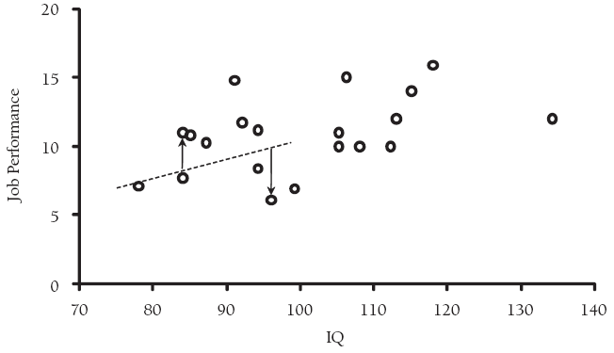
Example
Complete Data
Stochastic Regression Imputation (SRI)
Adds error term to regression line
More closely resembles original complete data
But different random error terms would change the outcome
Multiple Imputation (MI) averages different SRIs

Slide 25
Modern Missing Data Analysis
Expectation Maximization
Dempster, Laird, & Rubin (1977)
Multiple Imputation
Rubin (1976, 1987)
Full Information Maximum Likelihood
A chance for audience participation!

Slide 26
Expectation Maximization (EM)
Maximum likelihood approach to estimating a complete covariance matrix in the presence of missing data
Calculates the expected values of sufficient statistics (E-Step)
Maximizes the conditional loglikelihood derived from the above sufficient statistics (M-Step)
Converges to a stationary covariance matrix when the change in the loglikelihood between two subsequent M-Steps falls below a specified convergence criterion

Slide 27
Factored complete data PDF
Assuming the ignorability of the missing data mechanism:
EM replaces Y_{miss} with the expected values of Y_{miss}|Y_{obs},θ

Slide 28
Expectation (E) Step
Separate regression equations are calculated for every pattern of missingness
The predicted values from these equations are used to fill in the missing values
This “complete” data frame is used to calculate updated estimates of the sufficient statistics (i.e., sums of squares and sums of cross products)

Slide 29
Maximization (M) Step
The sufficient statistics produced by the E-Step are used to compute the complete-data loglikelihood
This loglikelihood is maximized as a complete data problem to reach new estimates of μ and Σ

Slide 30
EM Continued
The E-Step is calculating:
The M-Step maximizes the above such that:
for all θ

Slide 31
Multiple Imputation
Bayesian simulation approach to imputation
Developed to address many of the shortcomings of single imputation and early ML techniques
Accounts for our uncertainty in the true population values of Y_{miss}
Does not lead to downwardly biased standard errors

Slide 32
MI Continued
Through an iterative simulation technique m>1 plausible values of Y_{miss} are estimated
Creates m complete datasets
The variability in the values of Y_{miss} between every imputation (i.e., between imputation variance) quantifies our uncertainty in the true population values of Y_{miss}
m analysis models are run, and the resulting estimates are combined for statistical inference

Slide 33
Data Augmentation
Data Augmentation (Tanner & Wong, 1987) is a two step iterative procedure to create multiple imputations
I-Step uses a series of stochastic regression equations to fill in the missing values
P-Step pulls random draws from probability distributions derived from the complete data from the I-Step to introduce variability into the estimates of the parameters

Slide 34
Priors for MI
Prior distributions must be specified to inform initial estimates of θ
Informative Priors
Stationary EM covariance matrix
Sufficient statistics from a single regression imputation
Uninformative Priors
μ is drawn from a standard normal distribution
Σ is drawn from a Wishart distribution

Slide 35
Imputation (I) Step
Initial estimates of μ and Σ are used to calculate separate stochastic regression equations for each pattern of missingness
The predicted values from the above equations are used to replace Y_{miss}

Slide 36
Posterior (P) Step
The complete data frame from the I-Step is used to parameterize a normal and χ² distribution
New estimates of μ and Σ are estimated based on random draws from the above distributions

Slide 37
P-Step Continued
New estimates of σ² are drawn based on the following equality:
New estimates of μ are drawn as follows:

Slide 38
Markov Chains
The estimates from each subsequent P-Step create a Markov Chain
θ_{t+1} is dependent on θ_{t}
After a sufficient number of iterations the elements in the chain become independent
θ_{t+p} is independent of θ_{t}

Slide 39
Independent Draws
To achieve valid imputations, a number of P-Steps must be discarded (burn-in iterations) before the first draw
Insures that initial imputed estimates are independent of the prior
Between every imputation after the first, many more P-Steps must be discarded
Insures subsequent imputed values are independent
m_{t} is independent of m_{t+1}
A common recommendation for the number of P-Steps to discard is twice the number of iterations it takes the EM algorithm to converge

Slide 40
Combining Parameters in MI
All m sets of parameters must be combined into a single vector of statistics in order to reach an inferential conclusion
Rubin (1987) developed simple formulae to combine all m point estimates and variances into single statistics which can be used for Wald tests or CIs
Rubin’s Rules

Slide 41
Rubin's Rules for Point Estimates
The aggregate point estimate is simple the mean of all m statistics:

Slide 42
Rubin’s Rules for Variance Components
The variability around has two components:
Within Imputation Variance:
Between Imputation Variance

Slide 43
Total Variance of MI Estimates
The total variance of the MI estimates is a weighted sum of the between and within imputation variances:
As m becomes larger the influence of B is weighted downward and T becomes smaller

Slide 44
Assumptions of MI
Three assumptions of MI
The probability distribution giving rise to the data is of a specified form
Usually the normal distribution
The missingness mechanism is ignorable
The prior distribution used to inform the initial estimates of θ is appropriate
Note: Assumptions 1 & 2 must also be made for ML techniques

Slide 45
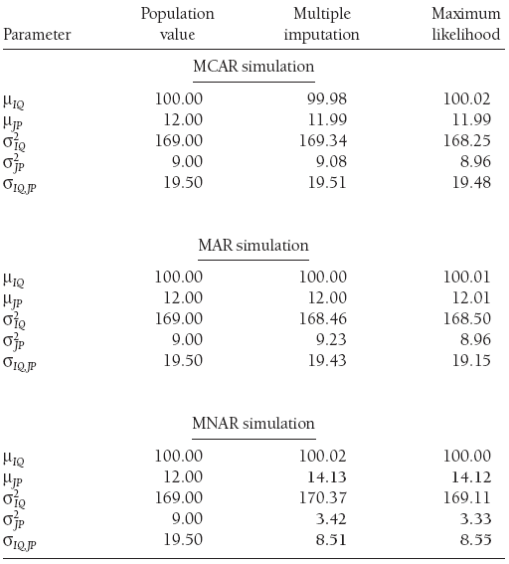
Example: Compare MI to FIML
The MCAR simulation randomly removed Job Performance data (unrelated to anything)
MAR simulation deleted JP data for low IQ (reason for missingness included in model)
MNAR deleted JP data for low JP scores (reason for JP missingness not recoverable because it is due to JP itself)

Slide 46
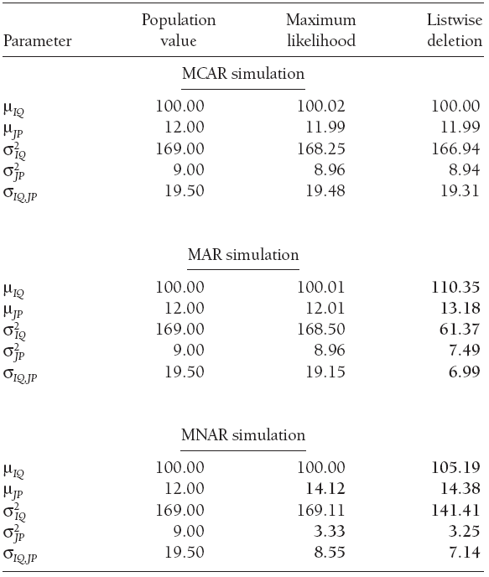
Example: Compare FIML to LD
The same simulation, but comparing FIML (which yield the same results as MI) to Listwise Deletion (LD)
Whereas FIML/MI yield bias for parameters affected by missingness (JP), LD yields bias for all estimates
LD only unbiased for MCAR (most missing data are not MCAR)

Slide 47
Full Information Maximum Likelihood (FIML)
FIML is a maximum likelihood estimator which is robust to the presence of missing data
Calculates an individual loglikelihood for each case in the data frame
Allows separate estimation of parameters for every pattern of missingness without the need to address the true population values of Y_{miss}

Slide 48
Multivariate Normal PDF
The multivariate normal PDF from which FIML derives the joint loglikelihood it maximizes is characterized by the following equation:

Slide 49
Casewise Loglikelihood
For each case in the data, the following loglikelihood is computed:
Which becomes the following in the presence of missing data:

Slide 50
Joint Loglikelihood
Each of the previous casewise loglikelihoods is summed to get:
FIML then maximizes the above equation to reach estimates of μ and Σ

Slide 51
FIML Continued
Because an individual loglikelihood is calculated for every case, the final joint loglikelihood is based only on Y_{obs}
Allows the estimation of parameters based on only observed information
No need to address the true population values of Y_{miss}

Slide 52
Inclusive vs. Exclusive Strategies
Both FIML and MI can be implemented with either an inclusive or an exclusive approach.
Inclusive: Including covariates that are correlated with the causes of missingness
Exclusive: Running either the imputation or analysis models with only the variables of substantive interest included.

Slide 53
Inclusive Approach in MI
An inclusive approach in MI entails including fully observed covariates in the imputation model (auxiliary variables).
Increases the predictive power of the regressions used in the I-step
Improves the precision and efficiency of the imputed values

Slide 54
Inclusive Approach in FIML
Similar to MI, covariates are added to the model to add information on the true value of the missing information.
Auxiliary variables must be included in the analysis model
The Saturated Correlates approach (Graham, 2003) is the most widely recommended

Slide 55
Saturated Correlates Technique
Three rules to implement in latent variable models:
1) Correlate auxiliary variables with manifest predictors
2) Correlate auxiliary variables with the residual terms of manifest indicators
3) Correlate auxiliary variables with other auxiliary variables

Slide 56
Problem with Calculating Incremental Fit Indices
Incremental fit indices require the comparison of the fitted model to a null model
Null model is usually specified as a model with no relationship between the indicators
Under the saturated correlates approach this leaves out the auxiliary information from the null model
Upwardly biases incremental fit indices

Slide 57
Take-Home Message
Missing data cannot simply be ignored
Ad hoc techniques lead to substantial bias in all but the most restrictive of cases
Modern missing data techniques recover information very well provided conformity to a few loose assumptions
All of the techniques described today are very easily implemented in nearly all common statistical packages
More precisely and efficiently recovered information leads to more valid estimates of parameters, higher statistical power, more valid statistical inferences and better science

Slide 58
Special Thanks
Wei Wu
Todd Little
Kris Preacher
Rawni Anderson
Waylon Howard
John Geldhof

