Slide 1
Power Analysis
Ben Kite and Terrance Jorgensen
KU CRMDA
2017 Stats Camp

Slide 2
Recall Hypothesis Testing?
Null Hypothesis Significance Testing (NHST) is the most common application in social science
Frame research hypothesis as an “alternative” (H₁) to a “null” hypothesis (H₀) that is given preference
Design study to test H₀, collect data
Reject H₀ when data are uncommon if H₀ is true
If you fail to reject H₀, you can’t reject H₀ as a plausible explanation for the observed data

Slide 3
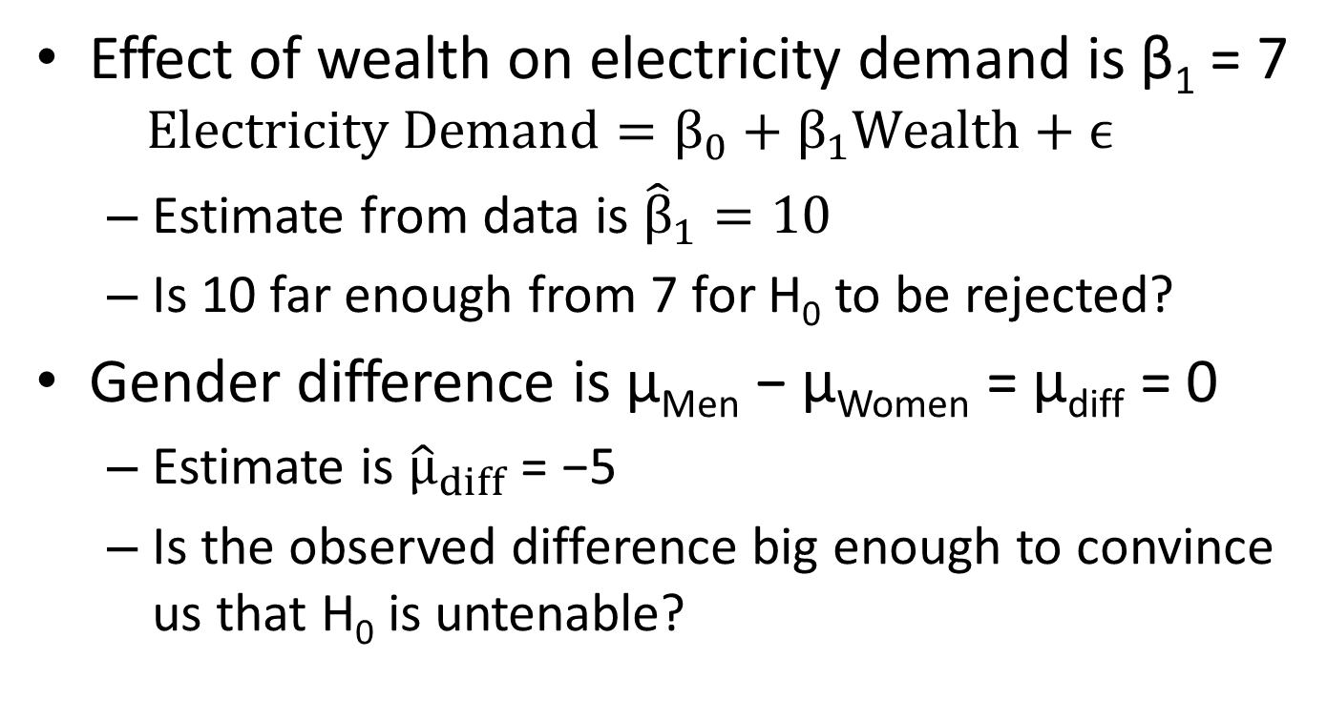
Examples of H₀
Effect of wealth on electricity demand is β₁ = 7
$$Electricity Demand=β_{0}+β_{1}Wealth+ϵ$$
Estimate from data is ${\hat{β}}_{1}=10$
Is 10 far enough from 7 for H₀ to be rejected?
Gender difference is μ_{Men} − μ_{Women} = μ_{diff} = 0
Estimate is ${\hat{μ}}_{diff}$ = −5
Is the observed difference big enough to convince us that H₀ is untenable?

Slide 4
What Is Statistical Power?
The probability of rejecting H₀, on the condition that it is FALSE (1 – Type II error)
Only makes sense in the context of NHST
Conduct before data collection (avoid post hoc)
Affected by 4 factors
Rejection criterion (α level)
Sample size (N)
Sampling variability (SD, σ²)
Effect size (the degree to which H₀ is false)

Slide 5
Motivation Behind Power Analyses
Important part of research proposals
How many cases are required to reject your H₀?
Funding agencies & dissertation advisors want to make sure they aren’t wasting time & money
Think backwards
Imagine a completed study, with data
MUST write down the actual model to be estimated
With “made up data” of size N, using carefully chosen population parameters, how often is a “significant” effect detected?
If not, how large must N be to detect the effect at least as often as a minimum threshold?

Slide 6
Real-Life Research Example
Researcher collects data on N = 10 people to find out whether tobacco causes cancer
Statistical procedure says there’s no relationship, so we can’t reject H₀ of no relationship
Suppose the effect of tobacco on cancer risk is actually present, but we missed it by not collecting enough data (Type II error)
80% is a customary threshold for “enough” power
We should design experiments so the power ≥ 0.8
Measure variables with little variance; collect large N
Effect must be “large” if it is to be detected with small N
If effect is “small,” then we increase N to increase chances of finding a “significant” result (i.e., of rejecting H₀)

Slide 7
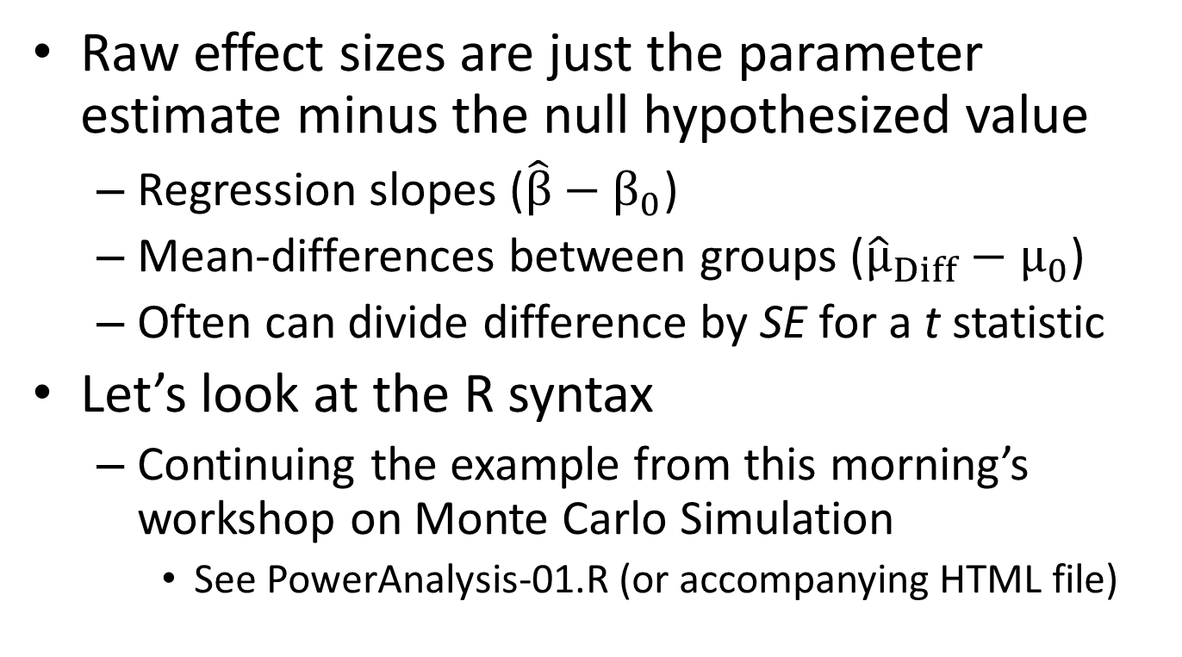
Effect Sizes
Raw effect sizes are just the parameter estimate minus the null hypothesized value
Regression slopes ($\hat{β}−β_{0}$)
Mean-differences between groups (${\hat{μ}}_{Diff}−μ_{0}$)
Often can divide difference by SE for a t statistic
Let’s look at the R syntax
Continuing the example from this morning’s workshop on Monte Carlo Simulation
See PowerAnalysis-01.R (or accompanying HTML file)

Slide 8
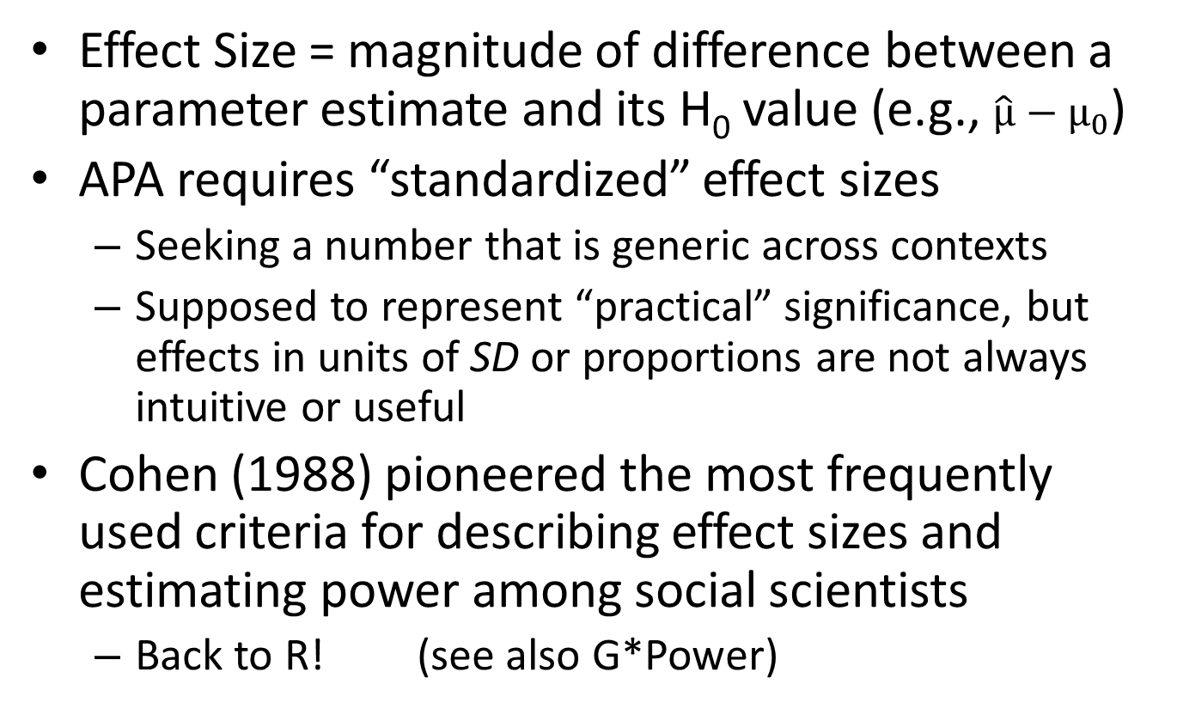
Effect Sizes
Effect Size = magnitude of difference between a parameter estimate and its H₀ value (e.g., $\hat{μ}−μ_{0}$)
APA requires “standardized” effect sizes
Seeking a number that is generic across contexts
Supposed to represent “practical” significance, but effects in units of SD or proportions are not always intuitive or useful
Cohen (1988) pioneered the most frequently used criteria for describing effect sizes and estimating power among social scientists
Back to R! (see also G*Power)

Slide 9
Monte Carlo Power Analysis
A Monte Carlo study where:
The outcome of interest is statistical power
The main manipulated factor is N
Useful because analytical methods only cover simple cases
Power = the proportion of samples in a condition for which H₀ was rejected
Can manipulate other factors
Effect size, alpha, variability, missing data, etc.

Slide 10
Free Power Analysis Resources
G*Power (http://www.gpower.hhu.de/en.html)
Linear Models (regression, correlation, t test, ANOVA, ANCOVA, MANOVA, MANCOVA)
Some generalized linear models (Poisson or logistic regression)
Contingency tables (χ², McNemar’s test)
Proportion tests
The user’s manual on the website is easy to read (lot’s of pictures and easy instructions)

Slide 11
Free Power Analysis Resources
WebPower (http://webpower.psychstat.org/wiki/)
Correlation, regression
Proportion/Mean differences
Mediation
Multilevel and Longitudinal modeling
Structural equation modeling
Fairly new, may have bugs

Slide 12
Free Power Analysis Resources
Multilevel Modeling power analysis software
PINT (http://www.stats.ox.ac.uk/~snijders/multilevel.htm#progPINT)
Uses analytical approximation, 2-level models only
MLPowSim (http://www.bristol.ac.uk/cmm/software/mlpowsim/)
Makers of MLwiN (among the best MLM software)
You input characteristics of your data (summary stats of predictors, sample size at each level) and population parameters, then MLPowSim writes an R script for Monte Carlo simulation-based power analysis

Slide 13
CRMDA Resources
For SEMs (and more), see KUant Guide #12: Monte Carlo Simulation in Mplus
See http://crmda.ku.edu/kuant-guides
This is primarily SEM software (not free), but it can also be used for anything that can be framed as a
Linear model (t test, ANOVA, regression)
Generalized linear model (Poisson or logistic regression)
Multilevel / mixed-effects model
Just need to know how to write model in Mplus syntax

