Slide 1
SENTIMENT ANALYSIS OF
LOK SABHA ELECTION
Guided By :
Prof. Sudipta Bhattacharya
Assistant Professor
Dept. of CSE & IT
Presented By :
Dibyendu Nandan - 12100119110
Imon Bera - 12100119075
Shouvik Sarkar - 12100119088
Jony Paul - 12100119073
Bitan Ranjan Maiti - 12100119115

Slide 2
Introduction
In today’s age where every social media platforms are generating huge amount of user data, if gathered and analyzed properly, It can provide an almost accurate picture of changing market trends, customer preferences or even user’s opinion regarding any subject.
Such a process is Sentiment Analysis. It is the process of collecting and analysing data based upon the person's feelings, reviews and thoughts. Hence, It is also called opinion mining.
For the ease of data collection we chose Twitter as source of data for such analysis. Twitter is a micro blogging platform where anyone can read or write short form of message which is called tweets.
Twitter Sentiment Analysis is the process of accessing tweets for a particular topic and predicts the sentiment of these tweets as positive, negative etc.

Slide 3
Objective
The main objective of this project is to perform the sentiment analysis on tweets from Indian Political Parties like BJP, INC and AAP, and gather public opinions/sentiment about these parties. And use that data to predict most favoured party in The Lok Sabha 2024.

Slide 4
Collecting Twitter data
We started by applying for an Elevated Twitter Developer account for API access in official Twitter developer portal.
Then we collected API key and Access Tokens from there and imported tweepy library in python. Then by using the official OAuth1UserHandler we were able to authenticate our python instance with twitter.
Using api.search_tweets function , we put a keyword query for “Lok Sabha” and set the language to English only.
We also imported csv library in python for the benefit of saving all the search results in “Lok_Sabha.csv” . We specified in csvWriter to only save tweet time, text, username and location for each query result.

Slide 5
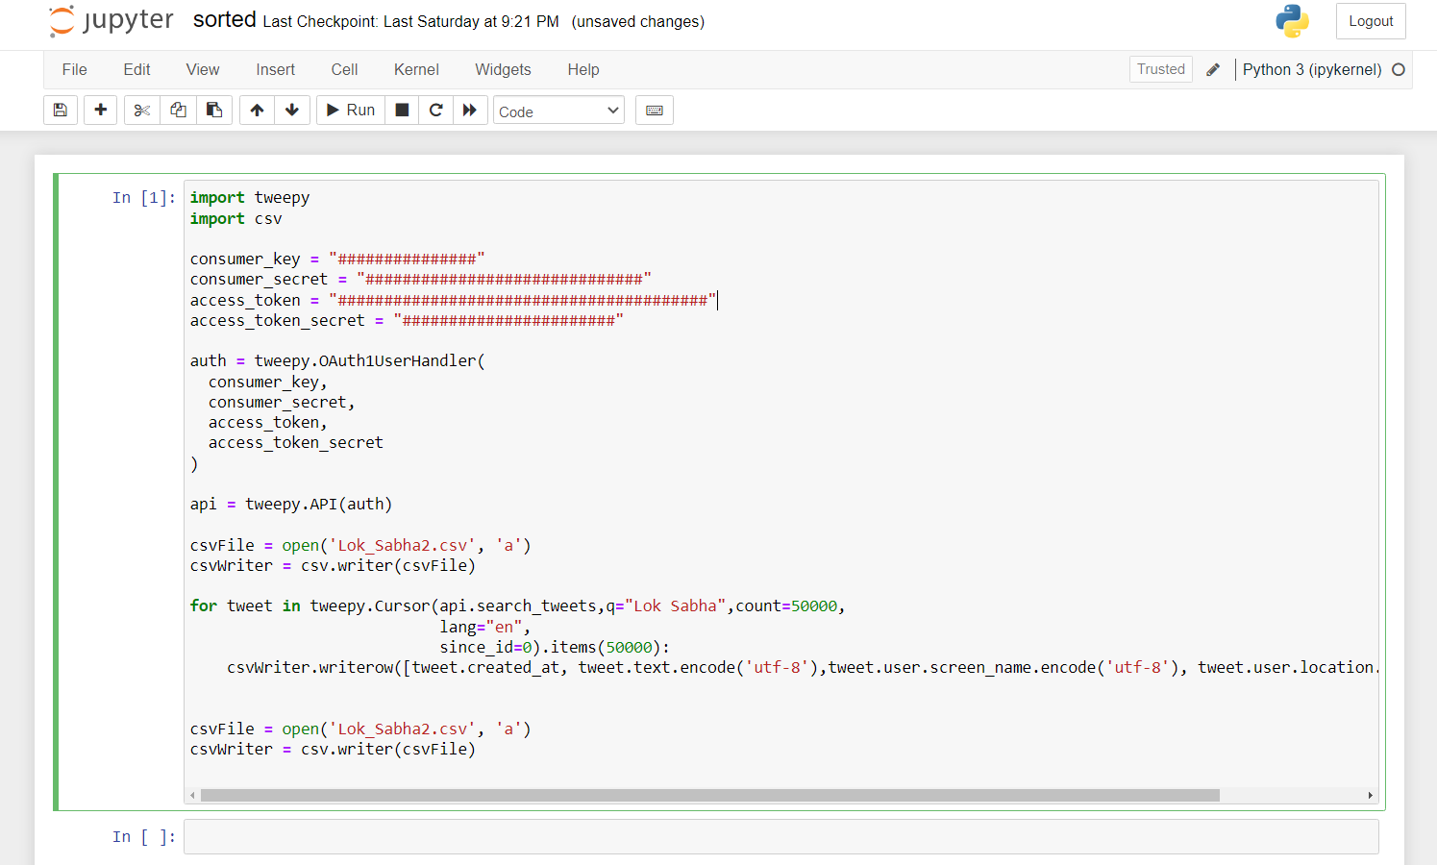

Code snippet from Jupyter

Slide 6
Processing data with NLTK
After the data scraping using tweepy, we prepare the data for noise filtering. Some of the various NLTK libraries we are using for the process are—
Normalization - To remove noise from the collected language data, so that machine can easily detects the patterns in the data. It removes special characters such as hashtags, punctuation, numbers from the text.
Tokenization - To split larger bodies of text into smaller lines and words to be able to perform analysis of the text.
Stop Word removal - To remove most commonly used words from the corpus. Typically, articles and pronouns are generally classified as stop words.
Lemmatize - To reduce the words to their root forms.

Slide 7
Text classification using GloVe Embeddings
Since sentiment is a human thing and machines can not understand them, to classify our data we need to use GloVe Embeddings. Word Embedding is a technique to convert each word into an equivalent float vector in multidimensional space. GloVe stands for Global Vectors which has pre-defined dense vectors for around every 6 billion words of English literature along with many commonly used characters. To use GloVe for text classification, first we need to create the dictionary. And then we need to traverse the GloVe file of specific dimension and compare each word with all words in the dictionary. The equivalent vector will be copied and pasted into embedding_matrix at corresponding index if match occurs.

Slide 8
Training Dataset and Creating Model
Since the dataset for the whole analysis is so huge, We currently were able to set it up and collect data for a few days. We also only used the keyword “Lok Sabha”, which did really limit the amount of data to collect. Currently, We are in process of preprocessing that data using aforementioned NLTK libraries.
Our current collected dataset is available here https://drive.google.com/drive/folders/1gLnsXyUe-y9mkH4xO6p8bcnWWTr1n1ky?usp=sharing
In the near future, we will be expanding the keywords for the data collection amount to be greater and provide sufficient data for the proposed model.

Slide 9
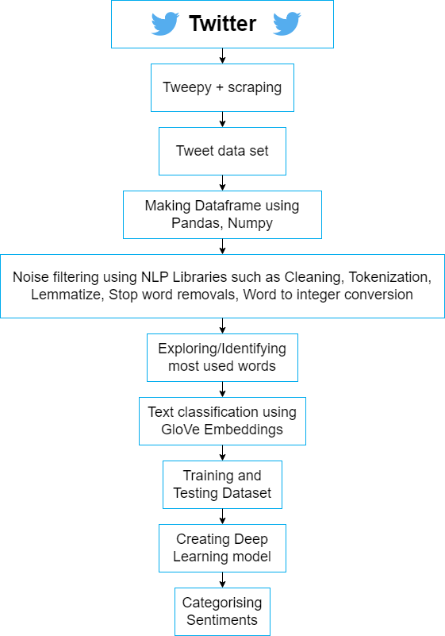
Flowchart of Methodology

Slide 10
Conclusion
Sentiment Analysis is used to identify people’s opinion, attitude and emotional states. The views of the people can be positive or negative.
Twitter is a large source of data, which makes it more attractive for performing sentiment analysis. We will be performing analysis on around 20,000 tweets, so that we will be able to analyse the results, understand the patterns and give a review on people's opinion.
We will be looking for progress and working procedure of different parties. We will also keep an eye out for how any social event, speech or rally causes a fluctuation in sentiment of people.
We will also get to know which policies are getting more support from people which are started by any of these parties.

Slide 11
Thanks

