Slide 1
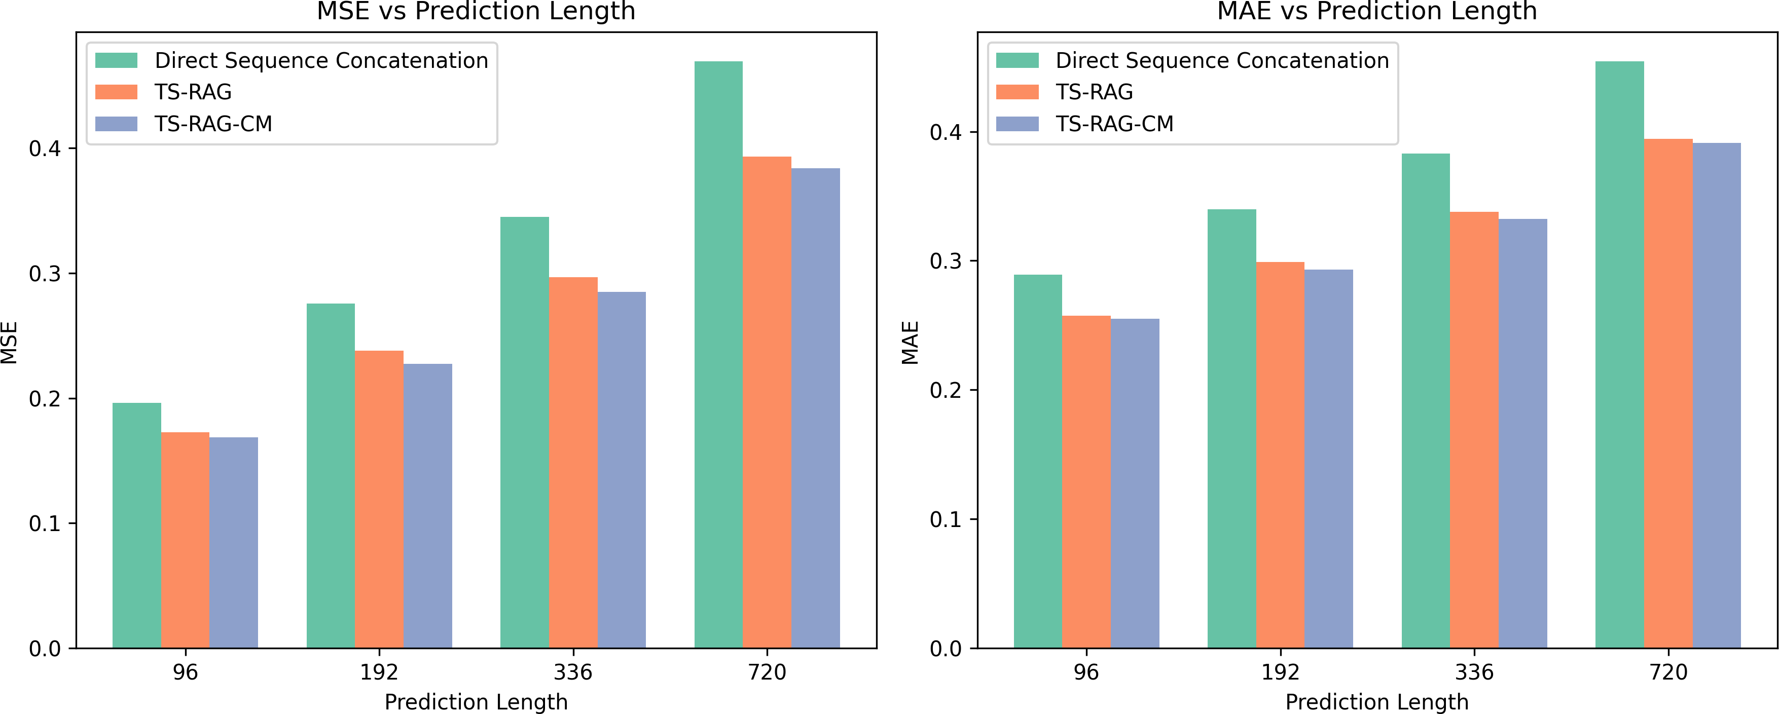
Xiao et al.
Table 1: Multivariate forecasting results. We compare extensive competitive models under different prediction lengths. The look-back length 𝐿 is set to 96 for all baselines. Results are averaged from all prediction lengths 𝑆 = {96, 192, 336, 720}.
Model | TS-RAG-CM | TS-RAG | TimeXer | iTransformer | RLinear | PatchTST | Crossformer | TiDE | TimesNet | DLinear
ECL | 0.169 / 0.270 | 0.181 / 0.279 | 0.171 / 0.270 | 0.178 / 0.270 | 0.219 / 0.298 | 0.205 / 0.290 | 0.244 / 0.334 | 0.251 / 0.244 | 0.192 / 0.295 | 0.212 / 0.300
ETTh1 | 0.437 / 0.439 | 0.438 / 0.442 | 0.437 / 0.437 | 0.454 / 0.447 | 0.446 / 0.434 | 0.469 / 0.454 | 0.529 / 0.522 | 0.541 / 0.507 | 0.458 / 0.450 | 0.456 / 0.452
ETTh2 | 0.366 / 0.396 | 0.374 / 0.399 | 0.367 / 0.396 | 0.383 / 0.407 | 0.374 / 0.398 | 0.387 / 0.407 | 0.942 / 0.684 | 0.611 / 0.550 | 0.414 / 0.427 | 0.559 / 0.515
ETTm1 | 0.379 / 0.395 | 0.383 / 0.399 | 0.382 / 0.397 | 0.407 / 0.410 | 0.414 / 0.407 | 0.387 / 0.400 | 0.512 / 0.496 | 0.419 / 0.419 | 0.400 / 0.406 | 0.403 / 0.407
ETTm2 | 0.266 / 0.318 | 0.275 / 0.322 | 0.274 / 0.322 | 0.288 / 0.332 | 0.286 / 0.327 | 0.281 / 0.326 | 0.757 / 0.610 | 0.358 / 0.404 | 0.291 / 0.333 | 0.350 / 0.401
Weather | 0.241 / 0.272 | 0.252 / 0.276 | 0.241 / 0.271 | 0.258 / 0.278 | 0.272 / 0.291 | 0.259 / 0.281 | 0.259 / 0.315 | 0.271 / 0.320 | 0.259 / 0.287 | 0.265 / 0.317
AVG | 0.310 / 0.348 | 0.317 / 0.353 | 0.312 / 0.349 | 0.328 / 0.357 | 0.335 / 0.359 | 0.331 / 0.360 | 0.540 / 0.493 | 0.409 / 0.407 | 0.336 / 0.366 | 0.374 / 0.399
Figure 3: Comparison of TS-RAG-CM, TS-RAG with Direct Sequence Concatenation.
a single reference sequence. In contrast, incorporating two or four reference sequences generally leads to higher MSE and MAE, sug-gesting that additional retrieved sequences do not always enhance forecasting accuracy and may introduce noise. A possible explana-tion is that retrieving too many similar sequences may introduce redundant or conflicting patterns, making it harder for the model to extract relevant information and effectively integrate it into the forecasting process.
5 Conclusion
In this work, we introduced TS-RAG, a novel retrieval-augmented generation (RAG) framework for time series forecasting, which effectively integrates retrieved historical sequences into the fore-casting process. Our approach addresses key limitations of exist-ing deep learning models by incorporating external information through reference tokens, facilitating a more structured fusion of complex temporal dependencies. By leveraging efficient vector search techniques instead of computationally expensive methods like Dynamic Time Warping (DTW), TS-RAG achieves faster in-ference while maintaining high predictive accuracy.Our extensive evaluation on multiple real-world time series forecasting bench-marks demonstrates that TS-RAG consistently outperforms state-of-the-art models, highlighting its potential to enhance forecasting performance in both common and rare-event scenarios. Unlike stan-dard transformer-based architectures that rely solely on internal feature extraction, our framework retrieves and utilizes relevant external sequences, allowing the model to make better-informed predictions, particularly when training data is scarce or lacks di-versity.This work bridges the gap between retrieval-augmented methods and time series forecasting, showcasing how ideas from
4.2.3 Comparison of different retrieval approaches. In addition to information fusion strategies and the number of retrieved se-quences, another crucial factor affecting model performance is the retrieval approach used to find similar sequences. The choice of retrieval method not only impacts forecasting accuracy but also plays a significant role in model inference efficiency. As shown in Table 2, TCN-based retrieval achieves the best forecasting perfor-mance, with lower MSE and MAE compared to DTW-based and Euclidean Distance (ED) retrieval methods. Although TCN-based retrieval is slightly slower than ED retrieval (0.004s vs. 0.002s), it is still significantly faster than DTW-based retrieval (14.27s), making it a more practical choice for real-time applications.

