Slide 1
S&P 500 Stock Regression Project
Paul Lopes | Regression Methods | Nov 28, 2025

Slide 2
Agenda
Project Overview & Research Question
Data and Feature Engineering
Regression Model
Results & Diagnostics
Interpretation, Limitations, Next Steps

Slide 3
Dataset Overview
Cam Nugent S&P 500 daily price dataset (Kaggle)
619k rows, 2013–2018 OHLCV plus ticker name
Used trading days in 2017 plus first day of 2018
Reproducible via scripts/sp500_regression.R

Slide 4
Research Question
Which observable trading characteristics explain cross-sectional variation in 1-year S&P 500 returns?

Slide 5
Variables
Response: y_log_return = log(price_2018-01-02 / price_2017-01-03)
Volatility: annualized sd of 2017 daily log returns
Avg Volume: mean 2017 trading volume in millions
Momentum 90: log return over first 90 trading days
Trend MA30: slope between Day 1 price and 30-day moving average

Slide 6
Feature Engineering
Cleaned columns, parsed dates, sorted by ticker/date
Calculated daily log returns and filtered incomplete tickers
Summarized 2017 trades to compute predictors
Calculated forward-looking log return to 2018 start

Slide 7
Modeling Approach
OLS: y_log_return ~ volatility + avg_volume_mln + momentum_90 + trend_ma30
Assumptions checked with residual vs fitted and Q-Q plots
Outputs saved (coefficients, metrics, residuals)

Slide 8
Summary Statistics
Metric | Value
Ticker Count | 503
Mean 1Y Log Return | 0.137
Median Volatility | 0.195
Median Avg Volume (M) | 2.20
Momentum 90 IQR | 0.163

Slide 9
Model Fit
R² = 0.529, Adjusted R² = 0.525
Residual Std. Error = 0.158
F-statistic = 139.7 (p = 5.5e-80)
Observations = 503

Slide 10
Coefficient Estimates
Term | Estimate | p-value
(Intercept) | 0.186 | 5.6e-18
volatility | -0.468 | 2.0e-07
avg_volume_mln | 0.001 | 5.3e-01
momentum_90 | 1.047 | 3.0e-39
trend_ma30 | 0.233 | 2.3e-01

Slide 11
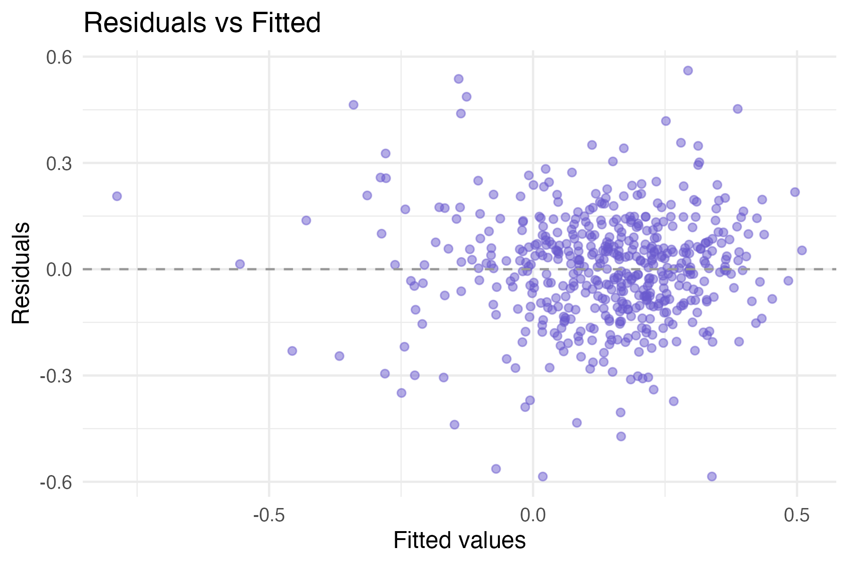
Diagnostic: Residuals vs Fitted

Slide 12
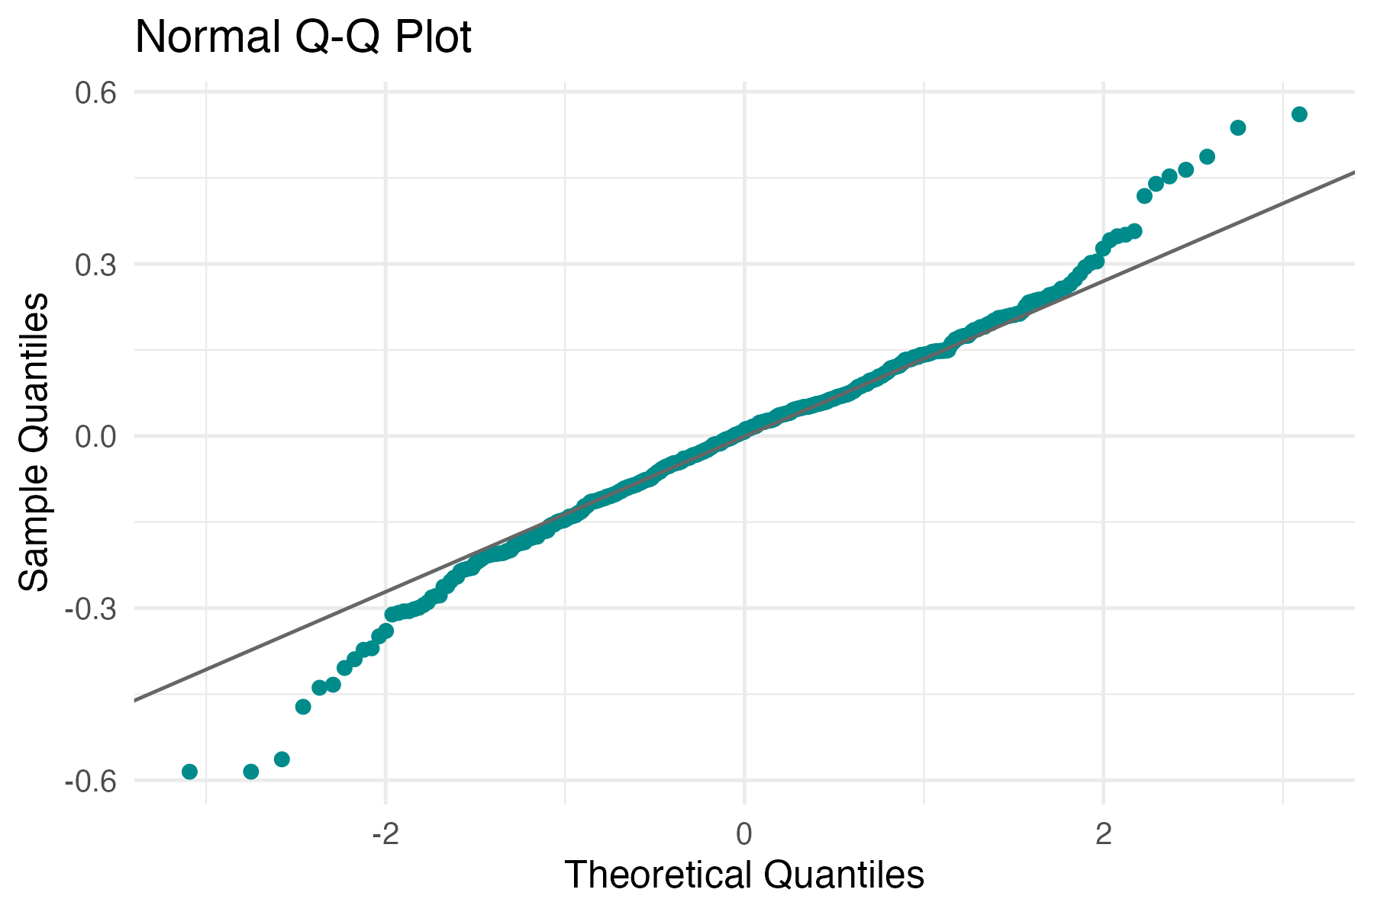
Diagnostic: Normal Q-Q

Slide 13
Key Takeaways
Momentum dominates: stronger early-year trends → higher annual returns
Volatility negatively related to returns; stability rewarded
Volume and short-term MA trend add limited incremental signal
Model captures >50% of return variation with simple technical inputs

Slide 14
Limitations & Next Steps
Single-year horizon—extend to multi-year panel to test stability
No sector fixed effects or macro controls—add in future work
Explore LASSO, tree ensembles, or interaction terms
Integrate fundamental factors (valuation, profitability)

Slide 15
References & Access
Cam Nugent. "S&P 500 Stock Data", Kaggle (Accessed Nov 2025).
Jegadeesh & Titman (1993). Returns to buying winners and selling losers.
Repository: https://github.com/paullopes2004/RegressionCourseProject
Contact: Paul Lopes (paullopes@iu.edu)

