Slide 1
Week two: simple linear regression
Paul Andrus (pandrus@regis.edu)
MSDS-660 Statistical methods and experimental design
College of computer and information sciences
Regis university

Slide 2
Overview
Regression analysis’s goal is to predict response from one or more variables. This week focus on simple linear regression, where relationship involves one response variable (dependent variable) and only one predictor (independent variable). The following topics will be discussed:
Fitting regression line with least square method
Inference for regression parameters, correlation, coefficient of determination, goodness of fit.
Underlying assumptions needed to be validated to make sure that the model is applicable.

Slide 3
Learner outcomes
Investigate the relationship between two numerical variables graphically (e.g. scatter diagrams)
Verify assumptions under regression analysis (visually and numerically)
Use linear regression to fit a line to the observations
Define parameters of interest and hypotheses using words and/or notations
Use statistical software to verify the model
Calculate, and interpret parameters such as slope and coefficient of determination
Summarize the model fitting

Slide 4
reading
1. James, G., Witten, D., Hastie, T., and Tibshirani, R. (2013). An Introduction to Statistical Learning with Applications in R. Springer. (pp. 59-68, 109-110). Retrieved from: http://www-bcf.usc.edu/~gareth/ISL/ISLR%20Fourth%20Printing.pdf
2. Stowell, S. (2014). Using R for Statistics. Apress Publication. (Safari Books Online via Regis library’s Books). Chapter 11 titled, “Regression and General Linear Models.”

Slide 5
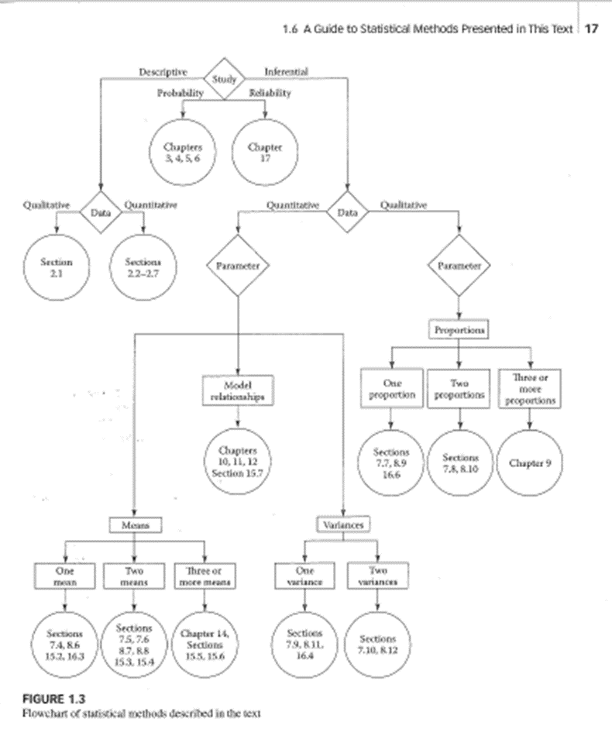

Slide 6
Simple linear regression
Model is a first degree polynomial in the form y = mx + b
m = slope
b =y-intercept
Single predictor or independent variable
Single response or dependent variable
Deterministic model
Probabilistic model
Notes:
A deterministic model fits all points exactly, e.g., perfect correlation
A probabilistic model acknowledges random variation of data points around the line.
Why random? What if they weren’t random? – Their effect would be captured by the model.

Slide 7
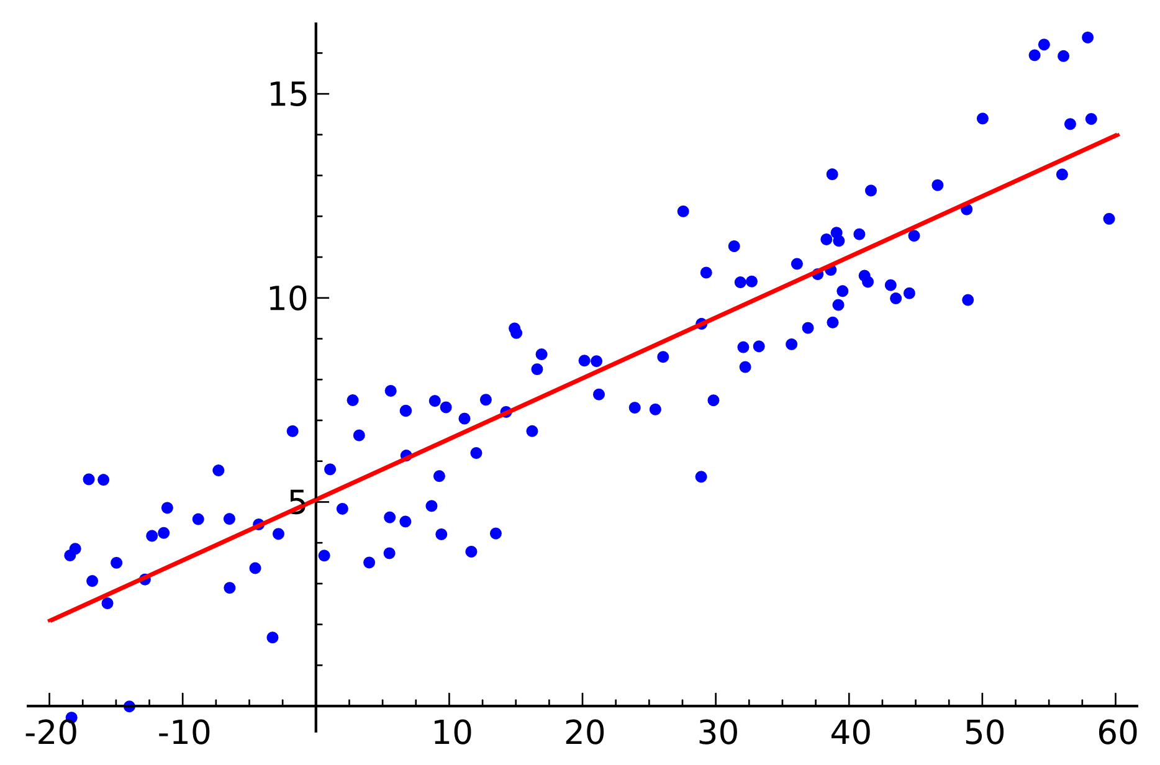
Simple linear regression plot
https://en.wikipedia.org/wiki/Simple_linear_regression#/media/File:Linear_regression.svg

Slide 8
Best-fit regression
Why can’t you simply minimize the residuals?
y = mx + b is the general formula for a straight line in Cartesian coordinates
Given any x, the formula for the response y is:
y = β₀ + β₁x + ε
β₀ and β₁ are unknown parameters (before modeling) of the deterministic portion of the model
ε is the non-deterministic portion of the model
This is the equation for the probabilistic solution
How to deal with ε?
Notes:
Infinite number of solutions. Infinite number of lines around the cluster centroid.

Slide 9
Method of least squares
The general solution for dealing with ε is called the “method of maximum likelihood”
When these assumptions hold:
The mean of the probability distribution of ε = 0
The variance of the probability distribution of ε is constant for all x
The probability distribution of ε is normal
ε for different observations are independent
then the method of least squares is accurate
Sum of the squares is minimized
Notes:
Maximum likelihood that residual is 0

Slide 10
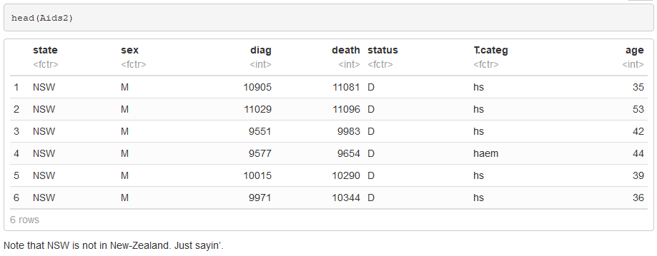
Investigate the relationship between two numerical variables graphically (e.g. scatter diagrams)
Notes:
Let's use MASS package Aids2 data set. "Data on patients diagnosed with AIDS in Australia before 1 July 1991."
Because you have have had or will have MSDS-640 Ethics, Privacy, and Social Justice, "Note: This data set has been slightly jittered as a condition of its release, to ensure patient confidentiality."

Slide 11
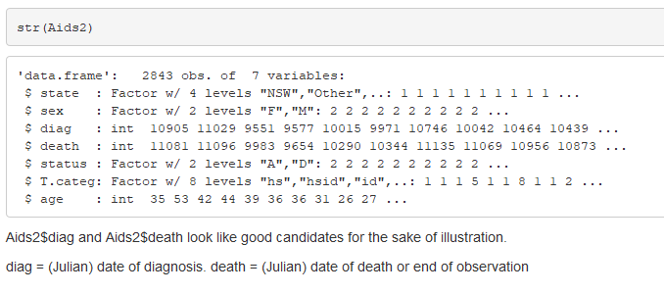
Notes:
Can’t die before diagnosed
What about the top line? Still alive
What to do with it? Get rid of it
How? Separate out Death = max(Death). Put back in Diagnosis = Max(diagnosis)

Slide 12
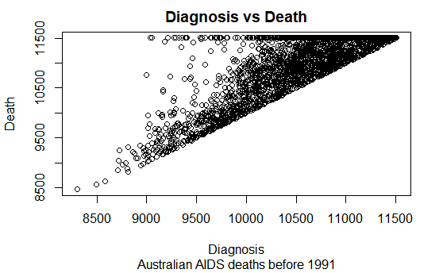

Slide 13
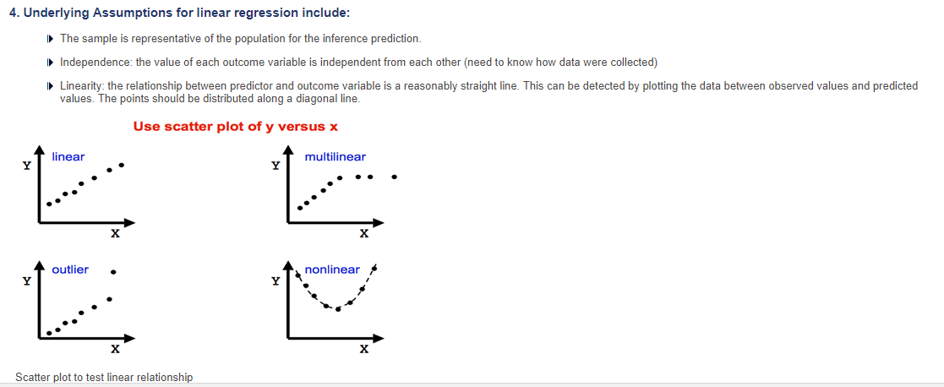
Verify assumptions under regression analysis (visually and numerically)

Slide 14
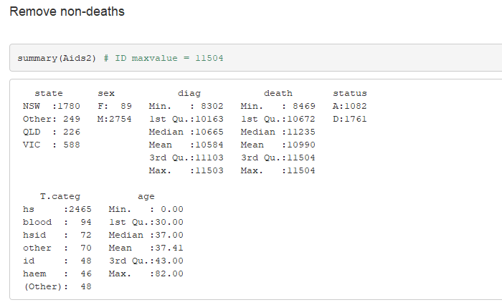
Use linear regression to fit a line to the observations

Slide 15
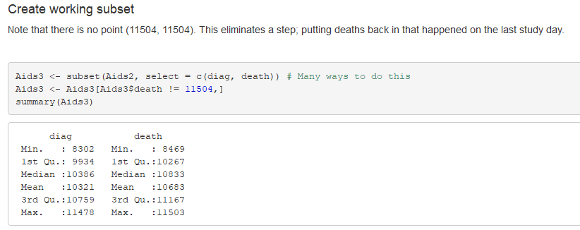

Slide 16
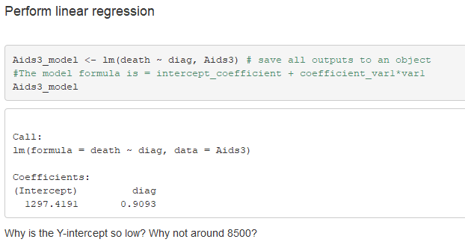
Notes:
Next time add glm()

Slide 17
Define parameters of interest and hypotheses using words and/or notations
Proof by contradiction
You can’t prove yourself right until you prove yourself wrong
What you really want to learn is the “alternative hypothesis”
Its opposite is the null hypothesis
There is no correlation
Levels are not high/low

Slide 18
terms
Null hypothesis
Alternative hypothesis
Test statistic
Rejection region
Conclusion

Slide 19
Error type
Type I
Reject null hypothesis when it is true
Type II
Accept null hypothesis when it is false

Slide 20
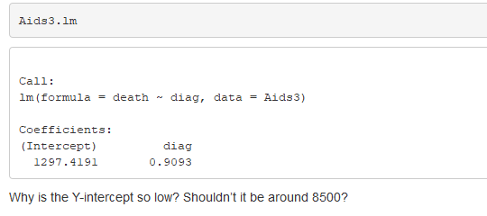
Calculate, and interpret parameters
Notes:
Aids3.lm

Slide 21
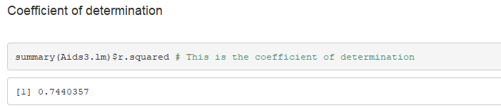
Summarize the model fitting
Notes:
In listwise deletion a case is dropped from an analysis because it has a missing value in at least one of the specified variables. The analysis is only run on cases which have a complete set of data.
Pairwise deletion occurs when the statistical procedure uses cases that contain some missing data. The procedure cannot include a particular variable when it has a missing value, but it can still use the case when analyzing other variables with non-missing values.
summary(Aids3.lm)$r.squared # This is the coefficient of determination

Slide 22
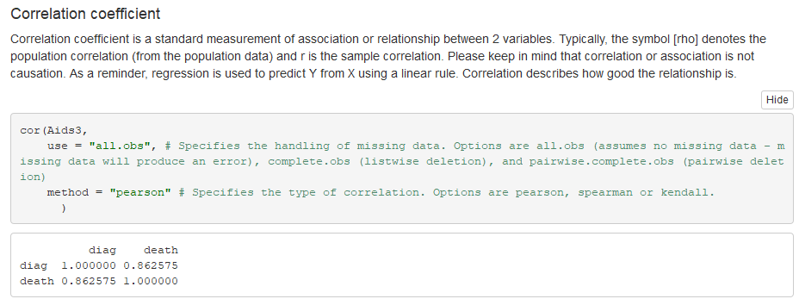
(R code in speaker notes)
Notes:
cor(Aids3,
use = "all.obs", # Specifies the handling of missing data. Options are all.obs (assumes no missing data - missing data will produce an error), complete.obs (listwise deletion), and pairwise.complete.obs (pairwise deletion)
method = "pearson" # Specifies the type of correlation. Options are pearson, spearman or kendall.
)

Slide 23
15
15
14
14
13
13
12
12
11
11
10
10
9
9
8
8
7
7
6
6
5
5
4
4
3
3
2
2
1
1
1
2
3
4
5
6
7
8
9
10
11
12
13
14
15
1
2
3
4
5
6
7
8
9
10
11
12
13
14
15

