Slide 1
Week three: multiple linear regression
Paul Andrus (pandrus@regis.edu)
MSDS-660 Statistical methods and experimental design
College of computer and information sciences
Regis university
Notes:
"C:\Users\pandr\OneDrive\Regis\!MSDS660Stats\Wk3"

Slide 2
Overview
Multiple linear regression (MLR) is used to predict the response variable from 2 or more predictor variables.
It is an extension model of simple linear regression.
Assumptions in simple linear regression are still applied to MLR.
Issues such as multicollinearity, interaction terms, methods to build the model, etc. needed to be addressed.

Slide 3
Learner outcomes
Explain what is multiple linear regression (MLR) and when to use it
Define parameters of interest and hypothesis using words and/or notations
Use statistical software to verify the model
Interpret the MLR coefficients correctly
Make summary conclusion about the findings based on evidences

Slide 4
reading
James, G., Witten, D., Hastie, T., and Tibshirani, R. (2013). An Introduction to Statistical Learning with Applications in R. Springer. (pp. 71-102, 113-119).Retrieved from: http://www-bcf.usc.edu/~gareth/ISL/ISLR%20Fourth%20Printing.pdf
Ferrari, D. (2009) Introduction to Regression in R Part II: Multivariate Linear Regression Retrieved from: http://scc.stat.ucla.edu/page_attachments/0000/0140/reg_2.pdf
Williams, R. (2015) Review of Multiple Regression. University of Notre Dame.
Retrieved from: http://www3.nd.edu/~rwilliam/stats2/l02.pdf

Slide 5
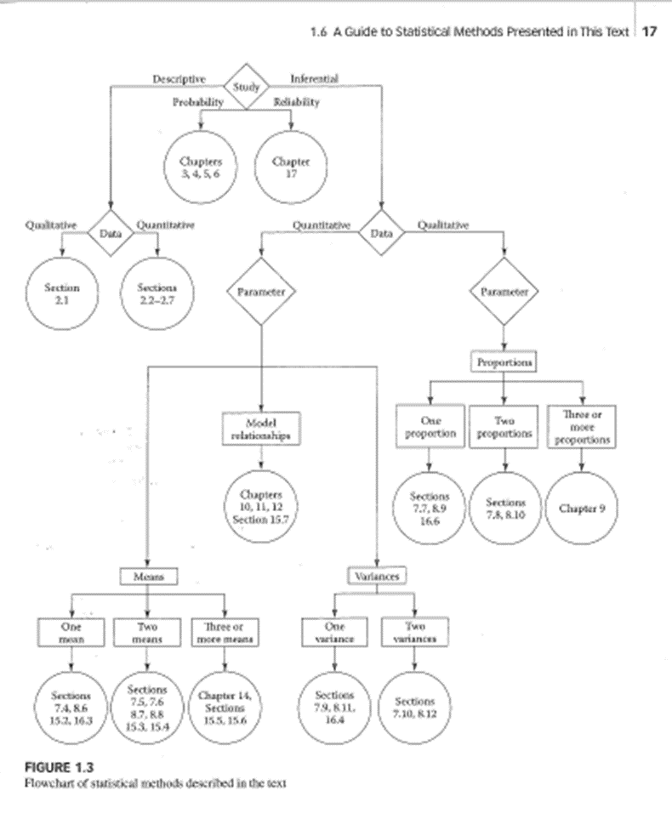

Slide 6
Explain what is multiple linear regression (MLR) and when to use it
Multiple – two or more predictor variables
Linear – model in every dimension is a plane
Regression – is not categorization
What does this say about the response variable?
When to use it
Need to extrapolate data set
All variables are quantitative
Think of scatterplot in n-dimensions
Notes:
What does this say about the response variable? It is also numeric. If it were factor this would be a categorization problem
Why can’t we do simple liner regression on the variables individually?
You will do these later
Multiple linear regression (MLR) is used to predict the response variable when there are 2 or more quantitative explanatory variables. For example, the selling price of a house may depend on location, number of bedrooms, number of bathrooms, year built, etc. The model can be represented as:
Where is the dependent variable

Slide 7
Some important questions
Is at least one independent variable useful in predicting the response?
Are all useful?
How well does the model fit the data
Given a set of predictor variables, what response do we expect, and how accurate is that prediction?
Notes:
See Introduction to Statistical Learning Using R page 75 -

Slide 8
Define parameters of interest and hypothesis using words and/or notations
y = β₀ + β₁x₁ + β₂x₂ + β₃x₃ … + β_{n}x_{n} + ε
Investigate each predictor variable
Mean
Standard deviation
Minimum
Maximum
Outliers
Use
Histogram
Scatter plot
Alternate hypotheses are more complicated
No longer binary
Which predictor variables correlate to responses?
Notes:
Walk through formula
Mendenhall and Sincich page 489
bottom of page 72 Intro to Statistical Learning
Here are suggestions to deal with multiple x variables:
Investigate each individual variable (e.g. mean, standard deviation, min,max, outliers, histogram, stem plot) to understand each variable.
Examine the relationship between different pairs of variables using correlation and scatter plots. The variables with strong relationships with y will be kept.
Perform a regression using all explanatory variables

Slide 9
Interpret the MLR coefficients correctly
N-dimensional space
Beta values are slopes in each dimension
Degrees of freedom
the number of values in the final calculation of a statistic that are free to vary
Of the regression is the number of variables
Of the error is the number of observations – number of variables – 1
R² is the amount of variation that can be explained by the regression
0 is no linear relationship
0.25 is a moderate relationship
0.50 is a strong relationship
1.0 is a perfect linear relationship
Notes:
In statistics, the number of degrees of freedom is the number of values in the final calculation of a statistic that are free to vary.

Slide 10
Multicollinearity
A predictor variable depends on other predictor variables
Coefficient estimates may vary widely with small changes in predictor variables
Variance Inflation Factor (VIF) is the ratio of variance in a model with multiple terms, divided by the variance of a model with one term alone
Quantifies multicollinearity
VIF = 1 means no multicollinearity
R VIF function from the car package
See Intro to Statistical Learning Using R page 114

Slide 11
15
15
14
14
13
13
12
12
11
11
10
10
9
9
8
8
7
7
6
6
5
5
4
4
3
3
2
2
1
1
1
2
3
4
5
6
7
8
9
10
11
12
13
14
15
1
2
3
4
5
6
7
8
9
10
11
12
13
14
15

