Slide 1

GITHUB
http://github.com/paulmey
paulmey@microsoft.com

Slide 2
Git basics
git
init/clone
add
commit
status
log
push/pull/fetch/merge
config

Slide 3
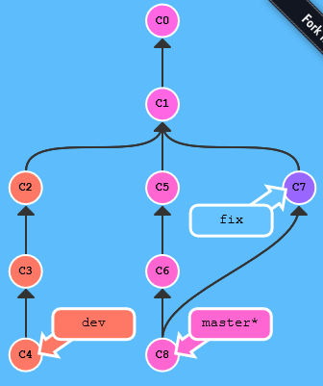

The tree graph of commits
Why branch?
Parallel development
feature work v.s. bug fixes
multiple features in flight at once
Release stability / quality control
What is a branch?
Look at it as creating another copy of the code
After branching comes merging
Hardly ever seen in a tree
Sometimes yields conflicts

Slide 4
Branching, merging
The first branch is named ‘master’, think of it as ‘the master copy’
Switching to a branch is done by ‘checkout’: git checkout otherbranch
Creating a branch is like checking out a branch: git checkout –b newbranch
You can list branches: git branch
You can merge some other branch into the branch you’re on: git merge otherbranch

Slide 5
Your own GitHub project
github.com/ username/ corefx
Go to github.com, log in or create a new user
Then, create a new repository
Open a command window:
git clone http://github.com/username/repo
cd repo
echo Hello world > hello.txt
git add hello.txt
git commit –m “initial commit”
git push (git may ask for you username & password)
Refresh your browser
clone
pull
push
c:\src\corefx

Slide 6
Your own GitHub project (2)
github.com/ username/ corefx
Let’s try this ‘pull’ thing:
cd ..
git clone http://github.com/username/repo repocopy
cd repocopy
echo Bye world > bye.txt
git add bye.txt
git commit –m “add bye.txt”
git push (git may ask for you username & password)
cd ..\repo (back in your first copy of the repo)
dir (shows only hello.txt)
git pull (‘pulls down’ any updates from github)
dir (shows both files)
clone
pull
push
c:\src\corefx

Slide 7

GitHub pull request workflow
github.com/ dotnet/ corefx
fork
github.com/ username/ corefx
The big idea: Instead of pushing to a repo you do not ‘own’, you can ask the owner to ‘pull’ from your repo
Try this out with a partner:
Find their repo on github.com
Click the button to create a copy under your account
Clone their repo on your machine:
git clone http://github.com/neighbor/repo
Add your own GitHub fork as a remote:
git remote add me http://github.com/me/repo
pull request
clone
pull
push
c:\src\corefx

Slide 8

GitHub pull request workflow (2)
github.com/ dotnet/ corefx
fork
github.com/ username/ corefx
Continued:
Check out a new branch for your PR:
git co -b fix-spelling
Make your changes, add it and commit it
Push your new branch to your GitHub repo:
git push me
Go to their repo on GitHub.com and open a new pull request
After discussion on GitHub, your partner may choose to merge your PR or close it.
pull request
clone
pull
push
c:\src\corefx

Slide 9
Merge conflict resolution
Resolve manually (look for >>> === <<< in the conflict file), fix it and git add file, git commit
Or… use visual merge tools like kdiff3: git mergetool

Slide 10
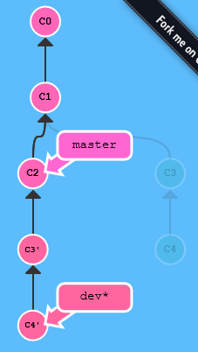

Rebasing
Like merging, but very different
Replay commits from last shared parent
Can yield conflict on every commit that’s being replayed
Conflict have to be resolved before rebasing can continue
Creates ‘linear history’, avoids ‘fix’ commits
git rebase ontothisbranch git rebase fromthiscommit --onto thisbranch

Slide 11
Interactive rebase & squashing
Interactive rebasing (-i) lets you pick an action per commit:
pick = use commit
reword = use commit, but edit the commit message
edit = use commit, but stop for amending
squash = use commit, but meld into previous commit
fixup = like "squash", but discard this commit's log message
exec = run command (the rest of the line) using shell
drop = remove commit
Squashing is melding multiple commits into one commit. This is sometimes requested before a PR is allowed to be merged.

Slide 12
Some references
http://help.github.com/
Everything you ever needed to know
http://rogerdudler.github.io/git-guide/
Some more git basics
http://learngitbranching.js.org/
Very nice graphical & command line branching tutorial
http://marklodato.github.io/visual-git-guide/index-en.html
Nitty gritty git fundamentals with good graphics

Slide 13
My aliases
alias.co=checkout
alias.l=log --graph --pretty=format:'%Cred%h%Creset -%C(auto)%d%Creset %s %Cgreen(%cr) %C(bold blue)<%an>%Creset' --abbrev-commit --date=relative
alias.cod=checkout paulmey/dev
alias.s=status -s -b
alias.fa=fetch –all
I also use “gitextensions” a lot for looking at the graph

