Slide 1
Criteo Campaign Analysis
Data-Driven Insights for CTR Optimization

Slide 2
Executive Summary
Analyzed 100,000 display ad impressions with 7.86% overall CTR
Mobile devices show +41.9% better performance than desktop
Peak hours (9-11 AM, 7-9 PM) drive +25.9% higher CTR
Machine learning model achieves 55.53% prediction accuracy (ROC AUC)
Potential 25-30% revenue increase with optimized targeting

Slide 3
Dataset Overview
100,000
Total Impressions
7,863
Total Clicks
7.86%
Overall CTR
$2.50
Avg Bid Price
Device Types: Mobile, Desktop, Tablet
Time Dimensions: 24-hour granularity across all campaigns
Site Categories: News, Sports, Entertainment, Tech, Shopping, Social
Bid Range: $0.01 - $5.00 per impression

Slide 4
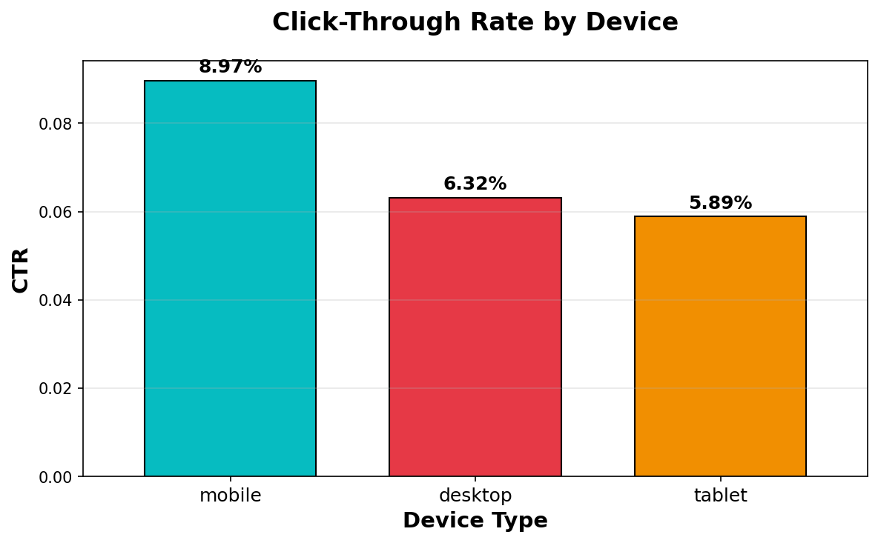
CTR Performance by Device Type

Slide 5
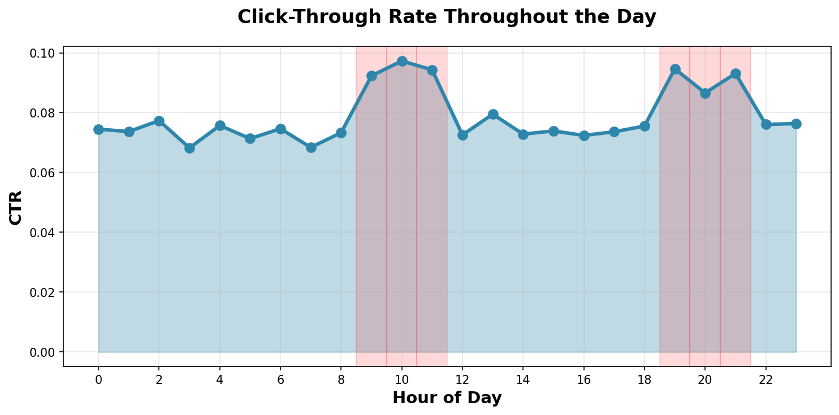
CTR Performance by Hour

Slide 6
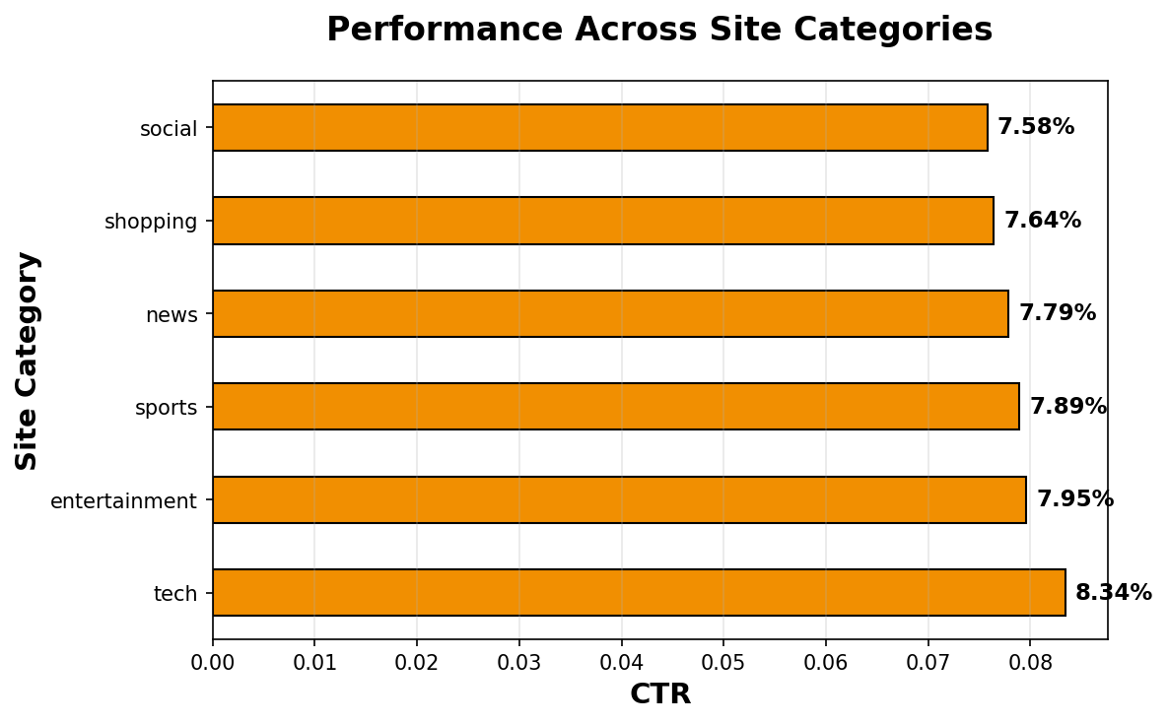
CTR by Site Category

Slide 7
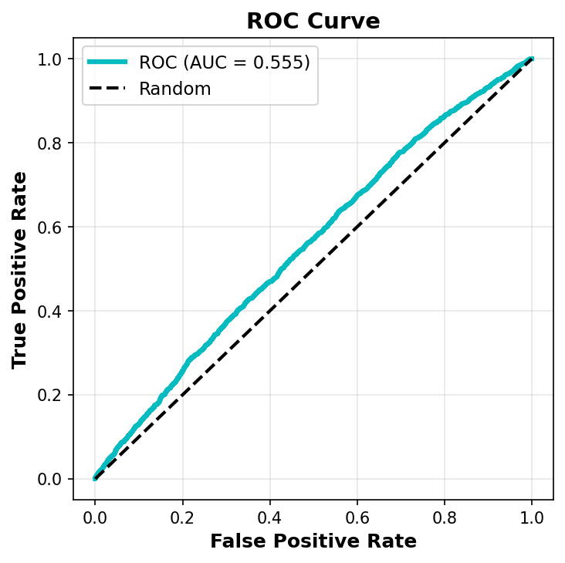
Predictive Model Performance
Model: Random Forest Classifier
ROC AUC Score: 0.5553
Prediction Accuracy: 55.5%
Training Samples: 80,000
Test Samples: 20,000
Features Used: 14

Slide 8
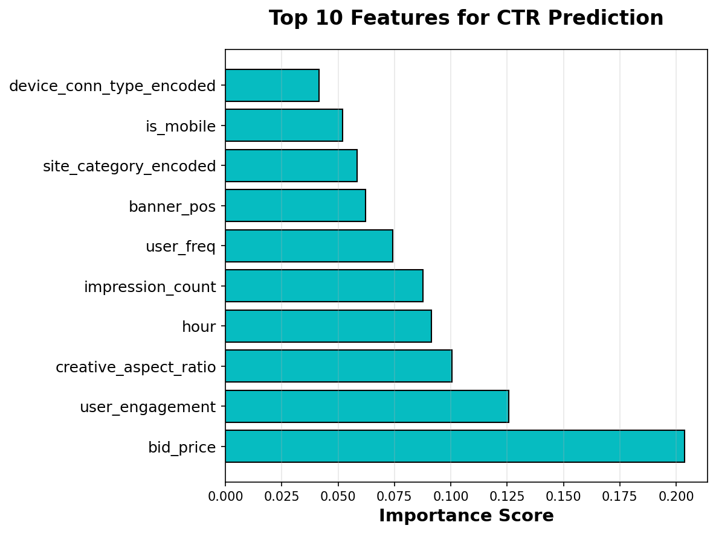
Top Predictive Features

Slide 9
Key Business Insights
> Device Optimization
Mobile CTR: 8.97% vs Desktop: 6.32%
Mobile performs +41.9% better
> Timing Strategy
Peak Hours CTR: 9.30% vs Off-Peak: 7.39%
Peak hours show +25.9% improvement
> Bidding Optimization
High Bid (>$3) CTR: 9.26% vs Low Bid: 6.94%
Strategic bidding increases CTR by +33.4%

Slide 10
Strategic Recommendations
1. Increase mobile ad spend by 15-20%
→ Capitalize on superior mobile performance
2. Concentrate 60% of budget during peak hours
→ Focus on 9-11 AM and 7-9 PM time slots
3. Implement dynamic bidding ($2.50-$4.00)
→ Optimize ROI with strategic bid ranges
4. Deploy predictive model for real-time optimization
→ Use ML model for automated bid adjustments
5. Prioritize top 3 performing site categories
→ Allocate budget to highest-converting categories

Slide 11
Expected Business Impact
Projected Outcomes
Current CTR: 7.86%
Projected CTR: 9.83%
CTR Improvement: +25.0%
Revenue Impact: +25-30%
Campaign Efficiency: +20-25%

Slide 12
Next Steps & Implementation
Phase 1: Immediate Actions (Week 1-2)
  • Adjust budget allocation to mobile platforms
  • Implement peak-hour scheduling
  • Begin A/B testing with new bid strategies
Phase 2: Model Deployment (Week 3-4)
  • Deploy Random Forest model to production
  • Set up real-time monitoring dashboard
  • Train team on new optimization tools
Phase 3: Optimization (Month 2+)
  • Fine-tune model parameters based on results
  • Expand to additional campaign segments
  • Continuous improvement and iteration

Slide 13
Thank You
Questions & Discussion

