Slide 1
Gold Price Analysis
Historical Analysis of Gold Market Prices

Slide 2
Analysis Overview
Dataset: Historical gold price data
Analysis Type: Time series and trend analysis
Key Metrics: Price movements, returns, volatility
Technical Analysis: Moving averages and trends
Investment Insights: Return calculations and patterns

Slide 3
Data Visualizations

Slide 4
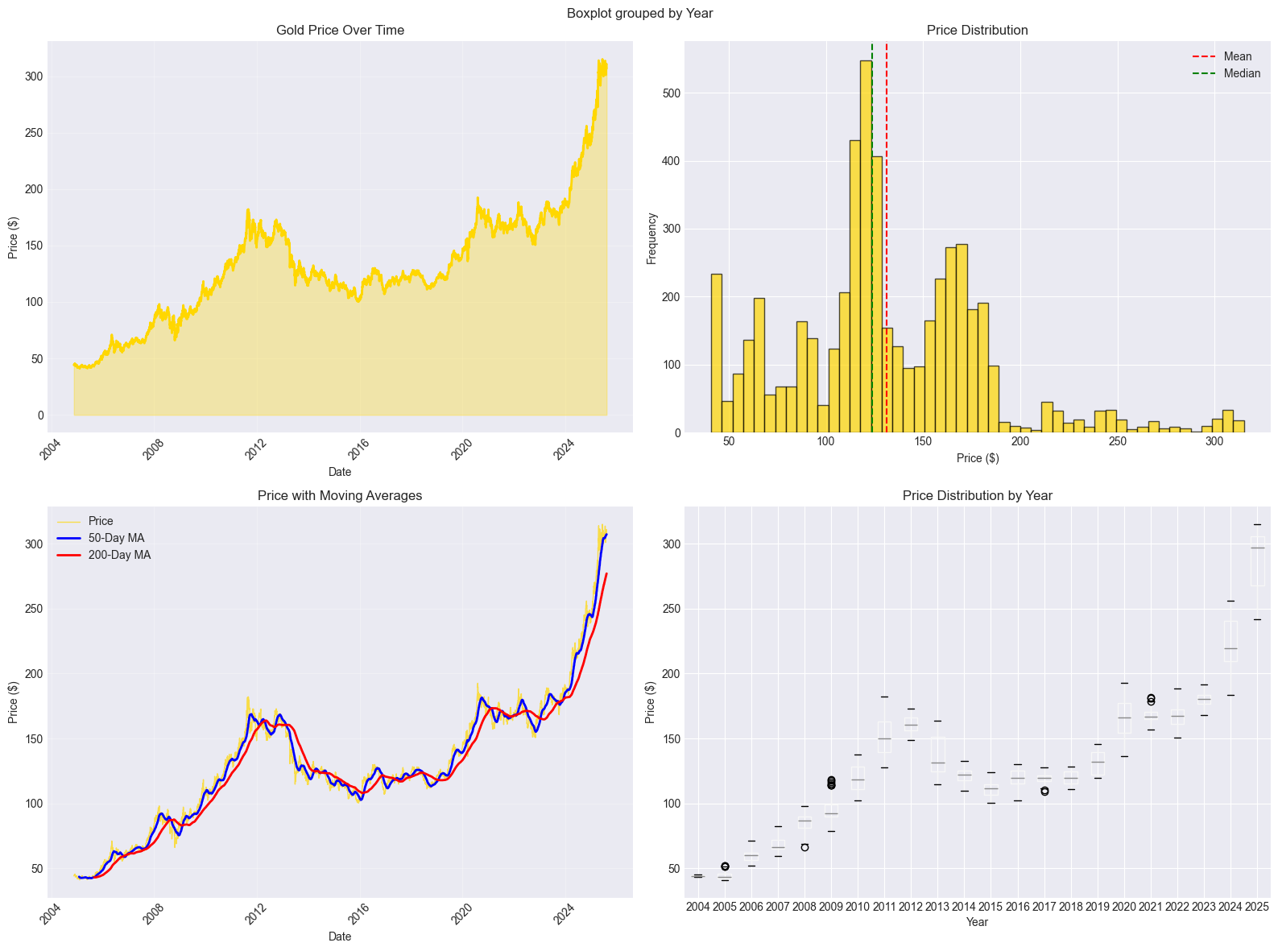
Price and Volume Analysis

Slide 5
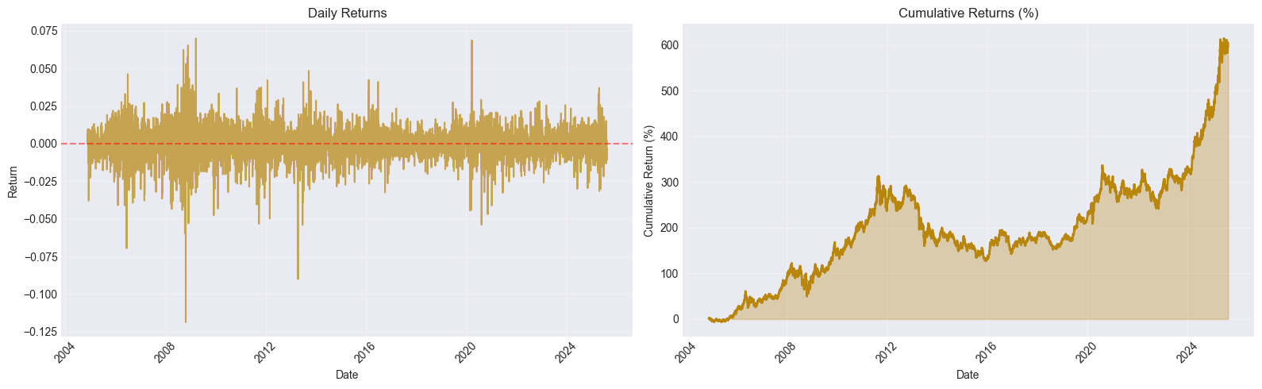
Statistical Distribution

Slide 6
Key Insights & Conclusions
Gold shows relatively stable price trends
Lower volatility compared to cryptocurrencies
Acts as hedge against market uncertainty
Long-term appreciation observed
Suitable for portfolio diversification

