Slide 1
NVIDIA Stock Market Analysis
Comprehensive Analysis of NVIDIA (NVDA) Stock Performance

Slide 2
Analysis Overview
Company: NVIDIA Corporation (NVDA)
Datasets: Stock data, history, and company info
Analysis: Price trends, returns, volatility
Technical Analysis: Moving averages and patterns
Performance: Growth metrics and statistics

Slide 3
Data Visualizations

Slide 4
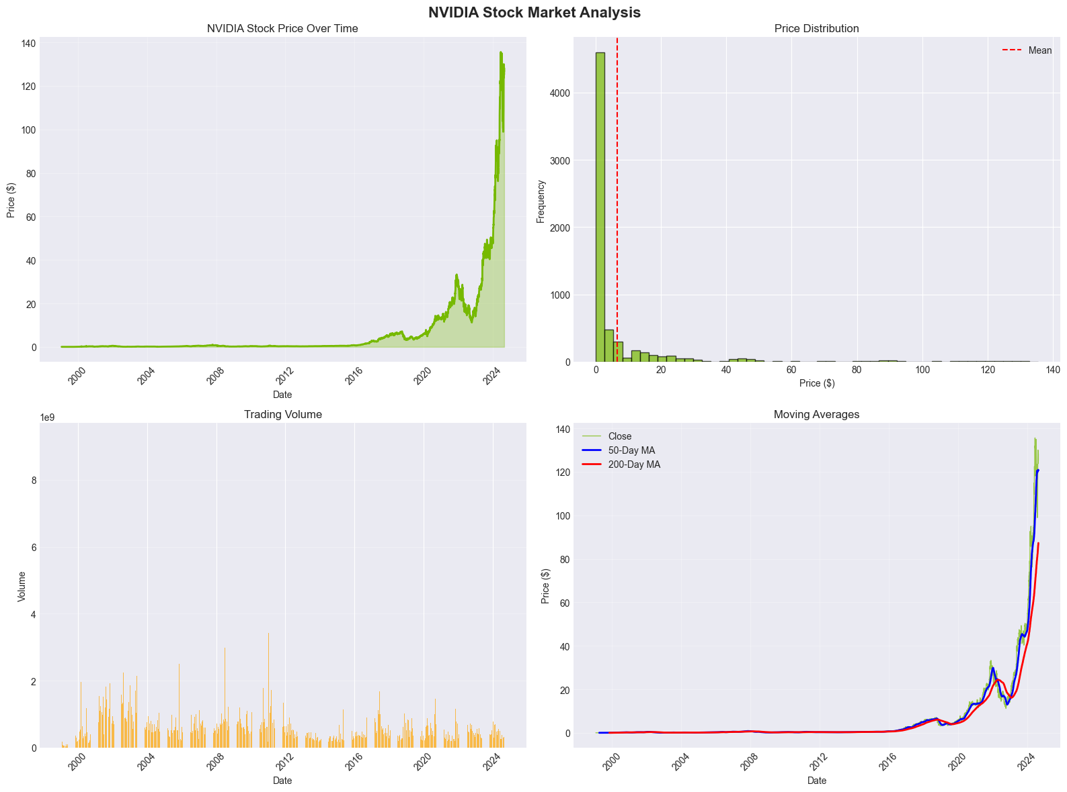
Price and Volume Analysis

Slide 5
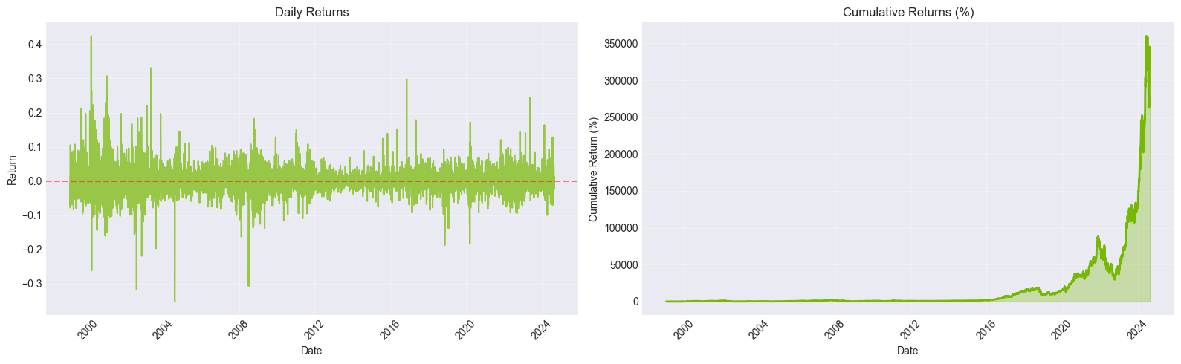
Statistical Distribution

Slide 6
Key Insights & Conclusions
NVIDIA shows exceptional growth performance
High volatility reflects growth stock nature
Strong market position in AI and GPU markets
Excellent liquidity for trading
Suitable for growth-oriented investors

