Slide 1
Nike Stock Market Analysis
Comprehensive Analysis of Nike (NKE) Stock Performance

Slide 2
Analysis Overview
Company: Nike Inc. (NKE)
Dataset: Historical stock market data
Analysis: Price, volume, returns, volatility
Technical Indicators: OHLC, moving averages
Performance Metrics: Returns, risk analysis, statistics

Slide 3
Data Visualizations

Slide 4
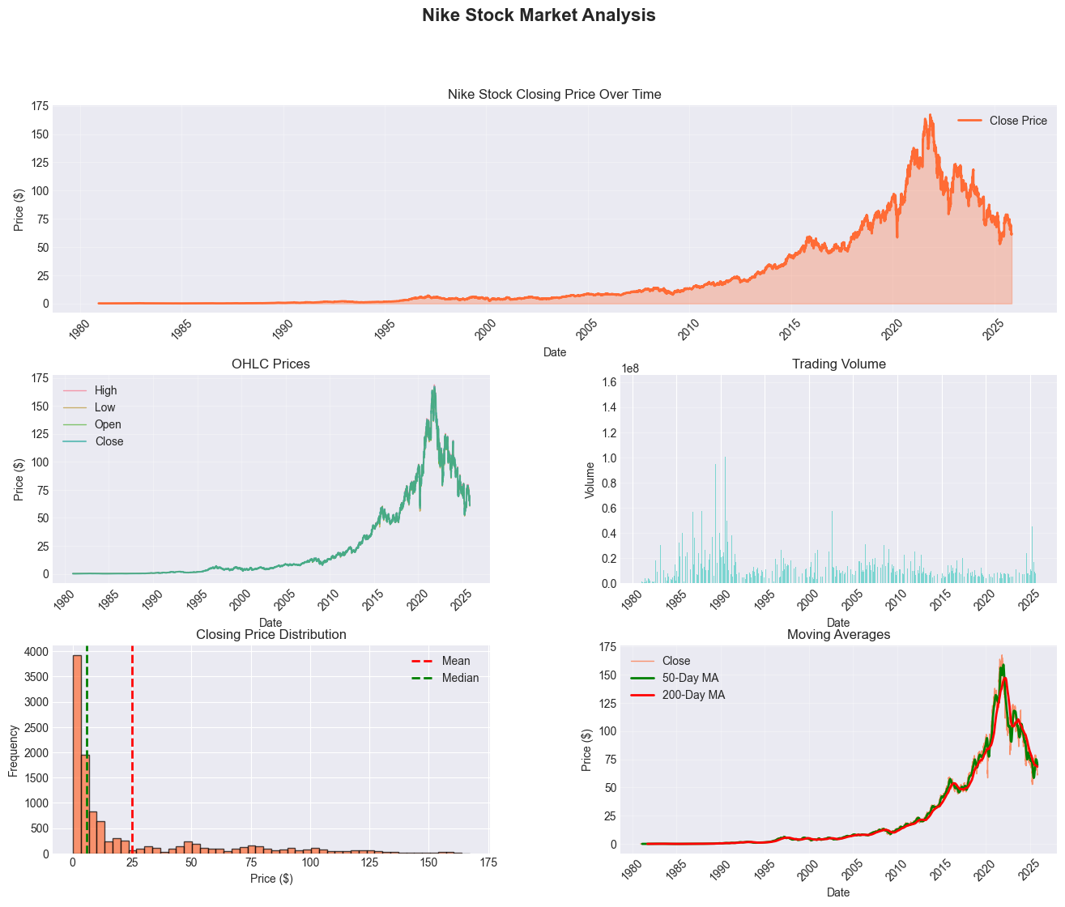
Price and Volume Analysis

Slide 5
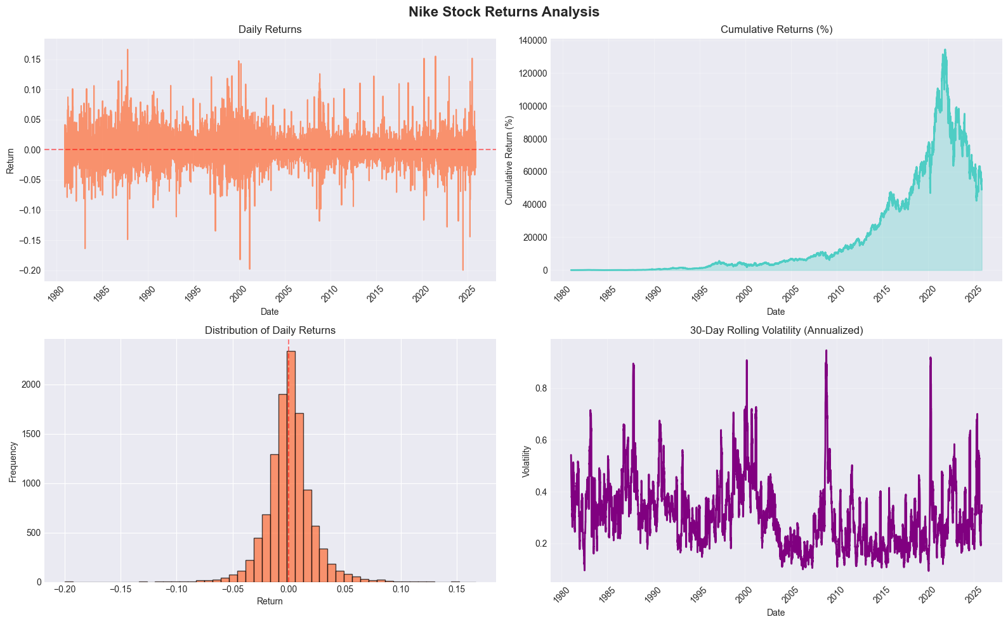
Statistical Distribution

Slide 6
Key Insights & Conclusions
Nike shows strong long-term performance
Moderate volatility for consumer goods sector
Healthy trading volumes indicate liquidity
Technical indicators suggest trends
Suitable for growth and value investors

