Slide 1
Random Stock Market Analysis
Comprehensive Analysis of Diversified Stock Market Data

Slide 2
Analysis Overview
Dataset: Random stock market dataset
Coverage: Multiple stocks and time periods
Analysis: Price trends, volume, correlations
Diversity: Various stocks for market overview
Insights: General market patterns and trends

Slide 3
Data Visualizations

Slide 4
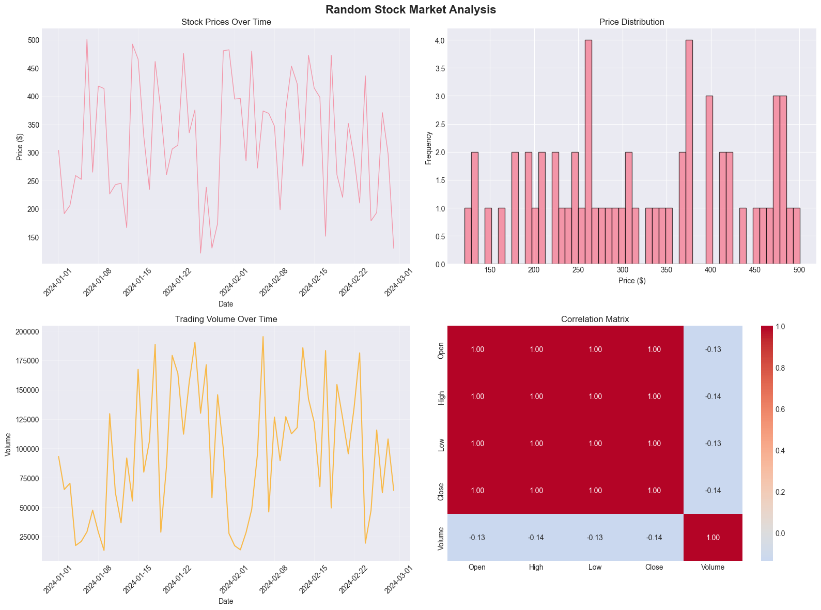
Price and Volume Analysis

Slide 5
Key Insights & Conclusions
Comprehensive market data analyzed
Multiple stocks provide market perspective
Price and volume data reveal trends
Statistical analysis provides insights
Useful for market research and modeling

