Slide 1
Walt Disney Company Stock Analysis
Comprehensive Analysis of Disney (DIS) Stock Performance

Slide 2
Analysis Overview
Company: The Walt Disney Company (DIS)
Dataset: Historical stock market data
Analysis: Price, volume, returns, risk metrics
Technical Analysis: OHLC, moving averages
Performance: Returns, Sharpe ratio, volatility

Slide 3
Data Visualizations

Slide 4
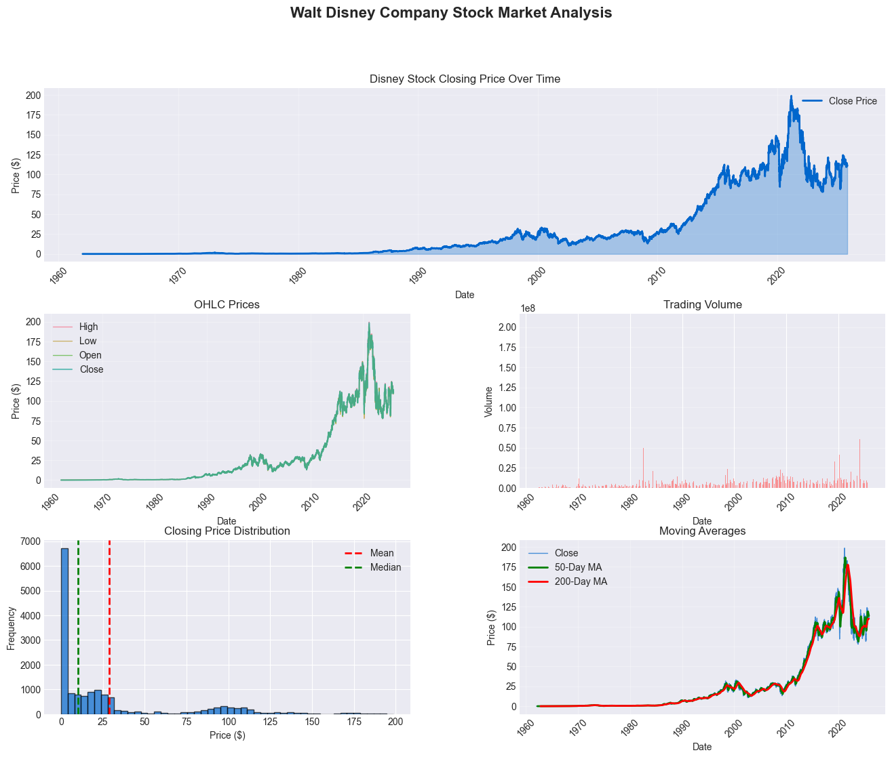
Price and Volume Analysis

Slide 5
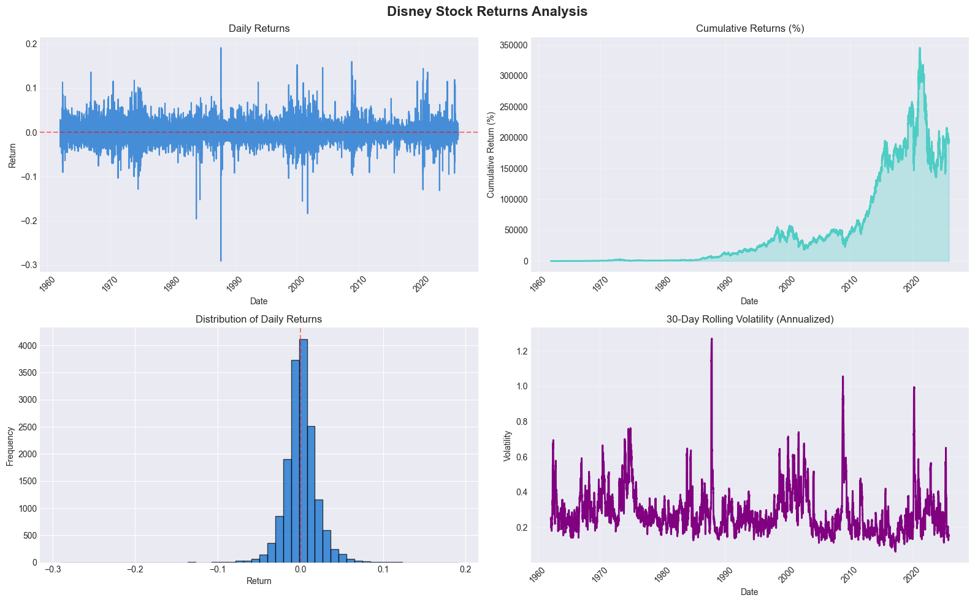
Statistical Distribution

Slide 6
Key Insights & Conclusions
Disney shows cyclical patterns
Entertainment sector exposure
Streaming growth opportunities
Moderate volatility for large-cap stock
Suitable for dividend and growth investors

