Slide 1
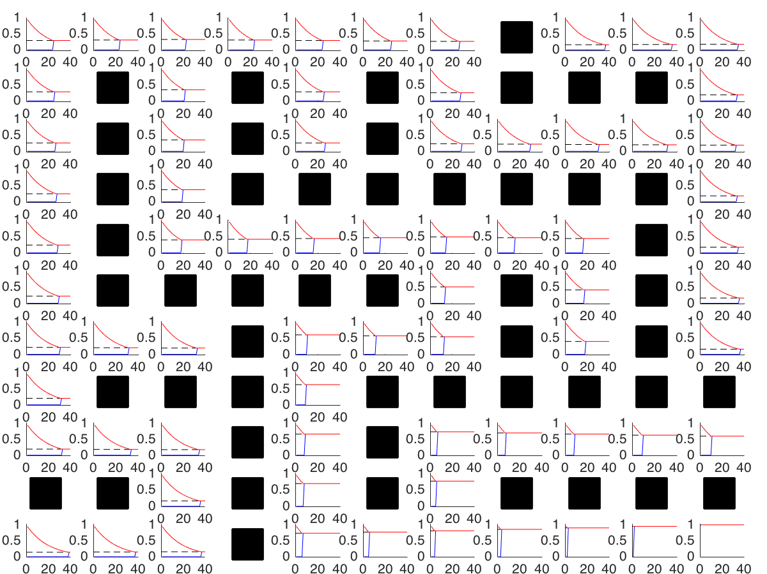
State Value
# Bellman Updates

