Slide 1
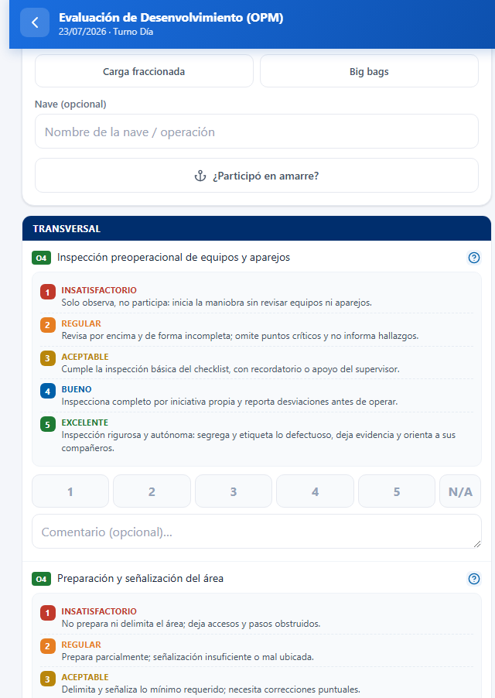
The prototype — scoring criteria
The score is explained before it is assigned
For each task, the supervisor can open the scoring rubric and compare the observed performance with the five defined levels.
1
Unsatisfactory
2
Fair
3
Acceptable
4
Good
5
Excellent
N/A
Use it when the task was not performed; it is not included in the average.
5
Visible scoring categories for every evaluation
14

