Slide 1
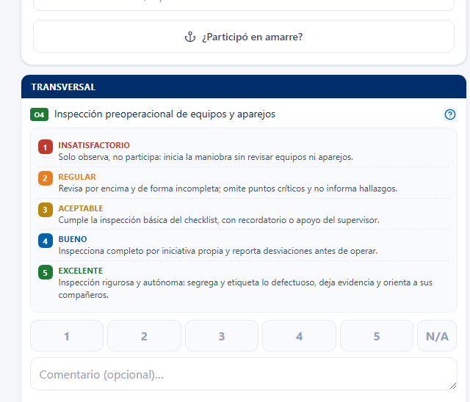
SCORING DURING THE SHIFT
When the supervisor can assign a score
TASK RUBRIC IN THE SYSTEM
Only for applicable work
After the shift, choose the cargo type and score only the tasks that were performed and observed.
Based on the task rubric
Select 1-5 only after comparing the observed performance with the description for that task.
Because every score is evidence
Each rating feeds its O1-O4 objective and creates traceable input for the quarterly appraisal.
Use N/A when it was not performed
N/A keeps a task out of the average; a safety event records Safety and Productivity below expectations.
OPM Performance Appraisal System
14

