Slide 1

Notes:
Export in VS Code: 1) Install "Marp for VS Code" 2) Open this file 3) Run "Marp: Export slide deck..."

Slide 2


Slide 3
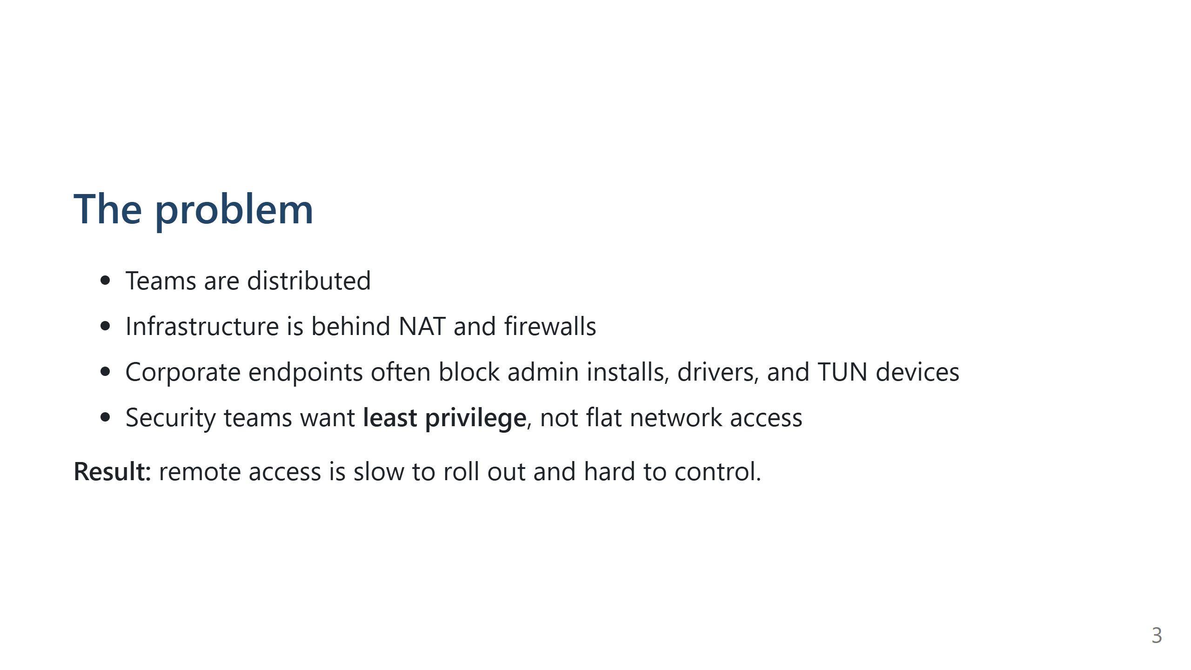

Slide 4
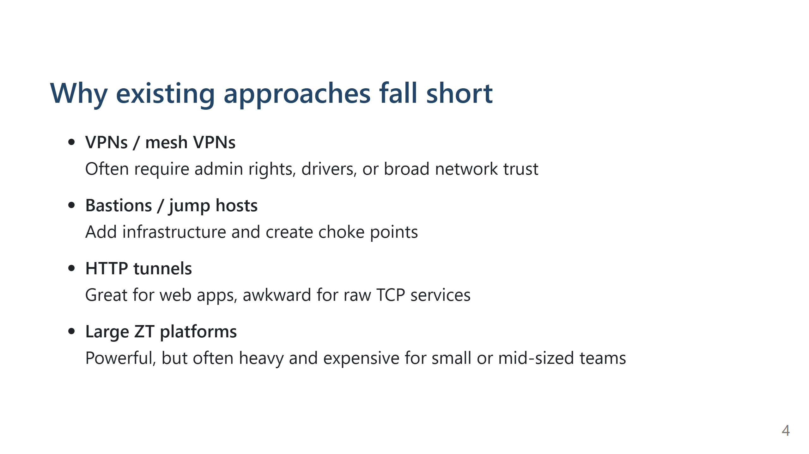

Slide 5


Slide 6


Slide 7
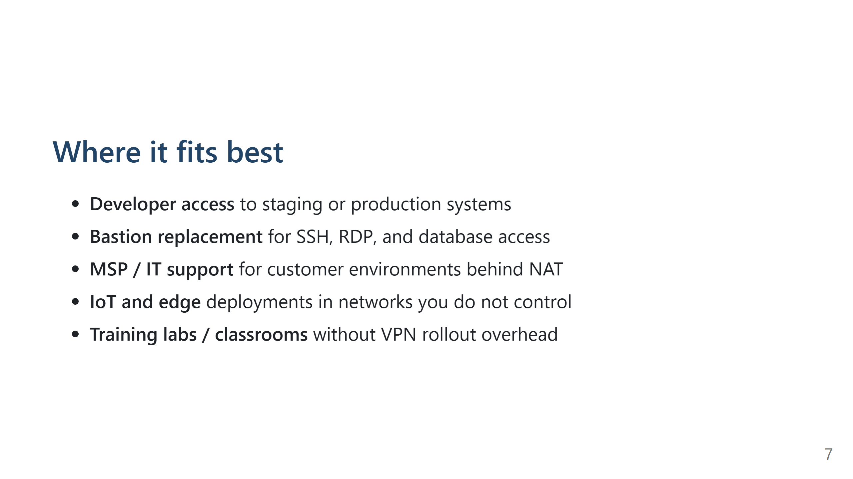

Slide 8
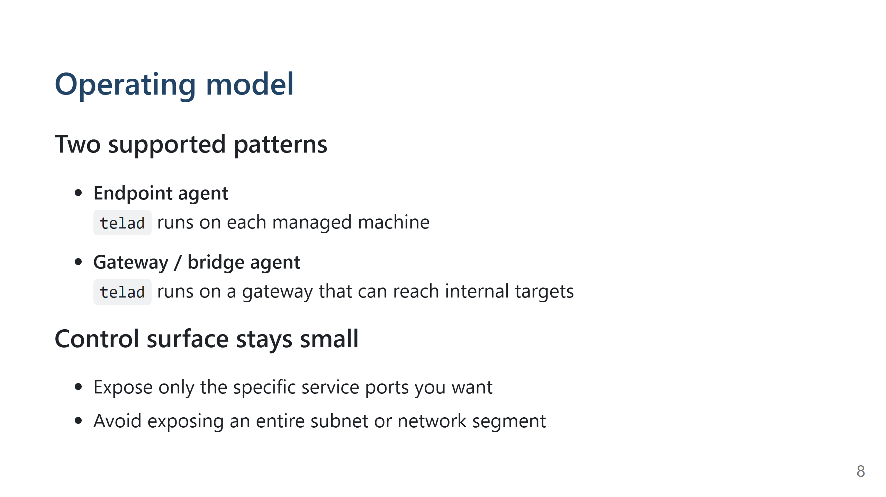

Slide 9
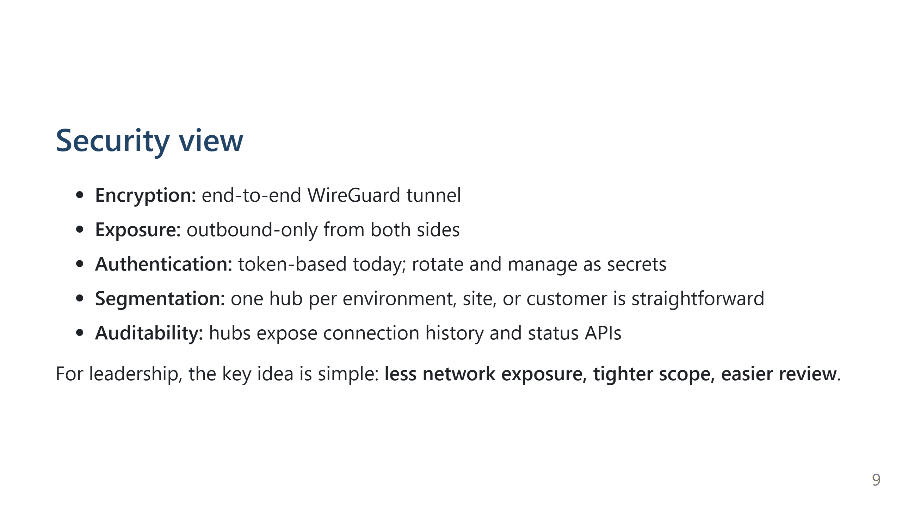

Slide 10
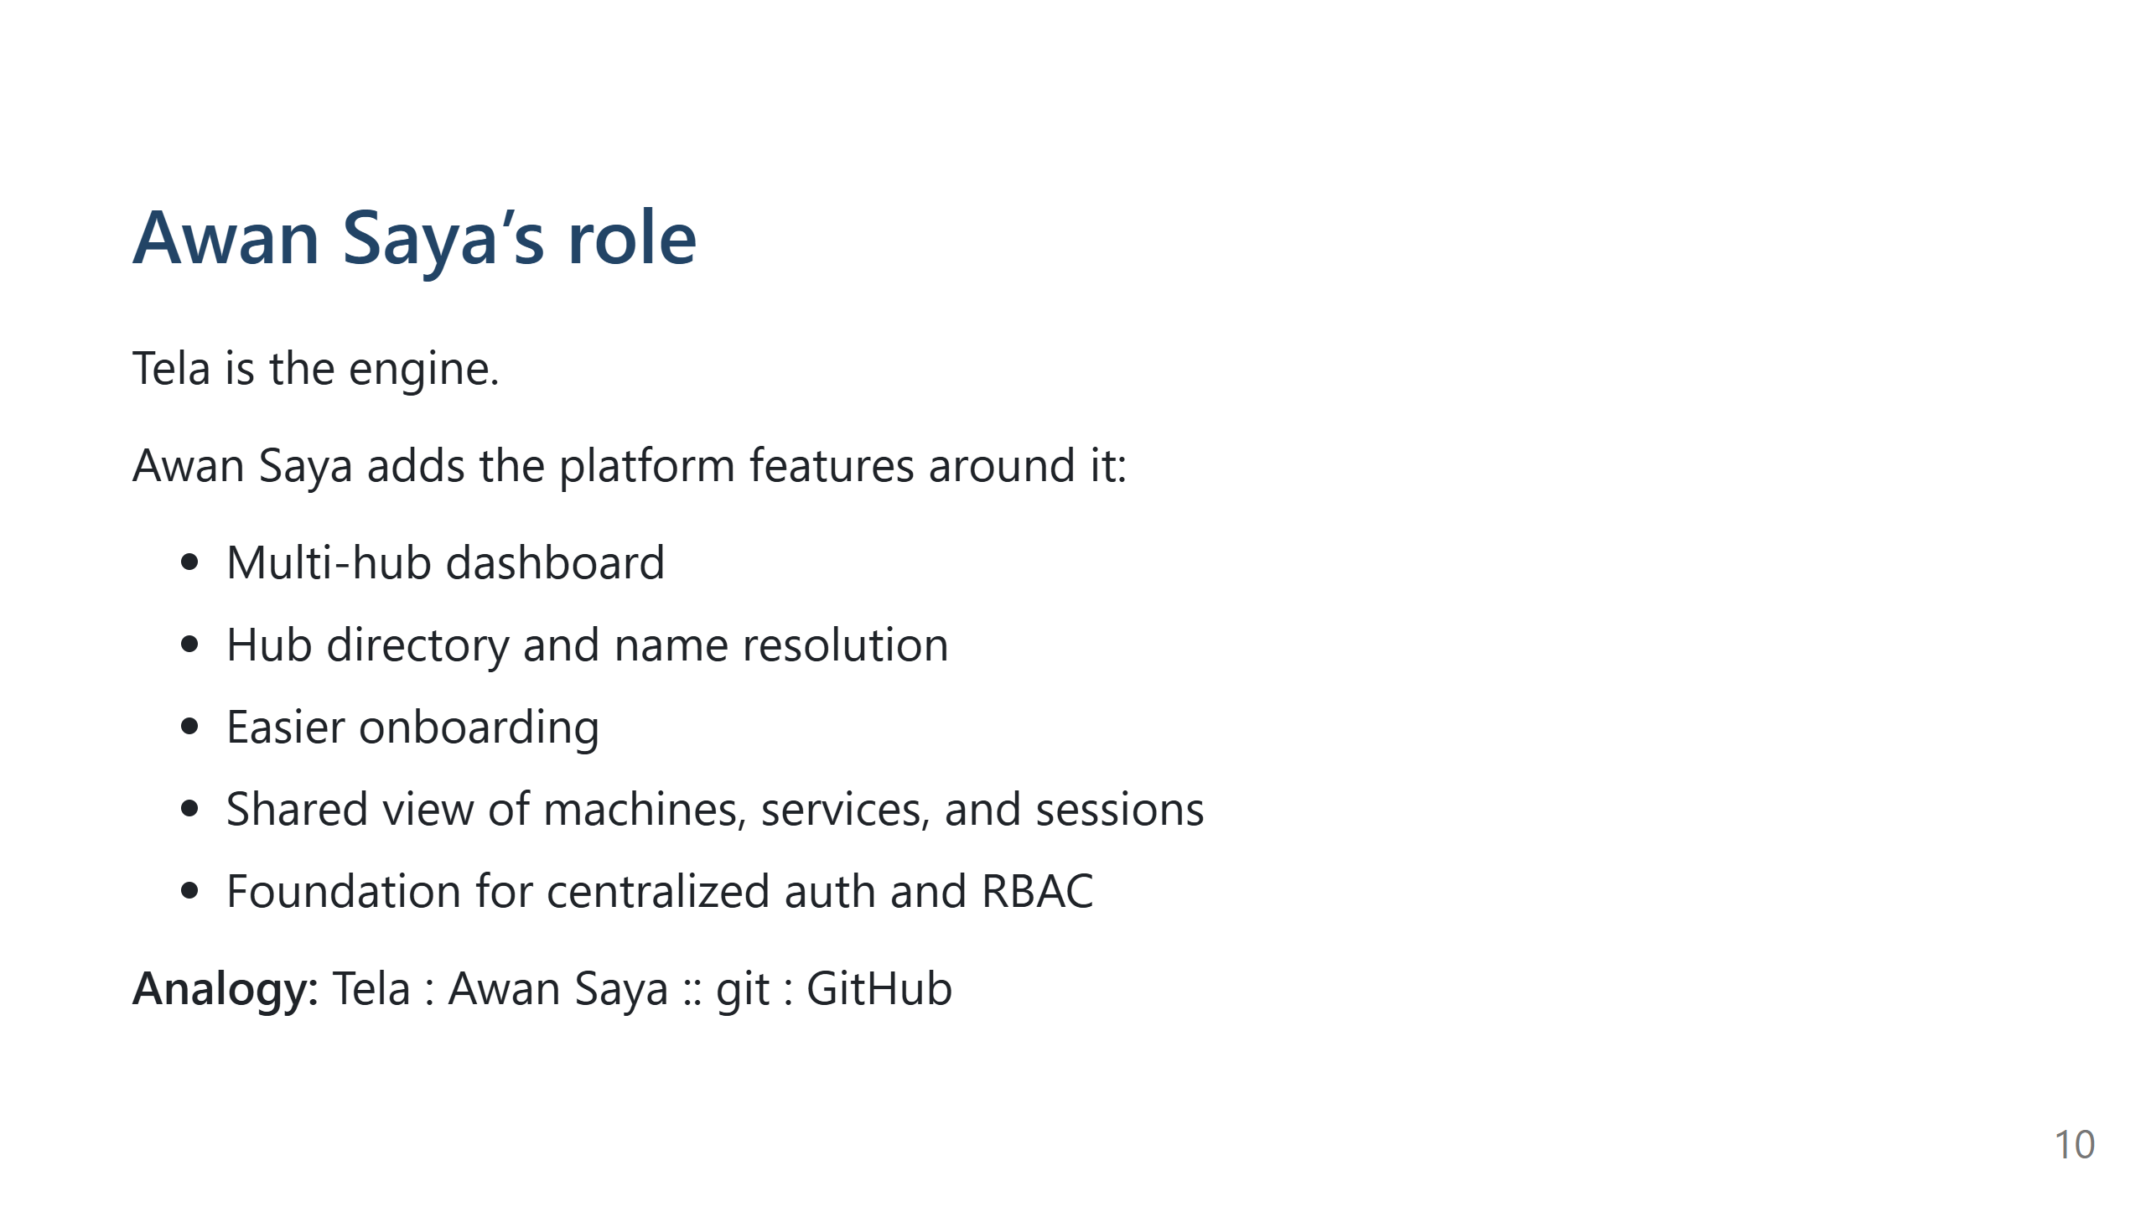

Slide 11
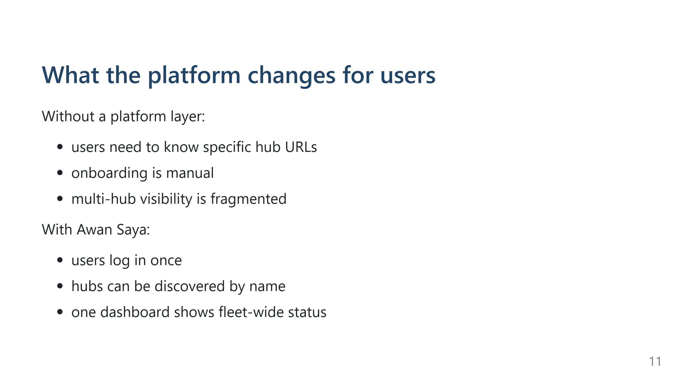

Slide 12
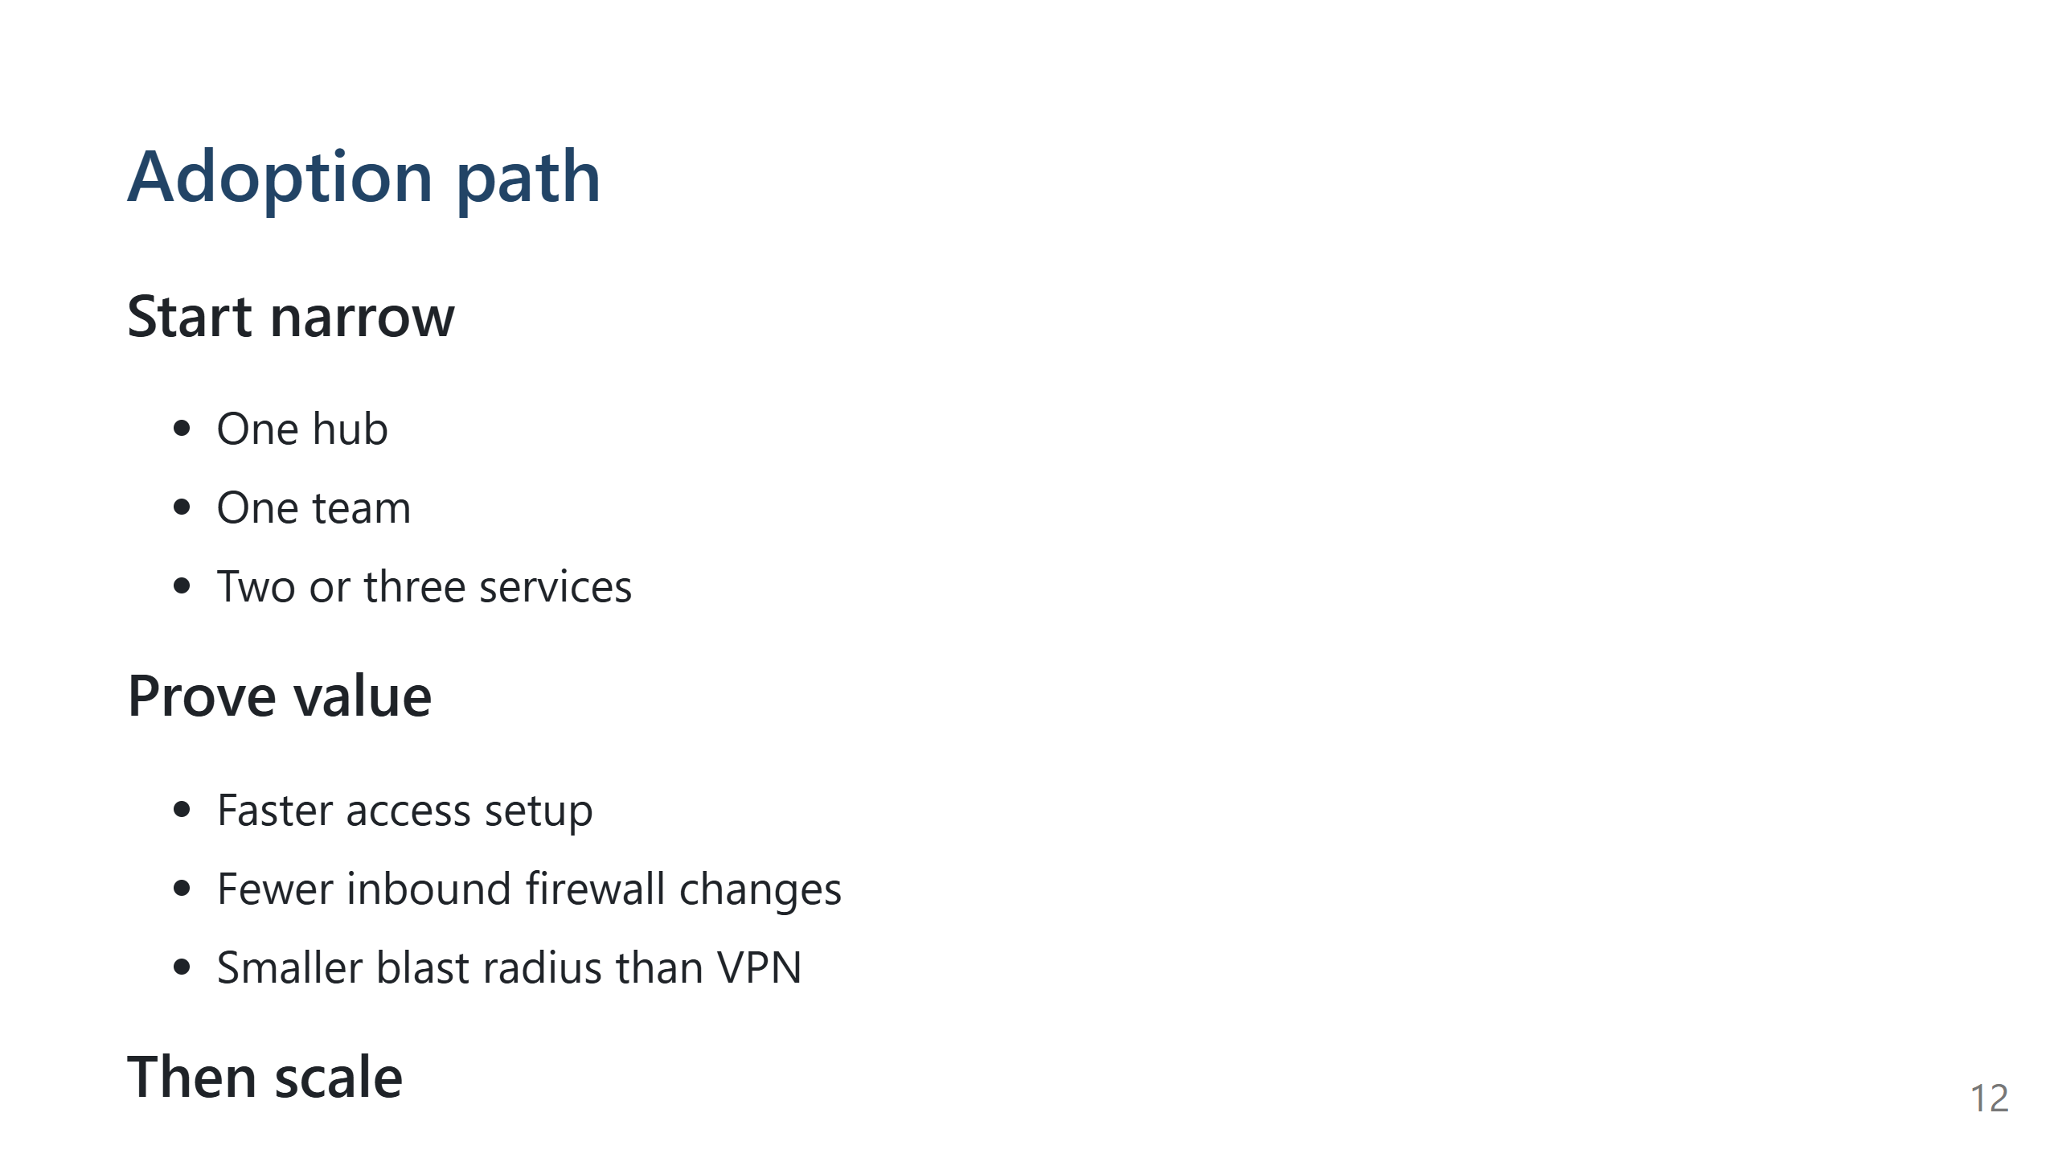

Slide 13
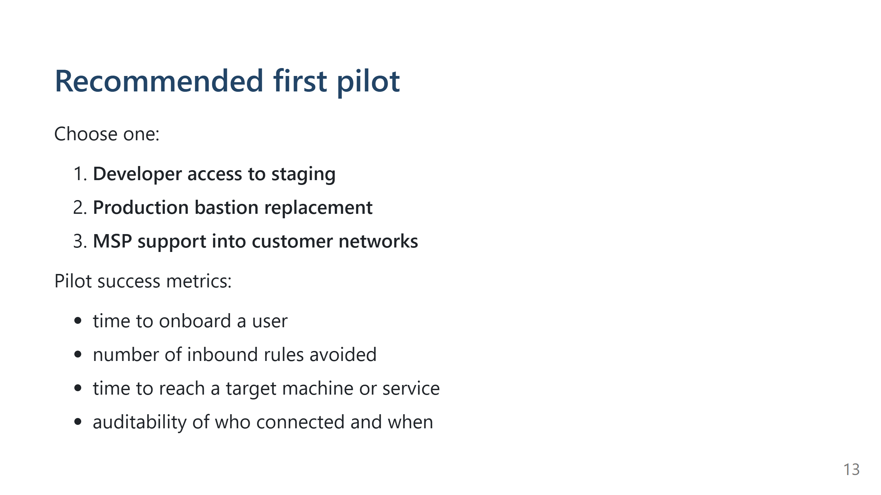

Slide 14
