Slide 1

Large dataset
Small dataset
Training
Training
…
…
Strong Performance
Weak Performance

Slide 2
Large dataset
Small dataset
Reuse base layers
Training
Training
…
50 Categories
…
30 Categories
Strong Performance
Strong Performance

Slide 3
1x1 Expansion Layer
Batch Normalization
ReLU6
3x3 Depth wise Conv.
Batch Normalization
ReLU6
1x1 Projection Layer
Batch Normalization
+

Slide 4
128x128x16
128x128x96
128x128x96
128x128x24
Residual
connection
Expansion
Convolution
(factor=6)
Depth wise
convolution
projection
convolution

Slide 5
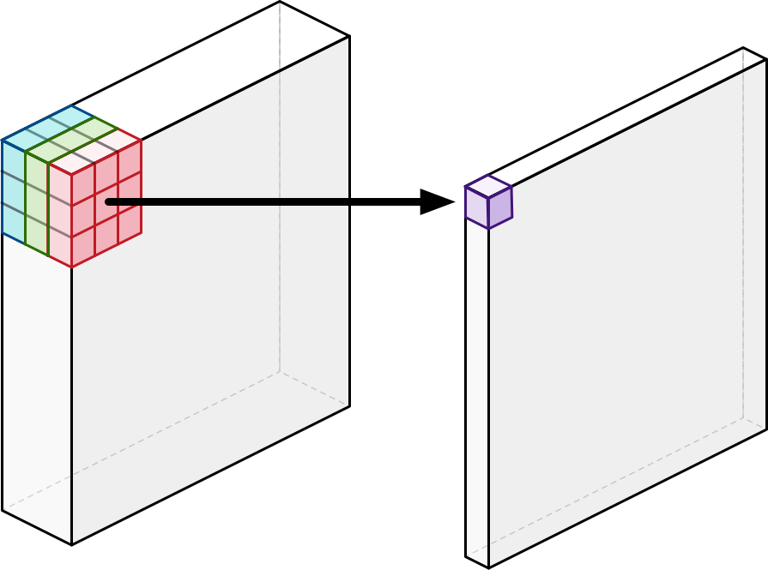
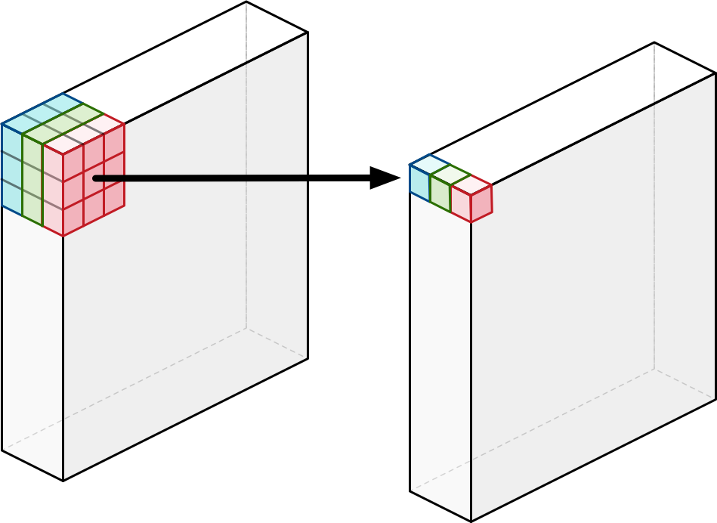
Traditional Convolution
Depth wise Convolution

Slide 6
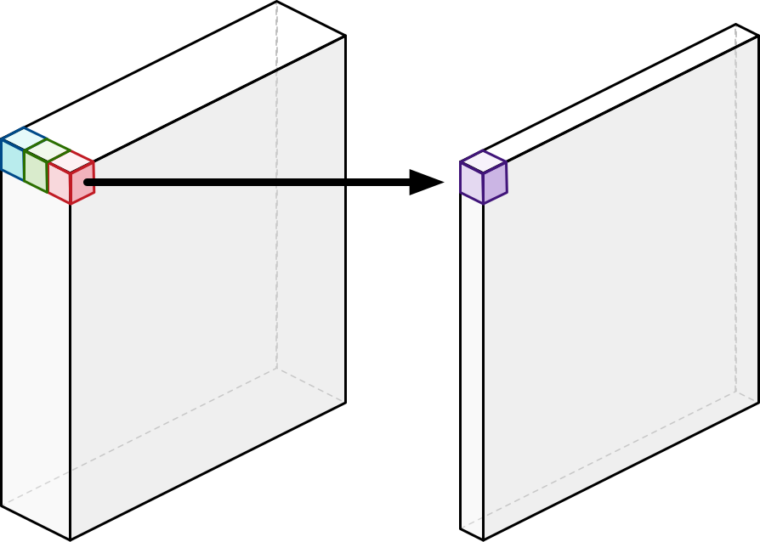
Point wise Convolution
Depth wise Convolution

