Slide 1
Semaphores

Slide 2
Two Operations of a Semaphore
P()
  A.K.A. “wait()”
  If Busy, wait
  Otherwise, decrement by one
V()
  A.K.A. “signal()”
  Increment by one
  Wake up any waiting processes/threads

Slide 3
Using Semaphores for Mutual Exclusion
Binary Semaphore.
A.K.A. “Mutex”

Slide 4
Using Semaphores for Mutual Exclusion
Mutual Exclusion (initial value = 1)
  Also called “Binary Semaphore”.
  Can be used for mutual exclusion:
    semaphore.P();
    // Critical section goes here
    semaphore.V();

Slide 5
Implementing P() and V() with busy waiting
P(S) // Wait
{
  while S <= 0
  ; // no-op (busy wait!)
  S-- ;
}
V(S) // Signal
{
  S++ ;
}

Slide 6

Semaphore with busy waiting (cont.)
P(S) // wait
{ while S <= 0 ;
  S-- ;
}
Semaphore
Resource
S = 1
S = 0
Thread A
Thread B
P()
Critical
Section
lock granted!
P()
while
S <= 0 ;
P(S) // wait
{ while S <= 0 ;
  S-- ;
}
Update Resource
V(S) // signal
{
  S++ ;
}
V()
P(S) // wait
{ while S <= 0 ;
  S-- ;
}
while S<=0;

Slide 7
Implementing P() and S() with a wait queue (Book Example)
P(S) // Wait
{ S--
if ( S < 0 ) {
waitListAdd( currentThread ) ;
// |S| = queue size
  sleep() ;
  }
}
V(S) // Signal
{ S++ ;
if ( S <= 0 ) {
T = waitListRemove() ;
T->wakeup() ;
}
}

Slide 8
Semaphore with wait queue (cont.)
P() {
t = currentThread ;
while ( S == 0 ) {
queue->Append ( t ) ;
t->Sleep();
}
S--;
}
Semaphore
Resource
S = 1
S = 0
Thread C
Thread A
Thread B
P()
P() {
t = currentThread ;
while ( S == 0) {
queue->Append ( t ) ;
t->Sleep();
}
S--;
}
Critical
Section
lock granted!
P()
while (S == 0)
{ … }
Update Resource
Selected
By
Scheduler
R
V(S) // signal
{ s = scheduler ;
  t = queue->Remove();
if ( t != NULL)
s->ReadyToRun(t) ;
S++;
}
V()
W
X
Cont. from Sleep() …
R = ready
W = waiting
X = running

Slide 9
Using Semaphores for Scheduling Constraints

Slide 10
Semaphores for Scheduling Constraints
Scheduling Constraints (initial value = 0)
  Locks are fine for mutual exclusion, but what if you want a thread to wait for something?
  Example: suppose you had to implement ThreadJoin which must wait for thread to terminiate:
    Initial value of semaphore = 0
    ThreadJoin {
    semaphore.P();
    }
    ThreadFinish {
    semaphore.V();
    }

Slide 11
Scheduling Constraint Semaphore
KERNEL/
SEMAPHORE
Thread A
Thread B
Thread Fork() // Thread B
ThreadJoin {
semaphore.P();
}
Thread Join( Thread B )
Wait() // S == 0
Sleep()
Initial
Value
= Zero
Thread Finish()
ThreadFinish {
semaphore.V();
}
Signal() //S++
Wake()

Slide 12
Producer – Consumer Problem
A.K.A. Bounded Buffer

Slide 13

Producer-consumer with a bounded buffer
Producer
Consumer
Buffer
Problem Definition
  Producer puts things into a shared buffer
  Consumer takes them out
  Need synchronization to coordinate producer/consumer
Don’t want producer and consumer to have to work in lockstep, so put a fixed-size buffer between them
  Need to synchronize access to this buffer
  Producer needs to wait if buffer is full
  Consumer needs to wait if buffer is empty
Example 1: GCC compiler
  cpp | cc1 | cc2 | as | ld
Example 2: Coke machine
  Producer can put limited number of cokes in machine
  Consumer can’t take cokes out if machine is empty

Slide 14
Correctness constraints for solution
Correctness Constraints:
  Consumer must wait for producer to fill buffers
  Producer must wait for consumer to empty buffers
  Only one thread can manipulate buffer queue at a time
General rule of thumb:
  Use a separate semaphore for each constraint
  Semaphore fullBuffers; // consumer’s constraint
  Semaphore emptyBuffers;// producer’s constraint
  Semaphore mutex; // mutual exclusion

Slide 15
Solution to Bounded Buffer
Semaphore fullBuffer = 0; // Initially, no coke
Semaphore emptyBuffers = numBuffers;
// Initially, num empty slots
Semaphore mutex = 1; // No one using machine
Producer(item) {
emptyBuffers.P(); // Wait until space
mutex.P(); // Wait until buffer free
Enqueue(item);
mutex.V();
fullBuffers.V(); // Tell consumers there is
// more coke
}
Consumer() {
fullBuffers.P(); // Check if there’s a coke
mutex.P(); // Wait until machine free
item = Dequeue();
mutex.V();
emptyBuffers.V(); // tell producer need more
return item;
}

Slide 16
Solution to Bounded Buffer (cont.)
Empty
Buffers
Mutex
Full
Buffers
PRODUCER
Thread A
CONSUMER
Thread B
wait()
Empty?
wait()
Producer(item) {
emptyBuffers.P();
mutex.P();
Enqueue(item);
mutex.V();
fullBuffers.V();
}
yes
Consumer() {
fullBuffers.P();
mutex.P();
item = Dequeue();
mutex.V();
emptyBuffers.V();
return item;
}
wait()
Lock Free?
sleep()
yes
Generate Data
signal()
signal()
wake up!
wait()
Consume Data
signal()
signal()
Fill Buffers…
Empty
Full
Empty
Full
Empty
Full
Empty Buffers…

Slide 17
Producer & Consumer Code is…
In the hands of App Developer.
Unfortunately, errors can occur!
  App Developer can use the Semaphore incorrectly…

Slide 18
For Example, Consider two Threads, T & S and two Semaphores, Q & R
Suppose: T(1), S(1), T(2), S(2), T(8), S(8), etc…
Can’t get here!
  Thread T
  1: Wait(R)
  2: Wait(Q)
  [ critical section ]
  8: Signal(R)
  9: Signal(Q)
  Thread S
  1: Wait(Q)
  2: Wait(R)
  [ critical section ]
  8: Signal(Q)
  9: Signal(R)
Holding R.
Holding Q.
Waiting on Q.
Waiting on R.

Slide 19
Sleeping inside a critical section
Producer(item) {
emptyBuffers.P(); mutex.P(); Enqueue(item);
mutex.V();
fullBuffers.V();
}
If We Swap the P’s…
Producer(item) {
mutex.P(); emptyBuffers.P(); Enqueue(item);
mutex.V();
fullBuffers.V();
}
We wait (go to sleep) Inside a Critical Section!

Slide 20
Sleeping inside a critical section (cont.)
Empty
Buffers
Mutex
Full
Buffers
Holding Lock!
PRODUCER
Thread A
CONSUMER
Thread B
Lock Free?
wait()
yes
Producer(item) {
mutex.P();
emptyBuffers.P();
Enqueue(item);
mutex.V();
fullBuffers.V();
}
wait()
Empty?
No.
wait()
Consumer() {
fullBuffers.P();
mutex.P();
item = Dequeue();
mutex.V();
emptyBuffers.V();
return item;
}
Full?
Waiting…
Yes!
wait()
Lock
Free?
No! sleep()
Consumer can’t enter
Critical section to
Empty buffers!!!
DEADLOCK!!!!
Consume Data
Full Buffers…
Empty
Full
Empty
Full
Empty
Full

Slide 21
Ordering of P()’s Matter.
What about order of the V()’s?
Producer(item) {
emptyBuffers.P(); mutex.P(); Enqueue(item);
mutex.V();
fullBuffers.V();
}
If We Swap the V’s…
Producer(item) {
emptyBuffers.P(); mutex.P(); Enqueue(item); fullBuffers.V();
mutex.V();
}

Slide 22
Problems with Semaphores
Easy for programming mistakes to cause deadlock
Need a better abstraction to deal with usage.

Slide 23
Monitors & Condition Variables
Basic Idea:
Instead of using Semaphores for “Locks” and “Scheduling Constraint”…
Separate these two concepts
  Use “Locks” for mutual exclusion
  Use “Condition” variables for scheduling constraints
Also, want to be able to…
  Sleep inside a critical section and wake up with the lock!

Slide 24
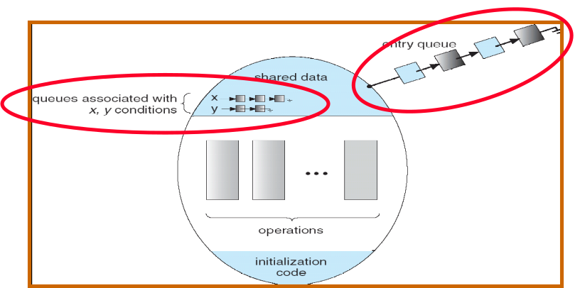
Definition of Monitors and Condition Variables
Monitor: a lock and zero or more condition variables for managing concurrent access to shared data
Lock: the lock provides mutual exclusion to shared data
Condition Variable: a queue of threads waiting for something inside a critical section

Slide 25
Monitor Definition (cont.)
A high-level abstraction that provides a convenient and effective mechanism for process synchronization
Only one process may be active within the monitor at a time
    monitor monitor-name
    {
    // shared variable declarations
    procedure P1 (…) { …. }
    …
    procedure Pn (…) {……}
    Initialization code ( ….) { … }
    …
    }
    }

Slide 26
Condition Variable Definition (cont.)
condition x, y;
Operations on a condition variable:
  x.wait () – a process that invokes the operation is
  suspended.
  x.signal () – resumes one of processes (if any) that
  invoked x.wait ()
  x.broadcast() – resumes all processes (if any) that invoked x.wait().
  Note: this method is not in the book!
  --Difference b/w Hoare & Mesa Monitors

Slide 27
Simple Monitor Example (version 1)
Here is an (infinite) synchronized queue
Lock lock;
Queue queue;
AddToQueue(item) {
lock.Acquire(); // Lock shared data
queue.enqueue(item); // Add item
lock.Release(); // Release Lock
}
RemoveFromQueue() {
lock.Acquire(); // Lock shared data
item = queue.dequeue();// Get next item or null
lock.Release(); // Release Lock
return(item); // Might return null!
// Should we spin loop?
}

Slide 28
Condition Variables
How do we change the RemoveFromQueue() routine to wait until something is on the queue?
  Could do this by keeping a count of the number of things on the queue (with semaphores), but error prone
Condition Variable = a queue of threads waiting for something inside a critical section
  Key idea: allow sleeping inside critical section by atomically releasing lock at time we go to sleep
  Contrast to semaphores: Can’t wait inside critical section

Slide 29
Condition Variables
Operations:
  Wait(&lock): Atomically release lock and go to sleep. Re-acquire lock later, before returning.
  Signal(): Wake up one waiter, if any
  Broadcast(): Wake up all waiters
  RULE: Hold lock while doing condition Variables operations.

Slide 30
Monitor Example (Version 2, with condition variable)
Here is an (infinite) synchronized queue
Lock lock;
Condition dataready;
Queue queue;
AddToQueue(item) {
lock.Acquire(); // Get Lock
queue.enqueue(item); // Add item
dataready.signal(); // Signal any waiters
lock.Release(); // Release Lock
}
RemoveFromQueue() {
lock.Acquire(); // Get Lock
while (queue.isEmpty()) {
dataready.wait(&lock); // If nothing, sleep
}
// Get Lock back when we’re back!
item = queue.dequeue(); // Get next item
lock.Release(); // Release Lock
return(item);
}
Why
Loop
Here?
Is this the same as a “spin loop”?

Slide 31
Need to be careful about precise definition of signal and wait (Hoare vs. Mesa)
Consider a piece of our dequeue code:
while (queue.isEmpty()) {
dataready.wait(&lock); // If nothing, sleep
}
item = queue.dequeue(); // Get next item
Why didn’t we do this?
if (queue.isEmpty()) {
dataready.wait(&lock); // If nothing, sleep
}
item = queue.dequeue(); // Get next item
Answer:
  Could get context switched on wait()
  Then, someone else gets CPU & dequeues items
  Then, get context switch back
  And, find empty queue!

Slide 32
Mesa vs. Hoare monitors
Hoare-style (most textbooks):
  Signaler gives lock & CPU to waiter; waiter runs immediately
  Waiter gives up lock & processor back to signaler when it exits critical section or if it waits again
Mesa-style (Nachos, most real operating systems):
  Signaler keeps lock and processor
  Waiter placed on ready queue with no special priority
  Practically, need to check condition again after wait

Slide 33
Readers-Writers Problem

Slide 34

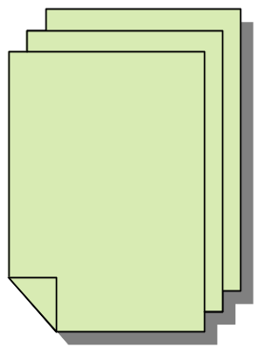



Readers/Writers Problem
W
R
R
R
Motivation: Consider a shared database
  Two classes of users:
    Readers – never modify database
    Writers – read and modify database
  Is using a single lock on the whole database sufficient?
    Like to have many readers at the same time
    Only one writer at a time

Slide 35
Basic Readers/Writers Solution
Correctness Constraints:
  Readers can access database when no writers
  Writers can access database when no readers or writers
  Only one writer at a time
  Only one thread manipulates state variables at a time
Basic structure of a solution:
  Reader()
  Wait until no writers
  Access data base
  Check out – wake up a waiting writer
  Writer()
  Wait until no active readers or writers
  Access database
  Check out – wake up waiting readers or writer
  State variables (Protected by a lock called “lock”):
    int AR: Number of active readers; initially = 0
    int WR: Number of waiting readers; initially = 0
    int AW: Number of active writers; initially = 0
    int WW: Number of waiting writers; initially = 0
    Condition okToRead = NIL
    Condition okToWrite = NIL

Slide 36
Code for a Reader
Reader() {
// First check self into system
lock.Acquire();
while ((AW + WW) > 0) { // Is it safe to read?
WR++; // No. Writers exist
okToRead.wait(&lock); // Sleep on cond var
WR--; // No longer waiting
}
AR++; // Now we are active!
lock.release();
// Perform actual read-only access
AccessDatabase(ReadOnly);
// Now, check out of system
lock.Acquire();
AR--; // No longer active
if (AR == 0 && WW > 0) // No other active readers
okToWrite.signal(); // Wake up one writer
lock.Release();
}
Why Release the Lock here?

Slide 37
Code for a Writer
Writer() {
// First check self into system
lock.Acquire();
while ((AW + AR) > 0) { // Is it safe to write?
WW++; // No. Active users exist
okToWrite.wait(&lock); // Sleep on cond var
WW--; // No longer waiting
}
AW++; // Now we are active!
lock.release();
// Perform actual read/write access
AccessDatabase(ReadWrite);
// Now, check out of system
lock.Acquire();
AW--; // No longer active
if (WW > 0){ // Give priority to writers
okToWrite.signal(); // Wake up one writer
} else if (WR > 0) { // Otherwise, wake reader
okToRead.broadcast(); // Wake all readers
}
lock.Release();
}
Why Give priority to writers?
Why broadcast() here instead of signal()?

Slide 38
Simulation of Readers/Writers solution
Consider the following sequence of operators:
  R1, R2, W1, R3
On entry, each reader checks the following:
  while ((AW + WW) > 0) { // Is it safe to read?
  WR++; // No. Writers exist
  okToRead.wait(&lock); // Sleep on cond var
  WR--; // No longer waiting
  }
AR++; // Now we are active!
First, R1 comes along:
AR = 1, WR = 0, AW = 0, WW = 0
Next, R2 comes along:
AR = 2, WR = 0, AW = 0, WW = 0
Now, readers make take a while to access database
  Situation: Locks released
  Only AR is non-zero

Slide 39
Simulation(2)
Next, W1 comes along:
while ((AW + AR) > 0) { // Is it safe to write?
WW++; // No. Active users exist
okToWrite.wait(&lock); // Sleep on cond var
WW--; // No longer waiting
}
AW++;
Can’t start because of readers, so go to sleep:
AR = 2, WR = 0, AW = 0, WW = 1
Finally, R3 comes along:
AR = 2, WR = 1, AW = 0, WW = 1
Now, say that R2 finishes before R1:
AR = 1, WR = 1, AW = 0, WW = 1
Finally, last of first two readers (R1) finishes and wakes up writer:
if (AR == 0 && WW > 0) // No other active readers
okToWrite.signal(); // Wake up one writer

Slide 40
Simulation(3)
When writer wakes up, get:
AR = 0, WR = 1, AW = 1, WW = 0
Then, when writer finishes:
if (WW > 0){ // Give priority to writers
okToWrite.signal(); // Wake up one writer
} else if (WR > 0) { // Otherwise, wake reader
okToRead.broadcast(); // Wake all readers
}
  Writer wakes up reader, so get:
  AR = 1, WR = 0, AW = 0, WW = 0
When reader completes, we are finished

Slide 41
Implementing Monitors

Slide 42
Can we construct Monitors from Semaphores?
Locking aspect is easy: Just use a mutex.
  Initial value = 1
        semaphore = new semaphore(1) ;
  Lock Acquire = P(), Lock Release = V().
      semaphore.P();
      // Critical section goes here
      semaphore.V();
What about Condition Variables? Can we implement them this way?
  Wait() { semaphore.P(); }
  Signal() { semaphore.V(); }
  Doesn’t work: Wait() may sleep with lock held
Notes:
TODO: Split This Out into Different Slides.

Slide 43
Condition Variables using Semaphores, 2nd Try.
Does this work better?
  Wait(Lock lock) {
  lock.Release();
  semaphore.P();
  lock.Acquire();
  }
  Signal() { semaphore.V(); }
  No: Semantics of condition variables are different from Semaphores!
    Condition variables have no history
    Semaphores have history.
Notes:
TODO: Split This Out into Different Slides.

Slide 44
Condition Variables vs. Semaphores
(is sound in the forest is heard if no one is there?)
Condition Variables
What if thread signals and no one is waiting?
  NO-OP
What if some other thread later waits? (misses signal)
  Thread Waits
Semaphores
What if thread V’s and no one is waiting?
  Increment
What if thread later does P?
  Decrement and continue
Notes:
TODO: Split This Out into Different Slides.

Slide 45
Construction of Monitors from Semaphores (Try #3)
Problem with previous try:
  P and V are commutative – result is the same no matter what order they occur
  Condition variables are NOT commutative
Does this fix the problem?
  Wait(Lock lock) {
  lock.Release();
  semaphore.P();
  lock.Acquire();
  }
  Signal() {
  if semaphore queue is not empty
  semaphore.V();
  }
  Not legal to look at contents of semaphore queue
  There is a race condition – signaler can slip in after lock release and before waiter executes semaphore.P()
It is actually possible to do this correctly
  Complex solution for Hoare scheduling in book
  Can you come up with simpler Mesa-scheduled solution?

Slide 46
Monitors, Basic Usage Pattern
Monitors represent the logic of the program
  Wait if necessary
  Signal when something changed so any waiting threads can proceed
Basic structure of monitor-based program:
  lock
  while (need to wait) {
  condvar.wait();
  }
  unlock
  do something so no need to wait
  lock
  condvar.signal();
  unlock
Check and/or update
state variables
Wait if necessary
Check and/or update
state variables

Slide 47
Bounded Buffer Monitor Example

Slide 48
Bounded Buffer Solution Using Semaphores
class bbsem {
public:
bbsem(int maxsize);
~bbsem();
void read(char *data);
void write(char data);
private:
  char *buffer ;
  int max ;
  int i ;
  Semaphore *full ;
  Semaphore *empty ;
  Semaphore *mutex ;
};
bbsem::bbsem(int maxsize)
{
buffer = new char[maxsize] ;
i = 0 ;
max = maxsize ;
full = new Semaphore( “full", 0 ) ;
empty = new Semaphore( “empty", max ) ;
mutex = new Semaphore( "mutex", 1 ) ;
}
bbsem::~bbsem()
{
delete full ;
delete empty ;
delete mutex ;
}

Slide 49
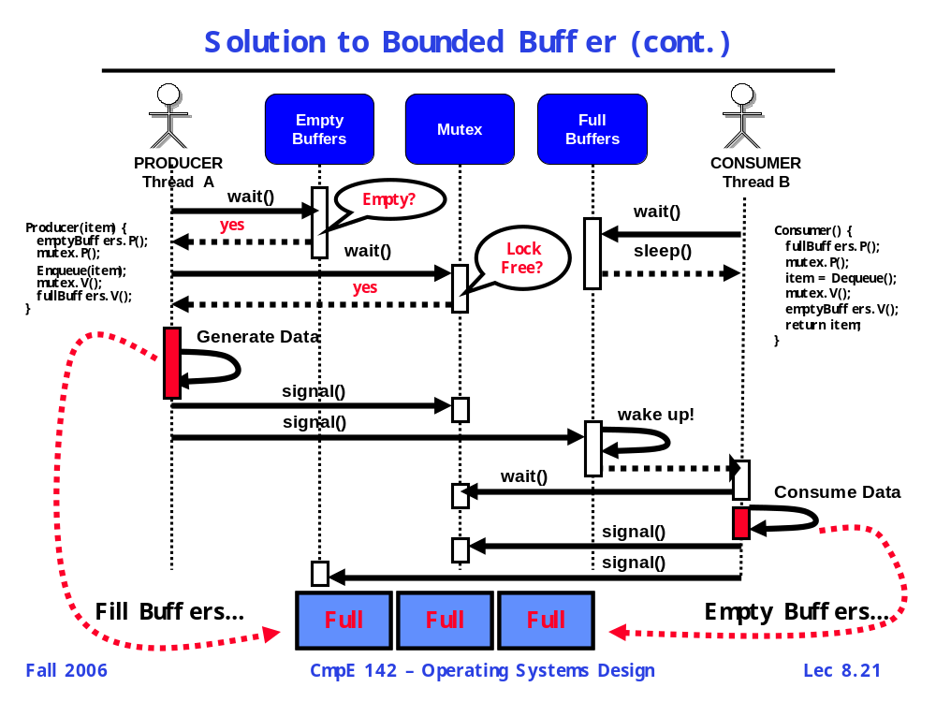
Bounded Buffer Solution Using Semaphores (cont.)
void bbsem::write(char data)
{
empty->P() ;
mutex->P() ;
buffer[i++] = data ;
mutex->V() ;
full->V() ;
}
void bbsem::read(char *data)
{
full->P() ;
mutex->P() ;
*data = buffer[--i] ;
mutex->V() ;
empty->V() ;
}
NOTE: Buffer should be FIFO, but to simplified code
for presentation, this example implements FILO. On
Homework, you should implement FIFO buffers. Hint:
Use your DLList implementation from HWK1.

Slide 50
Bounded Buffer Using Monitors
class bbmon {
public:
bbmon(int maxsize);
~bbmon();
void read(char *data);
void write(char data);
private:
  char *buffer ;
  int max ;
  int i ;
  Condition *full ;
  Condition *empty ;
  Lock *lock ;
} ;
bbmon::bbmon(int maxsize)
{
buffer = new char[maxsize] ;
i = 0 ;
max = maxsize ;
full = new Condition( "fullbuffer" ) ;
empty = new Condition( "emptybuffer" ) ;
lock = new Lock( "lock" ) ;
}
bbmon::~bbmon()
{
delete full ;
delete empty ;
delete lock ;
}
void bbmon::write(char data)
{
lock->Acquire() ;
while ( i == max )
empty->Wait(lock) ;
buffer[i++] = data ;
full->Signal(lock) ;
lock->Release() ;
}
void bbmon::read(char *data)
{
lock->Acquire() ;
while ( i < max )
full->Wait(lock) ;
*data = buffer[--i] ;
empty->Signal(lock) ;
lock->Release() ;
}
NOTE: Buffer should be FIFO, but to simplified code
for presentation, this example implements FILO. On
Homework, you should implement FIFO buffers. Hint:
Use your DLList implementation from HWK1.

Slide 51
Bounded Buffer Test Case
bbsem *buffer ; // should also work for monitor version “bbmon”
void Producer( int id )
{ char letters[ ] = { 'a', 'b', 'c', 'd', 'e', 'f', 'g', 'h', 'i' } ;
for (int num = 0; num < 50; num++) {
  printf("Producer #%d produced => %c \n", id, letters[num%sizeof(letters)]) ;
  buffer->write(letters[num%sizeof(letters)]) ;
}
}
void Consumer( int id )
{ char ch ;
for (int num = 0; num < 10; num++) {
buffer->read(&ch) ;
printf("Consumer #%d consummed => %c \n", id, ch) ;
}
}
void ThreadTest()
{
buffer = new bbsem(5) ;
Thread *P1 = new Thread("Producer 1") ;
Thread *C1 = new Thread("Consumer 1") ;
P1->Fork( Producer, 1 ) ;
C1->Fork( Consumer, 1 ) ;
}

