Slide 1


Slide 2
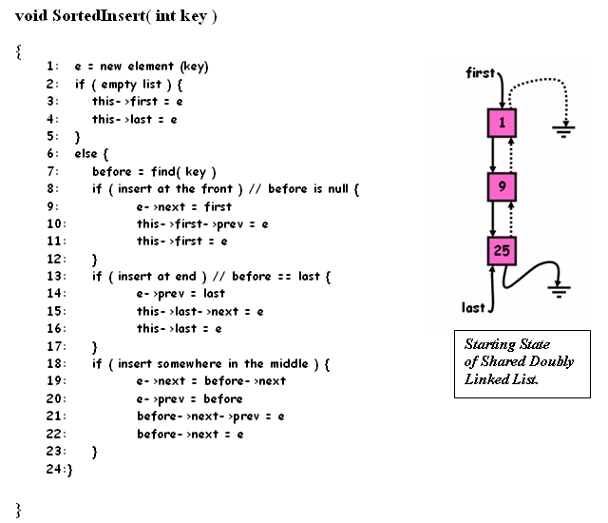
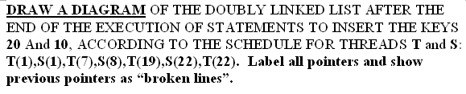
Problem
Thread T:
SortedInsert(20)
Thread S:
SortedInsert(10)

Slide 3
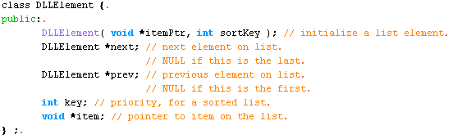
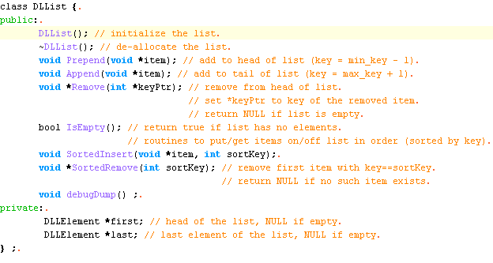
Code Setup

Slide 4
A Doubly-Linked List with Sort Keys
First “head”
Key = 9
Prev =
Next =
Key = 25
Prev =
Next =
Key = 100
Prev =
Next =
Last “tail”
Correctness Conditions For “Sorted” Operations:
  List must always be in sorted order (both directions)
  If we add, elements get added in sorted order
  If we remove from head, we get elements get removed in sorted order

Slide 5
Algorithm for Sorted Insert (pseudo code)
Slight Adaptation – i.e. just keys, no items.
1: e = new element (key)
2: if ( empty list ) {
3: this->first = e
4: this->last = e
5: }
6: else {
7: b = find( key ) // b is before key
8: if ( insert at the front ) // b is null {
9: e->next = first
10: this->first->prev = e
11: this->first = e
12: }
13: if ( insert at end ) // b == last {
14: e->prev = last
15: this->last->next = e
16: this->last = e
17: }
18: if ( insert somewhere in the middle ) {
19: e->next = b->next
20: e->prev = b
21: b>next->prev = e
22: b>next = e
23: }
24:}
Notes: “this” refers to a shared Data structure. All other variables
are on the stack.

Slide 6
Consider two threads T and S. T adds key 20, S adds key 10, and the following starting state for the list.
1: e = new element (key)
2: if ( empty list ) {
3: this->first = e
4: this->last = e
5: }
6: else {
7: b = find( key ) // b is before key
8: if ( insert at the front ) // b is null {
9: e->next = first
10: this->first->prev = e
11: this->first = e
12: }
13: if ( insert at end ) // b == last {
14: e->prev = last
15: this->last->next = e
16: this->last = e
17: }
18: if ( insert somewhere in the middle ) {
19: e->next = b->next
20: e->prev = b
21: b>next->prev = e
22: b>next = e
23: }
24:}
first
1
9
25
last

Slide 7
T add 20, S add 10,
With schedule: T(1),S(1),T(7),S(8),T(19),S(22),T(22)
T
e
S
1: e = new element (key)
2: if ( empty list ) {
3: this->first = e
4: this->last = e
5: }
6: else {
7: b = find( key ) // b is before key
8: if ( insert at the front ) // b is null {
9: e->next = first
10: this->first->prev = e
11: this->first = e
12: }
13: if ( insert at end ) // b == last {
14: e->prev = last
15: this->last->next = e
16: this->last = e
17: }
18: if ( insert somewhere in the middle ) {
19: e->next = b->next
20: e->prev = b
21: b>next->prev = e
22: b>next = e
23: }
24:}
T
S
first
b
e
b
1
S
T
S
T
20
9
10
T
S
25
T
S
T
S
T
S
T
last
S
T
S

Slide 8
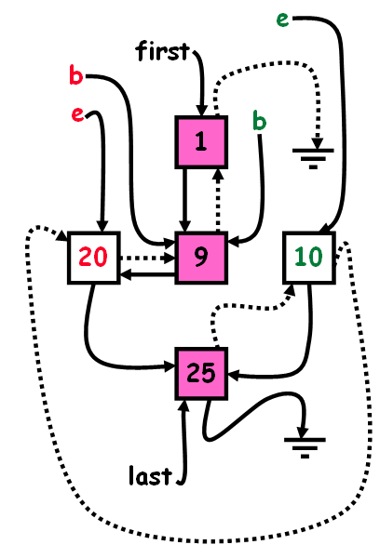
Result?
first
1
Which Correctness
Condition was violated?
9
20
10
25
last

