Slide 1
PyTable (tbl)
A small pure-Python library to work with data stored in text files
Paulo Herrera R.

Slide 2
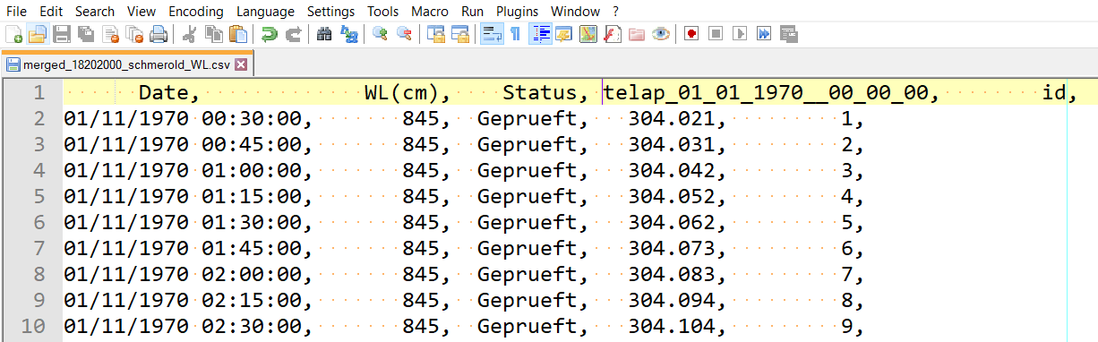
Introduction
Much data is stored in delimited text files, CSV (comma separated files), or TAB separated files (.dat or .txt)

Slide 3
Needs to handle data
Read file and create some container that allows querying, modifying and appending data
Normal workflow is: parse file (read content), separate values and eventually interpret text ´1.3450´ as floating point number 1.345.
Store data in some container. Typically in Python a list or dictionary.
Modify or append data to existing columns or create new columns.
Write data in container to files with known format, e.g. CSV or tab delimited, or eventually save it to a binary format (standard), e.g. HDF5 (free) or Excel (propietary).
Often, it is also needed to sort files, change files on the fly, walk tree directories, etc. => auxiliary functions.
PyTable = Provides all those functions an a little bit more
(no much more though by design).

Slide 4
Objectives
Easy of use (make working with data almost enjoyable)
Keep a Pythonic feeling: default argument values, use lists and dictionaries, one-liners if possible.
Functional style whenever possible. Many functions accept as arguments other functions that can be passed as lambdas. Something like: map-reduce style on streams of data.
Reasonably efficient to work with files up to a few 100 Mb (there are other libraries to work with larger files, e.g. PyTables).
Simple and basic plotting (based on Matplotlib) functions to explore data.
Kind of similar to Pandas (do not have much experience with it), but I hope easier to understand and use.
KISS principle as a paradigm: Keep It Simple Stupid.

Slide 5
Main classes
tbl.Table: Implements the container for all data in a single file => it can contain many Columns. Usually user interacts with Table more than Column
tbl.Column: Container for a single column. It stores header (column title), type of data: integer (´i´), float (´f´), datetime (´d´) or strings (´s´).
tbl.helpers: a few helper functions, e.g. elapsed_time (compute elapsed time in seconds or day since a given date for a list of datetime objects), walker (returns a list of all files given a root directory).

Slide 6
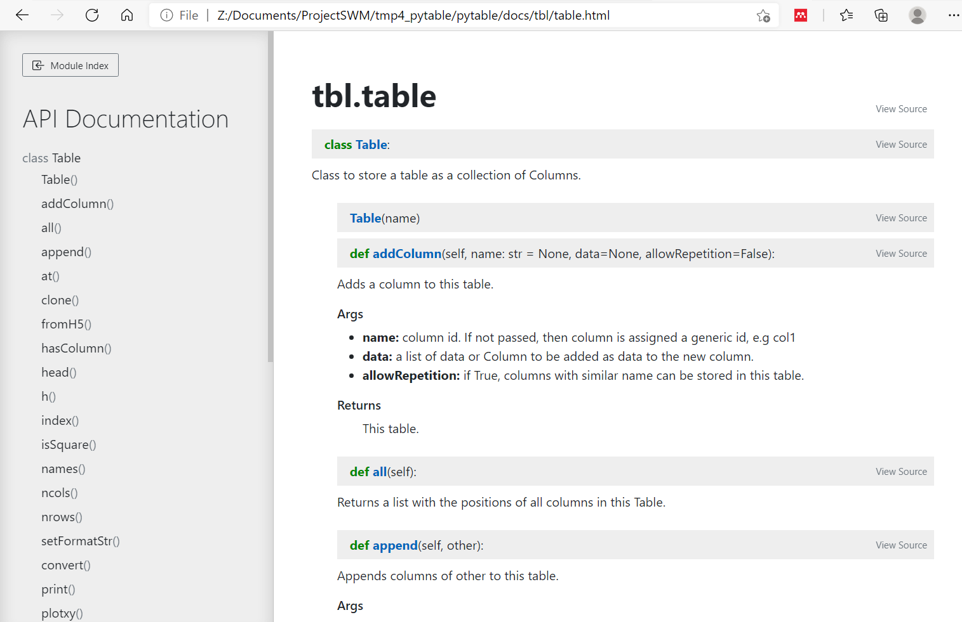
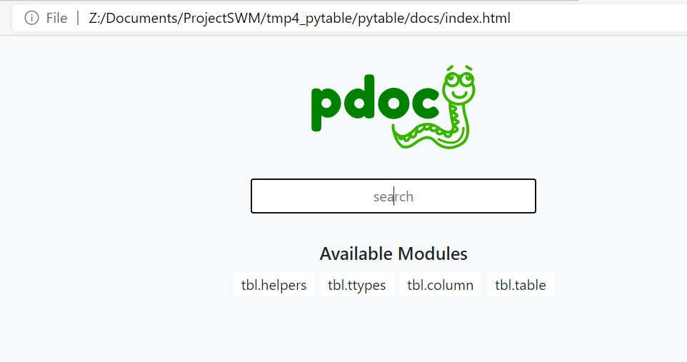
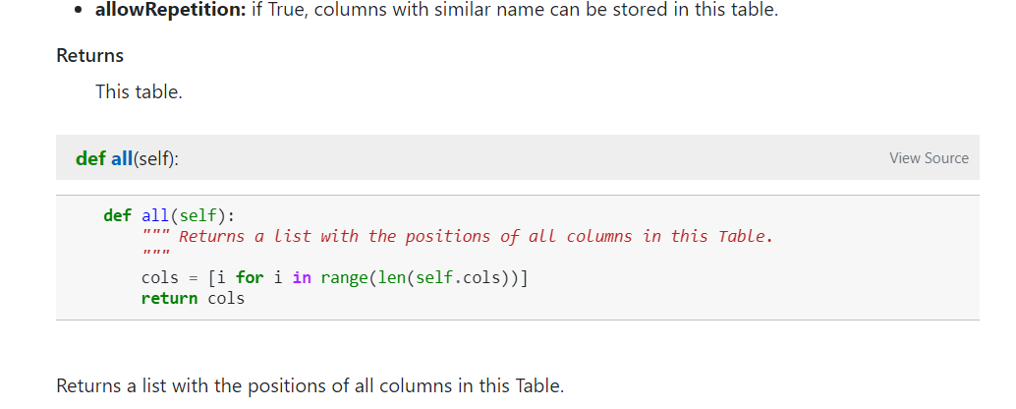
Documentation
This PPT
Docstrings in source code
A HTML version created from the source code (updated with the code)

Slide 7
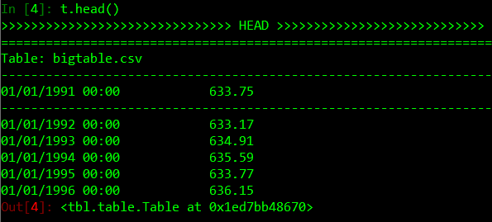
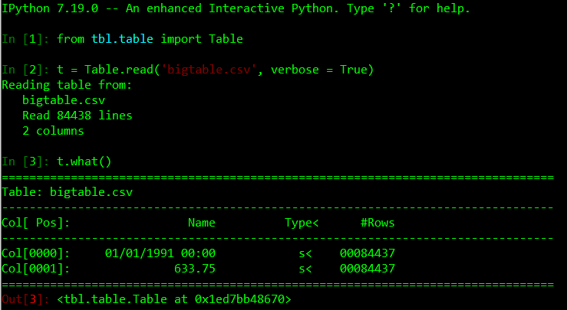
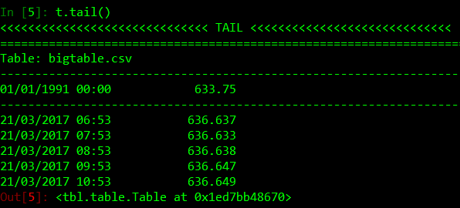
Read a table
head(): prints first n (=5 default) elements
tail(): prints last n (=5 default) elements
Read table with default options, all data read as strings (type = <s)
Most functions have as optional argument verbose (print additional info)
Table have a few useful methods,
e.g. what() (prints a summary of the content in Table)

Slide 8
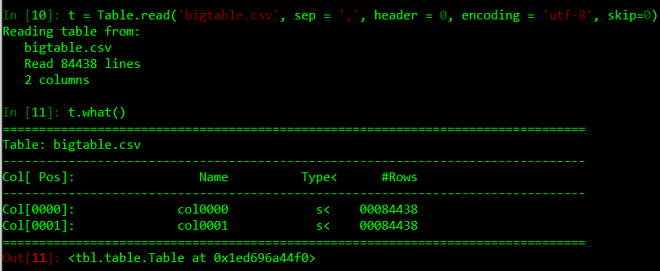
Default arguments for methods
Most functions have several arguments with default values, e.g.
To read a table that does not have a header line use header = 0 (default column names colXXXX)
Default values are logical ones, e.g. sep = ´,´ so most of the time there is no need to use arguments. However, they are there to handle complex cases and they are explained in the docstrings and in the HTML.
(IF there is something missing, please report as bug)

Slide 9
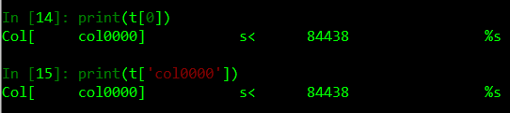
Access columns to different type
Two ways to access columns: by index (t[0]) or by name (t[´col0000´])
Indexes start at 0 as in Python.
There is an option when reading tables to forbid/permit repeated names for columns in the same table (I suggest always FORBID)
Prefer using indexes to select columns (easier to understand)
If you need to select more than two columns to create a list of columns, use at([idx0, idx1])

Slide 10
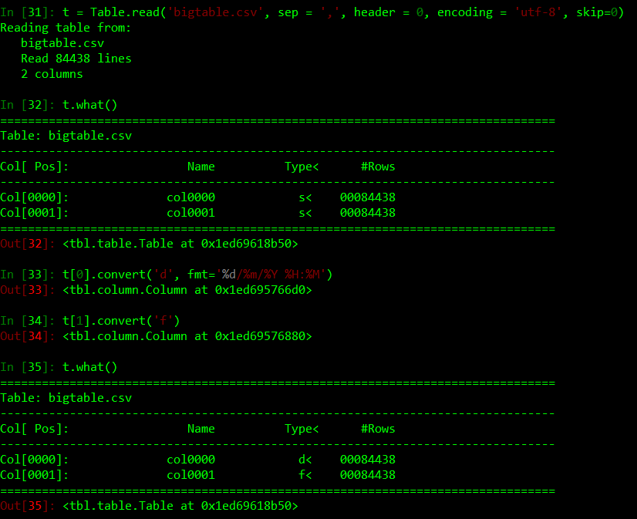
Convert columns to different type
Before working with data, it may be necessary to convert it to a different type. For example, after reading a table, all columns store strings that can be converted to any of the other 3 types: int, float, datetime.
Datetime type usually requires specifying the format, e.g. %d/%m/%Y

Slide 11
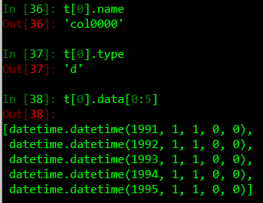
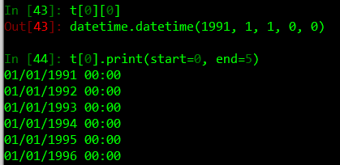
Column content
A column has 3 main elements: name, type, data (list of elements)
Possible to directly work with col.data as a normal Python list => Practical but not OO way to do things
You can also work with the methods of Column, e.g.

Slide 12
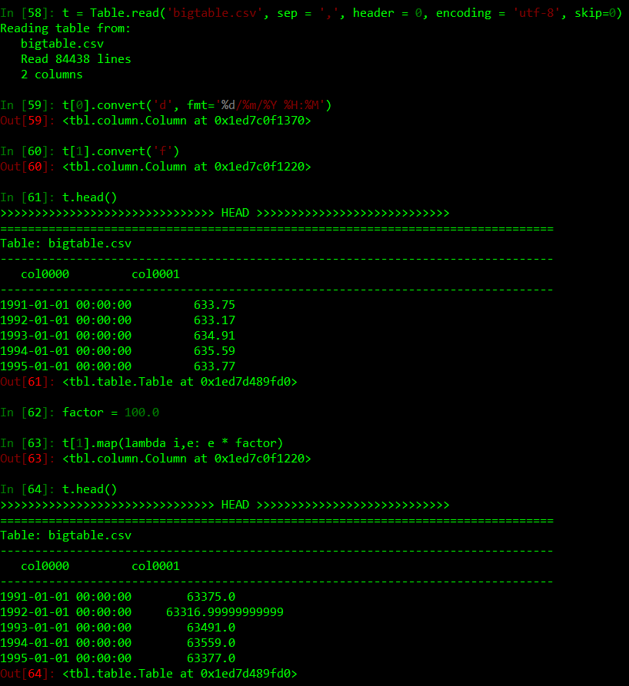
Functional style methods
Example:
Convert units of data stored in col[1] (e.g. m to cm, multiply by factor = 100.0)
Other useful ones:
reduce(): obtain a single result after processing all data in a column.
minval = c.reduce(func = lambda i, v, result: result if result < v else v, result = BIGVALUE)
total = c.reduce(func = lambda i, v, result: result + v, result = 0)
Functional style is very powerfull and easy to use once you get used to it.

Slide 13

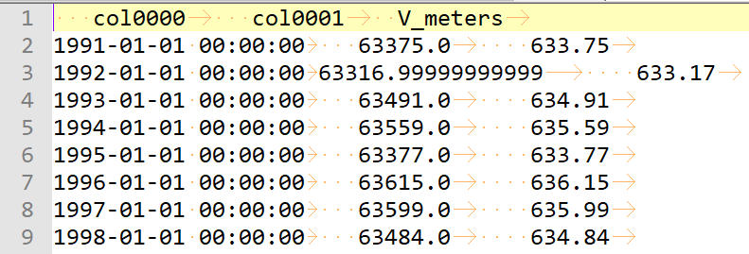

Add column/save
We can add columns. For example, create a new column with variable in meters.
apply() similar to map(),
but it returns a list.
t.addColumn(name, list)
And of course, we save() the new table to a file:
For large tables, explore using toH5() to create HDF5 files.

Slide 14
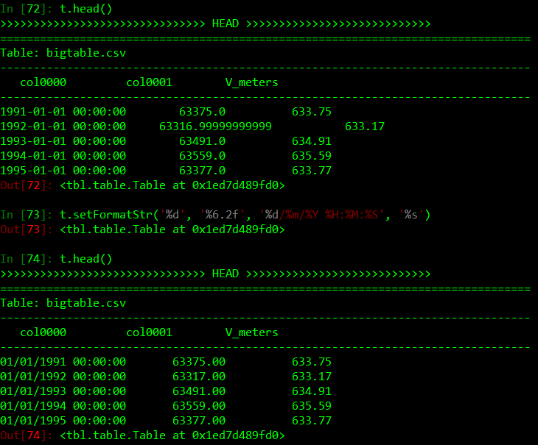
Formatting
Basic options to control formatting.
Use t.setFormatStr()
It controls formatting for all methods that print to screen and write to files.
KEEP a single format for dates to avoid confusion with multiple formats (KISS principle).

Slide 15
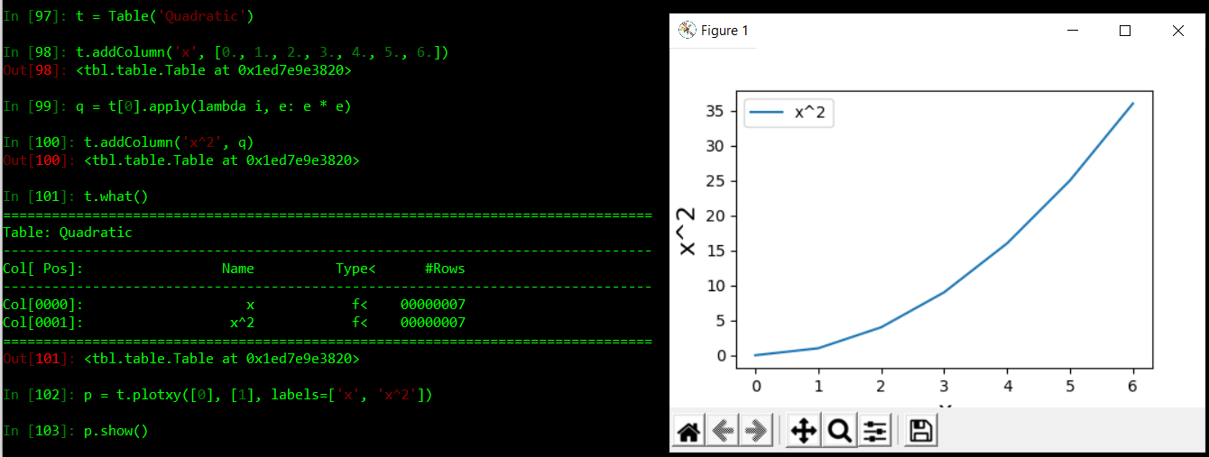
Plotting
t.plotxy() as shortcut to use Matplotlib.pyplot
plotxy() returns a handle to matplotlib.pyplot => you can do whatever you can do with pyplot, but without importing anything.
Useful for command line use.
Full potential, when need to plot many columns versus other columns or a single column.

Slide 16
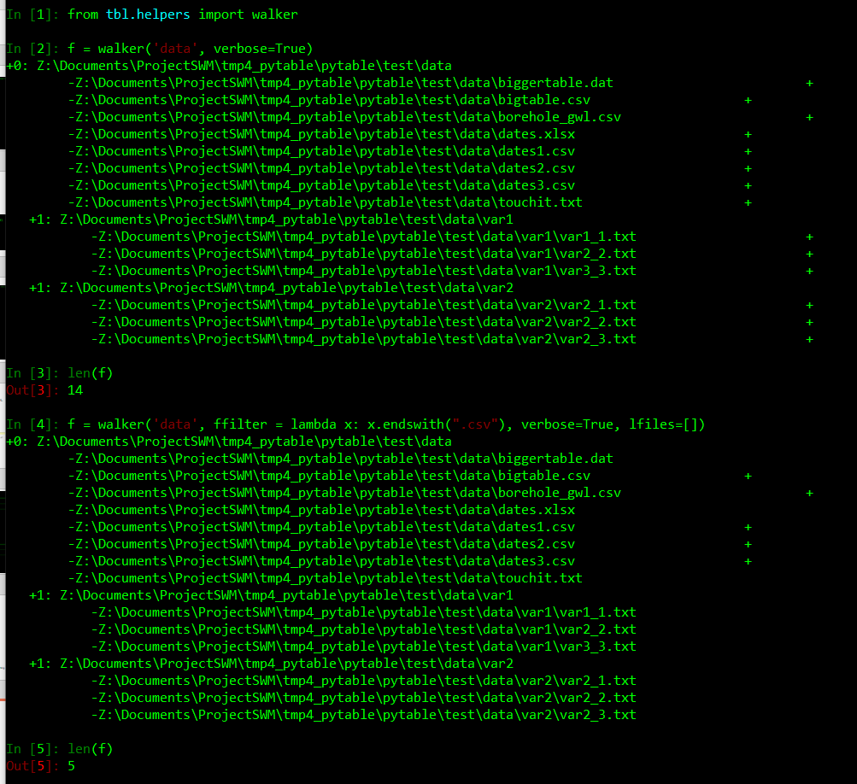
Helpers: from tbl.helpers import XXX
Return all .csv files in root directory:
files = walker(´rootdir´, ffilter = lambda fpath: ´.csv´ in fpath, verbose = True )
+: next to each file indicates, file was added to the returned list.
+1: indicates first subdirectory from parent directory.
NOTE: ipython seems to keep a version of the old lfiles argument passed to walker(). That seems to be a bug in this case. It does not happen with normal python interpreter.

Slide 17
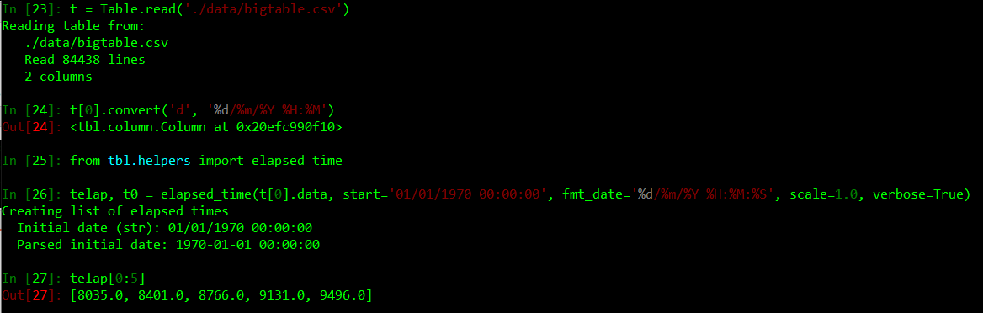
Helpers: from tbl.helpers import XXX
Use elapsed time instead of dates for plotting, processing, etc. Much faster.
Look at Column.telap() for an alternative to call elapsed_time() , without importing from helpers.
Compute elapsed time from a list of datetime objects with respect to an initial date.
elapsed_time(dates, ... verbose=True)

Slide 18
Helpers: from tbl.helpers import XXX
A few more useful methods in tbl.helpers:
Create a list of dates between two dates with a given interval datetime_list().
Compute checksum for files file_hash(). Useful for archiving and preventing possible modification or corruption of the files.
Etc.
Look at the docs and see if there is anything that can help you, or... write your own version, :-D!

Slide 19
Installation
I recommend using a simple install procedure:
Copy the source directory to a location such as the path does not have blank spaces. Then, add ROOT to your PYTHONPATH.
For example, for POWERSHELL (I recommend using it):
$env:PYTHONPATH=“PATH_TO_ROOT"
Write-Host "NEW: " $env:PYTHONPATH
You need to do this each time you open a PS window. Otherwise, you can make it permanent by changing the value of the environmental variable in Windows. BE CAREFUL THOUGH, TO NOT MESS UP WITH YOUR INSTALLATION OF PYTHON. It has worked well for me this way, but different software uses different ways to setup Python.

Slide 20
TODO
PyTable is an early implementation. There are a few things that I want to modify in the near future:
Set defaults formats for tables that are read and for new columns that are created.
Implement automatic conversion for columns based on sensible default assumptions (DEFAULT format for dates, etc)
Clean interface: remove some methods that are similar, rename others to make them easier to remember.
Implement a few more command line aliases for existing methods. For example, now we have t.what() == t.wh(), and t.head() == t.h()

Slide 21
Final remark
Look at Table.wait()...

