Slide 1
Wemaloo
Android Application
By TPI

Slide 2
Wemaloo?
The concept for Wemaloo was created by the president of 2CI Technologies Mr. Mohamed Chibani as a new way to connect the average consumer to their local grocers, health food stores, and fitness centers.
TPI picked up the task of developing the prototype for an Android application to fit Mr. Chibani’s specifications.
Mr. Chibani made it clear from the beginning that his main goal was to create the application with the end user in mind. Ease of use and speed are priority.

Slide 3
Wemaloo cont…
In the 4 months allotted to us we came to the conclusion that it was only going to be possible for us to complete the grocery store portion of the application, as Mr. Chibani’s vision was too large for the amount of time given.
He stated that he wanted a simple, easy to use application to present the user with a list of products for each grocery store in a region according to their category with a simple and fluid UI.

Slide 4
Why use Wemaloo?
Plan meals ahead – better for a healthier lifestyle
Save money – Know what's on sale, when its actually on sale. The application uses a live database to show all this information dynamically, sale items can be changed at any time with no updates to the app needed.
Easier connection. Rather than going through every store’s web page yourself to check the flyers, the app presents them all right to you with ease.

Slide 5
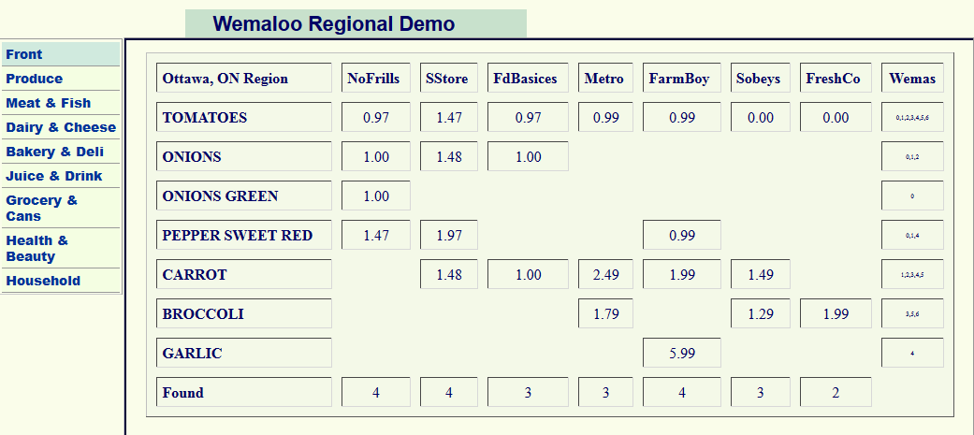
Original Implementation
Source: http://www.wemaloo.com/Regions/RLogs/PON_Ottawa.php

Slide 6
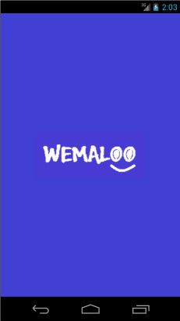
Application Design
Android devices have limited screen size, therefore we had to completely redesign the way it would look.
The application provides the user with a list of stores close to their location (based on GPS) and filters the results to only display the stores they select.
The application then provides the user with a list of different categories of groceries so they can better filter through items.
Those choices are then saved and sent into the final activity and the user is provided with a page that is able to swipe through the stores from left to right and displays the products on sale for that category for each store.

Slide 7
Technologies
Android SDK, API (Java)
JSON
PHP
MySQL Workbench
XML
Eclipse IDE
Github (for project management)
Hostgator shared server hosting
Photoshop ( parts of UI )

Slide 8
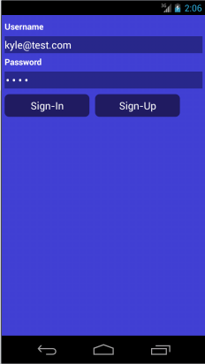
Login Activity
Login with an email address
Username and password must be 100% correct or you can’t login
Sends you to the dashboard activity if login is successful.

Slide 9
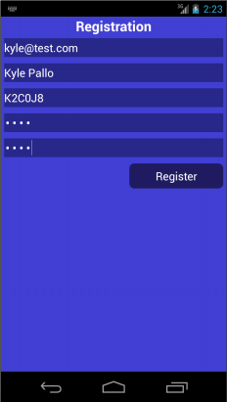
Registration Activity
All fields have validation that must pass in order to create an account.
No empty fields
Password must be 6 characters or longer
Passwords must match.
Passwords are salted and encrypted to ensure the users security.
Once the account is created you are sent back into the login activity so you can login.

Slide 10
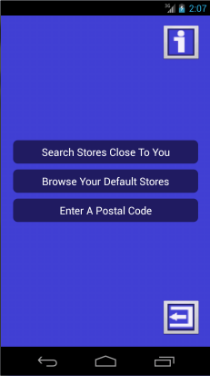
Landing Page
This is the homepage of the application. From here you can:
Search stores closest to you via GPS
Enter a postal code and view stores based on entered value
Logout of the application
We left the landing page simple for future programmers to build on it. We believe we have created a great foundation for the next team that will work on Wemaloo.

Slide 11
Closest stores by postal code / city name
You can enter any postal code and the app will convert the postal code or city name into a longitude / latitude.
Sends you to the closest stores page.

Slide 12
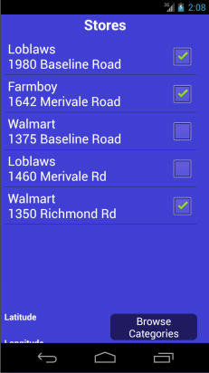
Closest Stores Activity
This is the page where all the closest stores to your location show up
Pulls store name and address from the database.
Currently shows up to 6 stores at a given time
Every Loblaws, Walmart, Farmboy and Freshco in Ottawa is supported.
The algorithm currently finds stores within 2 miles of a users location.
You select one or multiple stores, then you browse for categories

Slide 13
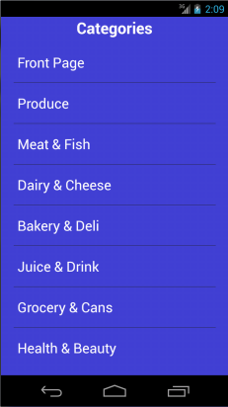
Categories Activity
This activity lets you select a category of grocery for stores selected.
This list of categories was provided by the original web implementation.

Slide 14
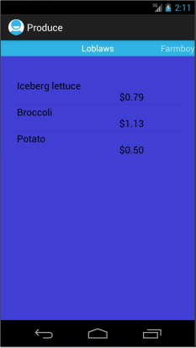
Products By Store Activity
Currently all products and their prices are being pulled from a live database.
Our database Product table is filled with approximately 400 test products spanning across 22 different stores supported. That works out to about 2 items on sale for each category for each store !
You can easily swipe between stores or press the built in back button to change the category.

Slide 15
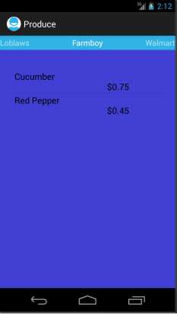
Products By Store Activity (cont.)

Slide 16
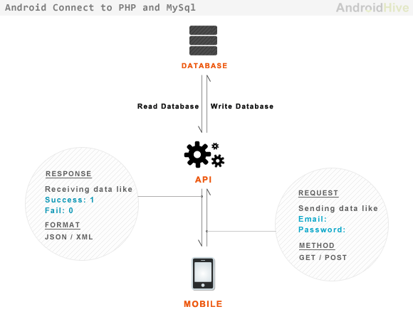
Database connectivity
PHP backend on server.
JSON connectivity in the application to relay information in a more object oriented way.
MySQL database containing all information relating to users, products or stores.

Slide 17
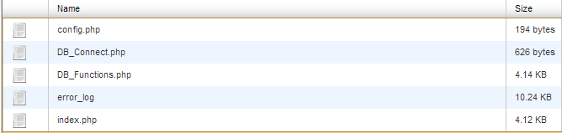
PHP backend
Hosted on remote server.
In charge of the discussion between JSON and the database
Contains database connection information
Works with POST tags

Slide 18
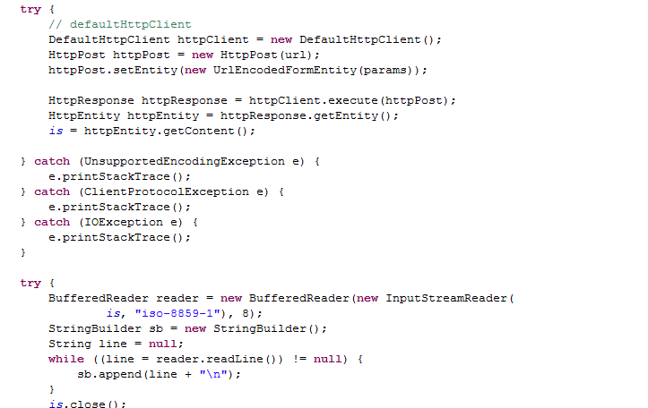
JSON connectivity
Uses a parser to translate from MySQL to JSON to Java or vice-versa
Present in any class containing connectivity to the database
Allows easier local manipulation of data retrieved from the database

Slide 19
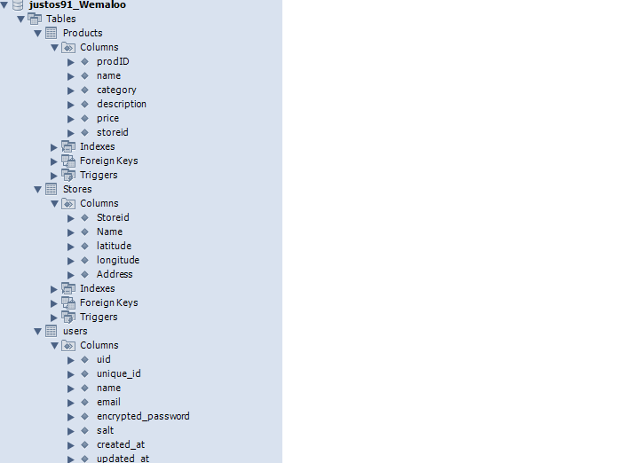
MySQL Database
Contains login information for users (with encrypted password)
Contains name and location of all grocery stores in Ottawa
Contains test data for products association at those stores
Hosted on remote server

