Slide 1
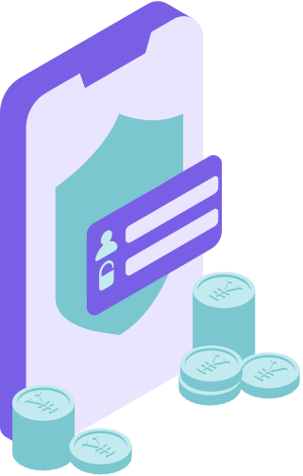
MediTrack
Health Care
Paulo Bolinhas 110976
Rui Martins 110890
Rui Moniz 99323

Slide 2
01 | Patients
02 | Doctors
03 | Insurance Company
04 | Server
05 | Database
Actors
Our project as several actors that must be known first

Slide 3
01 | Machine 1 - Client
02 | Machine 2 - Server (Port 12345)
03 | Machine 3 - Database Server (Port 50000)
Machines
How we implemented system distribution

Slide 4


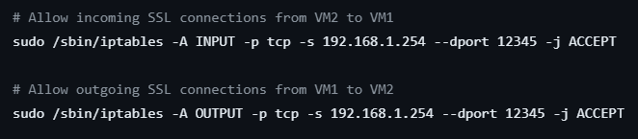
Machine 1 - Client Firewall
Set each channel Drop everything
Allow established and related connections
Allow communication with the loopback Interface
Allow incoming and outgoing SSL/TLS communications with machine 2

Slide 5
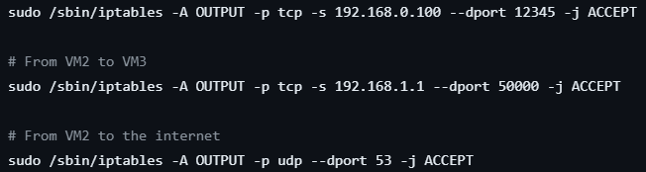
Machine 2 Server Firewall
Set each channel Drop everything
Allow established and related connections
Allow communication with the loopback Interface
Allow incoming and outgoing SSL/TLS communications with machine 1 and 3

Slide 6
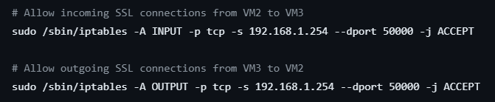
Machine 3 Database Firewall
Set each channel Drop everything
Allow established and related connections
Allow communication with the loopback Interface
Allow incoming and outgoing SSL/TLS communications with machine 2

Slide 7
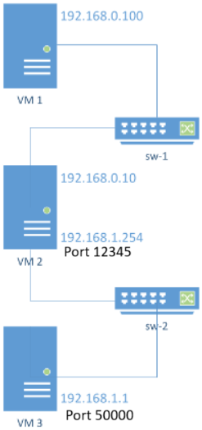
Network Structure

Slide 8
But how do these machines securily communicate?
MACHINE 1 - CLIENTS
MACHINE 2 - SERVER
MACHINE 3 - DATABASE
Client
Server Certificate
Other Entities
Doctor
Server Certificate
Other Entities
Insurance Company
Server Certificate
Other Entities
KeyStore
Private Key
Certificate w/ Public Key
TrustStore
Client Certificates
Database Certificate
KeyStore
Private Key
Certificate w/ Public Key
TrustStore
Server Certificate

Slide 9
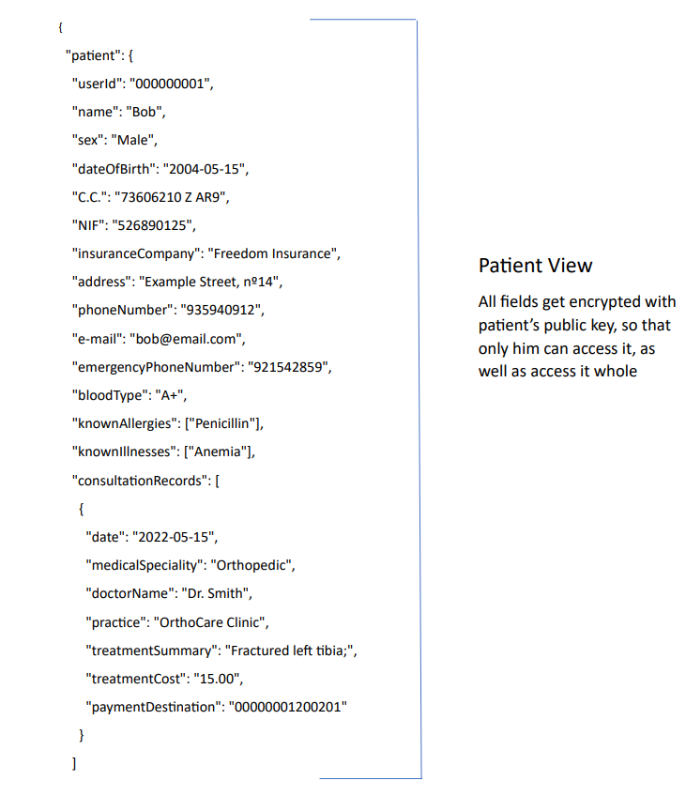
Views

Slide 10
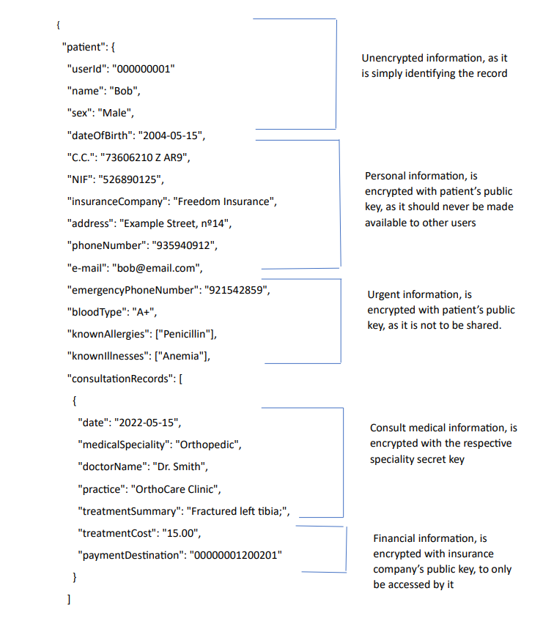
Views

Slide 11
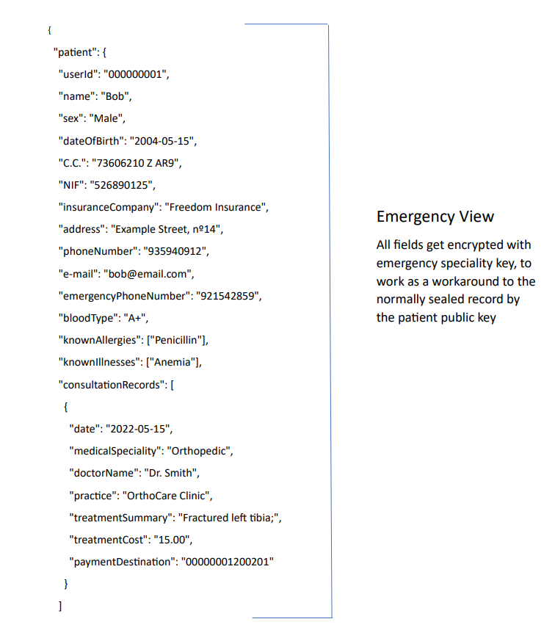
Views

Slide 12
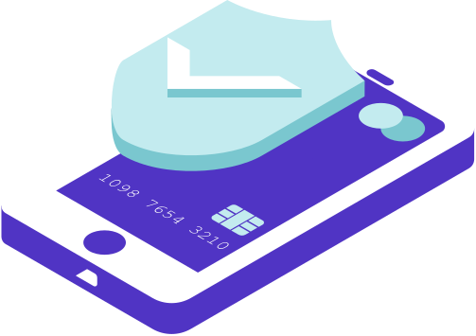



Security Challenge
Give authorization
Digital Signature
Emergency
Pacient
Doctor

Slide 13
Conclusion

